Slide 1
Behind Closed Doors
John 20:19-29

Slide 2
¹⁹ On the evening of that first day of the week, when the disciples were together, with the doors locked for fear of the Jewish leaders, Jesus came and stood among them and said, “Peace be with you!” ²⁰ After he said this, he showed them his hands and side. The disciples were overjoyed when they saw the Lord.
²¹ Again Jesus said, “Peace be with you! As the Father has sent me, I am sending you.” ²² And with that he breathed on them and said, “Receive the Holy Spirit. ²³ If you forgive anyone’s sins, their sins are forgiven; if you do not forgive them, they are not forgiven.”
Bible verses quoted are from the New International Version unless noted.

Slide 3
²⁴ Now Thomas (also known as Didymus), one of the Twelve, was not with the disciples when Jesus came. ²⁵ So the other disciples told him, “We have seen the Lord!”
But he said to them, “Unless I see the nail marks in his hands and put my finger where the nails were, and put my hand into his side, I will not believe.”
²⁶ A week later his disciples were in the house again, and Thomas was with them. Though the doors were locked, Jesus came and stood among them and said, “Peace be with you!” ²⁷ Then he said to Thomas, “Put your finger here; see my hands. Reach out your hand and put it into my side. Stop doubting and believe.”
²⁸ Thomas said to him, “My Lord and my God!”
²⁹ Then Jesus told him, “Because you have seen me, you have believed; blessed are those who have not seen and yet have believed.”

Slide 4
Behind Closed Doors
John 20:19-29

Slide 5
¹⁹ On the evening of that first day of the week, when the disciples were together, with the doors locked for fear of the Jewish leaders, Jesus came and stood among them and said, “Peace be with you!” ²⁰ After he said this, he showed them his hands and side. The disciples were overjoyed when they saw the Lord.
²¹ Again Jesus said, “Peace be with you! As the Father has sent me, I am sending you.” ²² And with that he breathed on them and said, “Receive the Holy Spirit. ²³ If you forgive anyone’s sins, their sins are forgiven; if you do not forgive them, they are not forgiven.”
Bible verses quoted are from the New International Version unless noted.

Slide 6
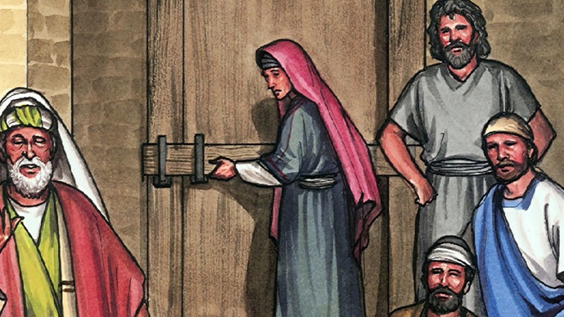

Slide 7
¹⁹ On the evening of that first day of the week, when the disciples were together, with the doors locked for fear of the Jewish leaders, Jesus came and stood among them and said, “Peace be with you!” ²⁰ After he said this, he showed them his hands and side. The disciples were overjoyed when they saw the Lord.
²¹ Again Jesus said, “Peace be with you! As the Father has sent me, I am sending you.” ²² And with that he breathed on them and said, “Receive the Holy Spirit. ²³ If you forgive anyone’s sins, their sins are forgiven; if you do not forgive them, they are not forgiven.”

Slide 8
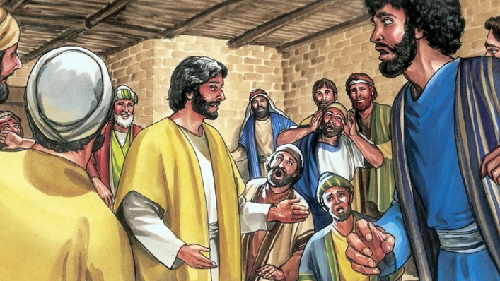

Slide 9
¹⁹ On the evening of that first day of the week, when the disciples were together, with the doors locked for fear of the Jewish leaders, Jesus came and stood among them and said, “Peace be with you!” ²⁰ After he said this, he showed them his hands and side. The disciples were overjoyed when they saw the Lord.
²¹ Again Jesus said, “Peace be with you! As the Father has sent me, I am sending you.” ²² And with that he breathed on them and said, “Receive the Holy Spirit. ²³ If you forgive anyone’s sins, their sins are forgiven; if you do not forgive them, they are not forgiven.”

Slide 10
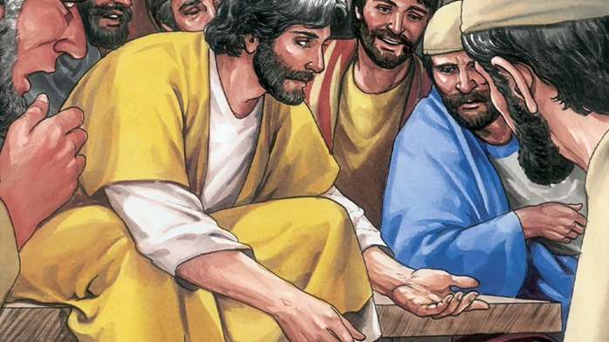

Slide 11
Jesus brings true peace won through his crucifixion.

Slide 12
¹⁹ On the evening of that first day of the week, when the disciples were together, with the doors locked for fear of the Jewish leaders, Jesus came and stood among them and said, “Peace be with you!” ²⁰ After he said this, he showed them his hands and side. The disciples were overjoyed when they saw the Lord.
²¹ Again Jesus said, “Peace be with you! As the Father has sent me, I am sending you.” ²² And with that he breathed on them and said, “Receive the Holy Spirit. ²³ If you forgive anyone’s sins, their sins are forgiven; if you do not forgive them, they are not forgiven.”

Slide 13
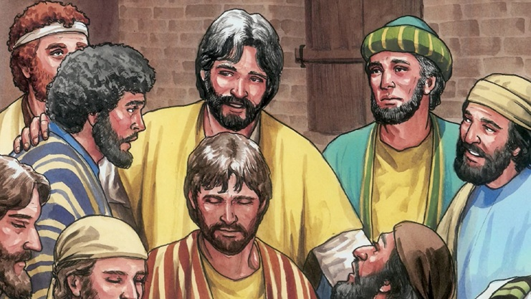

Slide 14
Jesus sends peace-filled disciples out to proclaim God’s forgiveness.

Slide 15
²⁴ Now Thomas (also known as Didymus), one of the Twelve, was not with the disciples when Jesus came. ²⁵ So the other disciples told him, “We have seen the Lord!”
But he said to them, “Unless I see the nail marks in his hands and put my finger where the nails were, and put my hand into his side, I will not believe.”
²⁶ A week later his disciples were in the house again, and Thomas was with them. Though the doors were locked, Jesus came and stood among them and said, “Peace be with you!” ²⁷ Then he said to Thomas, “Put your finger here; see my hands. Reach out your hand and put it into my side. Stop doubting and believe.”
²⁸ Thomas said to him, “My Lord and my God!”
²⁹ Then Jesus told him, “Because you have seen me, you have believed; blessed are those who have not seen and yet have believed.”

Slide 16
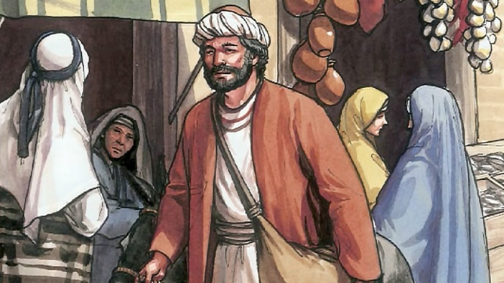

Slide 17
²⁴ Now Thomas (also known as Didymus), one of the Twelve, was not with the disciples when Jesus came. ²⁵ So the other disciples told him, “We have seen the Lord!”
But he said to them, “Unless I see the nail marks in his hands and put my finger where the nails were, and put my hand into his side, I will not believe.”
²⁶ A week later his disciples were in the house again, and Thomas was with them. Though the doors were locked, Jesus came and stood among them and said, “Peace be with you!” ²⁷ Then he said to Thomas, “Put your finger here; see my hands. Reach out your hand and put it into my side. Stop doubting and believe.”
²⁸ Thomas said to him, “My Lord and my God!”
²⁹ Then Jesus told him, “Because you have seen me, you have believed; blessed are those who have not seen and yet have believed.”

Slide 18
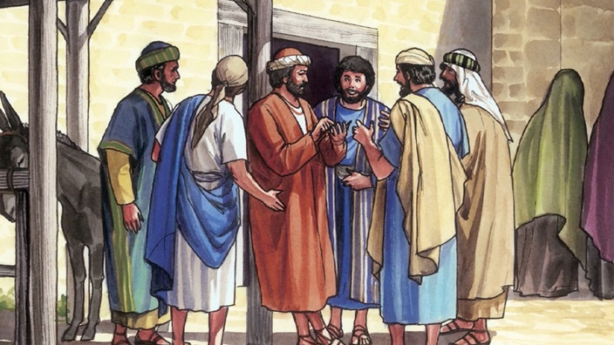

Slide 19
Thomas’ 3 Conditions
I see the nail marks in his hands
put my finger where the nails were
put my hand into his side

Slide 20
²⁴ Now Thomas (also known as Didymus), one of the Twelve, was not with the disciples when Jesus came. ²⁵ So the other disciples told him, “We have seen the Lord!”
But he said to them, “Unless I see the nail marks in his hands and put my finger where the nails were, and put my hand into his side, I will not believe.”
²⁶ A week later his disciples were in the house again, and Thomas was with them. Though the doors were locked, Jesus came and stood among them and said, “Peace be with you!” ²⁷ Then he said to Thomas, “Put your finger here; see my hands. Reach out your hand and put it into my side. Stop doubting and believe.”
²⁸ Thomas said to him, “My Lord and my God!”
²⁹ Then Jesus told him, “Because you have seen me, you have believed; blessed are those who have not seen and yet have believed.”

Slide 21
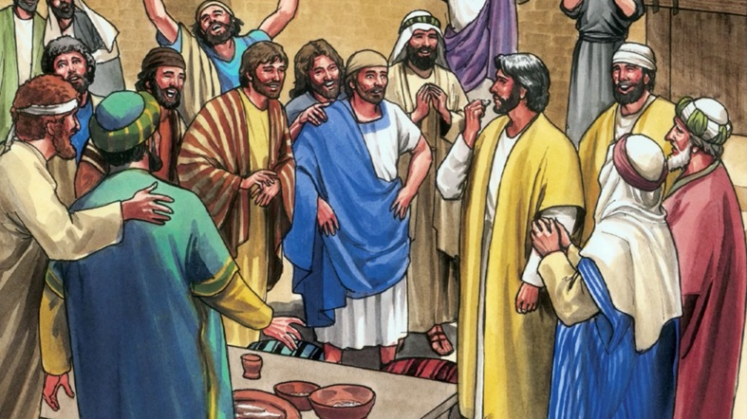

Slide 22
²⁴ Now Thomas (also known as Didymus), one of the Twelve, was not with the disciples when Jesus came. ²⁵ So the other disciples told him, “We have seen the Lord!”
But he said to them, “Unless I see the nail marks in his hands and put my finger where the nails were, and put my hand into his side, I will not believe.”
²⁶ A week later his disciples were in the house again, and Thomas was with them. Though the doors were locked, Jesus came and stood among them and said, “Peace be with you!” ²⁷ Then he said to Thomas, “Put your finger here; see my hands. Reach out your hand and put it into my side. Stop doubting and believe.”
²⁸ Thomas said to him, “My Lord and my God!”
²⁹ Then Jesus told him, “Because you have seen me, you have believed; blessed are those who have not seen and yet have believed.”

Slide 24
²⁴ Now Thomas (also known as Didymus), one of the Twelve, was not with the disciples when Jesus came. ²⁵ So the other disciples told him, “We have seen the Lord!”
But he said to them, “Unless I see the nail marks in his hands and put my finger where the nails were, and put my hand into his side, I will not believe.”
²⁶ A week later his disciples were in the house again, and Thomas was with them. Though the doors were locked, Jesus came and stood among them and said, “Peace be with you!” ²⁷ Then he said to Thomas, “Put your finger here; see my hands. Reach out your hand and put it into my side. Stop doubting and believe.”
²⁸ Thomas said to him, “My Lord and my God!”
²⁹ Then Jesus told him, “Because you have seen me, you have believed; blessed are those who have not seen and yet have believed.”

Slide 25
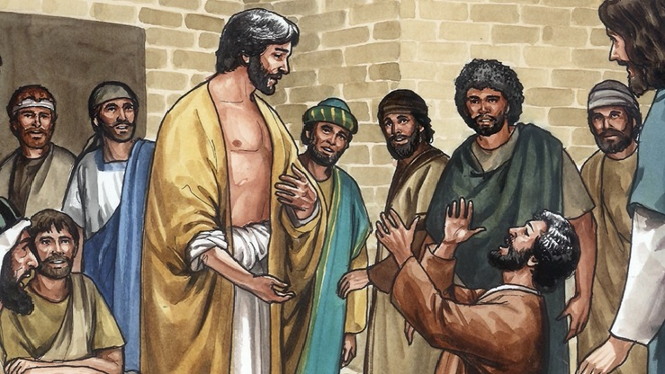

Slide 26
Jesus helps the sincere to overcome their doubts and trust in him.

Slide 27
The later life of Thomas

Slide 28
Life Application

Slide 29
Live in the peace Jesus gives
Bring our fear(s) to Jesus first & always
Remember that Jesus has victoriously conquered sin & death
Lock-in to Jesus and not circumstantial peace

Slide 30
Move out to where Jesus sends
Ask the Lord where he wants us to represent him
Talk to others about sin & forgiveness, not just love & kindness
Depend on God’s empowerment and not our eloquence

Slide 31
Bring doubts to Jesus unreservedly
Ask God questions in prayer and wait for his answers
Stay and seek truth in Christian community while waiting for God
Grow from demanding proof to decisive trust (and be blessed!)

Slide 32
Behind Closed Doors
John 20:19-29

