Slide 1
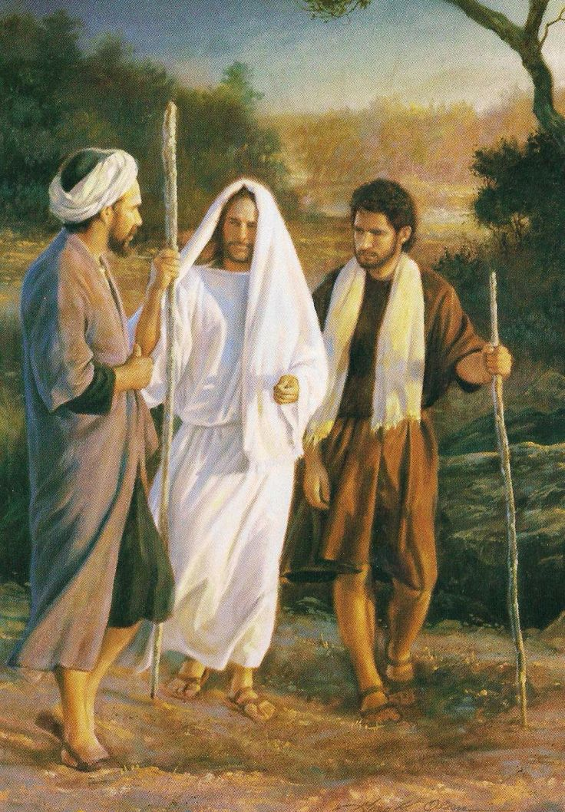
Walking with the Risen Lord
Luke 24:13-35

Slide 2
¹³ That very day two of them were going to a village named Emmaus, about seven miles from Jerusalem, ¹⁴ and they were talking with each other about all these things that had happened. ¹⁵ While they were talking and discussing together, Jesus himself drew near and went with them. ¹⁶ But their eyes were kept from recognizing him. ¹⁷ And he said to them, “What is this conversation that you are holding with each other as you walk?” And they stood still, looking sad. ¹⁸ Then one of them, named Cleopas, answered him, “Are you the only visitor to Jerusalem who does not know the things that have happened there in these days?” ¹⁹ And he said to them, “What things?” And they said to him, “Concerning Jesus of Nazareth, a man who was a prophet mighty in deed and word before God and all the people, ²⁰ and how our chief priests and rulers delivered him up to be condemned to death, and crucified him.

Slide 3
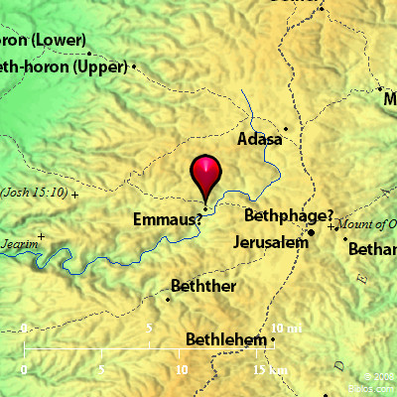
Vs 13
Where were the two of them going, and why?

Slide 4
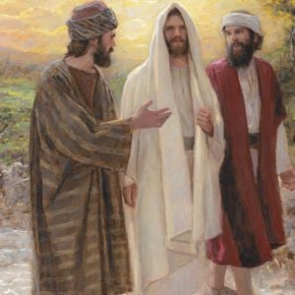
Vs 14-17
“Their eyes were kept from recognizing him.”
Why?

Slide 5
Vs 18
How could you not know?

Slide 6
²¹ But we had hoped that he was the one to redeem Israel. Yes, and besides all this, it is now the third day since these things happened. ²² Moreover, some women of our company amazed us. They were at the tomb early in the morning, ²³ and when they did not find his body, they came back saying that they had even seen a vision of angels, who said that he was alive. ²⁴ Some of those who were with us went to the tomb and found it just as the women had said, but him they did not see.” ²⁵ And he said to them, “O foolish ones, and slow of heart to believe all that the prophets have spoken! ²⁶ Was it not necessary that the Christ should suffer these things and enter into his glory?” ²⁷ And beginning with Moses and all the Prophets, he interpreted to them in all the Scriptures the things concerning himself.

Slide 7
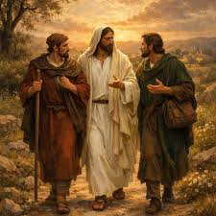
Vs 21 – 24
Dashed hopes - ”we had hoped.”
Doubting minds - “but him they did not see.”

Slide 8
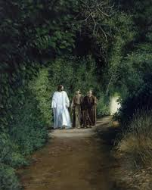
Vs 25-27
And beginning with Moses and all the Prophets, he interpreted to them in all the Scriptures.

Slide 9
Prophecies About Jesus | Old Testament Reference | New Testament Fulfilment
A close friend would betray him | Psalm 41:9 | Matt 10:4; 26:14-16; 23-25; 47-49
Jesus would be sold for 30 pieces of silver and the money given to a potter | Zechariah 11:12-13 | Matthew 26:15
False witnesses would accuse him | Psalm 27:12; 35:11 | Matthew 26:59-61
He will remain silent when accused | Isaiah 53:7 | Matthew 27:13-14
He will be mocked, beaten and spit on | Isaiah 50:6 | Matthew 26:67-68; 27:26-31
He will be given vinegar and gall on the cross | Psalm 69:21 | Matthew 27:34, 38
He will die among criminals | Isaiah 53:12 | Mathew 27:38
He will be buried with the rich | Isaiah 53:9 | Matthew 27:7-60
He will be resurrected | Psalm 16:10; Isaiah 53:10-11 | Matthew 28:1-10

Slide 10
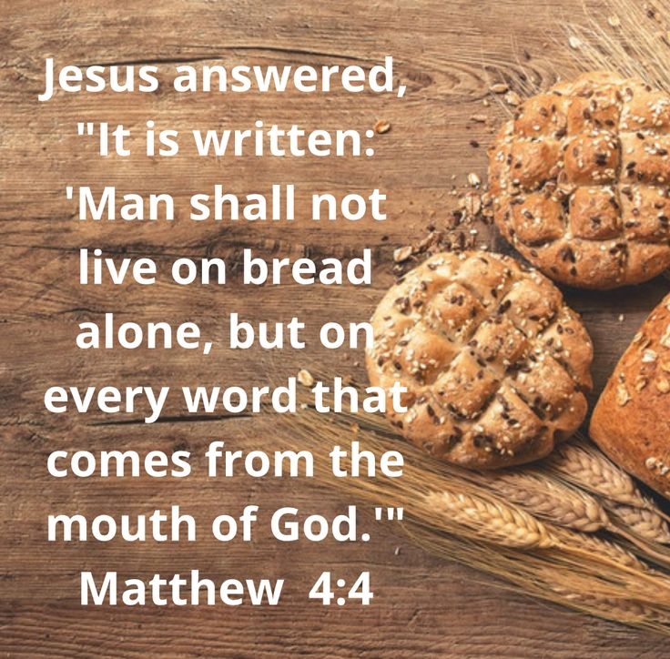

Slide 11
²⁸ So they drew near to the village to which they were going. He acted as if he were going farther, ²⁹ but they urged him strongly, saying, “Stay with us, for it is toward evening and the day is now far spent.” So he went in to stay with them. ³⁰ When he was at table with them, he took the bread and blessed and broke it and gave it to them. ³¹ And their eyes were opened, and they recognized him. And he vanished from their sight. ³² They said to each other, “Did not our hearts burn within us while he talked to us on the road, while he opened to us the Scriptures?” ³³ And they rose that same hour and returned to Jerusalem. And they found the eleven and those who were with them gathered together, ³⁴ saying, “The Lord has risen indeed, and has appeared to Simon!” ³⁵ Then they told what had happened on the road, and how he was known to them in the breaking of the bread.

Slide 12
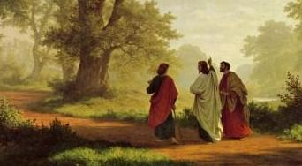
Vs 28-29
Stay with us

Slide 13
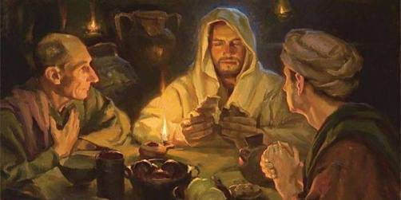
Vs 30-31
He broke bread and gave to them
Their eyes were opened….

Slide 14
Vs 32 – “Did not our hearts burn within us”
Vs 35 – “..he was known in the breaking of bread.”

Slide 15
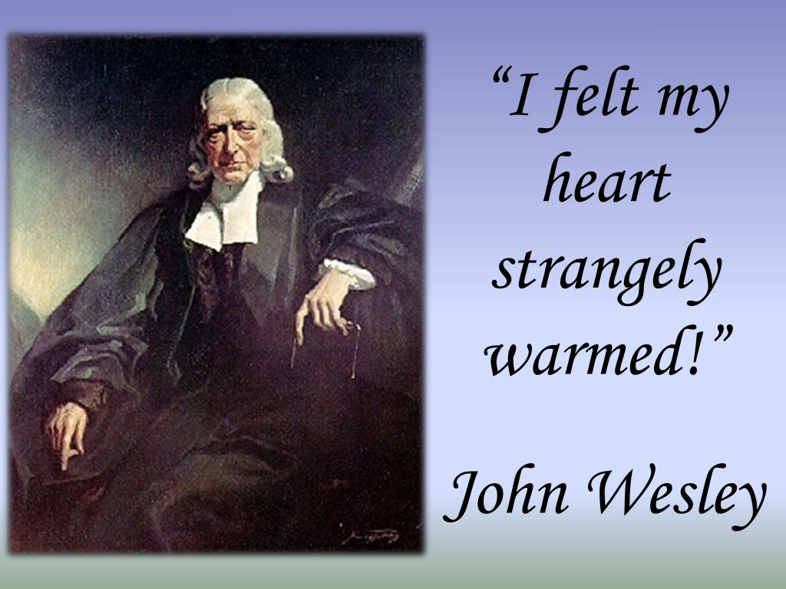

Slide 16
APPLICATION
Luke 24:13-35
The encounter with the resurrected Jesus is life-transforming.

Slide 17
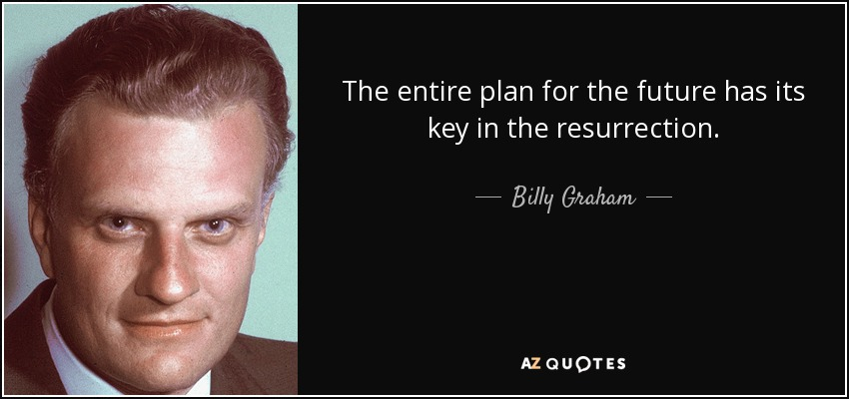

Slide 18
APPLICATION
Luke 24:13-35
The encounter with the resurrected Jesus is life-transforming.
We need Jesus to open His Scripture to us and to fellowship with us around His Table daily.

Slide 19
