Slide 1
Hyman Robles

Slide 2

My Family

Slide 3
The Heart of The Matter
1 Samuel 16:1–13
Crossroads International Church, Singapore
11 APRIL 2026

Slide 4
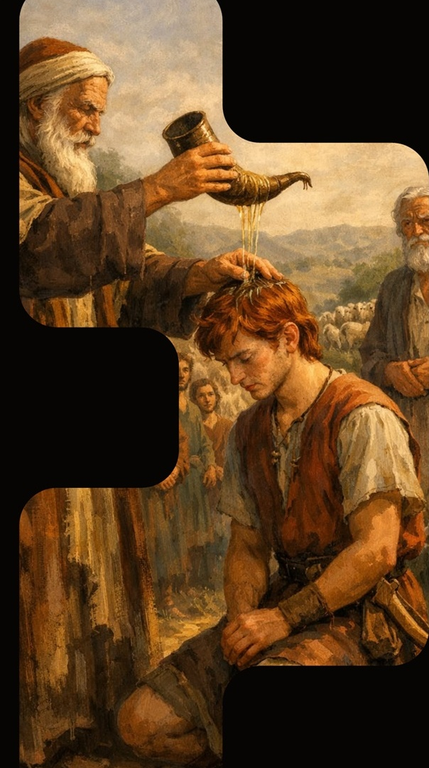
1 Samuel 16:7 ESV
But the Lord said to Samuel, “Do not look on his appearance or on the height of his stature, because I have rejected him. For the Lord sees not as man sees: man looks on the outward appearance, but the Lord looks on the heart

Slide 5
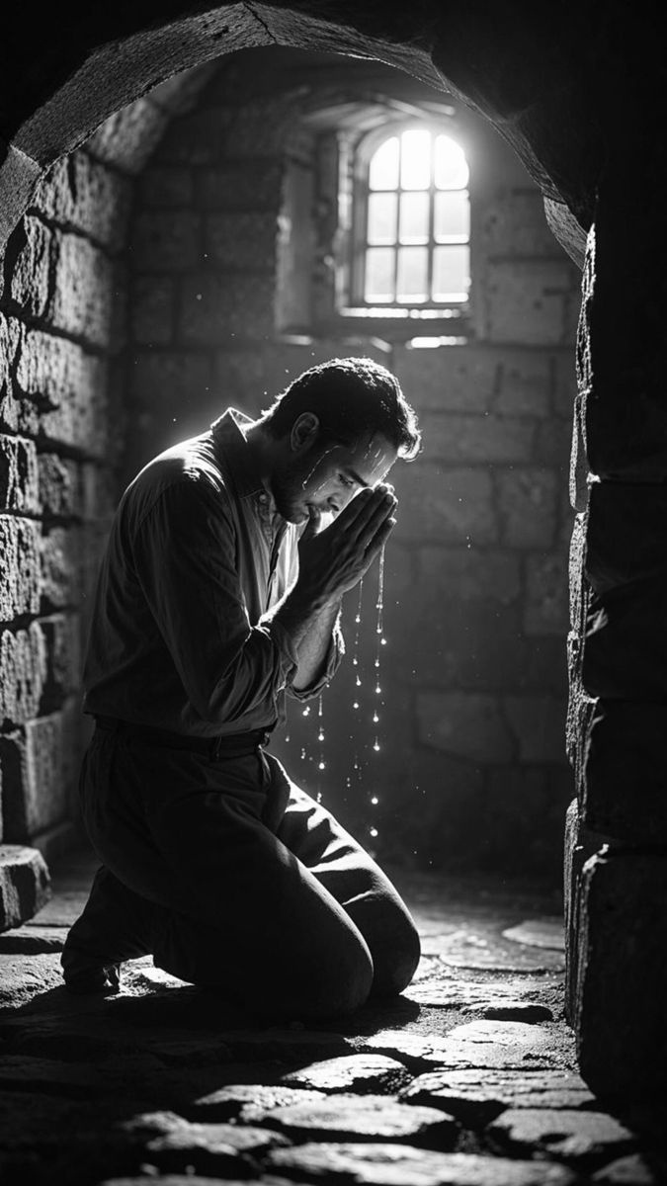
I. GOD’S CALL INTERRUPTS OUR GRIEF
- Ver. 1–3
The Lord said to Samuel, “How long will you grieve over Saul, since I have rejected him from being king over Israel? Fill your horn with oil, and go. I will send you to Jesse the Bethlehemite, for I have provided for myself a king among his sons.”

Slide 6
II. GOD SEES WHAT MAN CANNOT
- Ver. 4–10
“And Samuel did what the LORD commanded and came to Bethlehem... When they came, he looked on Eliab and thought, ‘Surely the LORD’s anointed is before him.’ But the LORD said to Samuel, ‘Do not look on his appearance or on the height of his stature, because I have rejected him. For the LORD sees not as man sees: man looks on the outward appearance, but the LORD looks on the heart.’”

Slide 7
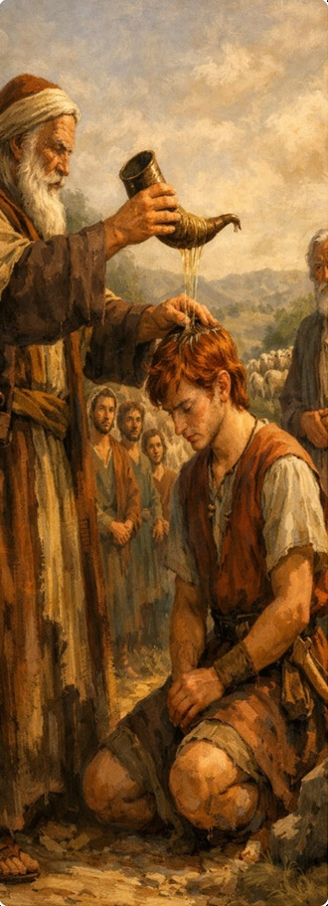
III. GOD’S CHOICE TRANSFORMS THE
FORGOTTEN - Ver. 11-13
“And Samuel said to Jesse, ‘Are all your sons here?’ And he said, ‘There remains yet the youngest, but behold, he is keeping the sheep.’ And Samuel said to Jesse, ‘Send and get him, for we will not sit down till he comes here.’ And he sent and brought him in... And the LORD said, ‘Arise, anoint him, for this is he.’ Then Samuel took the horn of oil and anointed him in the midst of his brothers. And the Spirit of the LORD rushed upon David from that day forward.”

Slide 8
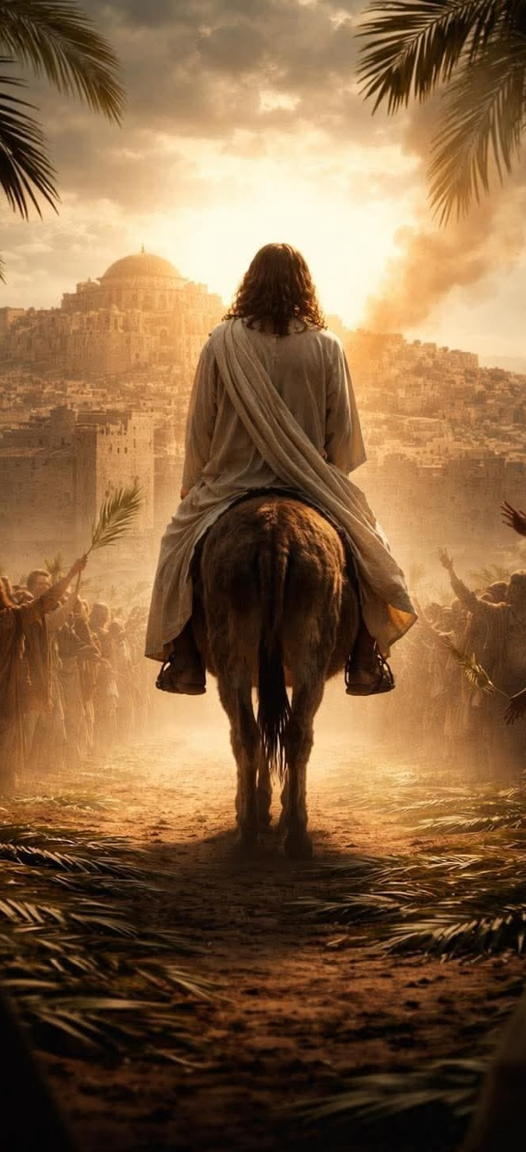
The Messianic Dimension
1. Jesus of Nazareth came from David’s line
- Matthew 1:1
2. Jesus was born in David’s city - Luke 2:4-11
3. Fulfilled everything David’s kingship
foreshadowed.
4. Like David, He was despised and overlooked:
“He had no form or majesty that we should
look at him, and no beauty that we should
desire him” - Isaiah 53:2

Slide 9
CONCLUSION

Slide 10
That is what the life of faith looks like most of the time. Not the dramatic anointing scene, but the ordinary, Spirit-filled, faithful moments in between.
The God who looked past seven impressive sons to find a shepherd boy in a field, that God is still looking. He is still saying to the overlooked, the forgotten, the unglamorous, and the field-dwelling ones: “Arise. This is he. This is she.”
When God acts, the Spirit will rush upon you, not because of your looks but because of your heart.

