Slide 1
Jesus:
The King We Need, Not the King We Expect
Luke 19:28-44
Notes:
PA please help to change slides for Scripture reading.

Slide 2
²⁸ After Jesus had said this, he went on ahead, going up to Jerusalem. ²⁹ As he approached Bethphage and Bethany at the hill called the Mount of Olives, he sent two of his disciples, saying to them, ³⁰ “Go to the village ahead of you, and as you enter it, you will find a colt tied there, which no one has ever ridden. Untie it and bring it here. ³¹ If anyone asks you, ‘Why are you untying it?’ say, ‘The Lord needs it.’”

Slide 3
³² Those who were sent ahead went and found it just as he had told them. ³³ As they were untying the colt, its owners asked them, “Why are you untying the colt?”
³⁴ They replied, “The Lord needs it.”
³⁵ They brought it to Jesus, threw their cloaks on the colt and put Jesus on it. ³⁶ As he went along, people spread their cloaks on the road.

Slide 4
³⁷ When he came near the place where the road goes down the Mount of Olives, the whole crowd of disciples began joyfully to praise God in loud voices for all the miracles they had seen:
³⁸ “Blessed is the king who comes in the name of the Lord!”
“Peace in heaven and glory in the highest!”

Slide 5
³⁹ Some of the Pharisees in the crowd said to Jesus, “Teacher, rebuke your disciples!”
⁴⁰ “I tell you,” he replied, “if they keep quiet, the stones will cry out.”
⁴¹ As he approached Jerusalem and saw the city, he wept over it ⁴² and said, “If you, even you, had only known on this day what would bring you peace—but now it is hidden from your eyes.

Slide 6
⁴³ The days will come upon you when your enemies will build an embankment against you and encircle you and hem you in on every side. ⁴⁴ They will dash you to the ground, you and the children within your walls. They will not leave one stone on another, because you did not recognize the time of God’s coming to you.”

Slide 7
Jesus:
The King We Need, Not the King We Expect
Luke 19:28-44
Notes:
PA please help to change slides for Scripture reading.

Slide 8
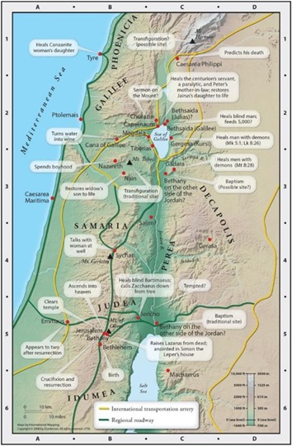
Source: NIV Study Bible, Fully Revised Edition

Slide 9
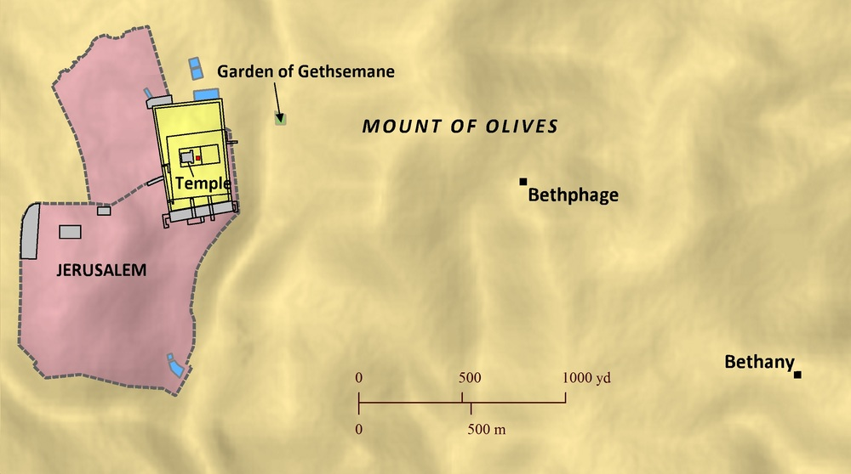
Source: David P. Barrett, Bible Mapper Maps

Slide 10
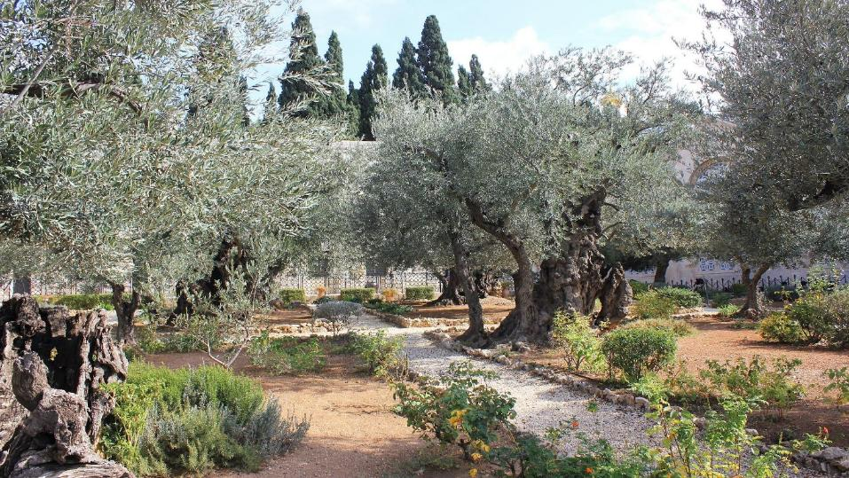
Old Olive trees in the Garden of Gethsemane

Slide 11
Passover:
A large festival to commemorate the departure of Israel from Egypt in haste.
Source: David P. Barrett, Bible Mapper Maps

Slide 12
²⁸ After Jesus had said this, he went on ahead, going up to Jerusalem. ²⁹ As he approached Bethphage and Bethany at the hill called the Mount of Olives, he sent two of his disciples, saying to them, ³⁰ “Go to the village ahead of you, and as you enter it, you will find a colt tied there, which no one has ever ridden. Untie it and bring it here. ³¹ If anyone asks you, ‘Why are you untying it?’ say, ‘The Lord needs it.’”

Slide 13
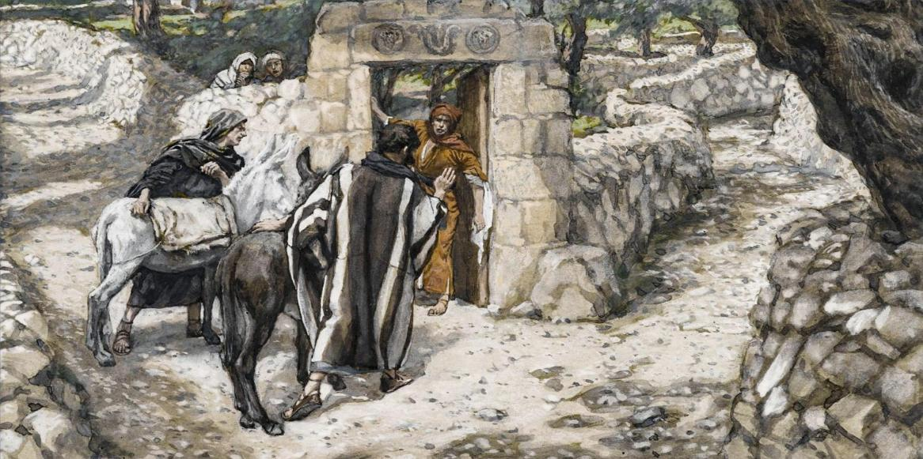
Source: commons.wikimedia.org

Slide 14
“Rejoice greatly, Daughter Zion! Shout, Daughter Jerusalem! See, your king comes to you, righteous and victorious, lowly and riding on a donkey, on a colt, the foal of a donkey.”
Zechariah 9:9

Slide 15
If anyone asks you, ‘Why are you untying it?’ say, ‘The Lord needs it.’” Luke 19:31

Slide 16
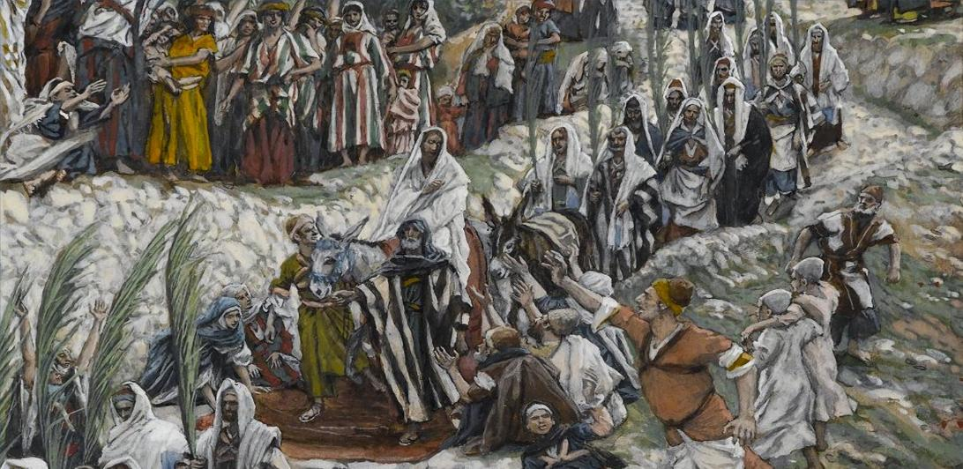
Source: commons.wikimedia.org

Slide 17
“They quickly took their cloaks and spread them under him on the bare steps. Then they blew the trumpet and shouted, "Jehu is king!” 2 Kings 9:13

Slide 18
³⁷ When he came near the place where the road goes down the Mount of Olives, the whole crowd of disciples began joyfully to praise God in loud voices for all the miracles they had seen:
³⁸ “Blessed is the king who comes in the name of the Lord!”
“Peace in heaven and glory in the highest!”

Slide 19
²⁶ “Blessed is he who comes in the name of the Lord!”
Psalm 118:26
³⁸ “Blessed is the king who comes in the name of the Lord!”
Luke 19:38

Slide 20
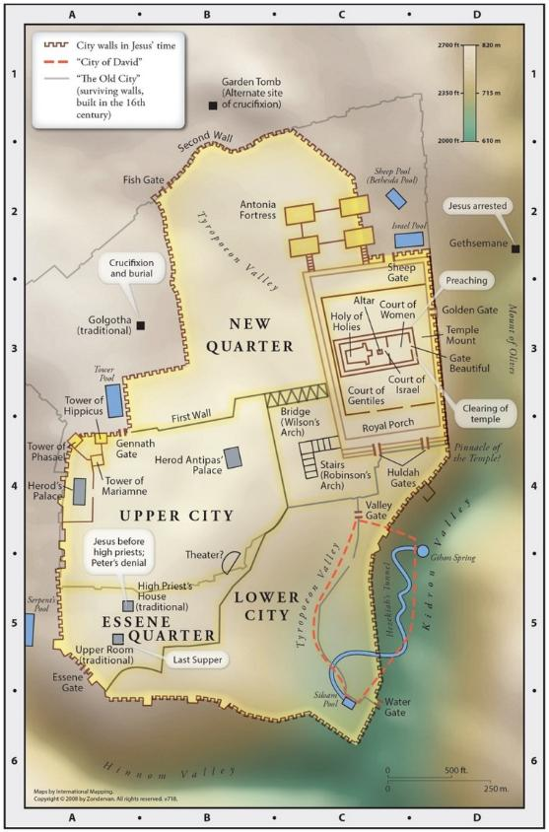
Source: NIV Study Bible, Fully Revised Edition

Slide 21
Jesus is The King sent by God to bring salvation.
Notes:
PA please help to change slides for Scripture reading.

Slide 22
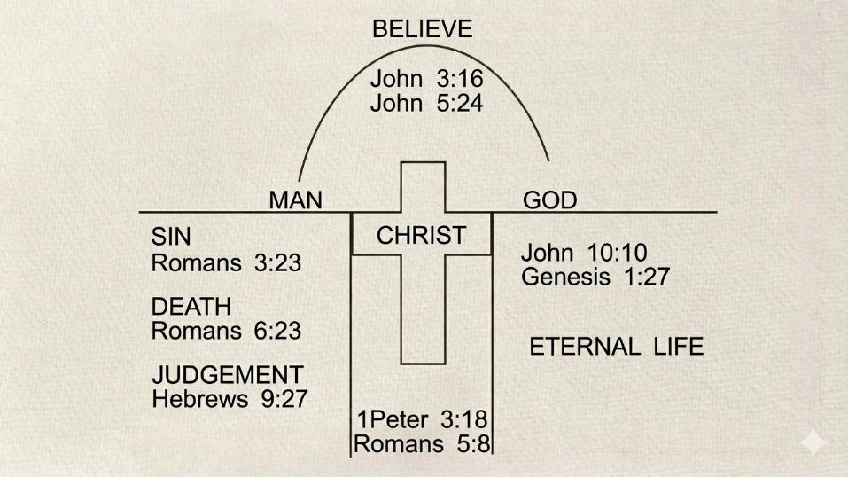
Source: bible.org

Slide 23
³⁹ Some of the Pharisees in the crowd said to Jesus, “Teacher, rebuke your disciples!”
⁴⁰ “I tell you,” he replied, “if they keep quiet, the stones will cry out.”

Slide 24
⁴¹ As he approached Jerusalem and saw the city, he wept over it ⁴² and said, “If you, even you, had only known on this day what would bring you peace—but now it is hidden from your eyes. ⁴³ The days will come upon you when your enemies will build an embankment against you and encircle you and hem you in on every side. ⁴⁴ …because you did not recognize the time of God’s coming to you.”

Slide 25
Jesus is The King we need, but not always the King we expect him to be.
Notes:
PA please help to change slides for Scripture reading.

Slide 26
⁴¹ As he approached Jerusalem and saw the city, he wept over it ⁴² and said, “If you, even you, had only known on this day what would bring you peace—but now it is hidden from your eyes. ⁴³ The days will come upon you when your enemies will build an embankment against you and encircle you and hem you in on every side. ⁴⁴ …because you did not recognize the time of God’s coming to you.”

Slide 27
⁴³ The days will come upon you when your enemies will build an embankment against you and encircle you and hem you in on every side. ⁴⁴ They will dash you to the ground, you and the children within your walls. They will not leave one stone on another, because you did not recognize the time of God’s coming to you.”

Slide 28
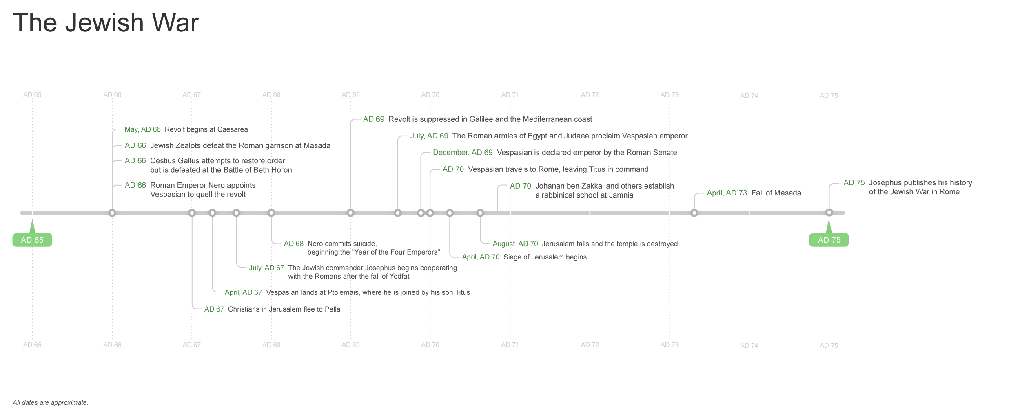
Source: Faithlife Study Bible

Slide 29
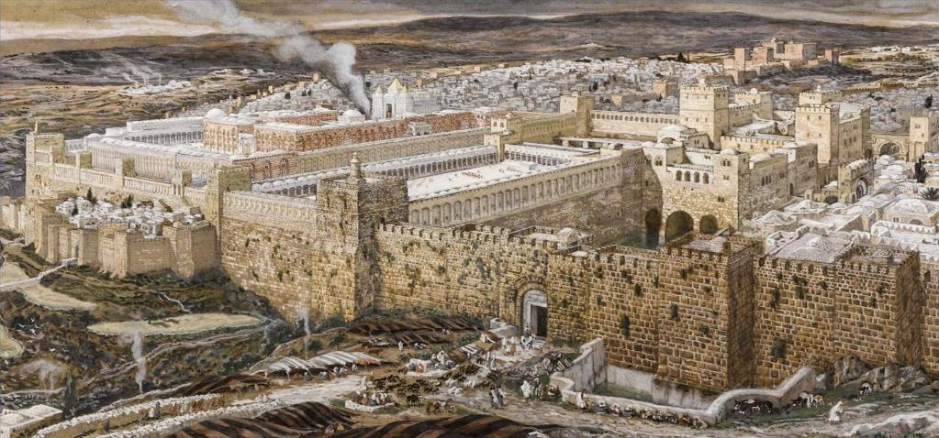
Source: commons.wikimedia.org

Slide 30
God offers salvation freely, but within a limited time.
Notes:
PA please help to change slides for Scripture reading.

Slide 31
Life Application
Notes:
PA please help to change slides for Scripture reading.

Slide 32
Life Application
Examine our expectations of Jesus
Notes:
PA please help to change slides for Scripture reading.

Slide 33
Life Application
Examine our expectations of Jesus
Improve our expectations of Jesus
Notes:
PA please help to change slides for Scripture reading.

Slide 34
Life Application
Examine our expectations of Jesus
Improve our expectations of Jesus
Surrender to Jesus as King
Notes:
PA please help to change slides for Scripture reading.

Slide 35
Life Application
Examine our expectations of Jesus
Improve our expectations of Jesus
Surrender to Jesus as King
Proclaim the Good News of Jesus Christ
Notes:
PA please help to change slides for Scripture reading.

Slide 36
Jesus:
The King We Need, Not the King We Expect
Luke 19:28-44
Notes:
PA please help to change slides for Scripture reading.

