Slide 1

NO TURNING BACK
Luke 9:57-62

Slide 2
What is a disciple?
Greek word mathētēs – lit. “a learner, a student”.
English word ‘Apprentice’.
In Gospels and Acts, used more than 260 times for believers/followers of Jesus.

Slide 3


Slide 4
What is a disciple?
Greek word mathētēs – lit. “a learner, a student”.
English word ‘Apprentice’.
In Gospels and Acts, used more than 260 times for believers/followers of Jesus.
‘Follow Me’

Slide 5
The Context – The Travel Narrative
Luke 9:51-19:47
Luke 9:51: “(Jesus) set his face to go to Jerusalem.”
The shadow of the cross looms large.
Luke 14:25 – Large crowds accompanied him.

Slide 6
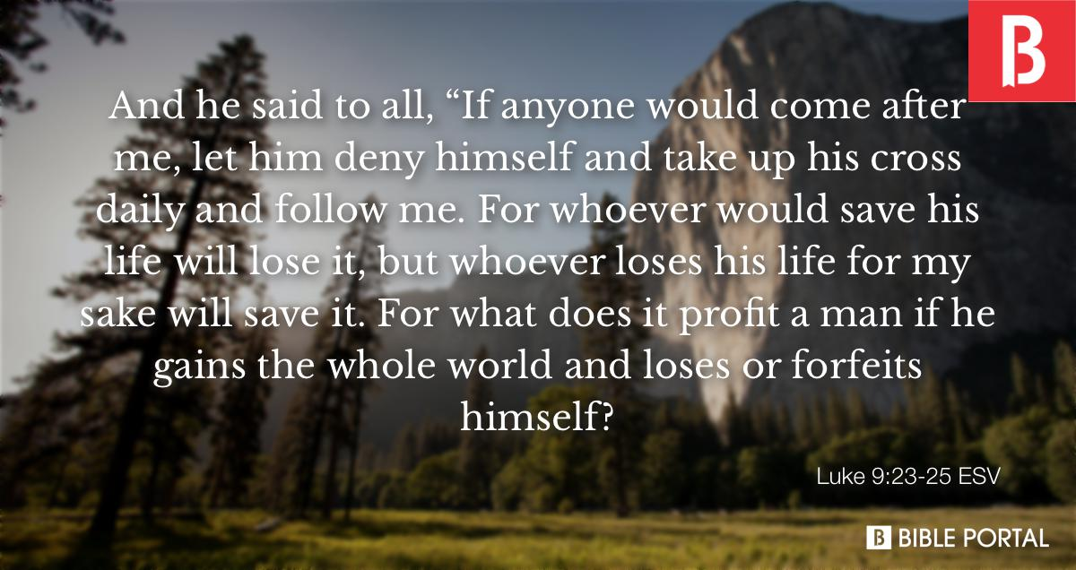

Slide 7
The Context – The Travel Narrative
Luke 9:51-19:47
Luke 9:51: “(Jesus) set his face to go to Jerusalem.”
The shadow of the cross looms large.
Luke 14:25 – Large crowds followed him.
"Jesus was not after decisions; He was after disciples." (Bruce Hedman)

Slide 8
Luke 9:57-62
Key word is “follow” – appears in verse 57, 59 and 61.
3 different response to Jesus’ call to follow.
1) Verse 57-58 - First would-be disciple - compare Matthew 8:18-19.
Follow Jesus entails hardships - (see Luke 12:11-12, 21:12-19; John16:1-3, 33; Acts 14:22, etc.).

Slide 9
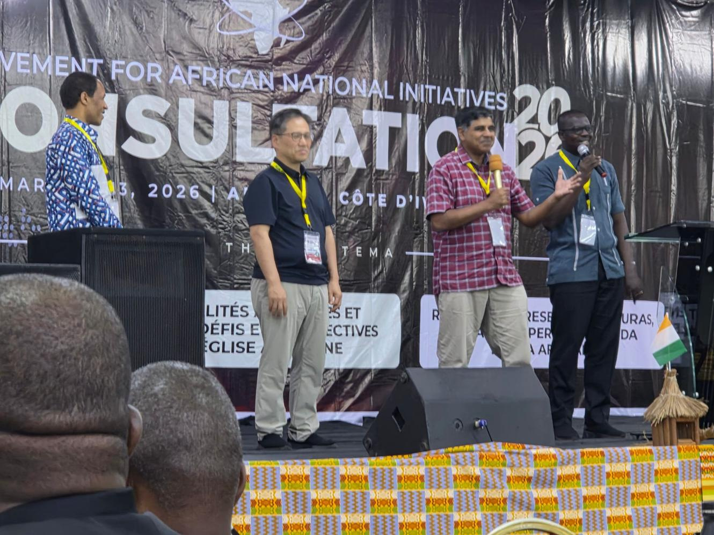

Slide 10
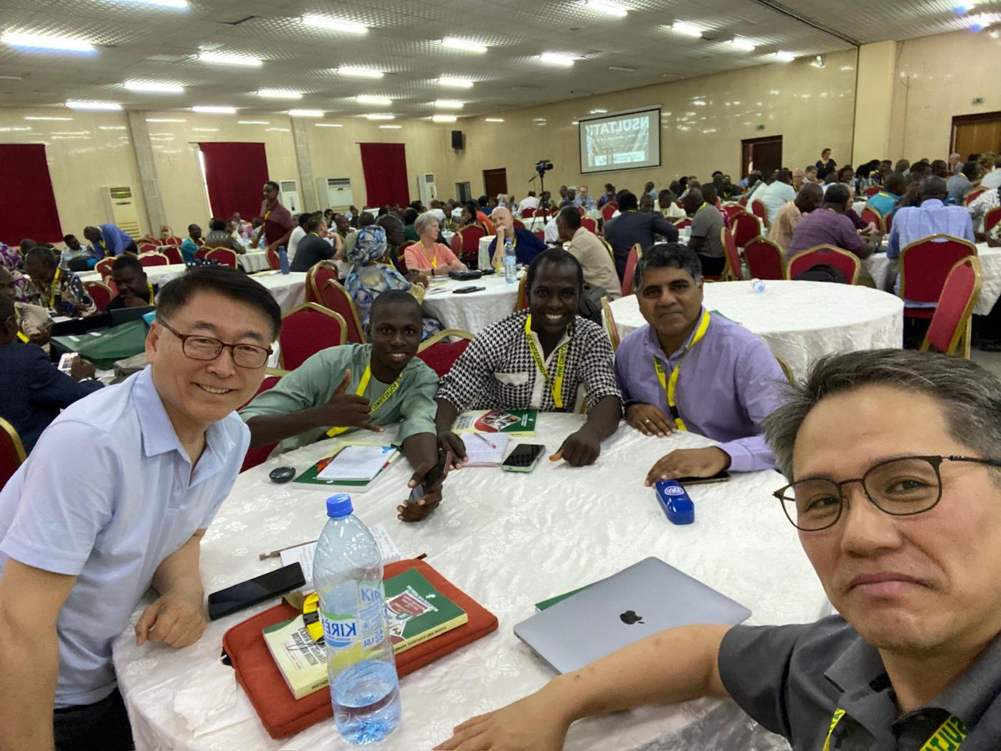

Slide 11
Luke 9:57-62
2) Verse 59-60
“Leave the dead to bury their own dead.”
3) Verse 61-62
No regrets! Look ahead, not back.

Slide 12
Summary
Discipleship is Total! It involves following, imitating and obeying Jesus.
Jesus FIRST before:
a) comfort,
b) cultural and family demands and
c) your own plans and desires

Slide 13
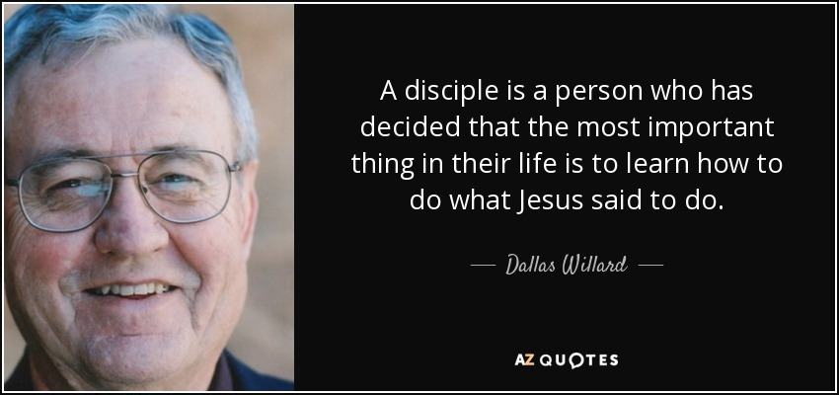

Slide 14
APPLICATION
Salvation is God’s gift to you. Discipleship is your whole-life, all-of-life response.
1) Commit to Following
2) Bring Others With You

Slide 15
