Slide 1
Worship and Sacrifice
GENESIS 22:1-18

Slide 2
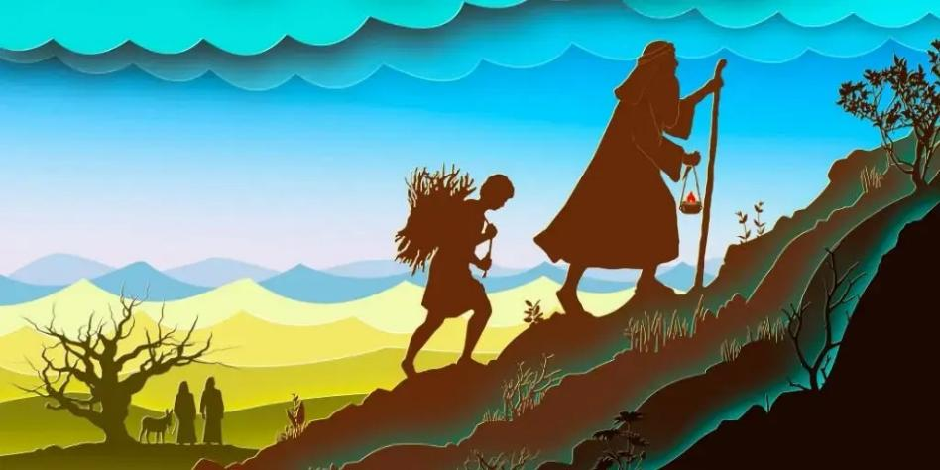
For Abraham: his Worship was his Sacrifice and his Sacrifice was his Worship
Picture from images at: https://www.google.com/

Slide 3
For Abraham: His Worship was his Sacrifice and his Sacrifice was his Worship
¹⁵ O Lord, open my lips,
and my mouth will declare your praise.
¹⁶ For you will not delight in sacrifice, or I would give it;
you will not be pleased with a burnt offering.
¹⁷ The sacrifices of God are a broken spirit;
a broken and contrite heart, O God, you will not despise.
Psalm 51:15-17

Slide 4

ABRAHAM’S SACRIFICE POINTS TO THE FUTURE: god sacrificed his only son for us
Picture from images at: https://www.google.com/

Slide 5
Abraham’s Sacrifice Points to the Future: God Sacrificed His Only Son
⁸ When he said above, “You have neither desired nor taken pleasure in sacrifices and offerings and burnt offerings and sin offerings” (these are offered according to the law), ⁹ then he added, “Behold, I have come to do your will.” He does away with the first in order to establish the second. ¹⁰ And by that will we have been sanctified through the offering of the body of Jesus Christ once for all. ¹¹ And every priest stands daily at his service, offering repeatedly the same sacrifices, which can never take away sins. ¹² But when Christ had offered for all time a single sacrifice for sins, he sat down at the right hand of God, ¹³ waiting from that time until his enemies should be made a footstool for his feet. ¹⁴ For by a single offering he has perfected for all time those who are being sanctified (Hebrews 10:8-14)

Slide 6

Our worship points to Abraham’s worship: worship is in spirit and truth
Picture from images at: https://www.google.com/

Slide 7
Our Worship Points to Abraham’s Worship: Worship is in Spirit and Truth
²³ But the hour is coming, and is now here, when the true worshipers will worship the Father in spirit and truth, for the Father is seeking such people to worship him. ²⁴ God is spirit, and those who worship him must worship in spirit and truth.”
John 4:23-24

