Slide 1


The Winningest NBA Teams Ever
Team Season Wins
Golden State Warriors 2015–16 73
Chicago Bulls 1995–96 72
Los Angeles Lakers 1971–72 69
Chicago Bulls 1996–97 69
Philadelphia 76ers 1966–67 68
Result
Lost NBA Finals
NBA Champions
NBA Champions
NBA Champions
NBA Champions

Slide 2

In your spot …
Asking better questions
Where do you see yourself ...?

Slide 3
Eccl 9:11 I have observed something else under the sun. The fastest runner doesn’t always win the race, and the strongest warrior doesn’t always win the battle.
Eccl 10:1 As dead flies cause even a bottle of perfume to stink,
so a little foolishness spoils great wisdom and honor.

Slide 4
Death Levels All, But Life Still Calls
Ecclesiastes 9:1-11:6

Slide 5
Without God, Life Stinks!
Ecclesiastes
Section 1: Futility of living in a Frustrating World
(Teacher's Search for meaning of life)
  Eccl 1-2 Genius Level Depression
  Eccl 3:1-5:1 Time Marches, Justice Crawls
  Eccl 5:1-6:9 Full Hands, Empty Lives
Section 2: Faithful Living in a Frustrating World (Teacher’s Advice)
  Eccl 6:10-8:17 When Wisdom Comes Up Short
  Eccl 9:1-11:6 Death Levels All, But Life Still Calls
  Eccl 11:7-12:14 TBD

Slide 6

Though Death is Certain, and life is Uncertain,
Faithful Living is Still Required.

Slide 7
1. The Grim Equalizer: (9:1-10)
  Although death is certain, there is advantage in living
2. The Broken Meritocracy (9:11-16)
  Life’s uncertainty’s introduce barriers to fruitful living
3. The Sharp Contrast (9:17-10:20)
  While wisdom cannot eliminate life’s uncertainty, foolish living multiplies its risks
4. The Bold Venture (11:1-6)
  Wisdom calls for generous investment and hard work despite uncertainty
Death Levels All, But Life Still Calls
Ecclesiastes 9:1-11:6

Slide 8
9 This, too, I carefully explored: Even though the actions of godly and wise people are in God’s hands, no one knows whether God will show them favor. ² The same destiny ultimately awaits everyone, whether righteous or wicked, good or bad, ceremonially clean or unclean, religious or irreligious. Good people receive the same treatment as sinners, and people who make promises to God are treated like people who don’t. ³ It seems so wrong that everyone under the sun suffers the same fate. Already twisted by evil, people choose their own mad course, for they have no hope. There is nothing ahead but death anyway.
Reality: Same fate for all
Eccl 9:1-3

Slide 9
9 This, too, I carefully explored: Even though the actions of godly and wise people are in God’s hands, no one knows whether God will show them favor. ² The same destiny ultimately awaits everyone, whether righteous or wicked, good or bad, ceremonially clean or unclean, religious or irreligious. Good people receive the same treatment as sinners, and people who make promises to God are treated like people who don’t. ³ It seems so wrong that everyone under the sun suffers the same fate. Already twisted by evil, people choose their own mad course, for they have no hope. There is nothing ahead but death anyway.
Reality: Same fate for all
Eccl 9:1-3

Slide 10
⁴ There is hope only for the living. As they say, “It’s better to be a live dog than a dead lion!” ⁵ The living at least know they will die, but the dead know nothing. They have no further reward, nor are they remembered. ⁶ Whatever they did in their lifetime—loving, hating, envying—is all long gone. They no longer play a part in anything here on earth.
better to
be a live dog
Advantage: Better alive than dead
Eccl 9:4-6

Slide 11
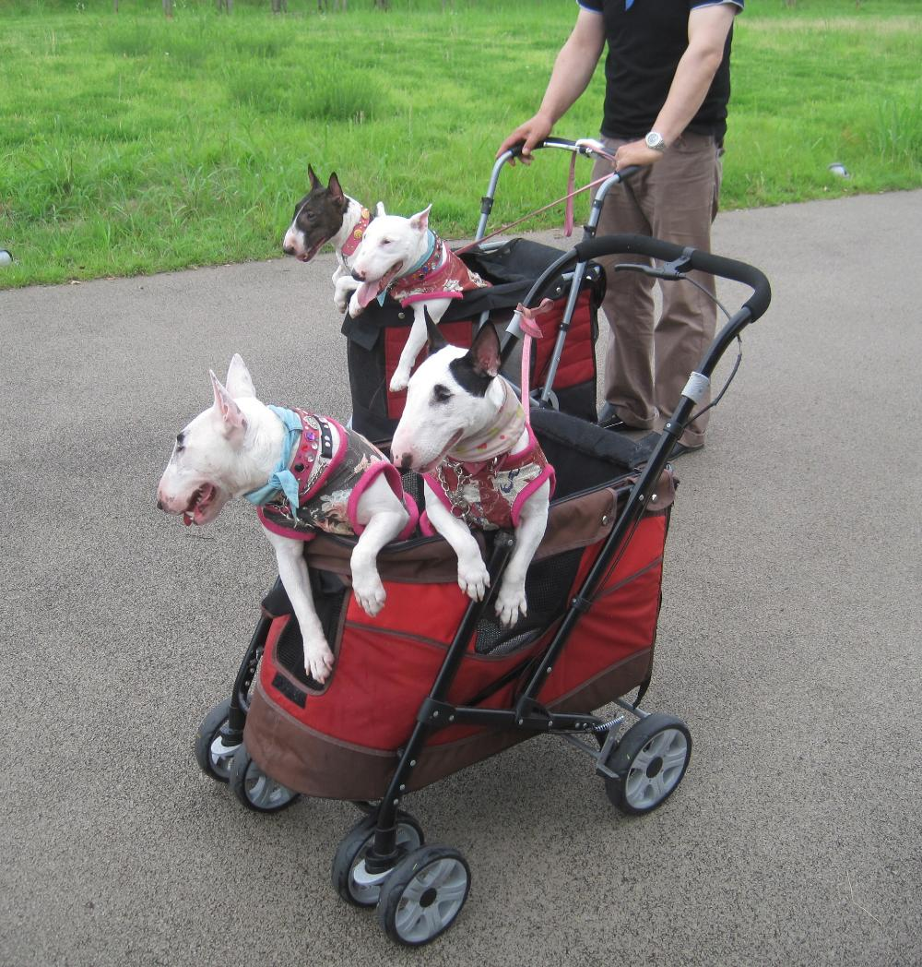
better to
be a live dog
Photo by Joel Abroad / CC BY-NC-SA 2.0
Notes:
Title: Dogs in strollers
Author: Joel Abroad (https://www.flickr.com/photos/40295335@N00/)
Source: Flickr (https://www.flickr.com/photos/40295335@N00/6109844368)
License: CC BY-NC-SA 2.0 (https://creativecommons.org/licenses/by-nc-sa/2.0/)

Slide 12
⁷ So go ahead. Eat your food with joy, and drink your wine with a happy heart, for God approves of this! ⁸ Wear fine clothes, with a splash of cologne! ⁹ Live happily with the woman you love through all the meaningless days of life that God has given you under the sun. The wife God gives you is your reward for all your earthly toil. ¹⁰ Whatever you do, do well. For when you go to the grave, there will be no work or planning or knowledge or wisdom.
Task: Enjoy Life
Eccl 9:7-10

Slide 13
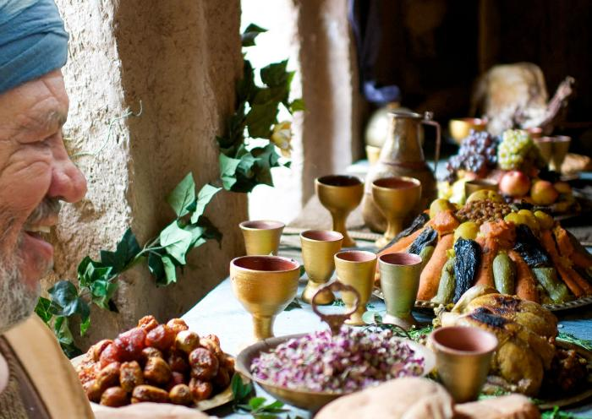
Parable of the Rich Fool
Luke 12:13-21
Image: FreeBibleimages / LUMO
Notes:
Source: FreeBibleimages (www.freebibleimages.org)
https://www.freebibleimages.org/photos/lumo-rich-fool/
Contributor: LUMO Project (The Gospels)
Image Title: The Parable of the Rich Fool
Image Number: 7
Terms of Use: This image is for educational and ministry use only and may not be used for commercial purposes.

Slide 14
1. The Grim Equalizer: (9:1-10)
  Although death is certain, there is advantage in living
  • Reality: Same fate for all (1-3)
  • Advantage: Better alive than dead (4-6)
  • Task: Enjoy life (7-10)
Death Levels All, But Life Still Calls
Ecclesiastes 9:1-11:6

Slide 15
1. The Grim Equalizer: (9:1-10)
  Although death is certain, there is advantage in living
  • Reality: Same fate for all (1-3)
  • Advantage: Better alive than dead (4-6)
  • Task: Enjoy life (7-10)
2. The Broken Meritocracy (9:11-16)
  Life’s uncertainty’s introduce barriers to fruitful living
Death Levels All, But Life Still Calls
Ecclesiastes 9:1-11:6

Slide 16
¹¹ I have observed something else under the sun. The fastest runner doesn’t always win the race, and the strongest warrior doesn’t always win the battle. The wise sometimes go hungry, and the skillful are not necessarily wealthy. And those who are educated don’t always lead successful lives. It is all decided by chance, by being in the right place at the right time. ¹² People can never predict when hard times might come. Like fish in a net or birds in a trap, people are caught by sudden tragedy.
The Barrier of an Uncertain Future
Eccl 9:11-12

Slide 17
¹³ Here is another bit of wisdom that has impressed me as I have watched the way our world works. ¹⁴ There was a small town with only a few people, and a great king came with his army and besieged it. ¹⁵ A poor, wise man knew how to save the town, and so it was rescued. But afterward no one thought to thank him. ¹⁶ So even though wisdom is better than strength, those who are wise will be despised if they are poor. What they say will not be appreciated for long.
The Barrier of Unrewarded Wisdom
  Eccl 9:13-16

Slide 18
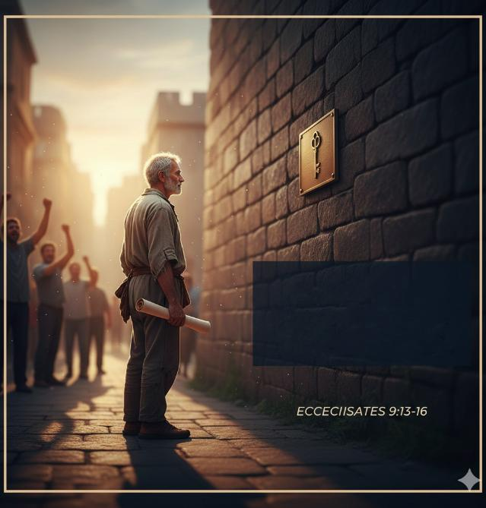
Social Amnesia
the "out of sight, out of mind" nature of human gratitude.
He saved …
…they forgot
Social Amnesia

Slide 19

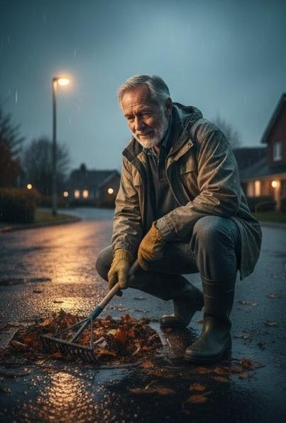

Slide 20
1. The Grim Equalizer: (9:1-10)
  Although death is certain, there is advantage in living
2. The Broken Meritocracy (9:11-16)
  Life’s uncertainty’s introduce barriers to fruitful living
  1. The Barrier of an Uncertain Future (9:11-12)
  2. The Barrier of Unrewarded Wisdom (9:13-16)
Death Levels All, But Life Still Calls
Ecclesiastes 9:1-11:6

Slide 21
1. The Grim Equalizer: (9:1-10)
  Although death is certain, there is advantage in living
2. The Broken Meritocracy (9:11-16)
  Life’s uncertainty’s introduce barriers to fruitful living
3. The Sharp Contrast (9:17-10:20)
  While wisdom cannot eliminate life’s uncertainty, foolish living multiplies its risks
1. Thesis (9:17-10:1)
2. Identity (10:2-14)
3. Application: Society Order (10:16-20)
Death Levels All, But Life Still Calls
Ecclesiastes 9:1-11:6

Slide 22
¹⁷ Better to hear the quiet words of a wise person
than the shouts of a foolish king.
¹⁸ Better to have wisdom than weapons of war,
but one sinner can destroy much that is good.
Ch 10 ¹ As dead flies cause even a bottle of perfume to stink,
so a little foolishness spoils great wisdom and honor.
Thesis: Wisdom is better than Foolishness
Eccl 9:17-10:1

Slide 23
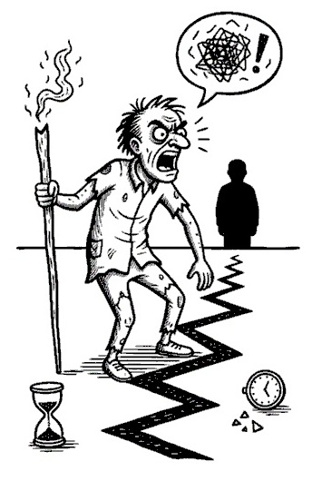
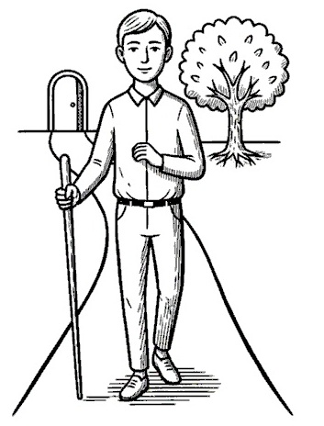
² A wise person chooses the right road;
a fool takes the wrong one.
³ You can identify fools
just by the way they walk down the street!
⁴ If your boss is angry at you, don’t quit!
A quiet spirit can overcome even great mistakes.
Identity: 1. How they Live
Eccl 10:2-4

Slide 24
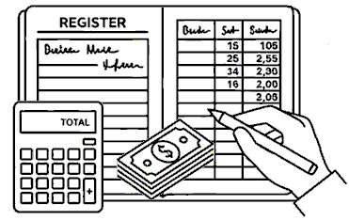
⁵ There is another evil I have seen under the sun. Kings and rulers make a grave mistake ⁶ when they give great authority to foolish people and low positions to people of proven worth. ⁷ I have even seen servants riding horseback like princes—and princes walking like servants!
Identity: 2. How they Lead
Eccl 10:5-7

Slide 25
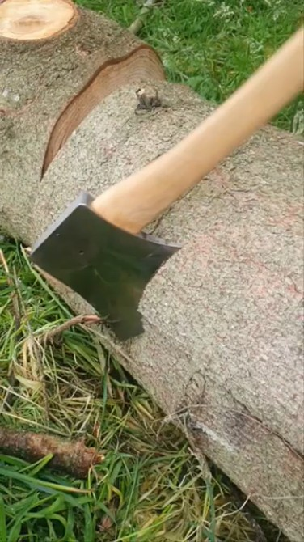
⁸ When you dig a well,
you might fall in.
When you demolish an old wall,
you could be bitten by a snake.
⁹ When you work in a quarry,
stones might fall and crush you.
When you chop wood,
there is danger with each stroke of your ax.
¹⁰ Using a dull ax requires great strength,
so sharpen the blade.
That’s the value of wisdom;
it helps you succeed.
¹¹ If a snake bites before you charm it,
what’s the use of being a snake charmer?
Identity: 3. How they labor (work)
Eccl 10:8-11
Notes:
https://www.youtube.com/shorts/6iGhHuwL9kQ
YouTube Video Attribution (Axe)
Video Title: "What a Scary Sharp Axe Looks Like"
Author: Ben Scott (YouTube) License: Standard YouTube License

Slide 26
¹² Wise words bring approval,
but fools are destroyed by their own words.
¹³ Fools base their thoughts on foolish assumptions,
so their conclusions will be wicked madness;
¹⁴ they chatter on and on.
No one really knows what is going to happen;
no one can predict the future.
¹⁵ Fools are so exhausted by a little work
that they can’t even find their way home.
Identity: 4. How they limit their lips
Eccl 10:12-15

Slide 27
¹⁶ What sorrow for the land ruled by a servant,
the land whose leaders feast in the morning.
¹⁷ Happy is the land whose king is a noble leader
and whose leaders feast at the proper time
to gain strength for their work, not to get drunk.
¹⁸ Laziness leads to a sagging roof;
idleness leads to a leaky house.
¹⁹ A party gives laughter,
wine gives happiness,
and money gives everything!
²⁰ Never make light of the king, even in your thoughts.
And don’t make fun of the powerful, even in your own bedroom.
For a little bird might deliver your message
and tell them what you said.
Application Society Order
Eccl 10:16-20

Slide 28
1. The Grim Equalizer: (9:1-10)
  Although death is certain, there is advantage in living
2. The Broken Meritocracy (9:11-16)
  Life’s uncertainty’s introduce barriers to fruitful living
3. The Sharp Contrast (9:17-10:20)
  While wisdom cannot eliminate life’s uncertainty, foolish living multiplies its risks
4. The Bold Venture (11:1-6)
  Wisdom calls for generous investment and hard work despite uncertainty
Death Levels All, But Life Still Calls
Ecclesiastes 9:1-11:6

Slide 29
11 Send your grain across the seas,
and in time, profits will flow back to you.
² But divide your investments among many places,
for you do not know what risks might lie ahead.
Application: The Strategy
Eccl 11:1-2

Slide 30



11 Send your grain across the seas,
and in time, profits will flow back to you.
² But divide your investments among many places,
for you do not know what risks might lie ahead.
Cast your bread upon the waters,
for you will find it after many days.
² Give a portion to seven, or even to eight,
for you know not what disaster may happen on earth.
NLT
ESV
Application: The Strategy
Eccl 11:1-2

Slide 31
³ When clouds are heavy, the rains come down.
Whether a tree falls north or south, it stays where it falls.
⁴ Farmers who wait for perfect weather never plant.
If they watch every cloud, they never harvest.
Application: The Snare
Eccl 11:3-4

Slide 32
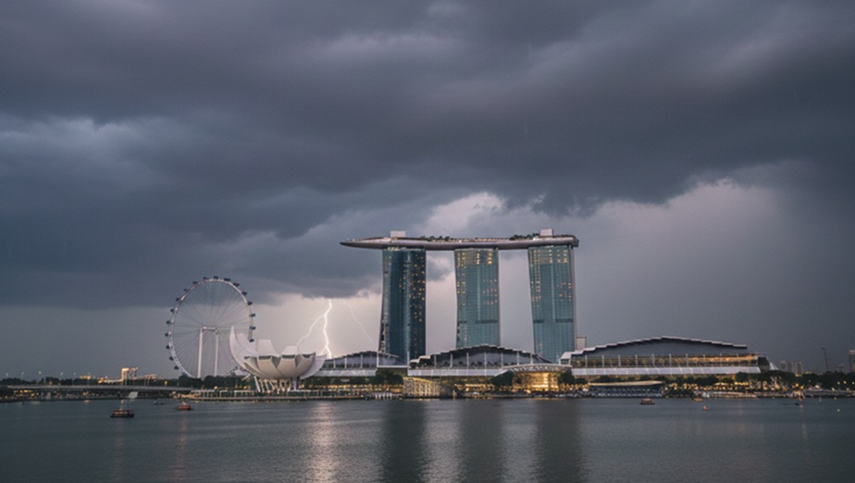
³ When clouds are heavy, the rains come down.

Slide 33
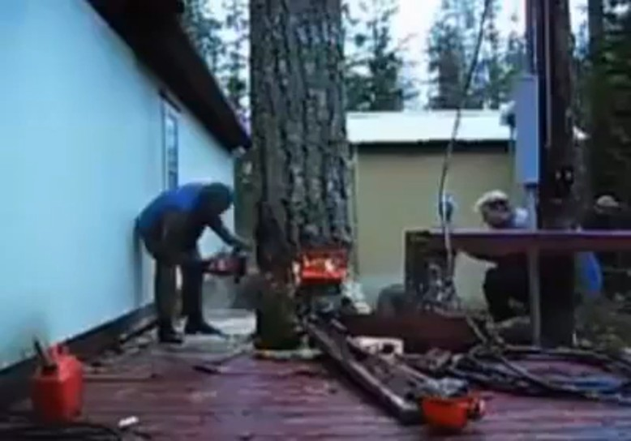
Whether a tree falls north or south, it stays where it falls.
Notes:
https://www.youtube.com/watch?v=UYrNXVdZq7Y
YouTube Video Attribution (A tree Falls)
Video Title: "Shoking video when a tree cut down between two house"
Author: FUN ADDA (YouTube)
License: Standard YouTube License

Slide 34
³ When clouds are heavy, the rains come down.
Whether a tree falls north or south, it stays where it falls.
⁴ Farmers who wait for perfect weather never plant.
If they watch every cloud, they never harvest.
Application: The Snare
Eccl 11:3-4

Slide 35
⁵ Just as you cannot understand the path of the wind or the mystery of a tiny baby growing in its mother’s womb, so you cannot understand the activity of God, who does all things.
⁶ Plant your seed in the morning and keep busy all afternoon, for you don’t know if profit will come from one activity or another—or maybe both.
Application: The Secret and Solution
Eccl 11:5-6

Slide 36

2006 – 2026
From Mission to Maturity

Slide 37
Don’t Watch the Clouds

Slide 38


CIC’s Bold Venture

Slide 39
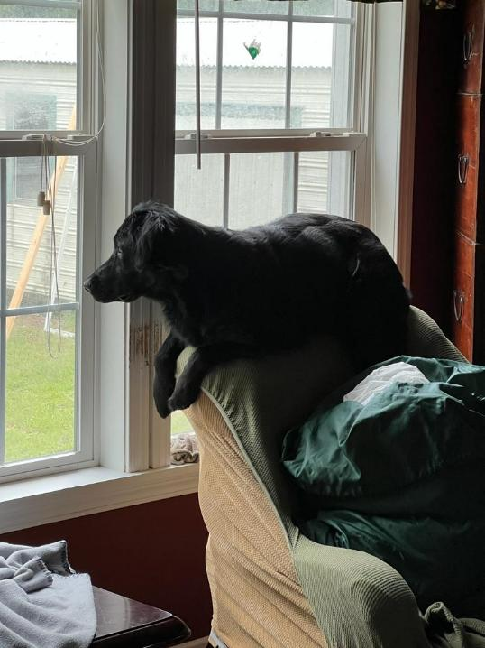
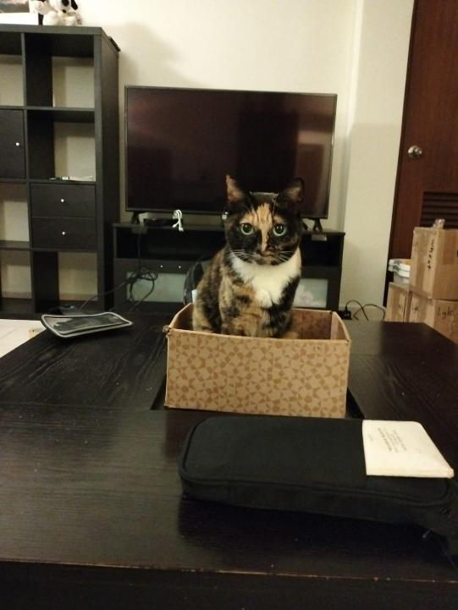
Dogs and Cats

Slide 40
From Under the Sun to the Son of God

Slide 41
1. The Grim Equalizer: (9:1-10)
  Although death is certain, there is advantage in living
2. The Broken Meritocracy (9:11-16)
  Life’s uncertainty’s introduce barriers to fruitful living
3. The Sharp Contrast (9:17-10:20)
  While wisdom cannot eliminate life’s uncertainty, foolish living multiplies its risks
4. The Bold Venture (11:1-6)
  Wisdom calls for generous investment and hard work despite uncertainty
Death Levels All, But Life Still Calls
Ecclesiastes 9:1-11:6

Slide 42
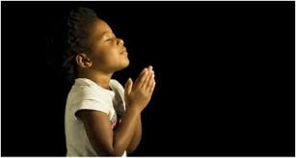
LET US PRAY….

