Slide 1
A Kingdom-first people
Matthew 6:19-34
CIC Sunday 10th January 2026

Slide 2


Slide 3
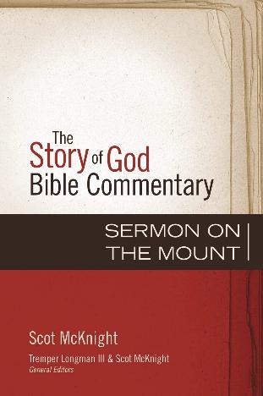
Scott Mcknight
Christians have looked at the Sermon in 4 ways:
A mirror showing us how far we’ve fallen from God’s law
A code of private morality.
A duty of the super-committed among us.
A way of living that requires first Gospel justification by grace, then sanctification into holiness.

Slide 4
Scott McKnight, The Story of God Bible Commentary – Sermon On The Mount, Zondervan Academic, 2013, page 3.
“Only as demand do we hear this Sermon as (Jesus) meant it to be heard: as the claim of Jesus upon our whole being.”

Slide 5
Matthew’s angle – Fulfilment:
The Coming one has arrived!
Jesus – ‘a prophet like Moses’ (Deuteronomy 18:15-19).

Slide 6
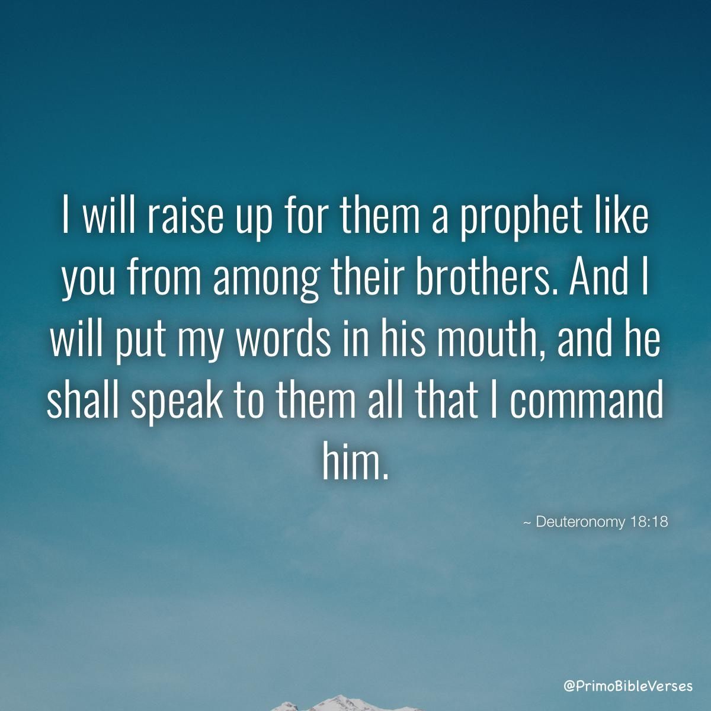

Slide 7
Matthew’s angle – Fulfilment:
The Coming one has arrived!
Jesus is greater than Moses – and brings a new and ‘better’ covenent (Hebrews 3:1-6).
Matthew’s Gospel parallels the Pentateuch (the 1st 5 books of the Old Testament) - the first covenant and laws.
Matthew has 5 main teaching sections:
Matthew 5-7 : Kingdom Living
Matthew 10 : Kingdom Mission
Matthew 13 : Kingdom Parables
Matthew 18 : Kingdom Community
Matthew 24-25 : Kingdom To Come

Slide 8
Matthew 5, Verse 1: The context
Matthew 5:1a – “Jesus went up on the mountain” – cf Exodus 19:3 – “Moses went up the mountain.”.
Matthew 5:1b – “….he sat down.” – cf Deuteronomy 9:9 – according to tradition, Moses ‘sat down’ on the mountain to receive the covenant.’
Matthew 5:1c – “…his disciples came to him.” – this is a teaching for disciples of the Kingdom.

Slide 9
Matthew 6:1-18
Jesus speaks about our worship before God - in giving, in prayer and in fasting.
The concern here in OUR WORSHIP.
The next part concerns OUR WORK.

Slide 10
Matthew 6:19-34
In previous passage, Jesus tells disciples not to be hypocritical. Performing our worship in front of others (vs 2, 5 and 16).
Here, tells them not to follow the materialism of the pagans or godless, represented by Gentiles (vs 32).

Slide 11
Matthew 6:19-34
MAIN IDEA:
We need to have a right vision of God’s kingdom that leads us to trust God’s provision.

Slide 12
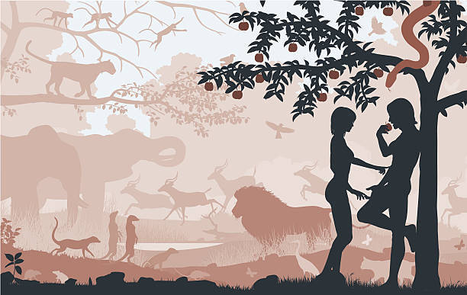

Slide 13
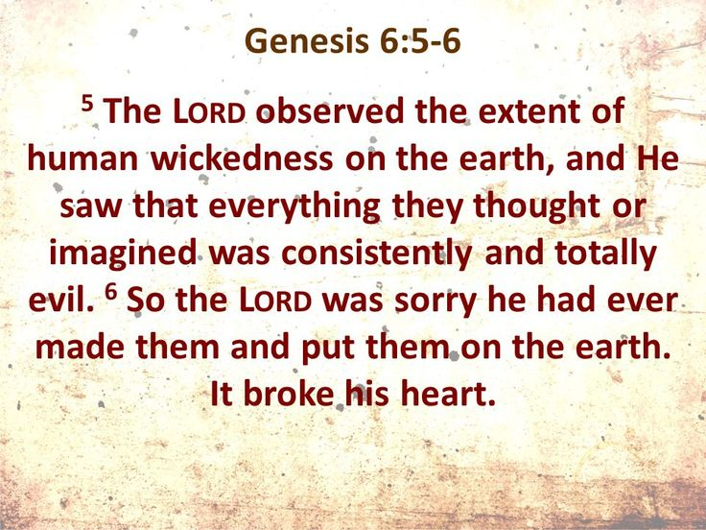

Slide 14
¹⁹ “Do not lay up for yourselves treasures on earth, where moth and rust destroy and where thieves break in and steal, ²⁰ but lay up for yourselves treasures in heaven, where neither moth nor rust destroys and where thieves do not break in and steal. ²¹ For where your treasure is, there your heart will be also.

Slide 15
Matthew 6:19-21
How do we lay up treasures in heaven? By holding God as your greatest treasure.

Slide 16
²² “The eye is the lamp of the body. So, if your eye is healthy, your whole body will be full of light, ²³ but if your eye is bad, your whole body will be full of darkness. If then the light in you is darkness, how great is the darkness!
²⁴ “No one can serve two masters, for either he will hate the one and love the other, or he will be devoted to the one and despise the other. You cannot serve God and money.

Slide 17
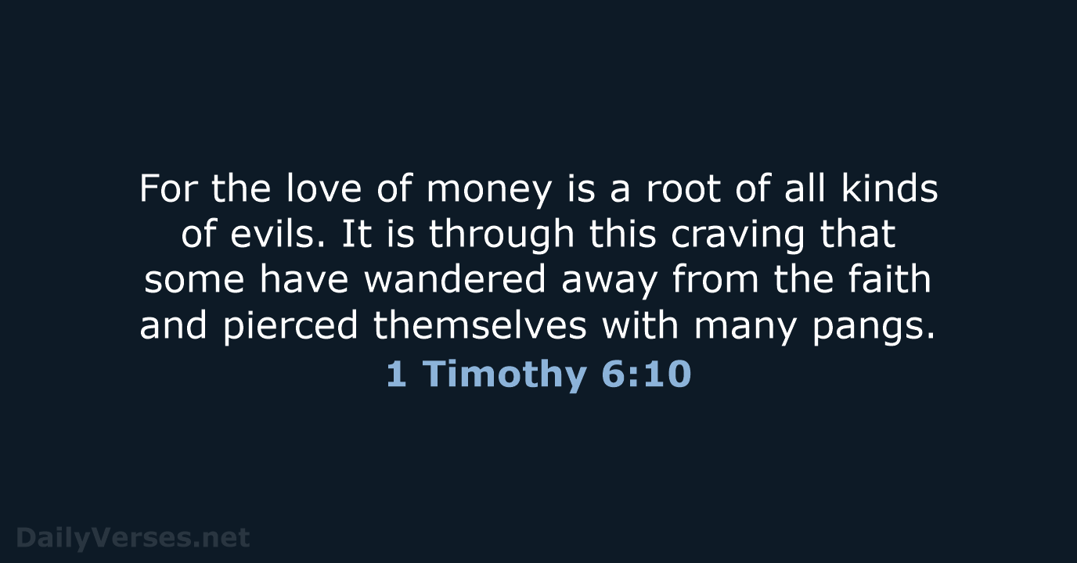

Slide 18
²² “The eye is the lamp of the body. So, if your eye is healthy, your whole body will be full of light, ²³ but if your eye is bad, your whole body will be full of darkness. If then the light in you is darkness, how great is the darkness!
²⁴ “No one can serve two masters, for either he will hate the one and love the other, or he will be devoted to the one and despise the other. You cannot serve God and money.

Slide 19
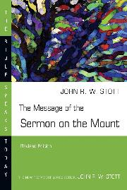
John Stott
”God can only be served with an entire and exclusive devotion. This is simply because he is God: “I am the Lord, that is my name; my glory I give to no other.” (Isaiah 42:8:48:11).”
John R. W. Stott, The Message of the Sermon on the Mount, (Leicester: InterVarsity, 1978), page 158-159

Slide 20
²⁵ “Therefore I tell you, do not be anxious about your life, what you will eat or what you will drink, nor about your body, what you will put on. Is not life more than food, and the body more than clothing? ²⁶ Look at the birds of the air: they neither sow nor reap nor gather into barns, and yet your heavenly Father feeds them. Are you not of more value than they? ²⁷ And which of you by being anxious can add a single hour to his span of life?^{[c]} ²⁸ And why are you anxious about clothing? Consider the lilies of the field, how they grow: they neither toil nor spin, ²⁹ yet I tell you, even Solomon in all his glory was not arrayed like one of these.

Slide 21
³⁰ But if God so clothes the grass of the field, which today is alive and tomorrow is thrown into the oven, will he not much more clothe you, O you of little faith? ³¹ Therefore do not be anxious, saying, ‘What shall we eat?’ or ‘What shall we drink?’ or ‘What shall we wear?’ ³² For the Gentiles seek after all these things, and your heavenly Father knows that you need them all. ³³ But seek first the kingdom of God and his righteousness, and all these things will be added to you.
³⁴ “Therefore do not be anxious about tomorrow, for tomorrow will be anxious for itself. Sufficient for the day is its own trouble.

Slide 22
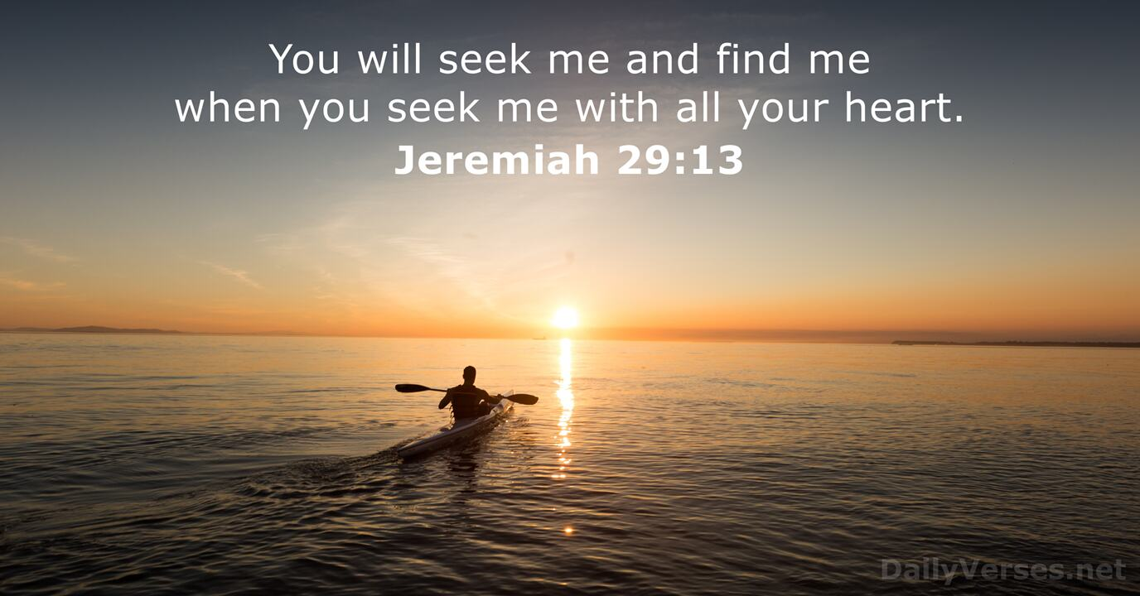

Slide 23
John Stott
“There are two treasures (on earth and in heaven 19-21), two bodily conditions (light and darkness, 22,23), two masters (God and mammon, 24) and two preoccupations (our bodies and God’s Kingdom, 25-34). We cannot sit on the fence.”
John R. W. Stott, The Message of the Sermon on the Mount, (Leicester: InterVarsity, 1978), page 153.

Slide 24
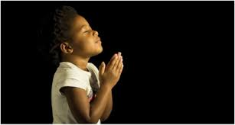
LET US PRAY….

