Slide 1

SHUTDOWN

Slide 2


Slide 3


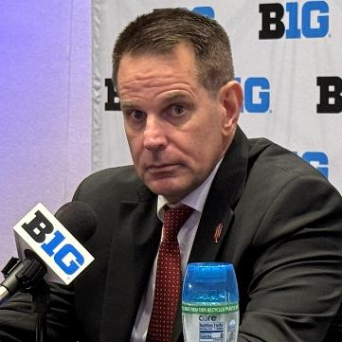



$13.3 million
$12.5 million
$11.6 million
Notes:
Georgia Bulldogs football
Logo: from https://en.wikipedia.org/wiki/Georgia_Bulldogs_football
By Brunswickian (talk) - http://www.sportslogos.net/logo.php?id=hr85j3g1duiqf59eiep9bvnsd, Public Domain, https://commons.wikimedia.org/w/index.php?curid=12445959
Coach: https://en.wikipedia.org/wiki/Kirby_Smart#/media/File:2023-0109-CFPtitlegame-Kirby_Smart.jpg
By Bobak Ha'Eri - Own work, CC BY 3.0, https://commons.wikimedia.org/w/index.php?curid=129467473
Ohio State Buckeyes football
logo: from https://en.wikipedia.org/wiki/Ohio_State_Buckeyes_football
By The original uploader was Buckeyes1186 at English Wikipedia. - Transferred from en.wikipedia to Commons., Public Domain, https://commons.wikimedia.org/w/index.php?curid=32332465
Coach: https://en.wikipedia.org/wiki/Ryan_Day_(American_football)
By Bobak Ha'Eri - Own work, CC BY 3.0, https://commons.wikimedia.org/w/index.php?curid=158352079
Indiana Hoosiers football
Logo: https://en.wikipedia.org/wiki/Indiana_Hoosiers_football#/media/File:Indiana_Hoosiers_logo.svg
By Unknown author - http://visualidentity.iu.edu/doc/manual072208.pdf, Public Domain, https://commons.wikimedia.org/w/index.php?curid=16892718
Coach: https://en.wikipedia.org/wiki/Curt_Cignetti#/media/File:2025-0722_-_Curt_Cignetti.jpg
By Bobak Ha'Eri - Own work, CC BY 3.0, https://commons.wikimedia.org/w/index.php?curid=170719785

Slide 4





$25.9
million
Notes:
Pep Guardiola
https://en.wikipedia.org/wiki/Pep_Guardiola#/media/File:2023-10-04_Fu%C3%9Fball,_M%C3%A4nner,_UEFA_Champions_League,_RB_Leipzig_-_Manchester_City_FC_1DX_2797_(cropped).jpg
By Steffen Prößdorf, CC BY-SA 4.0, https://commons.wikimedia.org/w/index.php?curid=165680540
Manchester United
https://en.wikipedia.org/wiki/Manchester_United_F.C.#/media/File:Manchester_United_FC_crest.svg
By http://hospitalityguide.manutd.com/global_assets/Wine_List.pdf, Fair use, https://en.wikipedia.org/w/index.php?curid=30961834

Slide 5
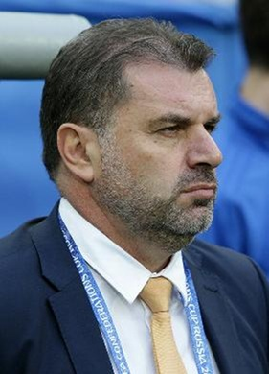

Ange Postecoglou
Notes:
Nottingham Forest logo
found at https://en.wikipedia.org/wiki/Nottingham_Forest_F.C.#/media/File:Nottingham_Forest_F.C._logo.svg
By The logo may be obtained from Nottingham Forest F.C.., Fair use, https://en.wikipedia.org/w/index.php?curid=64540277
Ange Postecoglou
Found at https://en.wikipedia.org/wiki/Ange_Postecoglou#/media/File:Ange_Postecoglou_(cropped).jpg
By Кирилл Венедиктов - soccer.ru, CC BY-SA 3.0, https://commons.wikimedia.org/w/index.php?curid=136829156

Slide 6
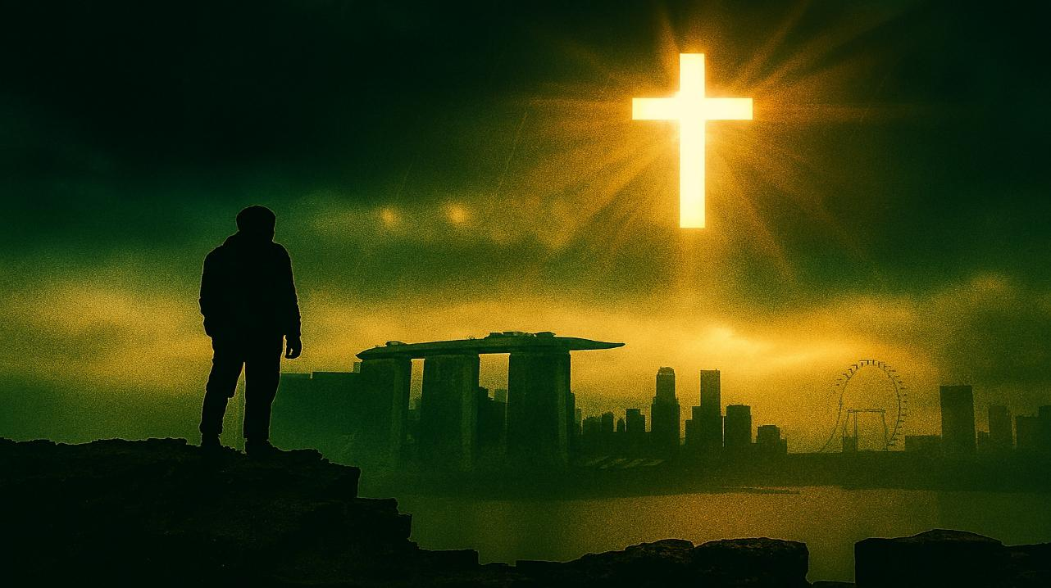
What in the World, God….
Habakkuk

Slide 7
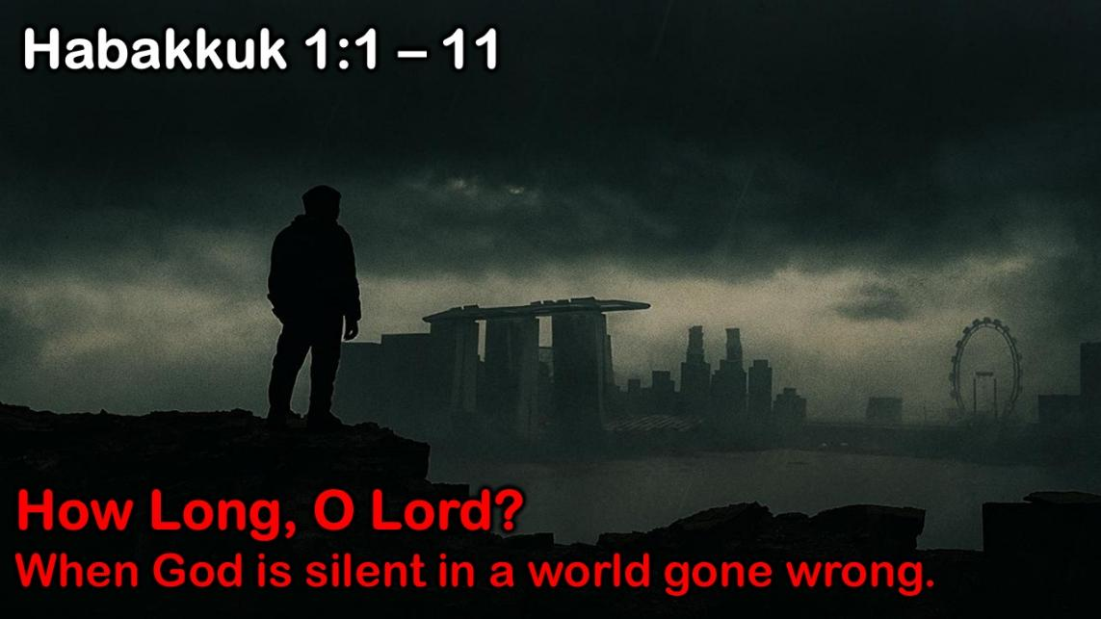
Habakkuk: Babylon's Destruction
Judah: 612 – 586 BC (some believe 607-605 BC)
God's Actions Challenged
Doubting
Prophets’ 1st Complaint
Question of God’s Inactivity
Habakkuk | God
Why aren't you judging Judah's sin, God? | I will. I'll judge Judah with the Babylonians!
1:1-4 | 1:5-11
Problem: Faith Troubled

Slide 8
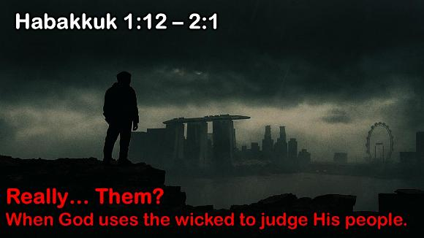
Habakkuk: Babylon's Destruction
Judah: 612 – 586 BC (some believe 607-605 BC)
God's Actions Challenged
Doubting | Debating God
Prophets’ 1st Complaint |  | Prophets’ 2nd Complaint
Question of God’s Inactivity |  | Question of God’s Inconsistency
Habakkuk | God | Habakkuk | God
Why aren't you judging Judah's sin, God? | I will. I'll judge Judah with the Babylonians! | But can you use a nation more wicked than Judah? | Sure, but I'll judge them too.
1:1-4 | 1:5-11 | 1:12–2:1 | 2:2-20
Problem: Faith Troubled |  |  | Resolution: Faith Triumphant

Slide 9
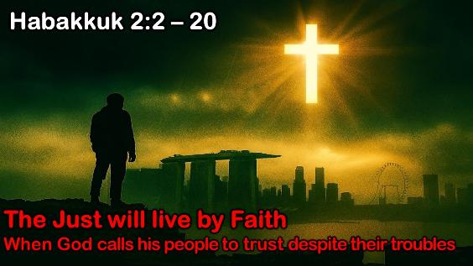
Habakkuk: Babylon's Destruction
Judah: 612 – 586 BC (some believe 607-605 BC)
God's Actions Challenged
Doubting | Debating God
Prophets’ 1st Complaint |  | Prophets’ 2nd Complaint
Question of God’s Inactivity |  | Question of God’s Inconsistency
Habakkuk | God | Habakkuk | God
Why aren't you judging Judah's sin, God? | I will. I'll judge Judah with the Babylonians! | But can you use a nation more wicked than Judah? | Sure, but I'll judge them too.
1:1-4 | 1:5-11 | 1:12–2:1 | 2:2-20
Problem: Faith Troubled |  |  | Resolution: Faith Triumphant

Slide 10
Habakkuk 3:1 – 19
Really… Rejoice?
When joy is chosen in the face of loss

Slide 11
Habakkuk: Babylon's Destruction
Judah: 612 – 586 BC (some believe 607-605 BC)
God's Actions Challenged |  |  |  | God's Actions Commended
Doubting | Debating God |  |  | Defending God
Prophets’ 1st Complaint |  | Prophets’ 2nd Complaint |  | Prophets’ Prayer of Trust
Question of God’s Inactivity |  | Question of God’s Inconsistency |  | Affirming God’s Sovereignty and Faithfulness
Habakkuk | God | Habakkuk | God | Habakkuk
Why aren't you judging Judah's sin, God? | I will. I'll judge Judah with the Babylonians! | But can you use a nation more wicked than Judah? | Sure, but I'll judge them too. | PRAYER | PRAISE | PLEDGE
 |  |  |  | In wrath remember mercy. | Our God is an awesome God! | I'll wait patiently & rejoice
1:1-4 | 1:5-11 | 1:12–2:1 | 2:2-20 | 3:1-2 | 3:3-15 | 3:16-19
Problem: Faith Troubled |  |  | Resolution: Faith Triumphant
Habakkuk 3:1 – 19
Really… Rejoice?
When joy is chosen in the face of loss

Slide 12

Prayer – God’s Faithfulness Remembered (3:1-2)
Praise – God’s Power Revealed (3:3-15)
Pledge – Rejoice in God’s Salvation (3:16-19)
Habakkuk 3:1 – 19
Really… Rejoice?
When joy is chosen in the face of loss

Slide 13
Ch 3 A prayer of Habakkuk the prophet, according to Shigionoth.
² O Lord, I have heard the report of you, and your work, O Lord, do I fear. In the midst of the years revive it; in the midst of the years make it known; in wrath remember mercy. ³ God came from Teman, and the Holy One from Mount Paran. His splendor covered the heavens, and the earth was full of his praise. ⁴ His brightness was like the light; rays flashed from his hand; and there he veiled his power. ⁵ Before him went pestilence, and plague followed at his heels. ⁶ He stood and measured the earth; he looked and shook the nations; then the eternal mountains were scattered; the everlasting hills sank low. His were the everlasting ways. ⁷ I saw the tents of Cushan in affliction; the curtains of the land of Midian did tremble. ⁸ Was your wrath against the rivers, O Lord? Was your anger against the rivers, or your indignation against the sea, when you rode on your horses, on your chariot of salvation? ⁹ You stripped the sheath from your bow, calling for many arrows. You split the earth with rivers. ¹⁰ The mountains saw you and writhed; the raging waters swept on; the deep gave forth its voice; it lifted its hands on high. ¹¹ The sun and moon stood still in their place at the light of your arrows as they sped, at the flash of your glittering spear. ¹² You marched through the earth in fury; you threshed the nations in anger. ¹³ You went out for the salvation of your people, for the salvation of your anointed. You crushed the head of the house of the wicked, laying him bare from thigh to neck. ¹⁴ You pierced with his own arrows the heads of his warriors, who came like a whirlwind to scatter me, rejoicing as if to devour the poor in secret. ¹⁵ You trampled the sea with your horses, the surging of mighty waters.
¹⁶ I hear, and my body trembles; my lips quiver at the sound; rottenness enters into my bones; my legs tremble beneath me. Yet I will quietly wait for the day of trouble to come upon people who invade us.
¹⁷ Though the fig tree should not blossom, nor fruit be on the vines, the produce of the olive fail and the fields yield no food, the flock be cut off from the fold and there be no herd in the stalls, ¹⁸ yet I will rejoice in the Lord; I will take joy in the God of my salvation. ¹⁹ God, the Lord, is my strength; he makes my feet like the deer's; he makes me tread on my high places.
Selah
Habakkuk’s Psalm of Faith
Selah
Selah
To the choirmaster: with stringed instruments.

Slide 14
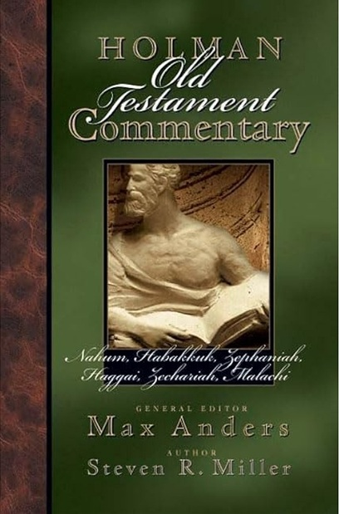
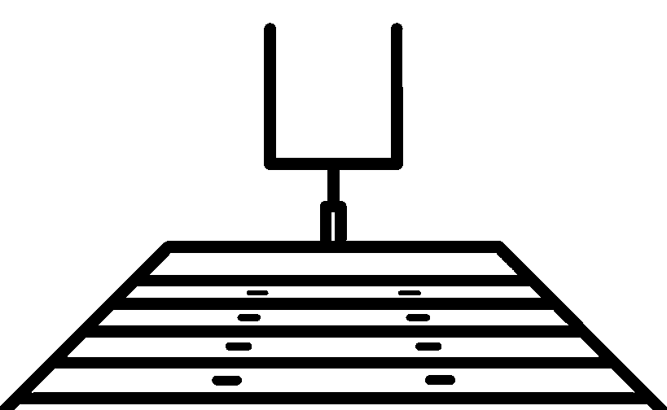

True worship focuses on our glorious God and produces greater faith, joy, and strength in the believer.
Holman Old Testament Commentary Nahum-Malachi Vol 20
Miller, S. R. (2004). Nahum-Malachi (M. Anders, Ed.; p. 76). B&H Publishing Group.
Big Idea

Slide 15
Prayer – God’s Faithfulness Remembered (3:1-2)
Faith looks backward to what God has done
Praise – God’s Power Revealed (3:3-15)
Pledge – Rejoice in God’s Salvation (3:16-19)
Habakkuk 3:1 – 19
Really… Rejoice?
When joy is chosen in the face of loss

Slide 16
3 A prayer of Habakkuk the prophet, according to Shigionoth.
² O Lord, I have heard the report of you, and your work, O Lord, do I fear. In the midst of the years revive it; in the midst of the years make it known; in wrath remember mercy.
Prayer – God’s Faithfulness Remembered (3:1-2)

Slide 17
3 A prayer of Habakkuk the prophet, according to Shigionoth.
² O Lord, I have heard the report of you, and your work, O Lord, do I fear. In the midst of the years revive it; in the midst of the years make it known; in wrath remember mercy.
Prayer Acknowledges God’s Sovereignty
Prayer – God’s Faithfulness Remembered (3:1-2)

Slide 18
3 A prayer of Habakkuk the prophet, according to Shigionoth.
² O Lord, I have heard the report of you, and your work, O Lord, do I fear. In the midst of the years revive it; in the midst of the years make it known; in wrath remember mercy.
Prayer Appeals to God’s Character
Prayer – God’s Faithfulness Remembered (3:1-2)

Slide 19
3 A prayer of Habakkuk …, according to Shigionoth.
תְּפִלָּה
שִׁגְיֹנוֹת
Psalm 17: A prayer of David.
Psalm 86: A prayer of David."
Psalm 90: A prayer of Moses the man of God."
Psalm 102: A prayer of an afflicted man.
Psalm 142: A psalm of David.
Psalm 7: A Shiggaion of David

Slide 20
Prayer – God’s Faithfulness Remembered (3:1-2)
Faith looks backward to what God has done
Praise – God’s Power Revealed (3:3-15)
Faith looks upward to who God is.
Pledge – Rejoice in God’s Salvation (3:16-19)
Habakkuk 3:1 – 19
Really… Rejoice?
When joy is chosen in the face of loss

Slide 21
³ God came from Teman, and the Holy One from Mount Paran. Selah His splendor covered the heavens, and the earth was full of his praise. ⁴ His brightness was like the light; rays flashed from his hand; and there he veiled his power. ⁵ Before him went pestilence, and plague followed at his heels.
Praise – God’s Power Revealed (3:3-15)

Slide 22
⁶ He stood and measured the earth; he looked and shook the nations; then the eternal mountains were scattered; the everlasting hills sank low. His were the everlasting ways. ⁷ I saw the tents of Cushan in affliction; the curtains of the land of Midian did tremble.
Praise – God’s Power Revealed (3:3-15)

Slide 23
³ God came from Teman, and the Holy One from Mount Paran. Selah His splendor covered the heavens, and the earth was full of his praise. ⁴ His brightness was like the light; rays flashed from his hand; and there he veiled his power. ⁵ Before him went pestilence, and plague followed at his heels.
⁶ He stood and measured the earth; he looked and shook the nations; then the eternal mountains were scattered; the everlasting hills sank low. His were the everlasting ways. ⁷ I saw the tents of Cushan in affliction; the curtains of the land of Midian did tremble.
The Redeemer’s Coming
Praise – God’s Power Revealed (3:3-15)

Slide 24
Teman – city in Edom
and Mount Paran
Mt Sinai
Midian (also Cushites)

Slide 25
³ God came from Teman, and the Holy One from Mount Paran. Selah His splendor covered the heavens, and the earth was full of his praise. ⁴ His brightness was like the light; rays flashed from his hand; and there he veiled his power. ⁵ Before him went pestilence, and plague followed at his heels.
⁶ He stood and measured the earth; he looked and shook the nations; then the eternal mountains were scattered; the everlasting hills sank low. His were the everlasting ways. ⁷ I saw the tents of Cushan in affliction; the curtains of the land of Midian did tremble.
The Redeemer’s Coming
Praise – God’s Power Revealed (3:3-15)

Slide 26
³ God came from Teman, and the Holy One from Mount Paran. Selah His splendor covered the heavens, and the earth was full of his praise. ⁴ His brightness was like the light; rays flashed from his hand; and there he veiled his power. ⁵ Before him went pestilence, and plague followed at his heels.
⁶ He stood and measured the earth; he looked and shook the nations; then the eternal mountains were scattered; the everlasting hills sank low. His were the everlasting ways. ⁷ I saw the tents of Cushan in affliction; the curtains of the land of Midian did tremble.
Conquest of Nature
(8–11)
Conquest over Nations
(12–15)
The Redeemer’s Coming
The Redeemer’s Conquest
Praise – God’s Power Revealed (3:3-15)

Slide 27
⁸ Was your wrath against the rivers, O Lord? Was your anger against the rivers, or your indignation against the sea, when you rode on your horses, on your chariot of salvation? ⁹ You stripped the sheath from your bow, calling for many arrows. Selah You split the earth with rivers. ¹⁰ The mountains saw you and writhed; the raging waters swept on; the deep gave forth its voice; it lifted its hands on high. ¹¹ The sun and moon stood still in their place at the light of your arrows as they sped, at the flash of your glittering spear.
The Redeemer’s Conquest
(over nature)
Praise – God’s Power Revealed (3:3-15)

Slide 28
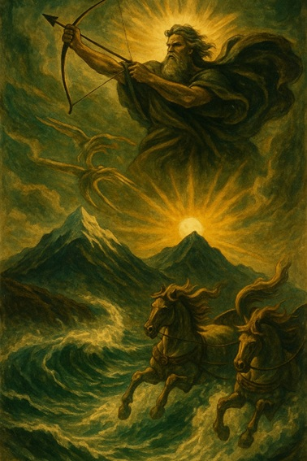
⁸ Was your wrath against the rivers, O Lord? Was your anger against the rivers, or your indignation against the sea, when you rode on your horses, on your chariot of salvation? ⁹ You stripped the sheath from your bow, calling for many arrows. Selah You split the earth with rivers. ¹⁰ The mountains saw you and writhed; the raging waters swept on; the deep gave forth its voice; it lifted its hands on high. ¹¹ The sun and moon stood still in their place at the light of your arrows as they sped, at the flash of your glittering spear.
The Redeemer’s Conquest
(over nature)
Praise – God’s Power Revealed (3:3-15)

Slide 29
¹² You marched through the earth in fury; you threshed the nations in anger. ¹³ You went out for the salvation of your people, for the salvation of your anointed. You crushed the head of the house of the wicked, laying him bare from thigh to neck. Selah ¹⁴ You pierced with his own arrows the heads of his warriors, who came like a whirlwind to scatter me, rejoicing as if to devour the poor in secret. ¹⁵ You trampled the sea with your horses, the surging of mighty waters.
The Redeemer’s Conquest (over nations)
Praise – God’s Power Revealed (3:3-15)

Slide 30
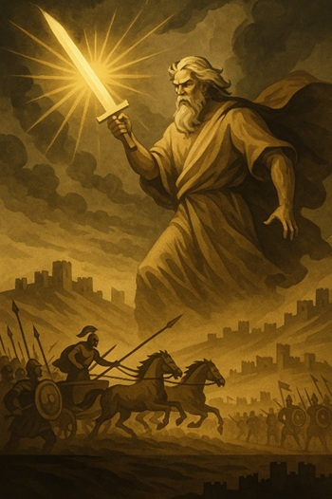
¹² You marched through the earth in fury; you threshed the nations in anger. ¹³ You went out for the salvation of your people, for the salvation of your anointed. You crushed the head of the house of the wicked, laying him bare from thigh to neck. Selah ¹⁴ You pierced with his own arrows the heads of his warriors, who came like a whirlwind to scatter me, rejoicing as if to devour the poor in secret. ¹⁵ You trampled the sea with your horses, the surging of mighty waters.
The Redeemer’s Conquest (over nations)
Praise – God’s Power Revealed (3:3-15)

Slide 31
Prayer – God’s Faithfulness Remembered (3:1-2)
Faith looks backward to what God has done
Praise – God’s Power Revealed (3:3-15)
Faith looks upward to who God is.
Pledge – Rejoice in God’s Salvation (3:16-19)
Faith looks forward to what God will do.
Habakkuk 3:1 – 19
Really… Rejoice?
When joy is chosen in the face of loss

Slide 32
¹⁶ I hear, and my body trembles; my lips quiver at the sound; rottenness enters into my bones; my legs tremble beneath me. Yet I will quietly wait for the day of trouble to come upon people who invade us.
¹⁷ Though the fig tree should not blossom, nor fruit be on the vines, the produce of the olive fail and the fields yield no food, the flock be cut off from the fold and there be no herd in the stalls, ¹⁸ yet I will rejoice in the Lord; I will take joy in the God of my salvation.
¹⁹ God, the Lord, is my strength; he makes my feet like the deer's; he makes me tread on my high places.
To the choirmaster: with stringed instruments.

Slide 33
¹⁶ I hear, and my body trembles; my lips quiver at the sound; rottenness enters into my bones; my legs tremble beneath me. Yet I will quietly wait for the day of trouble to come upon people who invade us.
¹⁷ Though the fig tree should not blossom, nor fruit be on the vines, the produce of the olive fail and the fields yield no food, the flock be cut off from the fold and there be no herd in the stalls, ¹⁸ yet I will rejoice in the Lord; I will take joy in the God of my salvation.
¹⁹ God, the Lord, is my strength; he makes my feet like the deer's; he makes me tread on my high places.
To the choirmaster: with stringed instruments.
Statement of Fear
Statement of Loss
Prayer of Strength

Slide 34
¹⁶ I hear, and my body trembles; my lips quiver at the sound; rottenness enters into my bones; my legs tremble beneath me. Yet I will quietly wait for the day of trouble to come upon people who invade us.
Pledge – Rejoice in God’s Salvation (3:16-19)

Slide 35
¹⁷ Though the fig tree should not blossom, nor fruit be on the vines, the produce of the olive fail and the fields yield no food, the flock be cut off from the fold and there be no herd in the stalls, ¹⁸ yet I will rejoice in the Lord; I will take joy in the God of my salvation.
Pledge – Rejoice in God’s Salvation (3:16-19)

Slide 36
¹⁹ God, the Lord, is my strength; he makes my feet like the deer's; he makes me tread on my high places.
To the choirmaster: with stringed instruments.
Pledge – Rejoice in God’s Salvation (3:16-19)

Slide 37
Application
Admit your fears but trust God’s timing
Choose joy in God, not your situation
Let God be your strength.

Slide 38
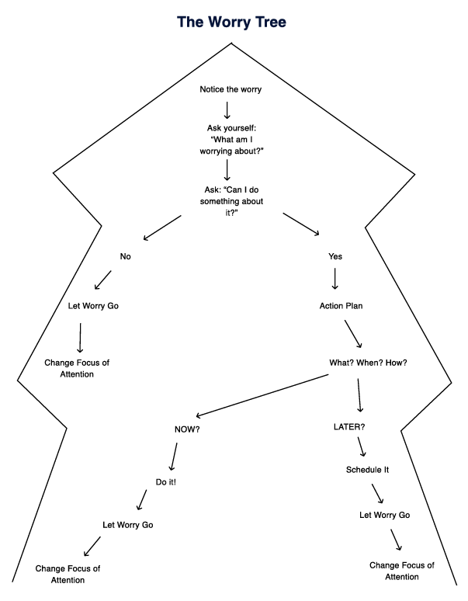
Notice the worry
Ask yourself: “What am I worrying about?”
Ask: “Can I do something about it?”
No
Yes
Action Plan
What? When? How?
Now
Later
Do it
Schedule it
Let Worry Go
Change Focus of Attention
https://www.carepatron.com/files/worry-tree.pdf
Notes:
https://www.carepatron.com/files/worry-tree.pdf

Slide 39
