Slide 1
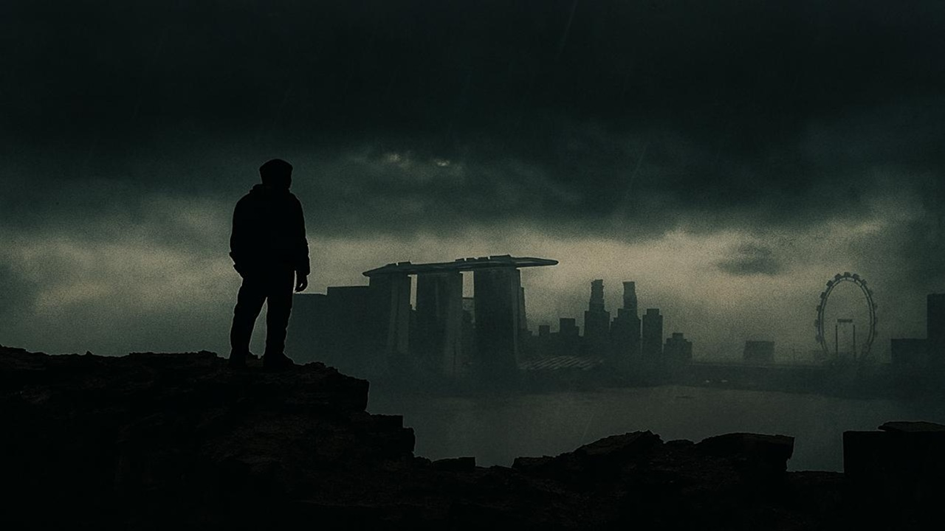
What in the World, God….
Habakkuk

Slide 2

Habakkuk 1:12 – 2:1
Really… Them?
When God uses the wicked to judge His people.

Slide 3

Habakkuk 2:2 – 20
“The Just will live by Faith” - when God calls his people to trust despite their troubles

Slide 4
² And the Lord answered me:
“Write the vision;
make it plain on tablets,
so he may run who reads it.
³ For still the vision awaits its appointed time;
it hastens to the end—it will not lie.
If it seems slow, wait for it;
it will surely come; it will not delay.
⁴ “Behold, his soul is puffed up; it is not upright within him,
but the righteous shall live by his faith.
⁵ “Moreover, wine is a traitor,
an arrogant man who is never at rest.
His greed is as wide as Sheol;
like death he has never enough.
He gathers for himself all nations
and collects as his own all peoples.”

Slide 5
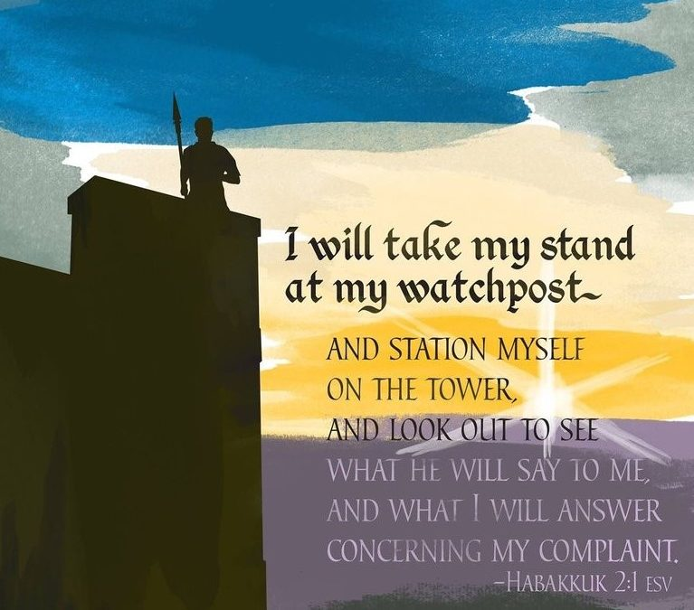

Slide 6
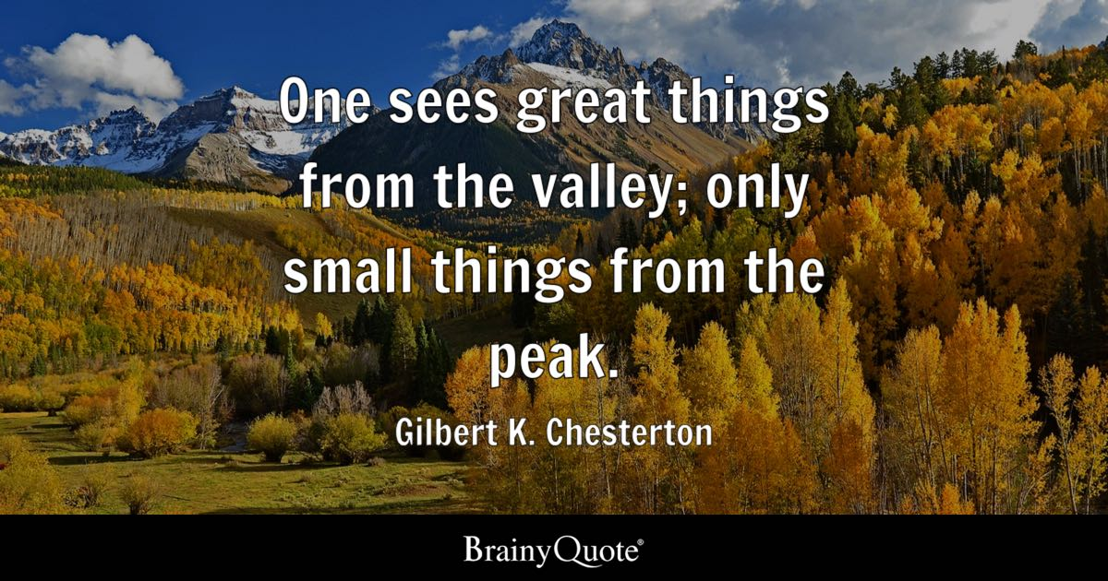

Slide 7
² And the Lord answered me:
“Write the vision;
make it plain on tablets,
so he may run who reads it.
³ For still the vision awaits its appointed time;
it hastens to the end—it will not lie.
If it seems slow, wait for it;
it will surely come; it will not delay.
⁴ “Behold, his soul is puffed up; it is not upright within him,
but the righteous shall live by his faith.
⁵ “Moreover, wine is a traitor,
an arrogant man who is never at rest.
His greed is as wide as Sheol;
like death he has never enough.
He gathers for himself all nations
and collects as his own all peoples.”

Slide 8
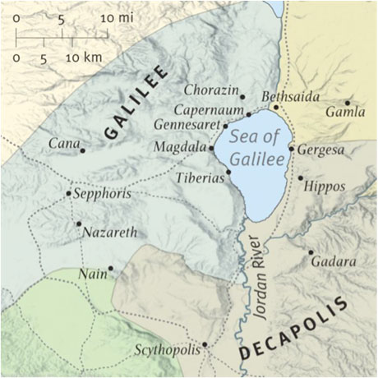

Slide 10
⁶ Shall not all these take up their taunt against him, with scoffing and riddles for him, and say,
“Woe to him who heaps up what is not his own—
for how long?—
and loads himself with pledges!”
⁷ Will not your debtors suddenly arise,
and those awake who will make you tremble?
Then you will be spoil for them.
⁸ Because you have plundered many nations,
all the remnant of the peoples shall plunder you,
for the blood of man and violence to the earth,
to cities and all who dwell in them.

Slide 11
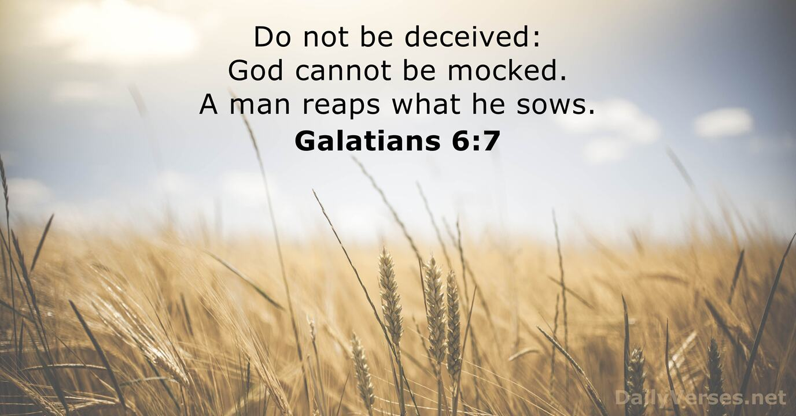

Slide 12
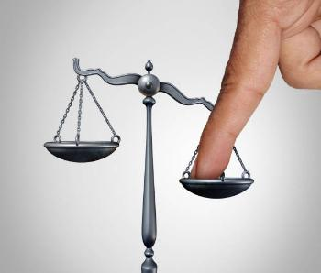
^{WOE AGAINST THEIR INJUSTICE}
“Woe to him who heaps up what is not his own—
for how long?—
and loads himself with pledges!”
⁷ Will not your debtors suddenly arise,
and those awake who will make you tremble?
Then you will be spoil for them.
⁸ Because you have plundered many nations,
all the remnant of the peoples shall plunder you,
for the blood of man and violence to the earth,
to cities and all who dwell in them.

Slide 13
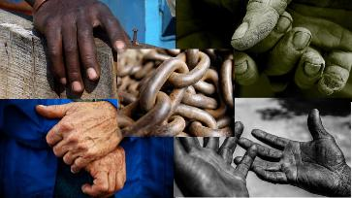
^{WOE AGAINST THEIR EXPLOITATION}
⁹ “Woe to him who gets evil gain for his house,
to set his nest on high,
to be safe from the reach of harm!
¹⁰ You have devised shame for your house
by cutting off many peoples;
you have forfeited your life.
¹¹ For the stone will cry out from the wall,
and the beam from the woodwork respond.

Slide 14

WOE AGAINST THEIR INHUMANTY AND BLOOSHED
¹² “Woe to him who builds a town with blood
and founds a city on iniquity!
¹³ Behold, is it not from the Lord of hosts
that peoples labour merely for fire,
and nations weary themselves for nothing?
¹⁴ For the earth will be filled
with the knowledge of the glory of the Lord
as the waters cover the sea.

Slide 15
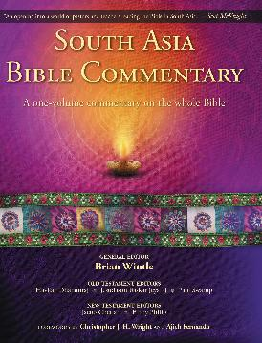
The South Asia Bible Commentary
“A day is coming when the Lord will judge with fire and bring his kingdom down on earth (Revelation 18:1-8). Then the knowledge of him and his glory will permeate every aspect of life. This is the hope that helps us endure life in the present.”
K.G. Jose, “Habakkuk”, in The South Asia Bible Commentary, Brian Wintle (ed.), India: Open Door Publications, 2015. page 1179.

Slide 16

WOE AGAINST THEIR DRUNKENESS AND SHAME
¹⁵ “Woe to him who makes his neighbours drink—
you pour out your wrath and make them drunk,
in order to gaze at their nakedness!
¹⁶ You will have your fill of shame instead of glory.
Drink, yourself, and show your uncircumcision!
The cup in the Lord's right hand
will come around to you,
and utter shame will come upon your glory!
¹⁷ The violence done to Lebanon will overwhelm you,
as will the destruction of the beasts that terrified them,
for the blood of man and violence to the earth,
to cities and all who dwell in them.

Slide 17
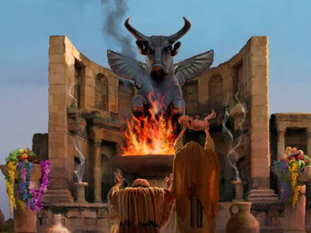
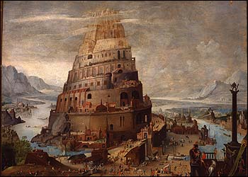
^{WOE AGAINST THEIR IDOLATRY}
¹⁸ “What profit is an idol
when its maker has shaped it,
a metal image, a teacher of lies?
For its maker trusts in his own creation
when he makes speechless idols!
¹⁹ Woe to him who says to a wooden thing, Awake;
to a silent stone, Arise!
Can this teach?
Behold, it is overlaid with gold and silver,
and there is no breath at all in it.
²⁰ But the Lord is in his holy temple;
let all the earth keep silence before him.”

Slide 18
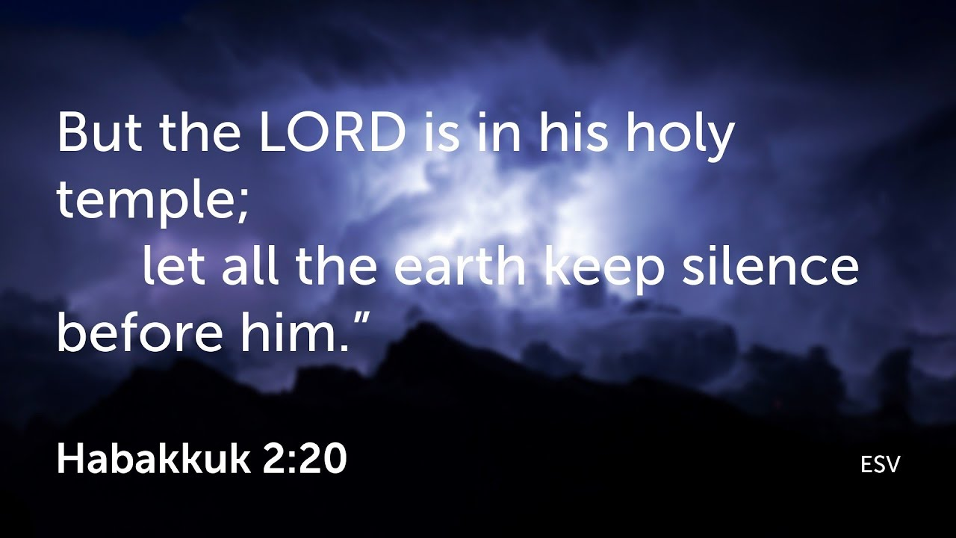

Slide 19
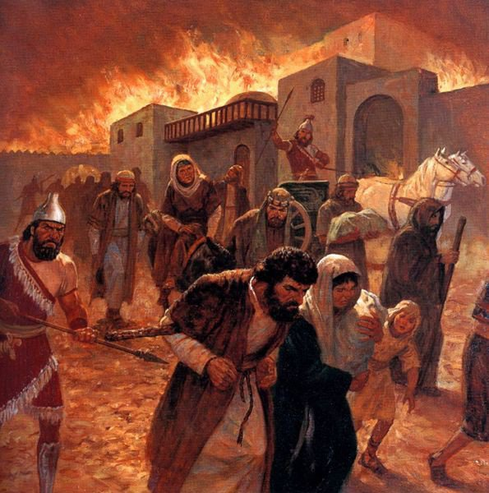
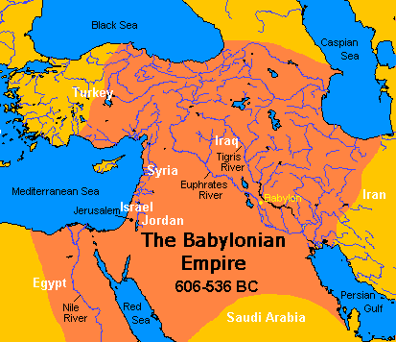

Slide 20
APPLICATION: HOW THEN SHALL WE LIVE?
3 GLORIOUS TRUTHS
“The just shall live by faith” (Habakkuk 2:4b)
Read God’s word and run with it (2:1)
See things from God’s perspective – trust in Him above all things.

Slide 21
APPLICATION: HOW THEN SHALL WE LIVE?
3 GLORIOUS TRUTHS
“The Just shall live by faith” (Habakkuk 2:4b)
“The earth will be filled with the glory of the Lord, as the waters cover the sea.” (Habakkuk 2:14)
We have a mission to get involved in, and a hope that secures it.

Slide 22
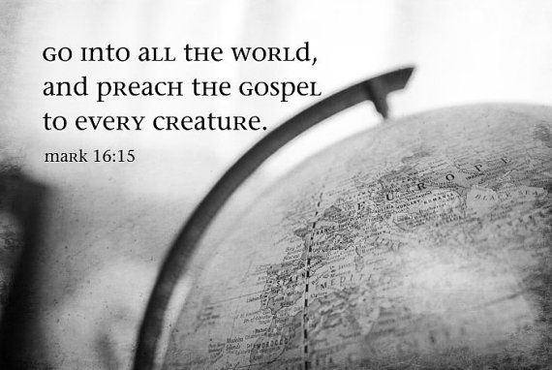

Slide 23
APPLICATION: HOW THEN SHALL WE LIVE?
3 GLORIOUS TRUTHS
“The Just shall live by faith” (Habakkuk 2:4b)
“The earth will be filled with the knowledge of the glory of the Lord, as the waters cover the sea.” (Habakkuk 2:14)
“The Lord is in his Holy temple; let all the earth keep silence before Him.” (Habakkuk 2:20)
God is on the throne – Worship and Wait on Him.

Slide 24
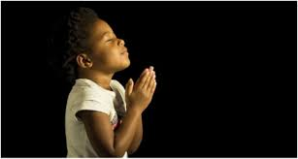
LET US PRAY….

