Slide 1
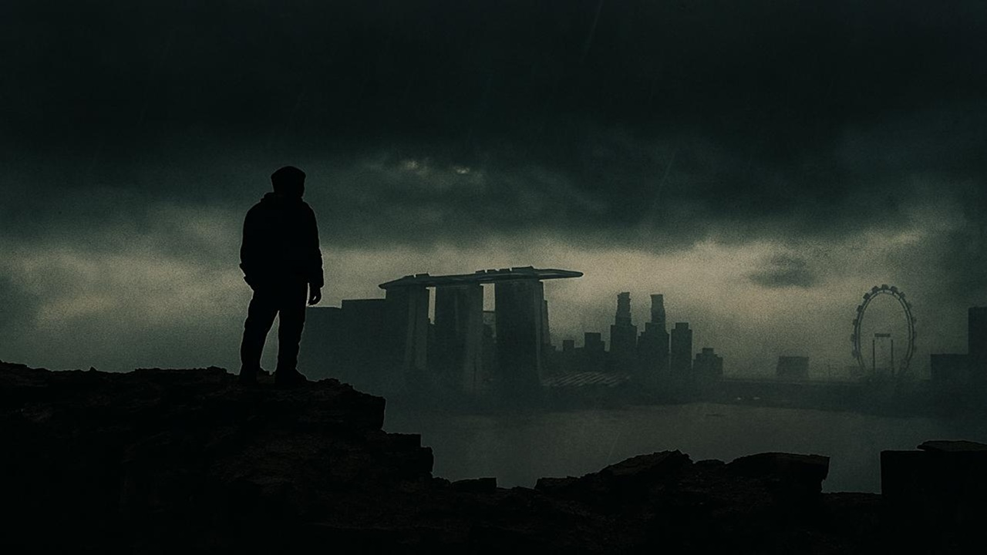
What in the World, God….
Habakkuk

Slide 2
Habakkuk 1:1 – 11
How Long, O Lord?
When God is silent in a world gone wrong.

Slide 3
“Life often raises hard questions: Why does God seem silent? Why does He use broken people and unjust systems? How long must we wait for His justice? How can we rejoice when everything falls apart?
The book of Habakkuk walks us through these struggles, showing that real faith doesn’t ignore our questions—it brings them to God, waits for His answer, lives by faith, and chooses joy.”

Slide 4
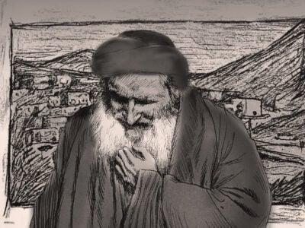
חֲבַקּוּק - Habakkuk = "embrace"

Slide 5
Habakkuk 1:1-11 – “How Long, o lord?”
Habakkuk wrote around 612 and 586 BC – before the Babylonians invaded and destroyed Judah and took the survivors into exile.

Slide 6
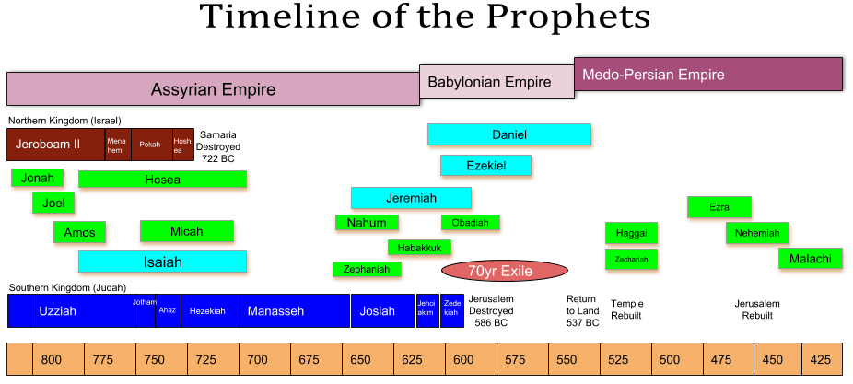
BC

Slide 7
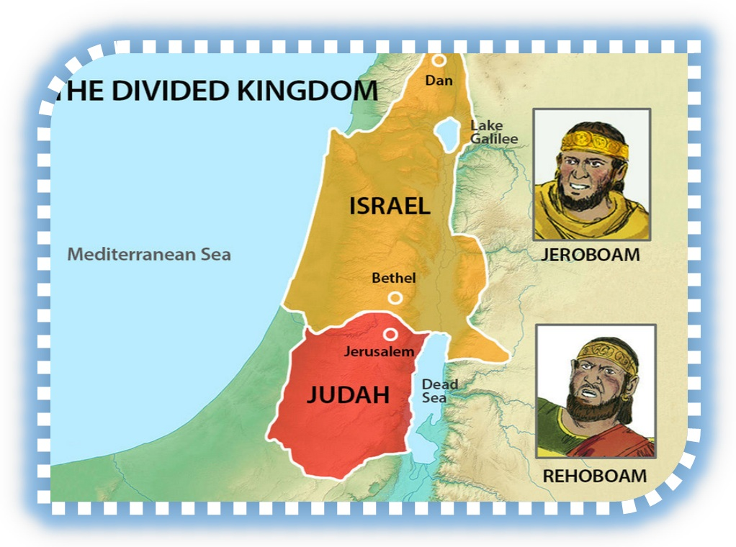

Slide 8
TWO DATES IN INFAMY
722 B.C. – the Northern Kingdom of Israel taken into exile by the Assyrians (2 Kings 17:1-6)
586 B.C. – the Southern Kingdom of Judan taken into exile by the Babylonians (2 Kings 25).

Slide 9
BC

Slide 10
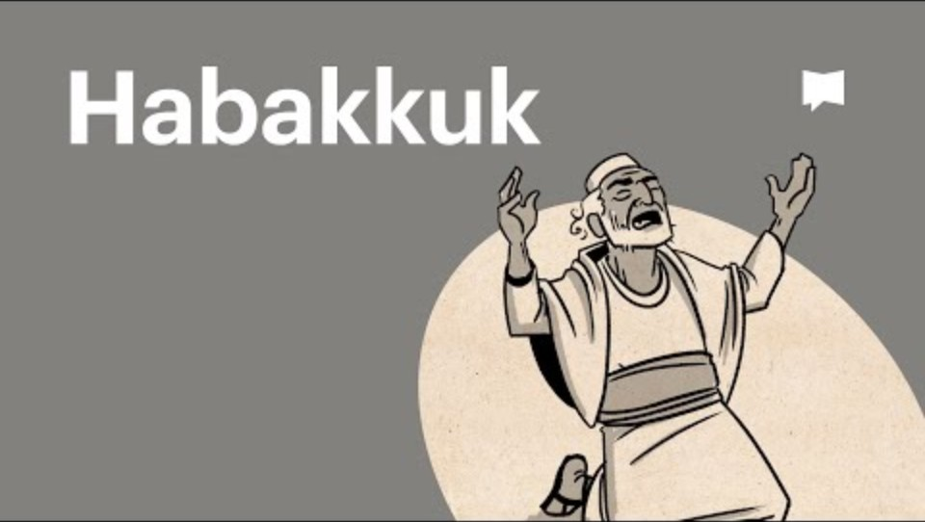
The Bible Project Video here
https://www.youtube.com/watch?v=OPMaRqGJPUU
Notes:
https://www.youtube.com/watch?v=OPMaRqGJPUU

Slide 11
Habakkuk 1:1-11 – “How Long, o lord?”
Habakkuk’s BIG QUESTION:
How do we deal with questions of injustice and suffering in light of our relationship with an all-powerful God?

Slide 12
Habakkuk – what in the world, God…
Theological themes
1. The problem of injustice:
Why does God allow injustice to continue in our world? (1:1-4)
B) Why does God use the wicked as part of his righteous judgement and discipline of the righteous? (1:12-2:1. See Deut 28:20-25)
2. The sovereignty of God. (3:17-19)
3. The need for faith and hope in times of crisis and hardship. (2:4b)

Slide 13
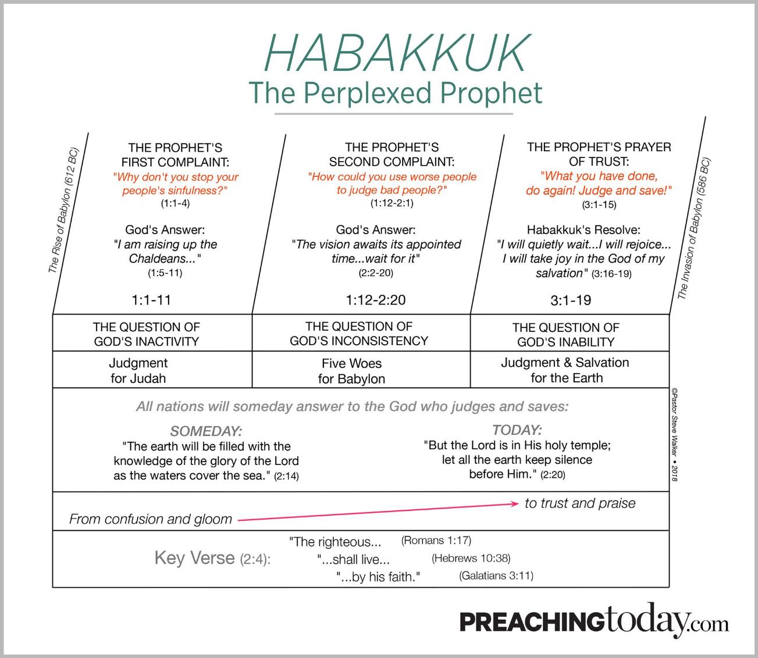

Slide 14
¹ The oracle that Habakkuk the prophet saw.
² O Lord, how long shall I cry for help, and you will not hear? Or cry to you “Violence!” and you will not save? ³ Why do you make me see iniquity, and why do you idly look at wrong? Destruction and violence are before me; strife and contention arise. ⁴ So the law is paralyzed, and justice never goes forth. For the wicked surround the righteous; so justice goes forth perverted.

Slide 15
Habakkuk 1:1-11 – “How Long, o lord?”
The first 4 verses are a prayer of lament, similar to those found in the psalms. See Psalm 6:3, 35:17, 82:2 and 94:3, for example.
There are also WHOLE individual psalms of lament like Psalm 6, 13, 22, and 88 as well as communal psalms of lament like Psalm 44, 74, and 79.
Habakkuk was apparently a man of prayer but he was getting impatient.

Slide 16
⁵ “Look among the nations, and see; wonder and be astounded. For I am doing a work in your days that you would not believe if told. ⁶ For behold, I am raising up the Chaldeans, that bitter and hasty nation, who march through the breadth of the earth, to seize dwellings not their own. ⁷ They are dreaded and fearsome; their justice and dignity go forth from themselves.

Slide 17
⁸ Their horses are swifter than leopards, more fierce than the evening wolves; their horsemen press proudly on. Their horsemen come from afar; they fly like an eagle swift to devour. ⁹ They all come for violence, all their faces forward. They gather captives like sand. ¹⁰ At kings they scoff, and at rulers they laugh. They laugh at every fortress, for they pile up earth and take it. ¹¹ Then they sweep by like the wind and go on, guilty men, whose own might is their god!”

Slide 18
Habakkuk 1:1-11 – “How Long, o lord?”
Lessons for God’s people:
1. God is immanent. He is closely involved in the socio-historical reality of Israel, and he is deeply involved in His people today. (Theism versus Deism).

Slide 19
Habakkuk 1:1-11 – “How Long, o lord?”
Lessons for God’s people:
2. There is mystery to our life of faith in this world. Yet, God is sovereign and will work out his good purposes (Rom. 8:28). We know now only in part (1 Cor 13:12 cf Deut 29:29, Isaiah 55:8).
WE MUST TRUST GOD ABOVE ALL!

Slide 20
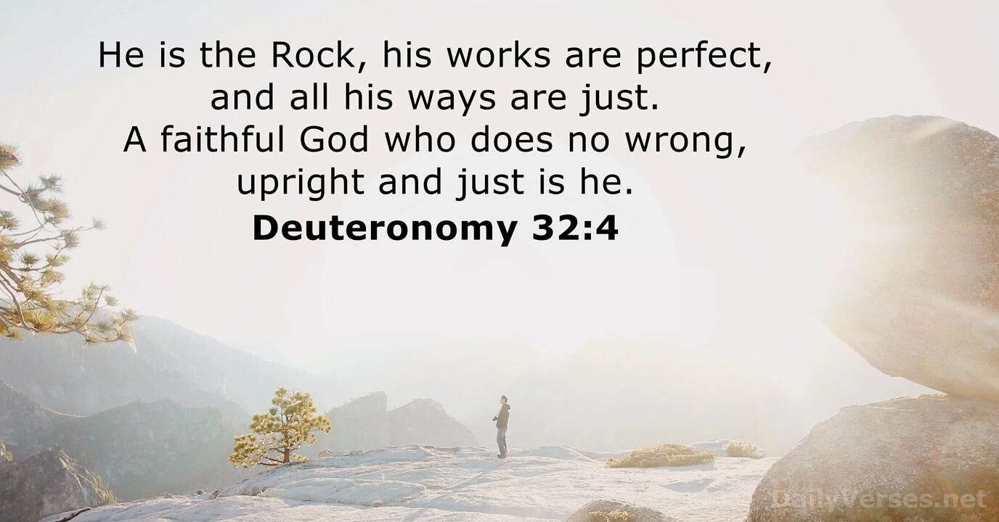

Slide 21
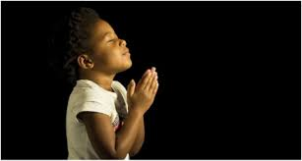
LET US PRAY….

