Slide 1
Ephesians
Inconceivable Blessings, Incredible Purpose.

Slide 2
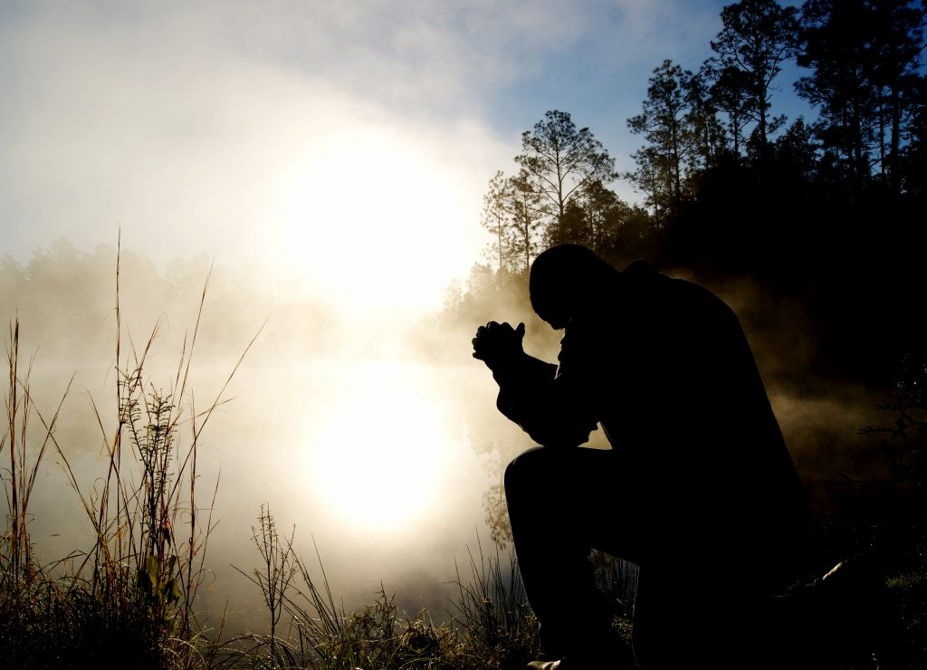
Ephesians 6:10-24:
“Above all, to stand”

Slide 3
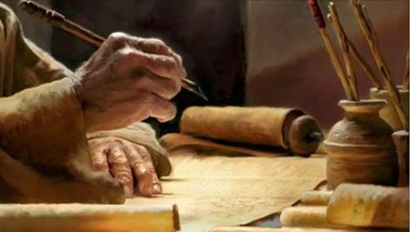

Slide 4
Paul’s Letter to the Ephesians
Main Themes:
CHAPTER 1 - Praising God the Father for His great, predestined purpose and grace, exerted in the Lord Jesus through His death and resurrection to give us an inheritance that is sealed by the Holy Spirit, and to put ALL things under Christ.

Slide 5
Paul’s Letter to the Ephesians
Main Themes:
CHAPTER 2 - The grace of God in saving us and creating a new society, where Jews and Gentiles are united as one new people.

Slide 6
Paul’s Letter to the Ephesians
Main Themes:
CHAPTER 3 - God has made Paul to be a messenger to reveal this great plan of God to all powers that be.
CHAPTER 4 - An appeal that they must live a life worthy of this calling, fitting their status as God’s new and reconciled society.

Slide 7
Paul’s Letter to the Ephesians
Main Themes:
CHAPTER 5-6:9 - God’s people must learn to submit to each other in family and domestic relationships, and so promote harmony in their homes.

Slide 8

John Stott
“Unity, diversity, purity and harmony – these the apostle has stressed as major characteristics of the new life and the new society in Christ.”
John R. W. Stott, The Message of Ephesians, Leicester: Inter-varsity Press, 1979. page 261.

Slide 9

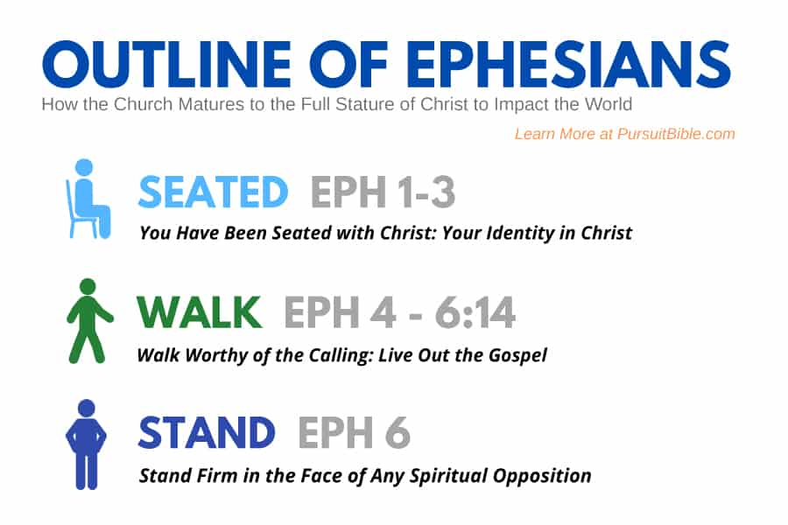

Slide 10
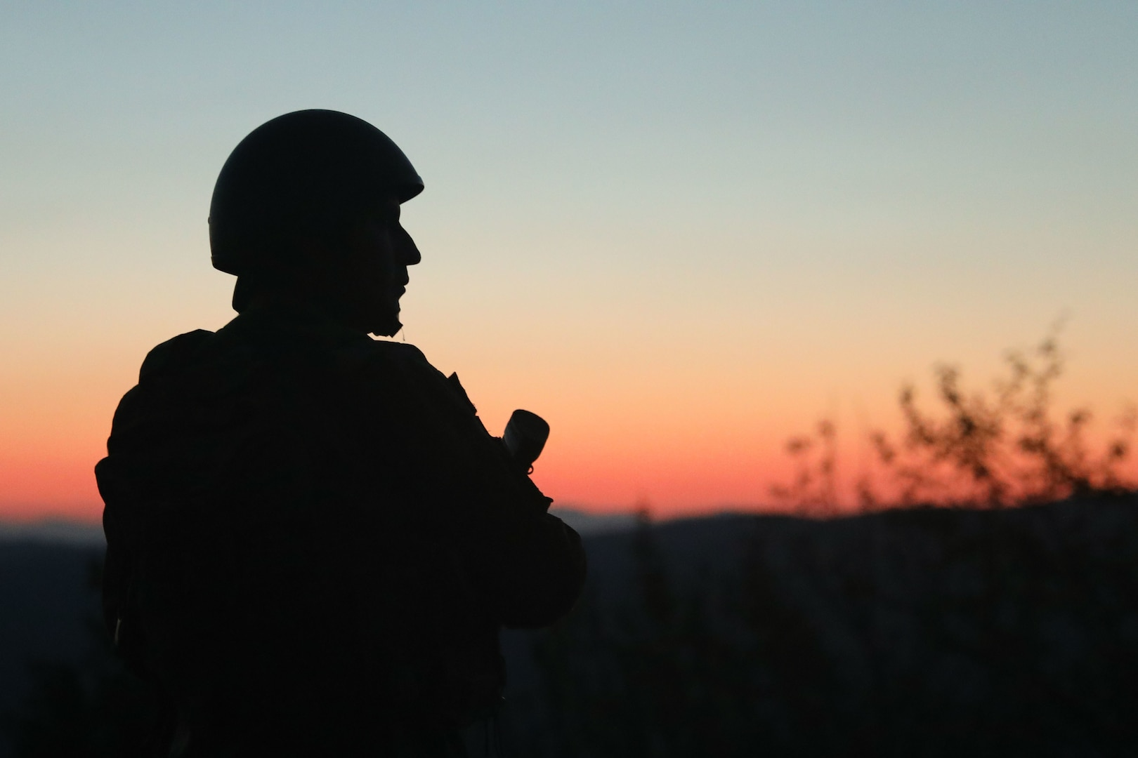
Are
you
ready?
2 Timothy 2:3-4

Slide 11


Slide 12
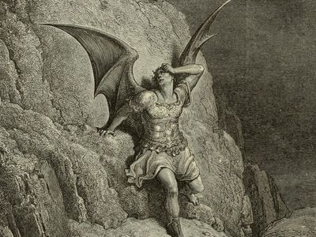
        The devil
        is real!
        Isaiah 14:12-15 & Ezekiel 28-12-19 cf Mattthew 4:1-10, 16:23; John 8:44; 1 Peter 5:8-9. Revelations 12:7-9.

Slide 13

Christianity asserts that
1. God is the
source of the
good and beautiful.
2. The Devil is behind
all evil and horror.
However, this is not DUALISM!

Slide 14
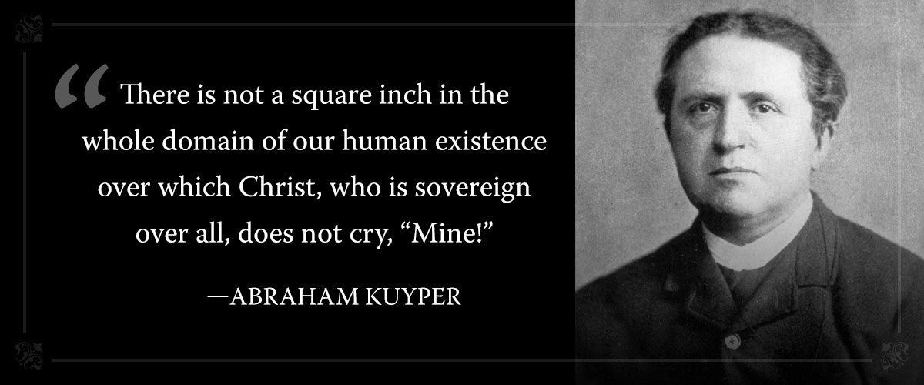

Slide 15
Two Opposite Errors to Avoid
`There are two equal and opposite errors into which we can fall about the devils. One is to disbelieve in their existence; the other is to believe and to feel an excessive and unhealthy interest in them. They themselves are equally pleased by both errors.’
C.S. Lewis
1. Disbelief
in the devil
2. Unhealthy
interest

Slide 16
Deuteronomy 18:10-11
“Let no one be found among you who sacrifices his son or daughter in the fire, who practices divination or sorcery, interprets omens, engages in witchcraft, or casts spells, or who is a medium or spiritist or who consults the dead.”

Slide 17
Ephesians 6:1—24, “Above all, to stand”
The devil and all evil powers (Ephesians 2:2 and 4:27).

Slide 18
¹⁰ Finally, be strong in the Lord and in the strength of his might. ¹¹ Put on the whole armour of God, that you may be able to stand against the schemes of the devil. ¹² For we do not wrestle against flesh and blood, but against the rulers, against the authorities, against the cosmic powers over this present darkness, against the spiritual forces of evil in the heavenly places. ¹³ Therefore take up the whole armour of God, that you may be able to withstand in the evil day, and having done all, to stand firm.

Slide 19
¹⁰ Finally, be strong in the Lord and in the strength of his might. ¹¹ Put on the whole armour of God, that you may be able to stand against the schemes of the devil. ¹² For we do not wrestle against flesh and blood, but against the rulers, against the authorities, against the cosmic powers over this present darkness, against the spiritual forces of evil in the heavenly places. ¹³ Therefore take up the whole armour of God, that you may be able to withstand in the evil day, and having done all, to stand firm.

Slide 20
¹⁴ Stand therefore, having fastened on the belt of truth, and having put on the breastplate of righteousness, ¹⁵ and, as shoes for your feet, having put on the readiness given by the gospel of peace. ¹⁶ In all circumstances take up the shield of faith, with which you can extinguish all the flaming darts of the evil one; ¹⁷ and take the helmet of salvation, and the sword of the Spirit, which is the word of God, ¹⁸ praying at all times in the Spirit, with all prayer and supplication. To that end, keep alert with all perseverance, making supplication for all the saints, ¹⁹ and also for me, that words may be given to me in opening my mouth boldly to proclaim the mystery of the gospel, ²⁰ for which I am an ambassador in chains, that I may declare it boldly, as I ought to speak.

Slide 21
2 Corinthians 2:11
‘For we are not unaware of his (the devil’s) schemes.’

Slide 22
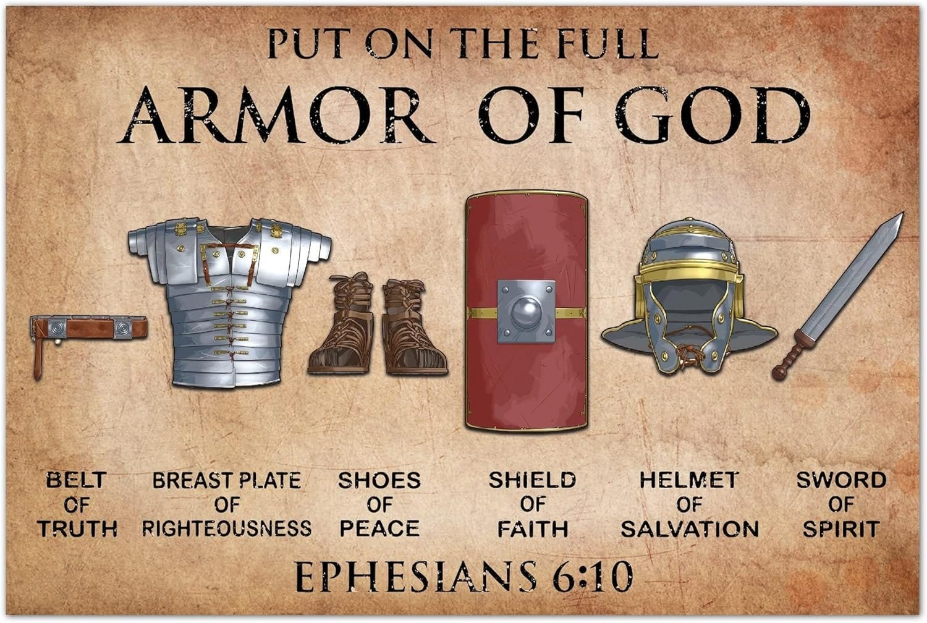
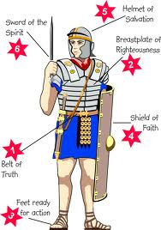

Slide 23
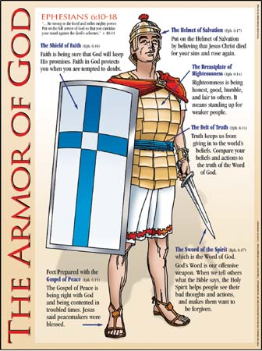
a. Belt of Truth (vs 14) - Live in the Truth

Slide 24
a. Belt of Truth (vs 14a) - Live in the Truth
b. Breastplate of righteousness (vs 14b)
- Live in Right Relationships

Slide 25

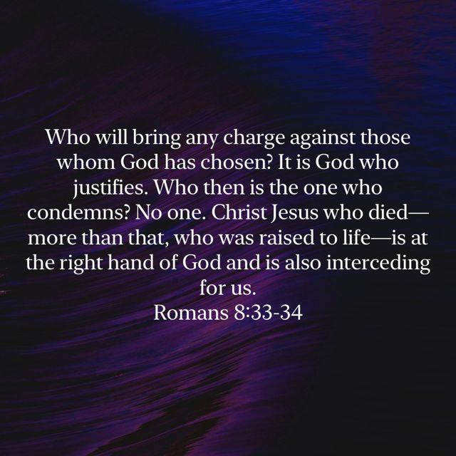

Slide 26
a. Belt of Truth (vs 14a) - Live in the Truth
b. Breastplate of righteousness (vs 14b)
- Live in Right Relationships
c. Shoes of the Gospel of Peace (vs 15)
- Ready to Go and Share the good news

Slide 27
a. Belt of Truth (vs 14a) - Live in the Truth
b. Breastplate of righteousness (vs 14b)
- Live in Right Relationships
c. Shoes of the Gospel of Peace (vs 15)
- Ready to Go and Share the good news
d. Shield of Faith (vs 16)
- Trust in God’s promises

Slide 28


Slide 29
a. Belt of Truth (vs 14a) - Live in the Truth
b. Breastplate of righteousness (vs 14b)
- Live in Right Relationships
c. Shoes of the Gospel of Peace (vs 15)
- Ready to Go and Share the good news
d. Shield of Faith (vs 16)
- Trust in God’s promises
e. Helmet of Salvation (vs 17a)
- Assurance of Hope and a Future

Slide 30
a. Belt of Truth (vs 14a) - Live in the Truth
b. Breastplate of righteousness (vs 14b)
- Live in Right Relationships
c. Shoes of the Gospel of Peace (vs 15)
- Be ready to Go & Share the good news
d. Shield of Faith (vs 16)
- Trust in God’s promises
e. Helmet of Salvation (vs 17a)
- Be Assured of your Hope and Future
f. The Sword of the Spirit (vs 17a)
- Know, Apply and Act on God’s Word

Slide 31
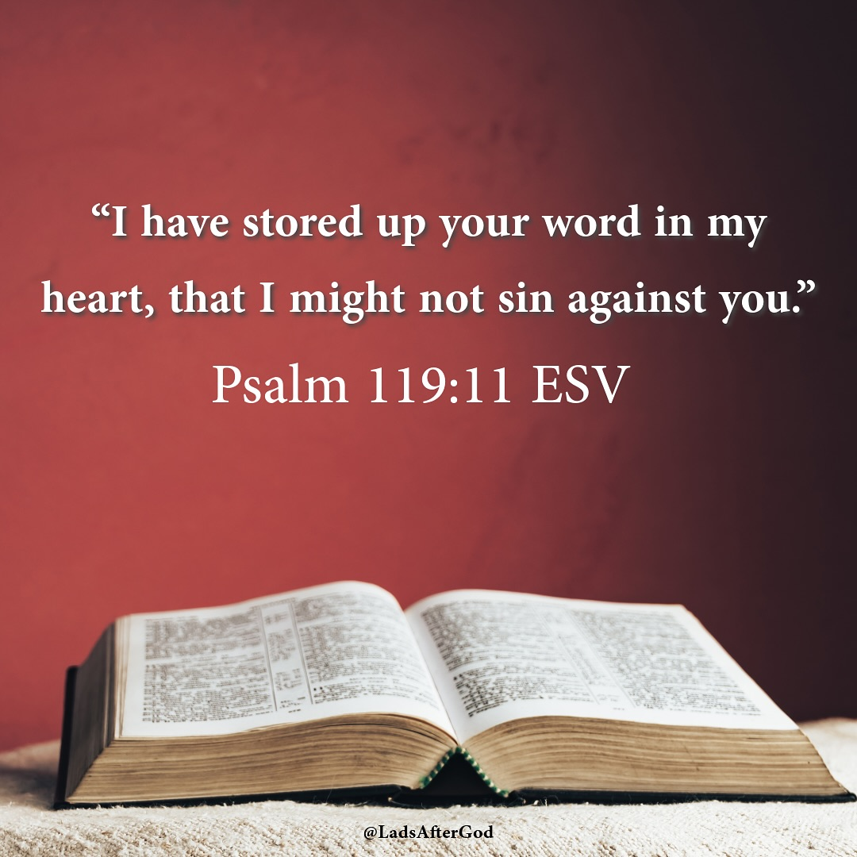

Slide 33
¹⁴ Stand therefore, having fastened on the belt of truth, and having put on the breastplate of righteousness, ¹⁵ and, as shoes for your feet, having put on the readiness given by the gospel of peace. ¹⁶ In all circumstances take up the shield of faith, with which you can extinguish all the flaming darts of the evil one; ¹⁷ and take the helmet of salvation, and the sword of the Spirit, which is the word of God, ¹⁸ praying at all times in the Spirit, with all prayer and supplication. To that end, keep alert with all perseverance, making supplication for all the saints, ¹⁹ and also for me, that words may be given to me in opening my mouth boldly to proclaim the mystery of the gospel, ²⁰ for which I am an ambassador in chains, that I may declare it boldly, as I ought to speak.

Slide 34
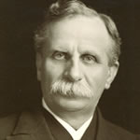
Samuel Chadwick wrote...
“The one concern of the devil is to keep Christians from praying. He fears nothing from prayerless studies, prayerless work and prayerless religion. He laughs at our toil, mocks at our wisdom, but he trembles when we pray.”

Slide 35
¹⁴ Stand therefore, having fastened on the belt of truth, and having put on the breastplate of righteousness, ¹⁵ and, as shoes for your feet, having put on the readiness given by the gospel of peace. ¹⁶ In all circumstances take up the shield of faith, with which you can extinguish all the flaming darts of the evil one; ¹⁷ and take the helmet of salvation, and the sword of the Spirit, which is the word of God, ¹⁸ praying at all times in the Spirit, with all prayer and supplication. To that end, keep alert with all perseverance, making supplication for all the saints, ¹⁹ and also for me, that words may be given to me in opening my mouth boldly to proclaim the mystery of the gospel, ²⁰ for which I am an ambassador in chains, that I may declare it boldly, as I ought to speak.

Slide 36
The Christian Life
GOD
THE CHURCH
THE WORLD
Ephesians 2:4-10; 19-22
UP
OUT
IN
Ephesians 5:3-17
Ephesians 4:1-7; 11-16
LIFE LIVED IN 3 DIRECTIONS

Slide 37

Worship…… Read God’s Word and Reflect …… Pray

Slide 38
Set up...
“Very early in the morning, while it was still dark, Jesus got up, left the house and went off to a solitary place, where he prayed.”
(Mark 1:35)
A Time
A Place
A Method

Slide 39
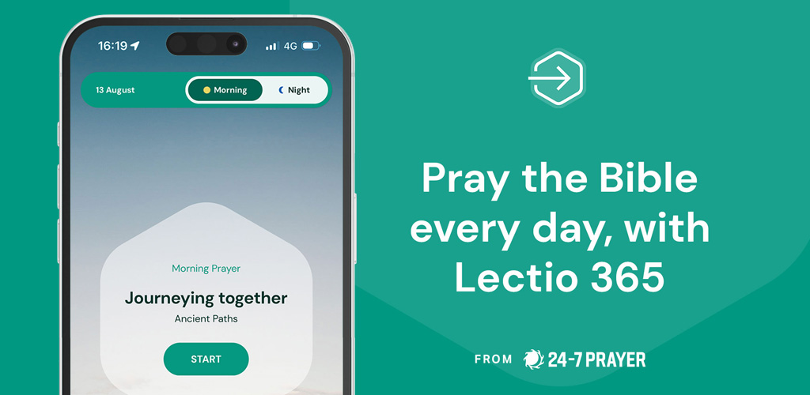

Slide 40
The Christian Life
GOD
THE CHURCH
THE WORLD
Ephesians 2:4-10; 19-22
UP
OUT
IN
Ephesians 5:3-17
Ephesians 4:1-7; 11-16
LIFE LIVED IN 3 DIRECTIONS

Slide 41
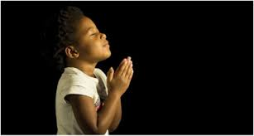
LET US PRAY….

