Slide 1
Ephesians
Inconceivable Blessings, Incredible Purpose.

Slide 2
1. The Wife’s Calling (22–24)
Submission is not fine print—it’s a response to the gospel
111
2. The Husband’s Command (25–30)
Love is not fine print—it’s Christlike sacrifice.
3. The Marriage Mystery (31–33)
Marriage is not fine print—it’s God’s gospel blueprint
Not Just Fine Print
—but God’s Blueprint
Ephesians 5:22-33

Slide 3
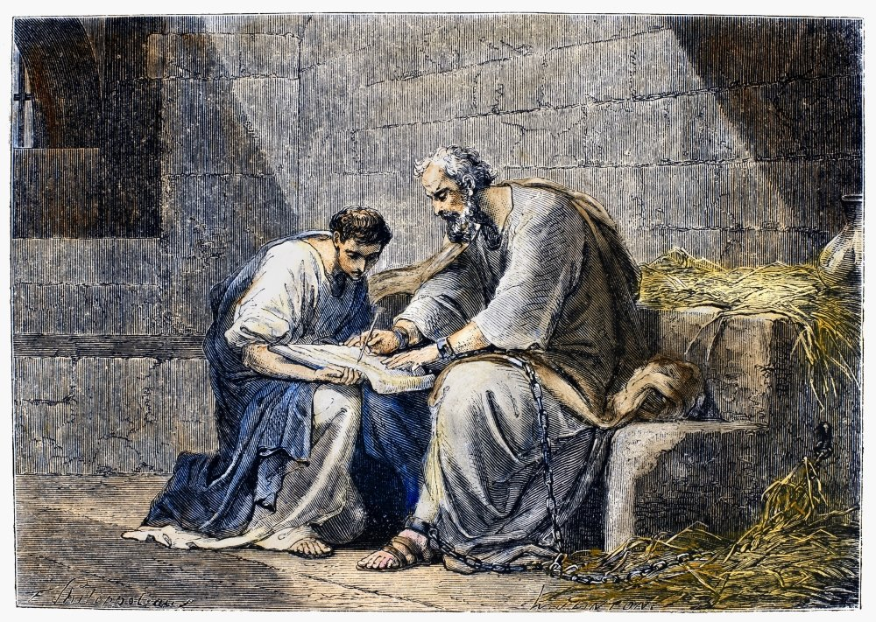
Ephesians 6:1-9: “As To the Lord”

Slide 4
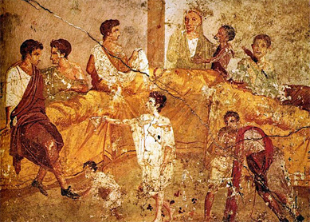
Household Codes

Slide 5

John Stott
“It is Jesus Christ who treated women with courtesy and honour in an age in which they were despised. It is Jesus Christ who said ‘Let the little children come to me’ in a period of history in which unwanted babies were consigned to the local rubbish dump (as they are today to the hospital incinerator), or abandoned for anybody to pick up and rear for slavery or prostitution. And it is Jesus Christ who taught the dignity of manual labour by working himself as a carpenter, washing his disciples’ feet and saying, ‘I am among you as one who serves.
John R. W. Stott, The Message of Ephesians, Leicester: Inter-varsity Press, 1979. page 90.

Slide 6
“Children, obey your parents in the Lord, for this is right. ² “Honor your father and mother” (this is the first commandment with a promise), ³ “that it may go well with you and that you may live long in the land.” ⁴ Fathers, do not provoke your children to anger, but bring them up in the discipline and instruction of the Lord.”

Slide 7


Slide 8
“Children, obey your parents in the Lord, for this is right. ² “Honor your father and mother” (this is the first commandment with a promise), ³ “that it may go well with you and that you may live long in the land.” ⁴ Fathers, do not provoke your children to anger, but bring them up in the discipline and instruction of the Lord.”

Slide 9
John Stott
“And, as we saw in the last chapter, a wife’s submission is something quite different from obedience. It is a voluntary self-giving to a lover whose responsibility is defined in terms of constructive care; it is love’s response to love.”
John R. W. Stott, The Message of Ephesians, Leicester: Inter-varsity Press, 1979. page 99.

Slide 10
Ephesians 6:1-9 – As Unto the Lord
Vs 1-4
Children are to obey their parents (vs 1b) because:
1. It is naturally right (Gk. dikaios lit. just and righteous).
2. It is written in the Law (vs 2 – see Ex 20:12, Deut. 5:16).
3. We are ‘in the Lord’ (vs 1a) – because of Christ.

Slide 11
“Children, obey your parents in the Lord, for this is right. ² “Honor your father and mother” (this is the first commandment with a promise), ³ “that it may go well with you and that you may live long in the land.” ⁴ Fathers, do not provoke your children to anger, but bring them up in the discipline and instruction of the Lord.”

Slide 12


Slide 13
Ephesians 6:1-9 – As Unto the Lord
Vs 1-4
Question – Are children always to obey their parents?

Slide 14
Ephesians 6:1-9 – As Unto the Lord
Vs 1-4
Question – Are children always to obey their parents?
John Stott advises that “obedience to parents should be the norm, and disobedience the rare exception.”
But we must obey Jesus is forced to choose. Jesus himself told us that parents and children would be in conflict over him (Matthew 10:21, Luke 12:53).

Slide 15
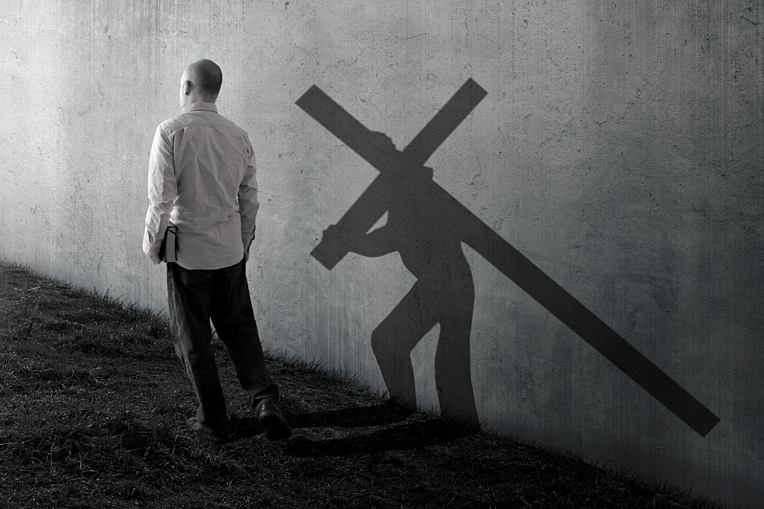

Slide 16
⁵ Bondservants, obey your earthly masters with fear and trembling, with a sincere heart, as you would Christ, ⁶ not by the way of eye-service, as people-pleasers, but as bondservants of Christ, doing the will of God from the heart, ⁷ rendering service with a good will as to the Lord and not to man, ⁸ knowing that whatever good anyone does, this he will receive back from the Lord, whether he is a bondservant or is free. ⁹ Masters, do the same to them, and stop your threatening, knowing that he who is both their Master and yours is in heaven, and that there is no partiality with him.

Slide 17
Ephesians 6:1-9 – As Unto the Lord
Vs 5-9
There were perhaps over 60 million slaves in the Roman empire at the time of Paul. That is an estimated one-third of the entire population!
Many of Jesus’ parables contain references to slaves (Mark 12:1-12; Matt 13:24-30; 18:23-35; Luke 12:42-48; Matthew 25:14-30; Luke 12:35-38; 15:11-32; 16:1-8; 17:7-10, etc.)

Slide 18
Ephesians 6:1-9 – As Unto the Lord
Vs 5-9
Slaves and their masters were part of the church and so instructions for living were given to them (see Col 3:22-24; Eph 6:5-9; 1 Tim 6:1-2; Titus 2:9-10).

Slide 19
⁵ Bondservants, obey your earthly masters with fear and trembling, with a sincere heart, as you would Christ, ⁶ not by the way of eye-service, as people-pleasers, but as bondservants of Christ, doing the will of God from the heart, ⁷ rendering service with a good will as to the Lord and not to man, ⁸ knowing that whatever good anyone does, this he will receive back from the Lord, whether he is a bondservant or is free.

Slide 20
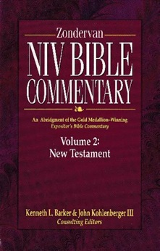
One GOAL
“The Christian slave has one goal before him: to obey his human master as an expression of his commitment to the divine Lord.”
A. Skevington Wood, Ephesians – The Zondervan NIV Bible Commentary, Grand Rapids: Zondervan, 1994, page 781.

Slide 21
⁹ Masters, do the same to them, and stop your threatening, knowing that he who is both their Master and yours is in heaven, and that there is no partiality with him.

Slide 22


Slide 23
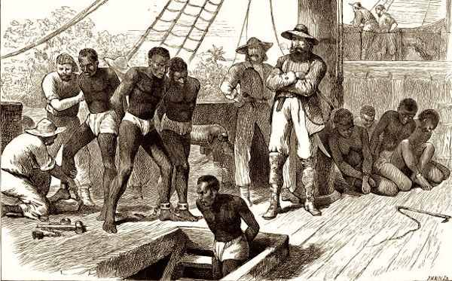

Slide 24
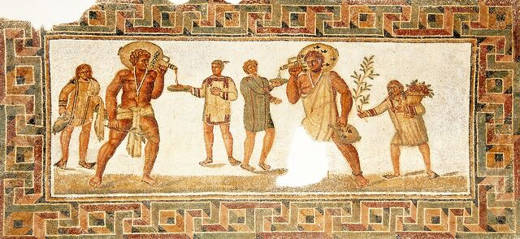
Slavery in the Bible
1) Slavery in the Roman times not race based.

Slide 25
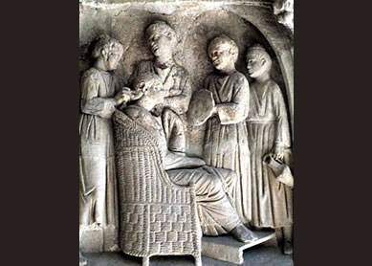
Slavery in the Bible
1) Slavery in the Roman times not race based.
2) It was possible for freedom to be bought.

Slide 26

Christianity was in its infancy - minority, persecuted, little or no political influence.
The priority was personal and communal transformation through the proclamation and demonstration of the Gospel. It was the seed from true societal and systemic transformation.

Slide 27
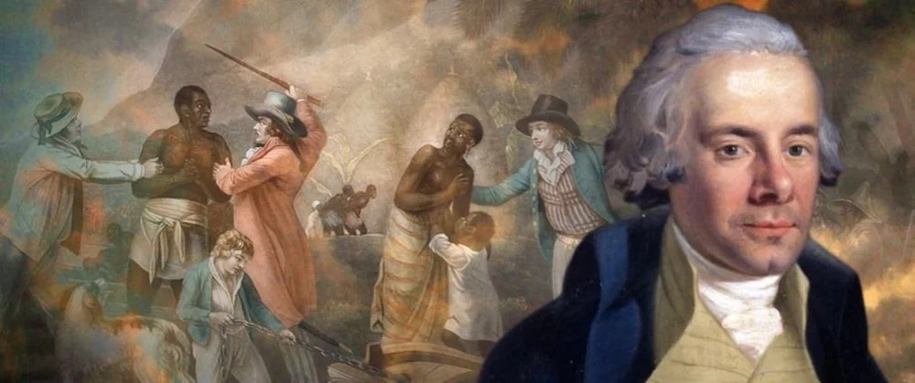
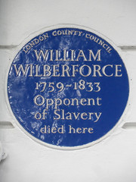
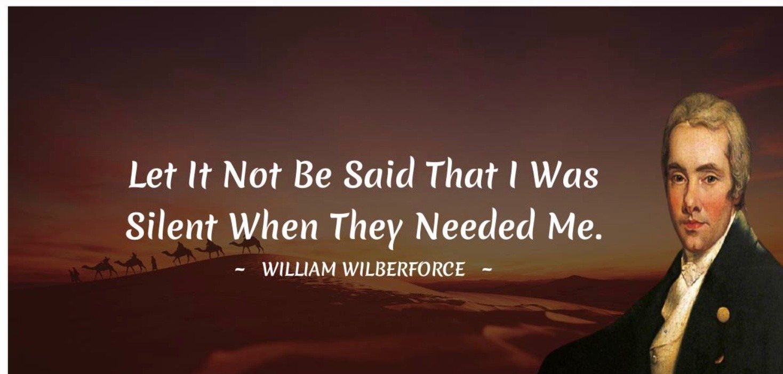

Slide 28
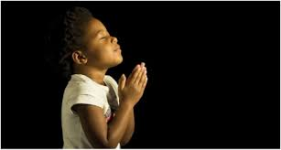
LET US PRAY….

