Slide 1
THE FINE PRINT
Microsoft Services Agreement
Your Privacy
1. Your Privacy. Your privacy is important to us. Please read the Microsoft Privacy Statement (https://go.microsoft.com/fwlink/?LinkId=521839) (the "Privacy Statement") as it describes the types of data we collect from you and your devices ("Data"), how we use your Data, and the legal bases we have to process your Data. The Privacy Statement also describes how Microsoft uses your content, which is your communications with others; postings submitted by you to Microsoft via the Services; and the files, photos, documents, audio, digital works, livestreams and videos that you upload, store, broadcast, create, generate, or share through the Services, or inputs that you submit in order to generate content ("Your Content"). Where processing is based on consent and to the extent permitted by law, by agreeing to these Terms, you consent to Microsoft’s collection, use and disclosure of Your Content and Data as described in the Privacy Statement. In some cases, we will provide separate notice and request your consent as referenced in the Privacy Statement.
Your Content
2. Your Content. Many of our Services allow you to create, store or share Your Content or receive material from others. We don’t claim ownership of Your Content. Your Content remains yours and you are responsible for it.
a. When you share Your Content with other people, you understand that they may be able to, on a worldwide basis, use, save, record, reproduce, broadcast, transmit, share and display Your Content for the purpose that you made Your content available on the Services, without compensating you. If you do not want others to have that ability, do not use the Services to share Your Content. You represent and warrant that for the duration of these Terms, you have (and will have) all the rights necessary for Your Content that is uploaded, stored, or shared on or through the Services and that the collection, use, and retention of Your Content will not violate any law or rights of others. Microsoft does not own, control, verify, pay for, endorse or otherwise assume any liability for Your Content and cannot be held responsible for Your Content or the material others upload, store or share using the Services.
b. To the extent necessary to provide the Services to you and others, to protect you and the Services, and to improve Microsoft products and services, you grant to Microsoft a worldwide and royalty-free intellectual property license to use Your Content, for example, to make copies of, retain, transmit, reformat, display, and distribute via communication tools Your Content on the Services. If you publish Your Content in areas of the Service where it is available broadly online without restrictions, Your Content may appear in demonstrations or materials that promote the Service. Some of the Services are supported by advertising. Controls for how Microsoft personalizes advertising are available at https://choice.live.com. We do not use what you say in email, chat, video calls or voice mail, or your documents, photos or other personal files to target advertising to you. Our

Slide 2
Microsoft Services Agreement
17,724 words
------
2,230 words
2,422 words
1,629 words
1,582 words
1,481 words
823 words
1,591 words
1,238 words
659 words
335 words
-------------------------------
Galatians
Ephesians
Philippians
Colossians
1 Thessalonians
2 Thessalonians
1 Timothy
2 Timothy
Titus
Philemon
1 Corinthians 6,830 words
2 Corinthians 4,477 words
Galatians 2,230 words
18,418 words
13,990 words

Slide 3
Instructions for Christian Households
Ephesians 5:22–33 Wives & Husbands
Ephesians 6:1-4 Children & Parents
Ephesians 6:5-9 Slaves & Masters
Ephesians 5:22-33

Slide 4
Not Just Fine Print
—but God’s Blueprint
Ephesians 5:22-33

Slide 5

Inconceivable blessings, Incredible Purpose.
Ephesians

Slide 6

Ephesians 5:1-21 – Imitators of God
SUMMARY of Chapter 5:1-21:
Be Imitators of God – Ephesians 5:1
Walk in Love - Ep 5:2-6
Walk in the Light - Ep 5:7-14
Walk in Wisdom - Ep 5:15-21

Slide 7
1. The Wife’s Calling (22–24)
  Submission is not fine print—it’s a gospel picture
111
2. The Husband’s Command (25–30)
111
111
3. The Marriage Mystery (31–33)
111
111
Not Just Fine Print
—but God’s Blueprint
Ephesians 5:22-33

Slide 8
²² Wives, submit to your own husbands, as to the Lord. ²³ For the husband is the head of the wife even as Christ is the head of the church, his body, and is himself its Savior. ²⁴ Now as the church submits to Christ, so also wives should submit in everything to their husbands.
²⁵ Husbands, love your wives, as Christ loved the church and gave himself up for her, ²⁶ that he might sanctify her, having cleansed her by the washing of water with the word, ²⁷ so that he might present the church to himself in splendor, without spot or wrinkle or any such thing, that she might be holy and without blemish. ²⁸ In the same way husbands should love their wives as their own bodies. He who loves his wife loves himself. ²⁹ For no one ever hated his own flesh, but nourishes and cherishes it, just as Christ does the church, ³⁰ because we are members of his body.
³¹ “Therefore a man shall leave his father and mother and hold fast to his wife, and the two shall become one flesh.” ³² This mystery is profound, and I am saying that it refers to Christ and the church. ³³ However, let each one of you love his wife as himself, and let the wife see that she respects her husband.
1. The Wife’s Calling
2. The Husband’s Command
3. The Marriage Mystery

Slide 9
²² Wives, submit to your own husbands, as to the Lord. ²³ For the husband is the head of the wife even as Christ is the head of the church, his body, and is himself its Savior. ²⁴ Now as the church submits to Christ, so also wives should submit in everything to their husbands.

Slide 10
²² Wives, submit to your own husbands, as to the Lord. ²³ For the husband is the head of the wife even as Christ is the head of the church, his body, and is himself its Savior. ²⁴ Now as the church submits to Christ, so also wives should submit in everything to their husbands.

Slide 11
Ephesians 5:21-33
English Standard Version
²¹ submitting to one another out of reverence for Christ.
Wives and Husbands
²² Wives, submit to your own husbands, as to the Lord
Ephesians 5:21-33
New International Version
Instructions for Christian Households
²¹ Submit to one another out of reverence for Christ.
²² Wives, submit yourselves to your own husbands as you do to the Lord

Slide 12
²¹ submitting to one another out of reverence for Christ.
²² Wives, submit to your own husbands, as to the Lord. ²³ For the husband is the head of the wife even as Christ is the head of the church, his body, and is himself its Savior. ²⁴ Now as the church submits to Christ, so also wives should submit in everything to their husbands.

Slide 13

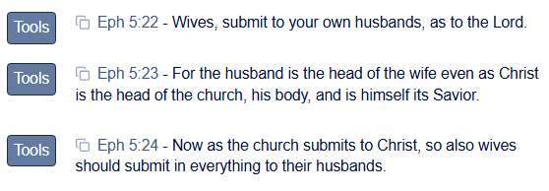
      Blue
      Letter
      Bible
www.blueletterbible.org

Slide 14
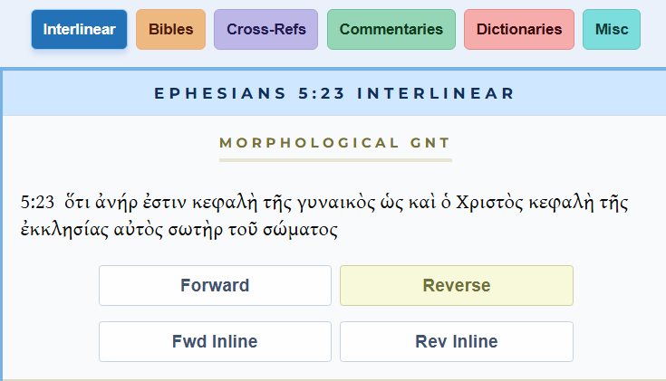

Slide 15
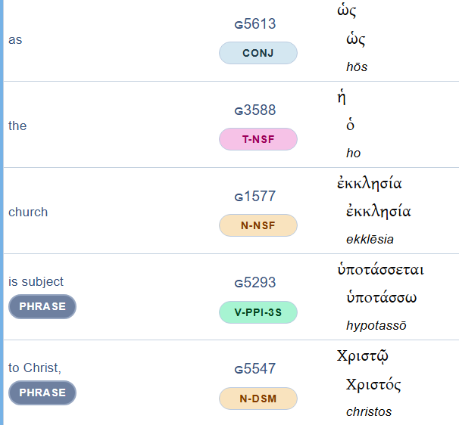

Slide 17
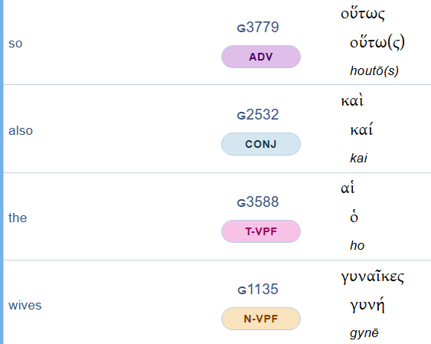

Slide 18
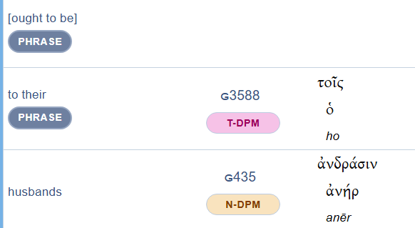

Slide 20
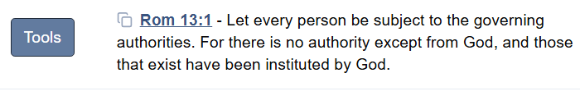
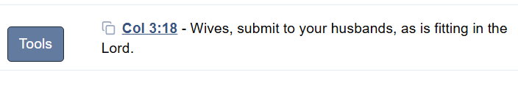

Slide 21
²² Wives, submit to your own husbands, as to the Lord. ²³ For the husband is the head of the wife even as Christ is the head of the church, his body, and is himself its Savior. ²⁴ Now as the church submits to Christ, so also wives should submit in everything to their husbands.
Wives
Christ
Husbands
The Church
submit

Slide 22
²² Wives, submit to your own husbands, as to the Lord. ²³ For
The Call to Submission
(it’s not a command)

Slide 23
²² Wives, submit to your own husbands, as to the Lord. ²³ For the husband is the head of the wife even as Christ is the head of the church, his body, and is himself its Savior.
Husbands
Christ
head
Wives
the Church
body

Slide 24

Too many cooks spoil the broth

Slide 25
²² Wives, submit to your own husbands, as to the Lord. ²³ For the husband is the head of the wife even as Christ is the head of the church, his body, and is himself its Savior. ²⁴ Now as the church submits to Christ, so also wives should submit in everything to their husbands.
The Pattern of the Church

Slide 26
²² Wives, submit to your own husbands, as to the Lord. ²³ For the husband is the head of the wife even as Christ is the head of the church, his body, and is himself its Savior. ²⁴ Now as the church submits to Christ, so also wives should submit in everything to their husbands.
The Pattern of the Church

Slide 27
Is a wife required to submit in everything,
even something sinful?

Slide 28
Rom 13:1 Let every person be subject to the governing authorities. For there is no authority except from God, and those that exist have been instituted by God.
Acts 5:28-29
²⁸ …. “We strictly charged you not to teach in this name, yet here you have filled Jerusalem with your teaching, and you intend to bring this man's blood upon us.”
²⁹ But Peter and the apostles answered, “We must obey God rather than men.

Slide 29
Is a wife required to submit in everything, even something sinful?
NO!
Submission is always under Christ’s authority.

Slide 30
Both man and woman are created in the image of God (Gen. 1:27).
Submission is about position and order, not about value or worth.
Husbands and wives are together under the lordship of Jesus.
Christ alone is the ultimate authority in every marriage.
God’s blueprint for marriage is always meant to bless and display the gospel.

Slide 31
1. The Wife’s Calling (22–24)
  Submission is not fine print—it’s a gospel picture
111
2. The Husband’s Command (25–30)
111 Love is not fine print—it’s Christlike sacrifice.
3. The Marriage Mystery (31–33)
111
111
Not Just Fine Print
—but God’s Blueprint
Ephesians 5:22-33

Slide 32
²⁵ Husbands, love your wives, as Christ loved the church and gave himself up for her, ²⁶ that he might sanctify her, having cleansed her by the washing of water with the word, ²⁷ so that he might present the church to himself in splendor, without spot or wrinkle or any such thing, that she might be holy and without blemish. ²⁸ In the same way husbands should love their wives as their own bodies. He who loves his wife loves himself. ²⁹ For no one ever hated his own flesh, but nourishes and cherishes it, just as Christ does the church, ³⁰ because we are members of his body.

Slide 33
²⁵ Husbands, love your wives, as Christ loved the church and gave himself up for her, ²⁶ that he might sanctify her, having cleansed her by the washing of water with the word, ²⁷ so that he might present the church to himself in splendor, without spot or wrinkle or any such thing, that she might be holy and without blemish. ²⁸ In the same way husbands should love their wives as their own bodies. He who loves his wife loves himself. ²⁹ For no one ever hated his own flesh, but nourishes and cherishes it, just as Christ does the church, ³⁰ because we are members of his body.
1. The Command to Love
2. The Goal of Love
3. The Picture of Love

Slide 34
²⁵ Husbands, love your wives, as Christ loved the church and gave himself up for her,
The Command to Love

Slide 35
Which is harder?
The wife’s calling to submit or
The husband’s command to love?

Slide 36
Matthew 11:28-30
English Standard Version
²⁸ Come to me, all who labor and are heavy laden, and I will give you rest. ²⁹ Take my yoke upon you, and learn from me, for I am gentle and lowly in heart, and you will find rest for your souls.
³⁰ For my yoke is easy, and my burden is light.”

Slide 37
and gave himself up for her, ²⁶ that he might sanctify her, having cleansed her by the washing of water with the word, ²⁷ so that he might present the church to himself in splendor, without spot or wrinkle or any such thing, that she might be holy and without blemish.
The Goal of Love

Slide 38

LULLABY
BABY
SLEEP
CADLE
SING
ROCK

Slide 39
GOSPEL
SALVATION
CROSS
RESURRECTION
GOOD NEWS
BLOOD

Slide 40
and gave himself up for her, ²⁶ that he might sanctify her, having cleansed her by the washing of water with the word, ²⁷ so that he might present the church to himself in splendor, without spot or wrinkle or any such thing, that she might be holy and without blemish.
The Goal of Love

Slide 41
and gave himself up for her, ²⁶ that he might sanctify her, having cleansed her by the washing of water with the word, ²⁷ so that he might present the church to himself in splendor, without spot or wrinkle or any such thing, that she might be holy and without blemish.
Not hygiene, but Holiness
The Goal of Love

Slide 42
Not Just Fine Print
—but God’s Blueprint
Ephesians 5:22-33

Slide 43
²⁸ In the same way husbands should love their wives as their own bodies. He who loves his wife loves himself. ²⁹ For no one ever hated his own flesh, but nourishes and cherishes it, just as Christ does the church, ³⁰ because we are members of his body.
The Picture of Love

Slide 44
²⁸ In the same way husbands should love their wives as their own bodies. He who loves his wife loves himself. ²⁹ For no one ever hated his own flesh, but nourishes and cherishes it, just as Christ does the church, ³⁰ because we are members of his body.
The Picture of Love

Slide 45
1. The Wife’s Calling (22–24)
  Submission is not fine print—it’s a gospel picture
111
2. The Husband’s Command (25–30)
  Love is not fine print—it’s Christlike sacrifice.
3. The Marriage Mystery (31–33)
  Marriage is not fine print—it’s God’s gospel blueprint
111
Not Just Fine Print
—but God’s Blueprint
Ephesians 5:22-33

Slide 46
³¹ “Therefore a man shall leave his father and mother and hold fast to his wife, and the two shall become one flesh.” ³² This mystery is profound, and I am saying that it refers to Christ and the church. ³³ However, let each one of you love his wife as himself, and let the wife see that she respects her husband.

Slide 47
³¹ “Therefore a man shall leave his father and mother and hold fast to his wife, and the two shall become one flesh.”
Genesis 2:24
Before the Fall / First Sin
God’s Blueprint for Marriage

Slide 48
³¹ “Therefore a man shall leave his father and mother and hold fast to his wife, and the two shall become one flesh.” ³² This mystery is profound, and I am saying that it refers to Christ and the church.

Slide 49
³¹ “Therefore a man shall leave his father and mother and hold fast to his wife, and the two shall become one flesh.” ³² This mystery is profound, and I am saying that it refers to Christ and the church.
Genesis 2:24 / Eph 5:31
Eph 3:1-12: Mystery of Gospel Revealed / Unity …
Eph 5:32: refers to Christ and the church.

Slide 50
³¹ “Therefore a man shall leave his father and mother and hold fast to his wife, and the two shall become one flesh.” ³² This mystery is profound, and I am saying that it refers to Christ and the church. ³³ However, let each one of you love his wife as himself, and let the wife see that she respects her husband.

Slide 51
³¹ “Therefore a man shall leave his father and mother and hold fast to his wife, and the two shall become one flesh.” ³² This mystery is profound, and I am saying that it refers to Christ and the church. ³³ However, let each one of you love his wife as himself, and let the wife see that she respects her husband.
Lofty mystery, practical takeaway
Big picture, daily practice

Slide 52
³¹ “Therefore a man shall leave his father and mother and hold fast to his wife, and the two shall become one flesh.” ³² This mystery is profound, and I am saying that it refers to Christ and the church. ³³ However, let each one of you love his wife as himself, and let the wife see that she respects her husband.
Husbands are not just told “lead” or “rule”—but “love.”
Wives are not just told “submit”—but “respect.”
Both are heart-level dispositions that mirror Christ and the church.

Slide 53
Response: Living the Blueprint
For Married Couples
See your marriage as more than companionship — it’s a living parable of the gospel.
Wives: your trusting respect reflects the church’s trust in Christ.
Husbands: your sacrificial love reflects Christ’s love for the church.
Together: embrace your marriage as both a blessing and a purpose.

Slide 54
Response: Living the Blueprint
For Singles, Widows, and Youth
Even if you’re not married, these verses still matter.
Support and pray for the marriages in our church — they are gospel billboards to the watching world.
Learn from the pattern: all of us are called to submit to Christ as Head and to love one another sacrificially.
Every believer is part of the bride of Christ, and every one of us reflects His gospel in our relationships.

Slide 55
Response: Living the Blueprint
For the Whole Church
Marriage is not just fine print — it’s God’s blueprint.
As a community, let’s encourage, protect, and uphold marriage as a sacred witness to Christ.
And let’s remember: whether married or single, we all display the gospel by living lives of love, trust, and self-giving sacrifice.

Slide 56
Without the gospel, the blueprint means nothing.
Only Christ’s love makes marriage and life complete.
Have you accepted the good news for yourself?

Slide 57

LET US PRAY….
Notes:
Photo by Yu Kato on Unsplash

