Slide 1
Ephesians
Inconceivable Blessings, Incredible Purpose.

Slide 2
Ephesians 5:1-21 – Imitators of God
Walking Together In Unity and Maturity - Ep 4:1-16
Walking In Holiness, Truth And Forgiveness - Ep 4:17-32

Slide 3
Ephesians 5:1-21 – Imitators of God
Overview themes of Chapter 5:1-21:
Be Imitators of God – Ephesians 5:1
Walk in Love - Ep 5:2-6
Walk in the Light - Ep 5:7-14
Walk in Wisdom - Ep 5:15-21

Slide 4



Slide 5
Therefore be imitators of God, as beloved children. ² And walk in love, as Christ loved us and gave himself up for us, a fragrant offering and sacrifice to God.

Slide 6
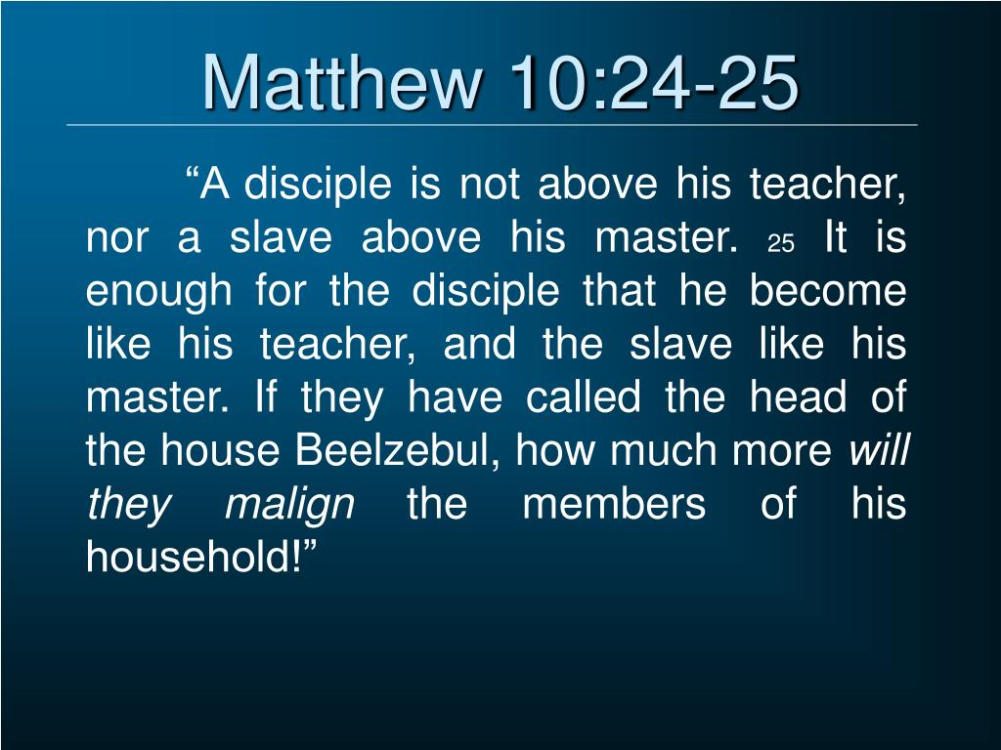

Slide 7
Therefore be imitators of God, as beloved children. ² And walk in love, as Christ loved us and gave himself up for us, a fragrant offering and sacrifice to God.

Slide 8
Ephesians 5:1-21 – Imitators of God
Vs 1-2
Jesus – the ”firstborn” – see Colossians 1:15, 18, Romans 8:29 cf Hebrews 1:6 and Revelation 1:5

Slide 9


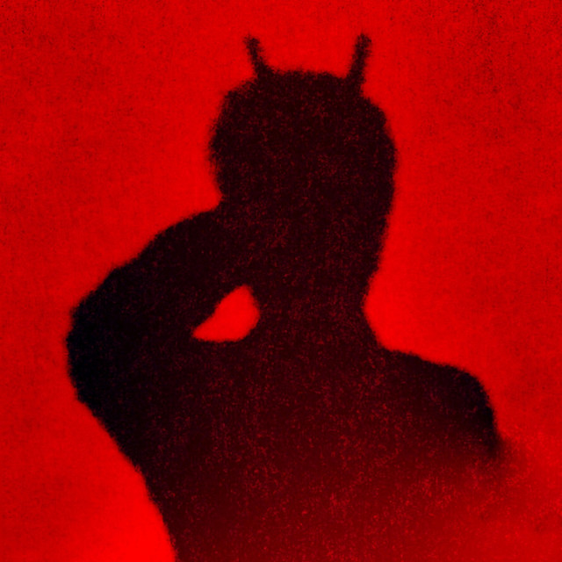

The 3 enemies of every Christian
1. The Devil
(Eph 2:2b)
2. The Self
(Eph 2:3)
3. The World
(Eph 2:2a)

Slide 10
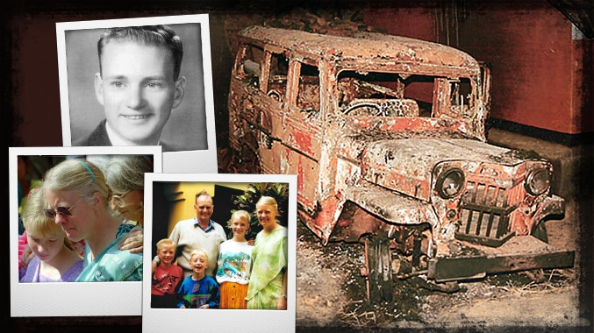
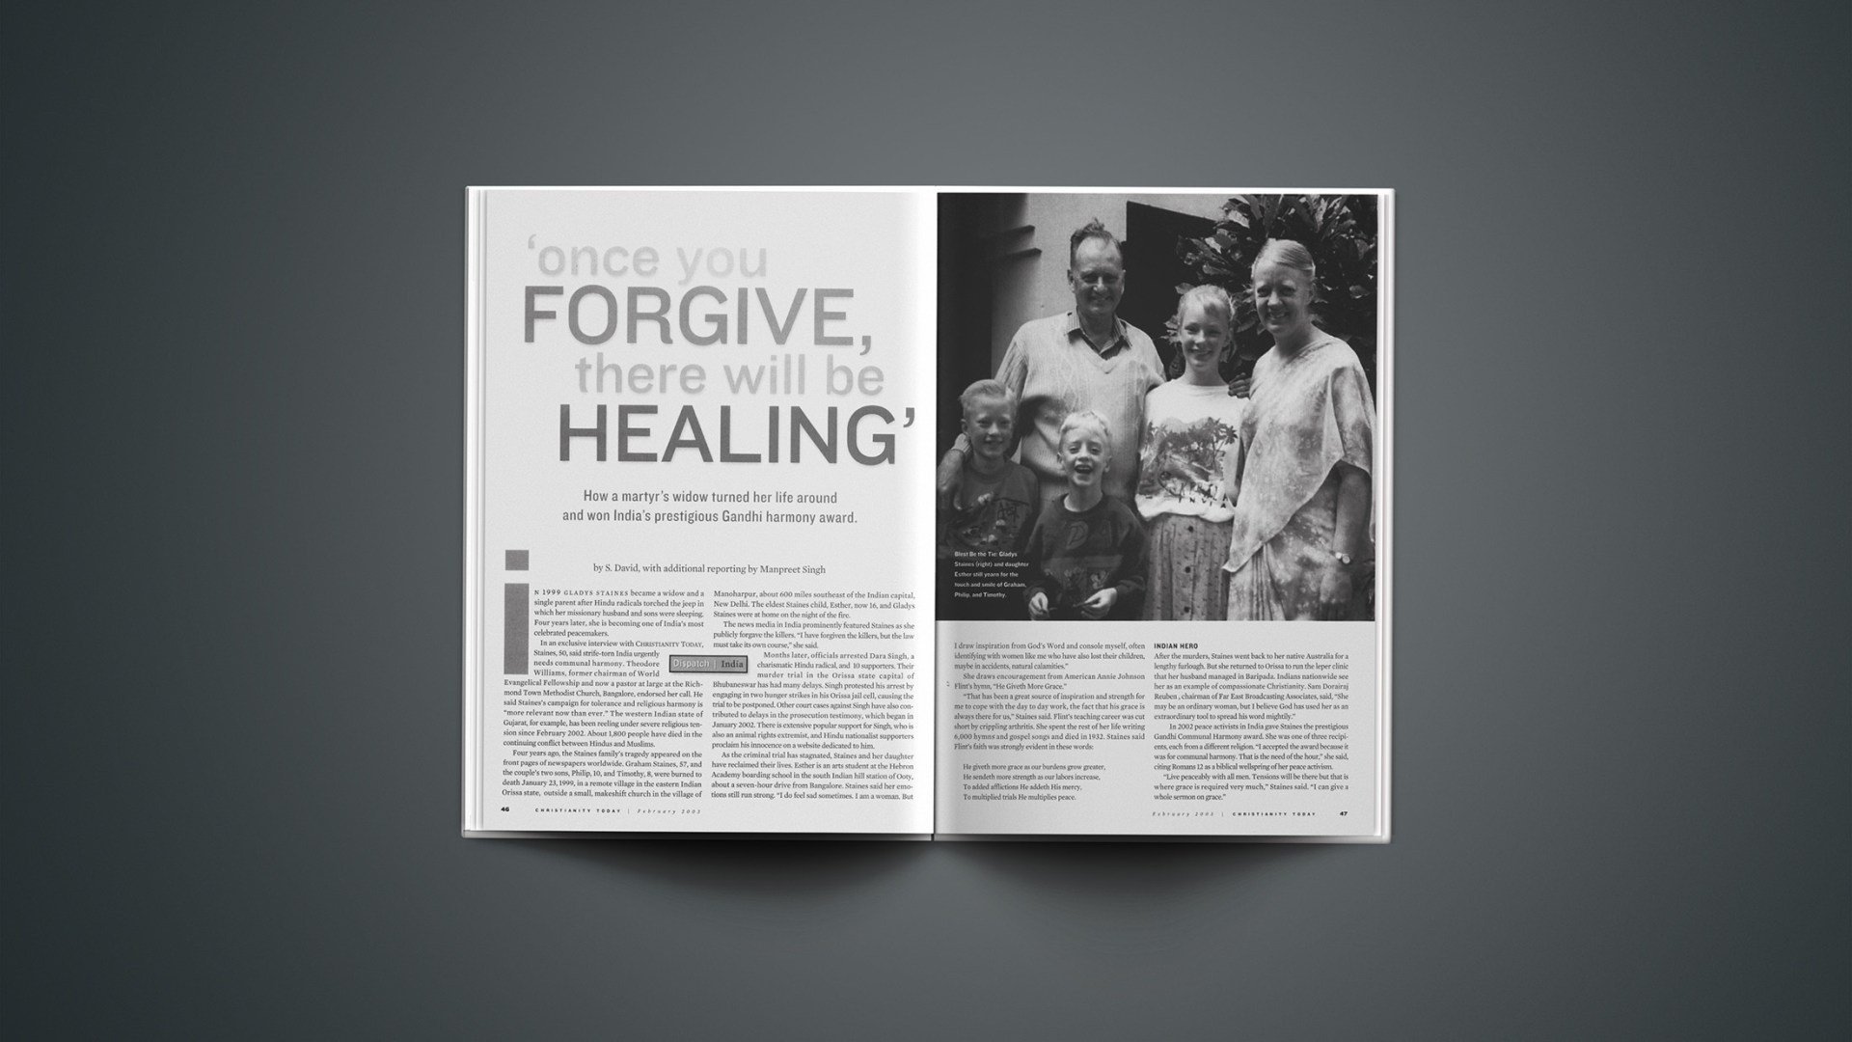

Slide 11

John Stott
“It is noteworthy how God-centered Paul’s ethic is. It is natural for him, in issuing his moral instructions, to mention the three Persons of the Trinity. He tells us to ‘copy God’, to ‘learn Christ’ and not to ‘grieve the Holy Spirit.”
John R. W. Stott, The Message of Ephesians, Leicester: Inter-varsity Press, 1979. page 191.

Slide 12




Slide 13


Slide 14
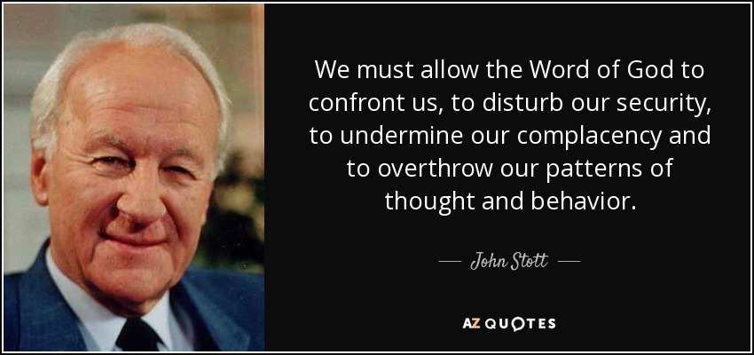

Slide 15
³ But sexual immorality and all impurity or covetousness must not even be named among you, as is proper among saints. ⁴ Let there be no filthiness nor foolish talk nor crude joking, which are out of place, but instead let there be thanksgiving. ⁵ For you may be sure of this, that everyone who is sexually immoral or impure, or who is covetous (that is, an idolater), has no inheritance in the kingdom of Christ and God. ⁶ Let no one deceive you with empty words, for because of these things the wrath of God comes upon the sons of disobedience.

Slide 16
³ But sexual immorality and all impurity or covetousness must not even be named among you, as is proper among saints. ⁴ Let there be no filthiness nor foolish talk nor crude joking, which are out of place, but instead let there be thanksgiving. ⁵ For you may be sure of this, that everyone who is sexually immoral or impure, or who is covetous (that is, an idolater), has no inheritance in the kingdom of Christ and God. ⁶ Let no one deceive you with empty words, for because of these things the wrath of God comes upon the sons of disobedience.

Slide 17

Imitators of God
Sexual Immorality – any sexual activity outside of the marriage relationship of husband and wife.

Slide 18
³ But sexual immorality and all impurity or covetousness must not even be named among you, as is proper among saints. ⁴ Let there be no filthiness nor foolish talk nor crude joking, which are out of place, but instead let there be thanksgiving. ⁵ For you may be sure of this, that everyone who is sexually immoral or impure, or who is covetous (that is, an idolater), has no inheritance in the kingdom of Christ and God. ⁶ Let no one deceive you with empty words, for because of these things the wrath of God comes upon the sons of disobedience.

Slide 19

Imitators of God
Idolatry is substituting God with someone or something else.
“Sin is the refusal to let God be God.” – (Gerard Hughes).

Slide 20
⁷ Therefore do not become partners with them; ⁸ for at one time you were darkness, but now you are light in the Lord. Walk as children of light ⁹ (for the fruit of light is found in all that is good and right and true), ¹⁰ and try to discern what is pleasing to the Lord. ¹¹ Take no part in the unfruitful works of darkness, but instead expose them. ¹² For it is shameful even to speak of the things that they do in secret. ¹³ But when anything is exposed by the light, it becomes visible, ¹⁴ for anything that becomes visible is light. Therefore it says,
“Awake, O sleeper,
and arise from the dead,
and Christ will shine on you.”

Slide 21
¹⁵ Look carefully then how you walk, not as unwise but as wise, ¹⁶ making the best use of the time, because the days are evil. ¹⁷ Therefore do not be foolish, but understand what the will of the Lord is. ¹⁸ And do not get drunk with wine, for that is debauchery, but be filled with the Spirit, ¹⁹ addressing one another in psalms and hymns and spiritual songs, singing and making melody to the Lord with your heart, ²⁰ giving thanks always and for everything to God the Father in the name of our Lord Jesus Christ, ²¹ submitting to one another out of reverence for Christ.

Slide 22
Ephesians 5:1-21 – Imitators of God
Vs 15-21
Three things that characterize those who walk in wisdom:
Vs 16 - Wise people make the most of their time.

Slide 23
Ephesians 5:1-21 – Imitators of God
Vs 15-21
Three things that characterize those who walk in wisdom:
Vs 16 - Wise people make the most of their time.
Vs 17 - Wise people understand and discern God’s will.
Note difference between God’s general and specific will.

Slide 24
Ephesians 5:1-21 – Imitators of God
Vs 15-21
Three things that characterize those who walk in wisdom:
Vs 16 - Wise people make the most of their time.
Vs 17 - Wise people understand and discern God’s will.
Note difference between God’s general and specific will.
Vs 18 – Wise people are filled with the Holy Spirit. A
continuous act is implied – i.e. go on being filled with
the Holy Spirit.

Slide 25
Ephesians 5:1-21 – Imitators of God
SUMMARY of Chapter 5:1-21:
Be Imitators of God – Ephesians 5:1
Walk in Love - Ep 5:2-6
Walk in the Light - Ep 5:7-14
Walk in Wisdom - Ep 5:15-21

Slide 26
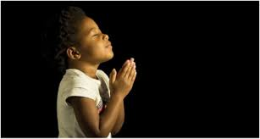
LET US PRAY….

