Slide 1
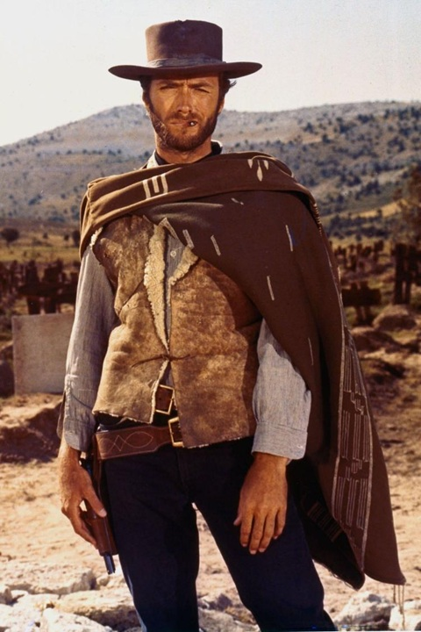



Slide 2


Slide 3


Slide 4
•Plot
•Writing
•Acting
•Long wait
between
seasons
•Cancelled
to make a
movie
•Movie
expected
in 2026

Slide 5

A Fantastic Transformation
Ephesians 4:17-32
Notes:
Photo by Håkon Grimstad on Unsplash
https://unsplash.com/photos/blue-and-black-butterfly-on-brown-stick-hteXWSF9jA4

Slide 6

Inconceivable blessings, Incredible Purpose.
Ephesians

Slide 7
¹⁷ Now this I say and testify in the Lord, that you must no longer walk as the Gentiles do, in the futility of their minds. ¹⁸ They are darkened in their understanding, alienated from the life of God because of the ignorance that is in them, due to their hardness of heart. ¹⁹ They have become callous and have given themselves up to sensuality, greedy to practice every kind of impurity. ²⁰ But that is not the way you learned Christ!— ²¹ assuming that you have heard about him and were taught in him, as the truth is in Jesus, ²² to put off your old self, which belongs to your former manner of life and is corrupt through deceitful desires, ²³ and to be renewed in the spirit of your minds, ²⁴ and to put on the new self, created after the likeness of God in true righteousness and holiness.
²⁵ Therefore, having put away falsehood, let each one of you speak the truth with his neighbor, for we are members one of another. ²⁶ Be angry and do not sin; do not let the sun go down on your anger, ²⁷ and give no opportunity to the devil. ²⁸ Let the thief no longer steal, but rather let him labor, doing honest work with his own hands, so that he may have something to share with anyone in need. ²⁹ Let no corrupting talk come out of your mouths, but only such as is good for building up, as fits the occasion, that it may give grace to those who hear. ³⁰ And do not grieve the Holy Spirit of God, by whom you were sealed for the day of redemption. ³¹ Let all bitterness and wrath and anger and clamor and slander be put away from you, along with all malice. ³² Be kind to one another, tenderhearted, forgiving one another, as God in Christ forgave you.
A Transformed Walk (17–24)

Slide 8
¹⁷ Now this I say and testify in the Lord, that you must no longer walk as the Gentiles do, in the futility of their minds. ¹⁸ They are darkened in their understanding, alienated from the life of God because of the ignorance that is in them, due to their hardness of heart. ¹⁹ They have become callous and have given themselves up to sensuality, greedy to practice every kind of impurity. ²⁰ But that is not the way you learned Christ!— ²¹ assuming that you have heard about him and were taught in him, as the truth is in Jesus, ²² to put off your old self, which belongs to your former manner of life and is corrupt through deceitful desires, ²³ and to be renewed in the spirit of your minds, ²⁴ and to put on the new self, created after the likeness of God in true righteousness and holiness.
²⁵ Therefore, having put away falsehood, let each one of you speak the truth with his neighbor, for we are members one of another. ²⁶ Be angry and do not sin; do not let the sun go down on your anger, ²⁷ and give no opportunity to the devil. ²⁸ Let the thief no longer steal, but rather let him labor, doing honest work with his own hands, so that he may have something to share with anyone in need. ²⁹ Let no corrupting talk come out of your mouths, but only such as is good for building up, as fits the occasion, that it may give grace to those who hear. ³⁰ And do not grieve the Holy Spirit of God, by whom you were sealed for the day of redemption. ³¹ Let all bitterness and wrath and anger and clamor and slander be put away from you, along with all malice. ³² Be kind to one another, tenderhearted, forgiving one another, as God in Christ forgave you.
The Calling of Holiness (17–24)

Slide 9
¹⁷ Now this I say and testify in the Lord, that you must no longer walk as the Gentiles do,

Slide 10
¹⁷ Now this I say and testify in the Lord, that you must no longer WALK as the Gentiles do,
4:¹ I therefore, a prisoner for the Lord, urge you to WALK in a manner worthy of the calling to which you have been called,

Slide 11
5:2 And WALK in love, as Christ loved us and gave himself up for us, a fragrant offering and sacrifice to God.
5:8 for at one time you were darkness, but now you are light in the Lord. WALK as children of light
5:15 Look carefully then how you WALK, not as unwise but as wise,

Slide 12



Slide 13

περιπατέω
peripateo
to Walk
• move at a regular pace by lifting and setting
down each foot in turn, never having both feet
off the ground at once.
• How you live
• to regulate one's life
• to conduct one's self

Slide 14
¹⁷ Now this I say and testify in the Lord, that you must no longer walk as the Gentiles do, in the futility of their minds.
Futile /ˈfjuːtʌɪl/
incapable of producing any useful result; pointless.

Slide 15
¹⁷ Now this I say and testify in the Lord, that you must no longer walk as the Gentiles do, in the
futility of their minds.
perverseness [in the folly, vanity, and emptiness of their souls and the futility] of their minds.
Amplified Bible, Classic Edition

Slide 16
¹⁷ Now this I say and testify in the Lord, that you must no longer walk as the Gentiles do, in the futility of their minds.
What
• ¹⁸ They are darkened in their understanding,
•alienated from the life of God
• ¹⁹ They have become callous
• and have given themselves up to sensuality, greedy to practice every kind of impurity.
Why
• because of the ignorance that is in them,
• due to their hardness of heart.

Slide 17


What
• ¹⁸ They are darkened in their understanding,
•alienated from the life of God
• ¹⁹ They have become callous
• and have given themselves up to sensuality, greedy to practice every kind of impurity.
Why
• because of the ignorance that is in them,
• due to their hardness of heart.

Slide 18
A Transformed Walk (17–24)
  The Calling
  of Holiness
  The Ugly Walk (17-19)
A Fantastic Transformation
Ephesians 4:17-32

Slide 19
If the world walks in futility, what makes our walk any different?

Slide 20
²⁰ But that is not the way you learned Christ!— ²¹ assuming that you have heard about him and were taught in him, as the truth is in Jesus,
1 Cor 15:3-5 ³ For I delivered to you as of first importance what I also received: that Christ died for our sins in accordance with the Scriptures, ⁴ that he was buried, that he was raised on the third day in accordance with the Scriptures, ⁵ and that he appeared to Cephas, then to the twelve.

Slide 21
²⁰ But that is not the way you learned Christ!— ²¹ assuming that you have heard about him and were taught in him, as the truth is in Jesus,
Now the children will deliver an important message

Slide 22

Notes:
https://www.youtube.com/watch?v=O2u_w5rcFqY

Slide 23

Notes:
https://www.youtube.com/watch?v=E2BZV7m4BUY

Slide 24
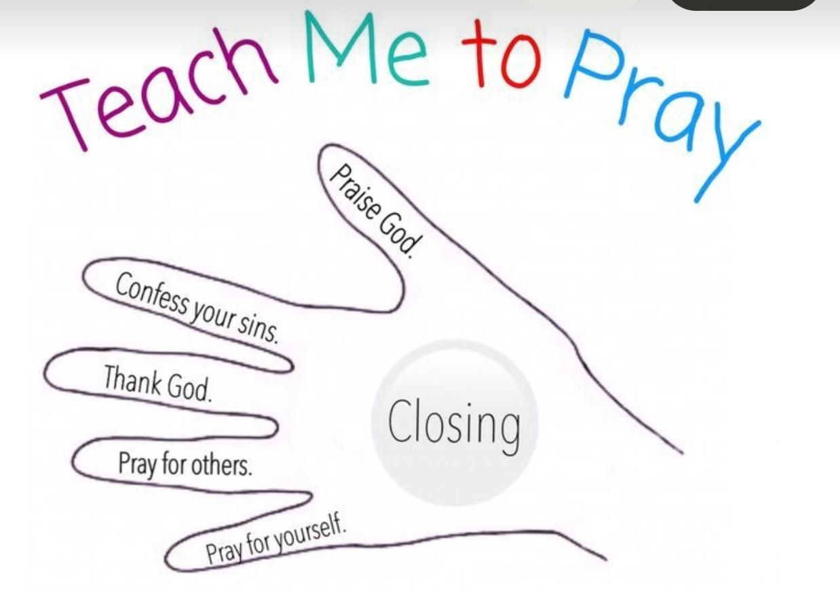

Slide 25
A Transformed Walk (17–24)
  The Calling of Holiness
  The Ugly Walk
  The Trigger to Transform
A Fantastic Transformation
Ephesians 4:17-32

Slide 26
A Transformed Walk (17–24)
  The Calling of Holiness
  The Ugly Walk
  The Trigger to Transform
  The Bad-to-Good Exchange
A Fantastic Transformation
Ephesians 4:17-32

Slide 27
The Bad-to-Good Exchange
²² to put off your old self, which belongs to your former manner of life and is corrupt through deceitful desires, ²³ and to be renewed in the spirit of your minds, ²⁴ and to put on the new self, created after the likeness of God in true righteousness and holiness.

Slide 28


Jesus
²² to put off your old self, which belongs to your former manner of life and is corrupt through deceitful desires, ²³ and to be renewed in the spirit of your minds, ²⁴ and to put on the new self, created after the likeness of God in true righteousness and holiness.

Slide 29



Slide 30
¹⁷ Now this I say and testify in the Lord, that you must no longer walk as the Gentiles do, in the futility of their minds. ¹⁸ They are darkened in their understanding, alienated from the life of God because of the ignorance that is in them, due to their hardness of heart. ¹⁹ They have become callous and have given themselves up to sensuality, greedy to practice every kind of impurity. ²⁰ But that is not the way you learned Christ!— ²¹ assuming that you have heard about him and were taught in him, as the truth is in Jesus, ²² to put off your old self, which belongs to your former manner of life and is corrupt through deceitful desires, ²³ and to be renewed in the spirit of your minds, ²⁴ and to put on the new self, created after the likeness of God in true righteousness and holiness.
²⁵ Therefore, having put away falsehood, let each one of you speak the truth with his neighbor, for we are members one of another. ²⁶ Be angry and do not sin; do not let the sun go down on your anger, ²⁷ and give no opportunity to the devil. ²⁸ Let the thief no longer steal, but rather let him labor, doing honest work with his own hands, so that he may have something to share with anyone in need. ²⁹ Let no corrupting talk come out of your mouths, but only such as is good for building up, as fits the occasion, that it may give grace to those who hear. ³⁰ And do not grieve the Holy Spirit of God, by whom you were sealed for the day of redemption. ³¹ Let all bitterness and wrath and anger and clamor and slander be put away from you, along with all malice. ³² Be kind to one another, tenderhearted, forgiving one another, as God in Christ forgave you.
A Transformed Walk (17–24)
Keep Walking (25–32)

Slide 31
¹⁷ Now this I say and testify in the Lord, that you must no longer walk as the Gentiles do, in the futility of their minds. ¹⁸ They are darkened in their understanding, alienated from the life of God because of the ignorance that is in them, due to their hardness of heart. ¹⁹ They have become callous and have given themselves up to sensuality, greedy to practice every kind of impurity. ²⁰ But that is not the way you learned Christ!— ²¹ assuming that you have heard about him and were taught in him, as the truth is in Jesus, ²² to put off your old self, which belongs to your former manner of life and is corrupt through deceitful desires, ²³ and to be renewed in the spirit of your minds, ²⁴ and to put on the new self, created after the likeness of God in true righteousness and holiness.
²⁵ Therefore, having put away falsehood, let each one of you speak the truth with his neighbor, for we are members one of another. ²⁶ Be angry and do not sin; do not let the sun go down on your anger, ²⁷ and give no opportunity to the devil. ²⁸ Let the thief no longer steal, but rather let him labor, doing honest work with his own hands, so that he may have something to share with anyone in need. ²⁹ Let no corrupting talk come out of your mouths, but only such as is good for building up, as fits the occasion, that it may give grace to those who hear. ³⁰ And do not grieve the Holy Spirit of God, by whom you were sealed for the day of redemption. ³¹ Let all bitterness and wrath and anger and clamor and slander be put away from you, along with all malice. ³² Be kind to one another, tenderhearted, forgiving one another, as God in Christ forgave you.
The Calling of Holiness (17–24)
The Cultivation of Holiness (25–32)

Slide 32
A Transformed Walk (17–24)
  The Calling of Holiness
  The Ugly Walk
  The Trigger to Transform
  The Bad-to-Good Exchange
Keep Walking (25-32)
  The Cultivation of Holiness
  The Enduring Walk
A Fantastic
Transformation
Ephesians 4:17-32

Slide 33

Notes:
https://www.youtube.com/watch?v=QXM2o_Hb9Ls

Slide 34
²⁵ Therefore, having put away falsehood, let each one of you speak the truth with his neighbor, for we are members one of another.
Speak Truth, Not Lies

Slide 35


Christians break the bonds of love and fellowship by which they have come to be bound when they try to deceive one another. They belong together as members of the one body and so must be completely honest with one another.
Notes:
Foulkes, F. (1989). Ephesians: an introduction and commentary (Vol. 10, p. 139). InterVarsity Press.

Slide 36
²⁶ Be angry and do not sin; do not let the sun go down on your anger, ²⁷ and give no opportunity to the devil.
Anger Without Sin

Slide 37
• Protects Ourselves
• Defend Others
• Confront Injustice
• Isolates Ourselves
• Attack Others
• Cause Injustice
Anger Without Sin

Slide 38
²⁸ Let the thief no longer steal, but rather let him labor, doing honest work with his own hands, so that he may have something to share with anyone in need.
Proverbs 16:27
Idle hands are the devil’s workshop;
idle lips are his mouthpiece.
Work to Give, Not Steal

Slide 39


²⁹ Let no corrupting talk come out of your mouths, but only such as is good for building up, as fits the occasion, that it may give grace to those who hear.
Build Up with Words

Slide 40
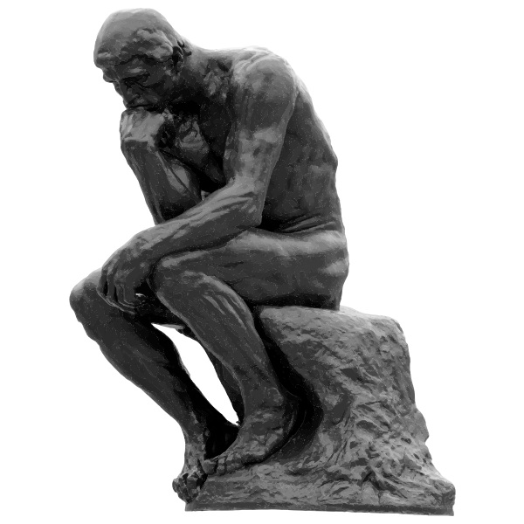
True (Eph 4:25)
Helpful (Eph 4:29)
Inspiring (1 Thess 5:11)
Necessary (Prov 10:19)
Kind (Eph. 4:32)

Slide 41
³⁰ And do not grieve the Holy Spirit of God, by whom you were sealed for the day of redemption.
Don’t Grieve the Spirit

Slide 42
³¹ Let all bitterness and wrath and anger and clamor and slander be put away from you, along with all malice. ³² Be kind to one another, tenderhearted, forgiving one another, as God in Christ forgave you.
Put Away Sin, Put On Virtues

Slide 43
A Transformed Walk (17–24)
  The Calling of Holiness
  The Ugly Walk
  The Trigger to Transform
  The Bad-to-Good Exchange
Keep Walking (25-32)
  The Cultivation of Holiness
  The Enduring Walk
A Fantastic
Transformation
Ephesians 4:17-32

Slide 44
The gospel not only changes our hearts—it changes our walk

Slide 45
https://www.facebook.com/reel/638331312606262
Notes:
https://www.facebook.com/reel/638331312606262

Slide 46
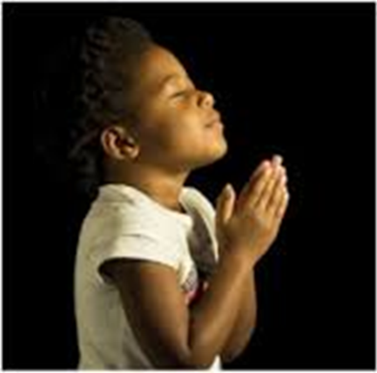
LET US PRAY….
Notes:
Photo by Yu Kato on Unsplash

