Slide 1
Ephesians
Inconceivable Blessings, Incredible Purpose.

Slide 2
How Can We Pray with Confidence?
The Posture of Prayer (14–15)
  How do you approach your prayers?
The Petitions of Prayer (16-19)
  What do you pray for?
The Purpose of Prayer (20-21)
  Why do you pray?

Slide 3

Ephesians 4:1-16 –
UNITY and MATURITY

Slide 4

Source: https://www.thebibleinitiative.com/week-8-letters

Slide 5
¹ I therefore, a prisoner for the Lord, urge you to walk in a manner worthy of the calling to which you have been called, ² with all humility and gentleness, with patience, bearing with one another in love, ³ eager to maintain the unity of the Spirit in the bond of peace. ⁴ There is one body and one Spirit—just as you were called to the one hope that belongs to your call— ⁵ one Lord, one faith, one baptism, ⁶ one God and Father of all, who is over all and through all and in all.

Slide 6



Slide 7
¹ I therefore, a prisoner for the Lord, urge you to walk in a manner worthy of the calling to which you have been called, ² with all humility and gentleness, with patience, bearing with one another in love, ³ eager to maintain the unity of the Spirit in the bond of peace. ⁴ There is one body and one Spirit—just as you were called to the one hope that belongs to your call— ⁵ one Lord, one faith, one baptism, ⁶ one God and Father of all, who is over all and through all and in all.

Slide 8
¹ I therefore, a prisoner for the Lord, urge you to walk in a manner worthy of the calling to which you have been called, ² with all humility and gentleness, with patience, bearing with one another in love, ³ eager to maintain the unity of the Spirit in the bond of peace. ⁴ There is one body and one Spirit—just as you were called to the one hope that belongs to your call— ⁵ one Lord, one faith, one baptism, ⁶ one God and Father of all, who is over all and through all and in all.

Slide 9
¹ I therefore, a prisoner for the Lord, urge you to walk in a manner worthy of the calling to which you have been called, ² with all humility and gentleness, with patience, bearing with one another in love, ³ eager to maintain the unity of the Spirit in the bond of peace. ⁴ There is one body and one Spirit—just as you were called to the one hope that belongs to your call— ⁵ one Lord, one faith, one baptism, ⁶ one God and Father of all, who is over all and through all and in all.

Slide 10
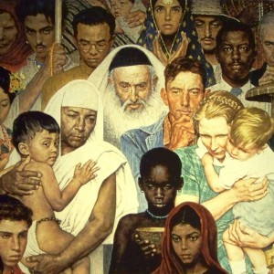


Slide 11
⁷ But grace was given to each one of us according to the measure of Christ's gift. ⁸ Therefore it says,
“When he ascended on high he led a host of captives,
and he gave gifts to men.”
⁹ (In saying, “He ascended,” what does it mean but that he had also descended into the lower regions, the earth? ¹⁰ He who descended is the one who also ascended far above all the heavens, that he might fill all things.)

Slide 12


Slide 13
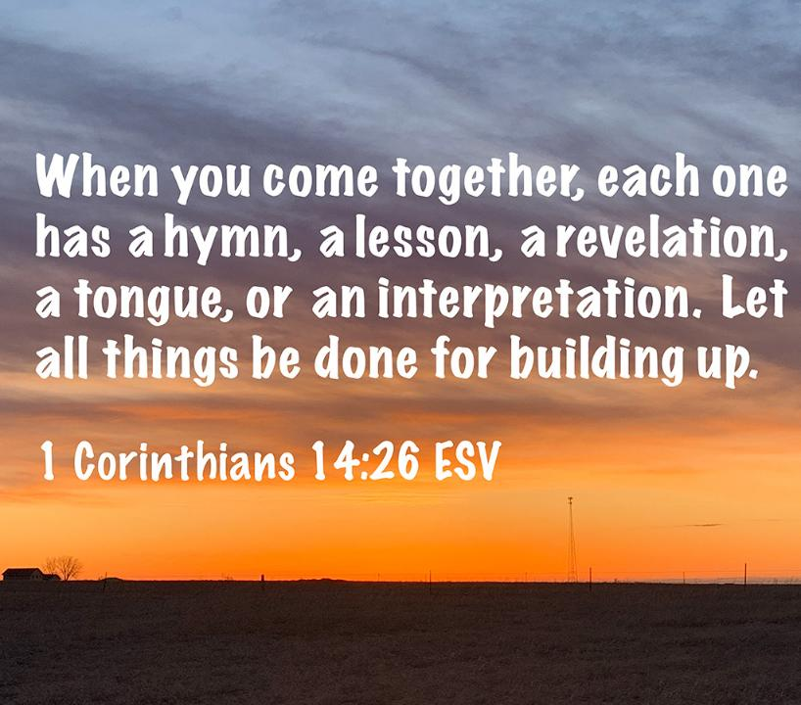


Slide 14
⁷ But grace was given to each one of us according to the measure of Christ's gift. ⁸ Therefore it says,
“When he ascended on high he led a host of captives,
and he gave gifts to men.”
⁹ (In saying, “He ascended,” what does it mean but that he had also descended into the lower regions, the earth? ¹⁰ He who descended is the one who also ascended far above all the heavens, that he might fill all things.)

Slide 15
¹¹ And he gave the apostles, the prophets, the evangelists, the shepherds and teachers, ¹² to equip the saints for the work of ministry, for building up the body of Christ, ¹³ until we all attain to the unity of the faith and of the knowledge of the Son of God, to mature manhood, to the measure of the stature of the fullness of Christ, ¹⁴ so that we may no longer be children, tossed to and fro by the waves and carried about by every wind of doctrine, by human cunning, by craftiness in deceitful schemes. ¹⁵ Rather, speaking the truth in love, we are to grow up in every way into him who is the head, into Christ, ¹⁶ from whom the whole body, joined and held together by every joint with which it is equipped, when each part is working properly, makes the body grow so that it builds itself up in love.

Slide 16
5 Ministry Gifts for the Good of the Church
Ephesians 4:11

Slide 17
5 Ministry Gifts for the Good of the Church
Ephesians 4:11
Apostles – Pioneers of God’s Mission

Slide 18
5 Ministry Gifts for the Good of the Church
Ephesians 4:11
Apostles – Pioneers of God’s Mission
Prophets – Tellers of God’s Truth

Slide 19
5 Ministry Gifts for the Good of the Church
Ephesians 4:11
Apostles – Pioneers of God’s Mission
Prophets – Tellers of God’s Truth
Evangelists – Communicators of God’s Good News

Slide 20
5 Ministry Gifts for the Good of the Church
Ephesians 4:11
Apostles – Pioneers of God’s Mission
Prophets – Tellers of God’s Truth
Evangelists – Communicators of God’s Good News
Pastors – Shepherds of God’s People

Slide 21
5 Ministry Gifts for the Good of the Church
Ephesians 4:11
Apostles – Pioneers of God’s Mission
Prophets – Tellers of God’s Truth
Evangelists – Communicators of God’s Good News
Pastors – Shepherds of God’s People
Teachers – Instructors of God’s Word

Slide 22
¹¹ And he gave the apostles, the prophets, the evangelists, the shepherds and teachers, ¹² to equip the saints for the work of ministry, for building up the body of Christ, ¹³ until we all attain to the unity of the faith and of the knowledge of the Son of God, to mature manhood, to the measure of the stature of the fullness of Christ, ¹⁴ so that we may no longer be children, tossed to and fro by the waves and carried about by every wind of doctrine, by human cunning, by craftiness in deceitful schemes. ¹⁵ Rather, speaking the truth in love, we are to grow up in every way into him who is the head, into Christ, ¹⁶ from whom the whole body, joined and held together by every joint with which it is equipped, when each part is working properly, makes the body grow so that it builds itself up in love.

Slide 23

Ephesians 4:1-16 – Unity and Maturity
What are the point of the ministry gifts?
For us to be equipped (vs 12)

Slide 24
Ephesians 4:1-16 – Unity and Maturity
What are the point of the ministry gifts?
For us to be equipped (vs 12)
For us to be edified (vs 13)

Slide 25
Ephesians 4:1-16 – Unity and Maturity
What are the point of the ministry gifts?
For us to be equipped (vs 12)
For us to be edified (vs 13)
For us to be established (vs 14)

Slide 26
¹¹ And he gave the apostles, the prophets, the evangelists, the shepherds and teachers, ¹² to equip the saints for the work of ministry, for building up the body of Christ, ¹³ until we all attain to the unity of the faith and of the knowledge of the Son of God, to mature manhood, to the measure of the stature of the fullness of Christ, ¹⁴ so that we may no longer be children, tossed to and fro by the waves and carried about by every wind of doctrine, by human cunning, by craftiness in deceitful schemes. ¹⁵ Rather, speaking the truth in love, we are to grow up in every way into him who is the head, into Christ, ¹⁶ from whom the whole body, joined and held together by every joint with which it is equipped, when each part is working properly, makes the body grow so that it builds itself up in love.

Slide 27
¹¹ And he gave the apostles, the prophets, the evangelists, the shepherds and teachers, ¹² to equip the saints for the work of ministry, for building up the body of Christ, ¹³ until we all attain to the unity of the faith and of the knowledge of the Son of God, to mature manhood, to the measure of the stature of the fullness of Christ, ¹⁴ so that we may no longer be children, tossed to and fro by the waves and carried about by every wind of doctrine, by human cunning, by craftiness in deceitful schemes. ¹⁵ Rather, speaking the truth in love, we are to grow up in every way into him who is the head, into Christ, ¹⁶ from whom the whole body, joined and held together by every joint with which it is equipped, when each part is working properly, makes the body grow so that it builds itself up in love.

Slide 28

John Stott
“(T)ruth becomes hard if it is not softened by love; love becomes soft if it is not strengthened by truth.”
John R. W. Stott, The Message of Ephesians, Leicester: Inter-varsity Press, 1979. page 172.

Slide 29
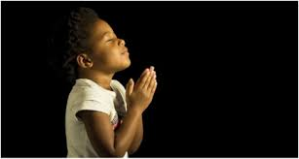
LET US PRAY….

