Slide 1


Slide 2
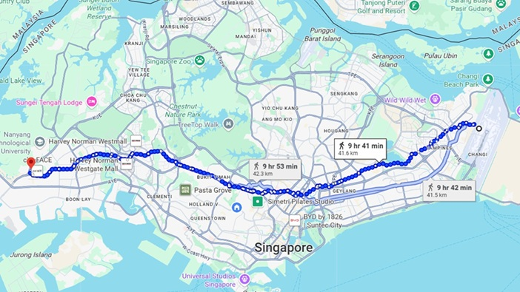

Slide 3
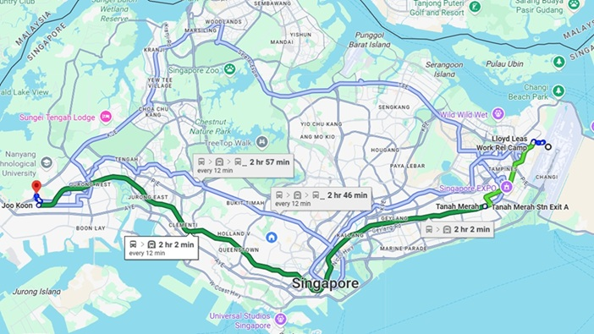

Slide 4
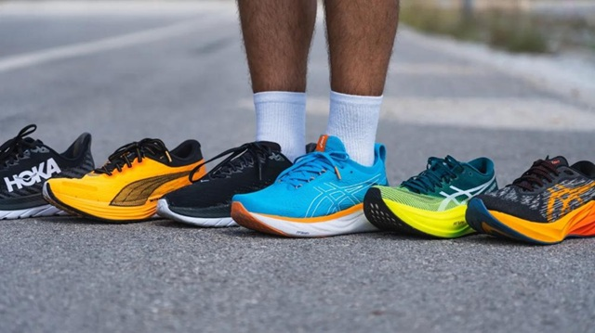
https://runrepeat.com/guides/best-marathon-running-shoes

Slide 5

Confidence isn’t bought—it’s built through training!
Smilie027, CC BY-SA 4.0 <https://creativecommons.org/licenses/by-sa/4.0>, via Wikimedia Commons
Notes:
https://commons.wikimedia.org/wiki/File:Positive_thinking_and_self_confidence.jpg
Smilie027, CC BY-SA 4.0 <https://creativecommons.org/licenses/by-sa/4.0>, via Wikimedia Commons

Slide 6
This was according to the eternal purpose that he has realized in Christ Jesus our Lord,
in whom we have boldness
and access with confidence
through our faith in him.
Eph 3:11-12

Slide 7
How Can We Pray with Confidence?

Slide 8
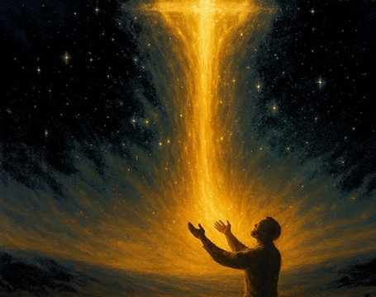
Praying Beyond Limits
Ephesians 3:14-21
Notes:
Photo by Yu Kato on Unsplash

Slide 9

Inconceivable blessings, Incredible Purpose.
Ephesians

Slide 10
¹⁴ For this reason I bow my knees before the father, ¹⁵from whom every family in heaven and on earth is named, ¹⁶that according to the riches of his glory he may grant you to be strengthened with power through his Spirit in your inner being, ¹⁷ so that Christ may dwell in your hearts through faith—that you, being rooted and grounded in love, ¹⁸ may have strength to comprehend with all the saints what is the breadth and length and height and depth, ¹⁹ and to know the love of Christ that surpasses knowledge, that you may be filled with all the fullness of God.
²⁰ Now to him who is able to do far more abundantly than all that we ask or think, according to the power at work within us, ²¹ to him be glory in the church and in Christ Jesus throughout all generations, forever and ever. Amen.

Slide 11


Inconceivable Blessings, Incredible Purpose.
Jew-Gentile Unity Shown in Love
Love as Equals |  |  |  | Love as Testimony
Chapters 1–3 |  |  |  | Chapters 4–6
Doctrine |  |  |  | Application
Position |  |  |  | Practice
Belief |  |  |  | Behaviour
Privileges |  |  |  | Responsibilities
Salutation | Position | Reconcil-iation | Unique-ness | Unity | Holiness | Submission | Reliance | Love
1:1-2 | 1:3-23 | 2 | 3 | 4:1-16 | 4:17–5:20 | 5:21–6:9 | 6:10-20 | 6:21-24

Slide 12
The Posture of Prayer (14–15)
  How do you approach your prayers?
Praying Beyond Limits
Ephesians 3:14-21

Slide 13
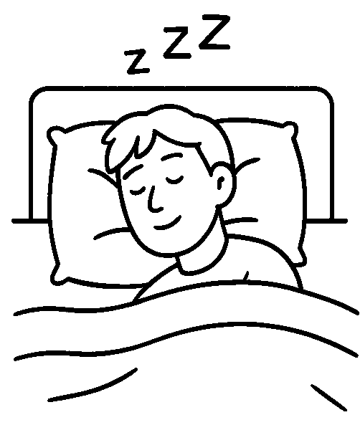
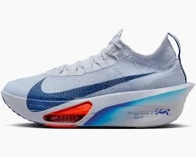
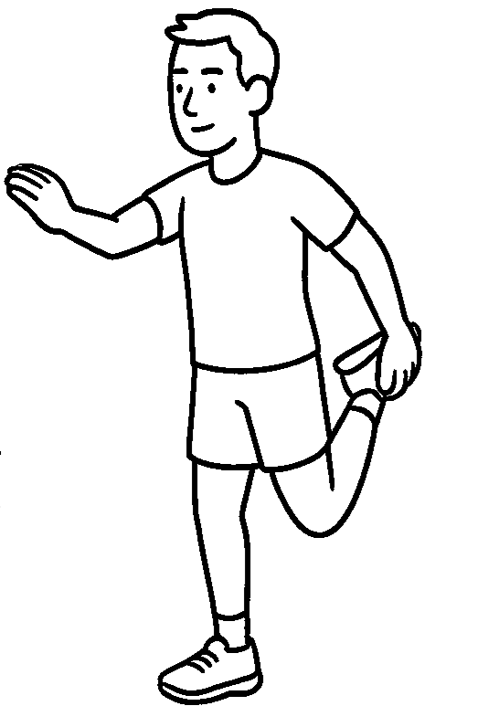
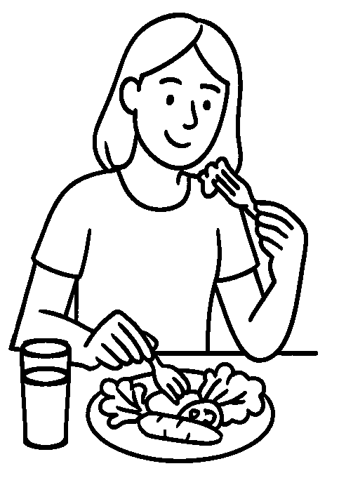

Slide 14
¹⁴ For this reason I bow my knees before the father,
Lifting or stretching out one’s hands
Kneeling
Standing
Lifting eyes upward
Sitting
Lying on your bed
Being still and silent
Being still and silent
Bowing
Prostrate on your face
Writing
Walking

Slide 15

EASY LONG TEMPO INTERVAL
PROGRESSION RECOVERY HILL

Slide 16
CHALLENGE: Try different postures of prayer
Lifting or stretching out one’s hands
Kneeling
Standing
Lifting eyes upward
Sitting
Lying on your bed
Being still and silent
Being still and silent
Bowing
Prostrate on your face
Writing
Walking

Slide 17
¹⁴ For this reason I bow my knees before the father, ¹⁵from whom every family^{[a]} in heaven and on earth is named,

Slide 18
¹⁴ For this reason I bow my knees before the father, ¹⁵from whom every family^{[a]} in heaven and on earth is named,
Footnote
Or from whom all fatherhood; the Greek word patria in verse 15 is closely related to the word for Father in verse 14
πατέρα… πατριὰ
(patera… patria)

Slide 19
¹⁴ For this reason I bow my knees
before the father,
¹⁵from whom all fatherhood
in heaven and on earth is named,
πατέρα patera
πατριὰ patria

Slide 20

¹⁵from whom all fatherhood
in heaven and on earth is named

Slide 21
The Posture of Prayer (14–15)
  How do you approach your prayers?
The Petitions of Prayer (16-19)
  What do you pray for?
Praying Beyond Limits
Ephesians 3:14-21

Slide 22
¹⁶that according to the riches of his glory he may grant you to be strengthened with power through his Spirit in your inner being, ¹⁷ so that Christ may dwell in your hearts through faith—that you, being rooted and grounded in love, ¹⁸ may have strength to comprehend with all the saints what is the breadth and length and height and depth, ¹⁹ and to know the love of Christ that surpasses knowledge, that you may be filled with all the fullness of God.

Slide 23
¹⁶that according to the riches of his glory he may grant you to be strengthened with power through his Spirit in your inner being, ¹⁷ so that Christ may dwell in your hearts through faith—that you, being rooted and grounded in love, ¹⁸ may have strength to comprehend with all the saints what is the breadth and length and height and depth, ¹⁹ and to know the love of Christ that surpasses knowledge, that you may be filled with all the fullness of God.

Slide 24
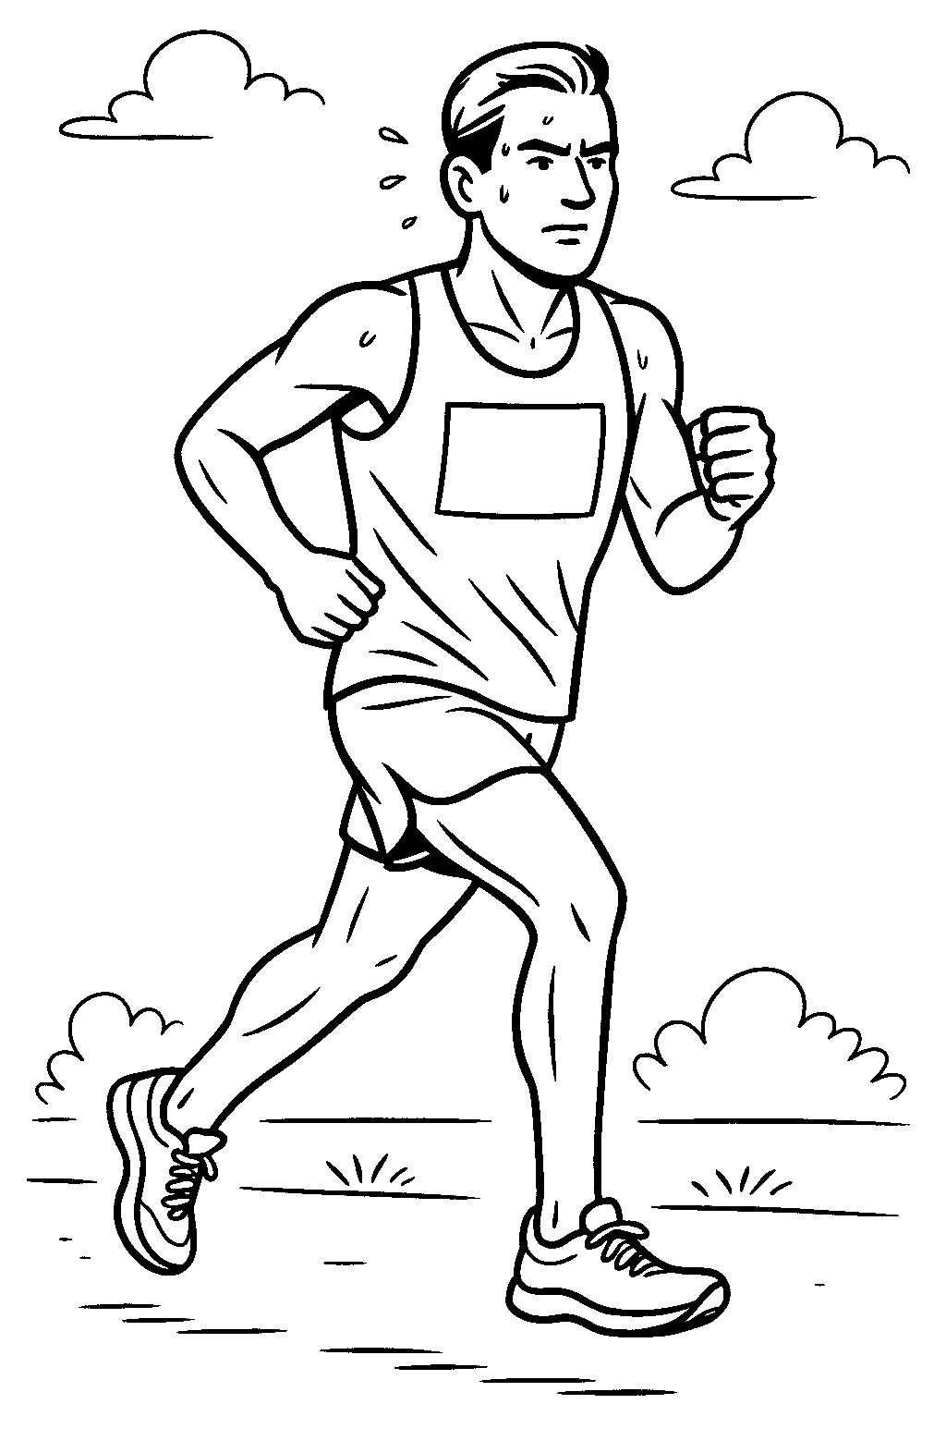
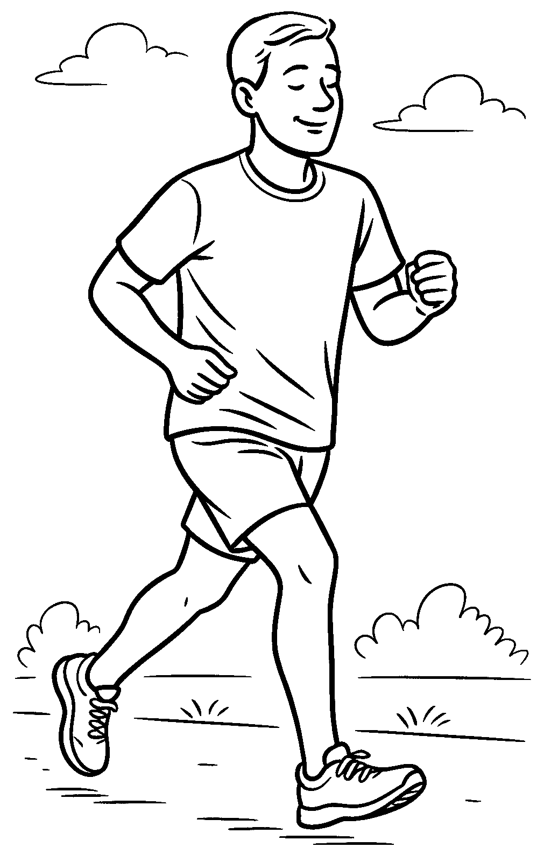
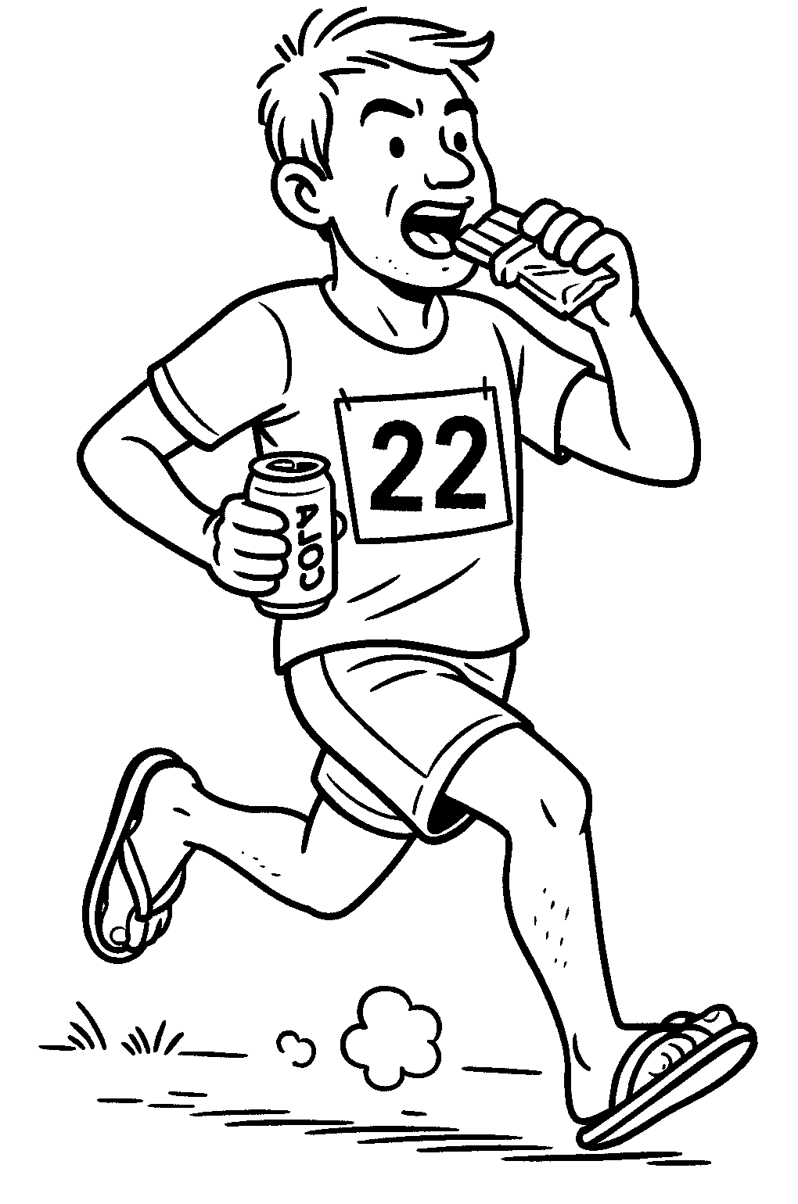
^{5K}
^{10K}
^{Marathon}

Slide 25
¹⁶that according to the riches of his glory he may grant you to be strengthened with power through his Spirit in your inner being,

Slide 26
New Password
samson
Weak

Slide 27
New Password
samson
Weak
New Password
saMs0nwithha!r
Strong

Slide 28
¹⁶that according to the riches of his glory he may grant you to be strengthened with power through his Spirit in your inner being,

Slide 29
¹⁶that according to the riches of his glory he may grant you to be strengthened with power through his Spirit in your inner being, ¹⁷ so that Christ may dwell in your hearts through faith

Slide 30
¹⁶that according to the riches of his glory he may grant you to be strengthened with power through his Spirit in your inner being, ¹⁷ so that Christ may dwell in your hearts through faith—that you, being rooted and grounded in love, ¹⁸ may have strength to comprehend with all the saints what is the breadth and length and height and depth, ¹⁹ and to know the love of Christ that surpasses knowledge,

Slide 31
¹⁶that according to the riches of his glory he may grant you to be strengthened with power through his Spirit in your inner being, ¹⁷ so that Christ may dwell in your hearts through faith—that you, being rooted and grounded in love, ¹⁸ may have strength to comprehend with all the saints what is the breadth and length and height and depth, ¹⁹ and
to know the love of Christ that surpasses knowledge,

Slide 32
¹⁶that according to the riches of his glory he may grant you to be strengthened with power through his Spirit in your inner being, ¹⁷ so that Christ may dwell in your hearts through faith—that you, being rooted and grounded in love, ¹⁸ may have strength to comprehend with all the saints what is the breadth and length and height and depth, ¹⁹ and to know the love of Christ that surpasses knowledge,

Slide 33
¹⁶that according to the riches of his glory he may grant you to be strengthened with power through his Spirit in your inner being, ¹⁷ so that Christ may dwell in your hearts through faith—that you, being rooted and grounded in love, ¹⁸ may have strength to comprehend with all the saints what is the breadth and length and height and depth, ¹⁹ and to know the love of Christ that surpasses knowledge,

Slide 34
¹⁹ and to know
the love of Christ
that surpasses knowledge,
γνῶναι gnōnai
γνώσεως gnōseōs
You can’t just study your way into Christ’s love.
True knowledge is relational, not merely intellectual.
Christ’s love surpasses what can be grasped by human wisdom.

Slide 35
Gnosticism:
The False “Knowledge
Countered by Paul
o Colossians 2:2–4
o 1 John 4:2–3
o 1 Timothy 6:20–21
True knowledge is found in Christ

Slide 36

www.gotquestions.org
What is agnosticism?
“agnostic” essentially means “without knowledge
a more intellectually honest form of atheism
  Atheism claims that God does not exist
  Agnosticism argues that God’s existence cannot be proven or unproven

Slide 37
¹⁶that according to the riches of his glory he may grant you to be strengthened with power through his Spirit in your inner being, ¹⁷ so that Christ may dwell in your hearts through faith—that you, being rooted and grounded in love, ¹⁸ may have strength to comprehend with all the saints what is the breadth and length and height and depth, ¹⁹ and to know the love of Christ that surpasses knowledge, that you may be filled with all the fullness of God.

Slide 38
Timid Prayers
samson
stuff
Confident Prayers
saMs0nwithha!r
Strength Faith Know Love Fullness

Slide 39
that you may be filled
with all the fullness
of God.
πληρωθῆτε plērōthēte
πληρώματος plērōmatos

Slide 40
Can man be filled with the fullness of God
ESV: that you may be filled with all the fullness of God
NIV: that you may be filled to the measure of all the
fullness of God

Slide 41
The Posture of Prayer (14–15)
  How do you approach your prayers?
The Petitions of Prayer (16-19)
  What do you pray for?
The Purpose of Prayer (20-21)
  Why do you pray?
Praying Beyond Limits
Ephesians 3:14-21

Slide 42
²⁰ Now to him who is able to do far more abundantly than all that we ask or think, according to the power at work within us, ²¹ to him be glory in the church and in Christ Jesus throughout all generations, forever and ever. Amen.
Why you pray shows who you trust.

Slide 43
God’s Power
²⁰ Now to him who is able to do far more abundantly than all that we ask or think, according to the power at work within us, ²¹ to him be glory in the church and in Christ Jesus throughout all generations, forever and ever. Amen.
Why you pray shows who you trust.

Slide 44
God’s Power
God’s Glory
²⁰ Now to him who is able to do far more abundantly than all that we ask or think, according to the power at work within us, ²¹ to him be glory in the church and in Christ Jesus throughout all generations, forever and ever. Amen.
Why you pray shows who you trust.

Slide 45
God’s Power
God’s Glory
God’s Eternity
²⁰ Now to him who is able to do far more abundantly than all that we ask or think, according to the power at work within us, ²¹ to him be glory in the church and in Christ Jesus throughout all generations, forever and ever. Amen.
Why you pray shows who you trust.

Slide 46
How Can We Pray with Confidence?
The Posture of Prayer (14–15)
  How do you approach your prayers?
The Petitions of Prayer (16-19)
  What do you pray for?
The Purpose of Prayer (20-21)
  Why do you pray?

Slide 47
Praying Beyond Limits
Ephesians 3:14-21
Notes:
Photo by Yu Kato on Unsplash

Slide 48
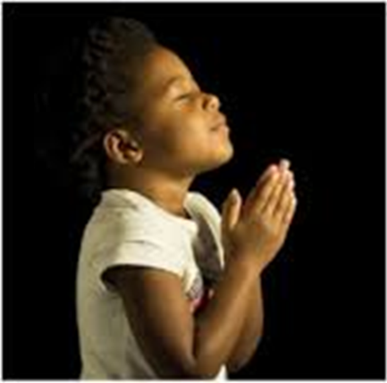
LET US PRAY….
Notes:
Photo by Yu Kato on Unsplash

