Slide 1

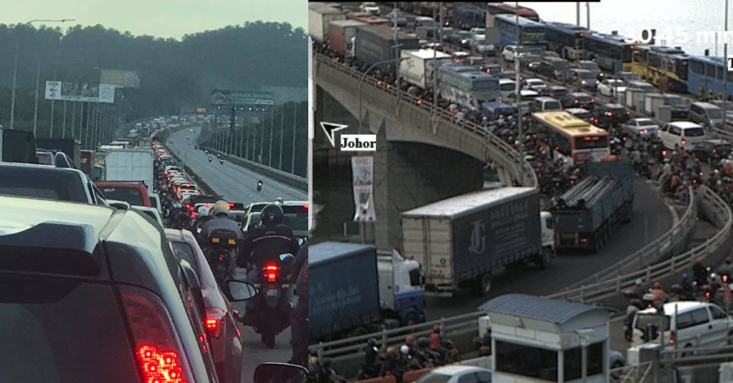




Slide 2



Slide 3


Slide 4
from MYSTERY
to MANIFEST
Ephesians 3:1-13
Notes:
Photo by Yu Kato on Unsplash

Slide 5


Slide 6
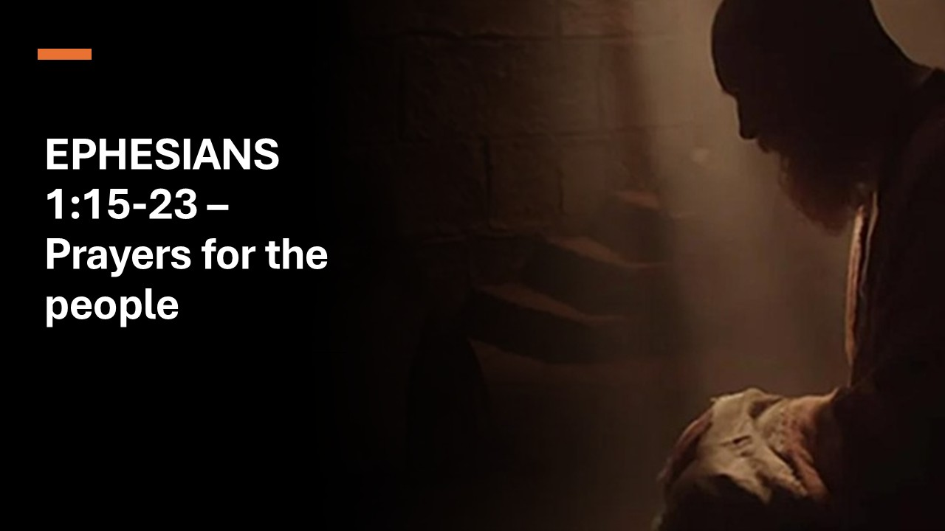

Slide 7


Slide 8
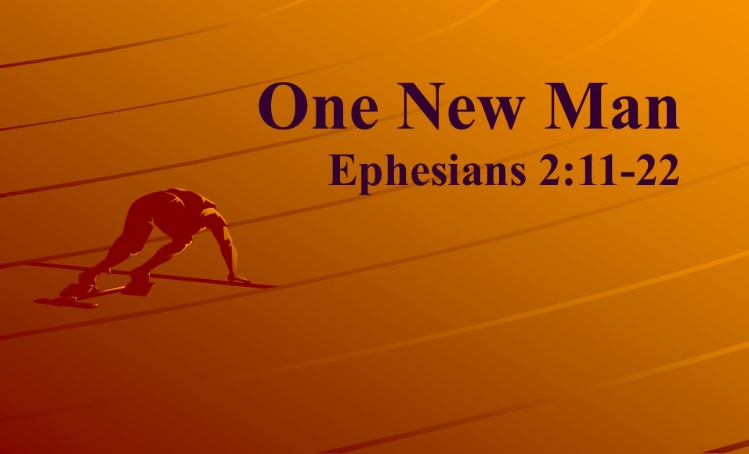

Slide 9
About SG60 What's On Initiatives Care & Share Partner Us SG60 Stories FAQ Media
Frequently Asked Questions
1. What is SG60?
SG60 is a nationwide effort to celebrate the next chapter of our nation-building journey. Over the past 60 years, Singapore has survived and prospered against the odds. Our diamond jubilee is an opportune time to reflect on our journey as a nation and rally Singaporeans to contribute to our shared future.
Following from the Forward SG exercise, this is also an opportunity for us to redefine our social compact by reaffirming the shared commitment Singaporeans have
to each other
and the nation,
and to build a stronger society that we are proud to call home.

Slide 10
Christian ‘mysteries’ are truths which, although beyond human discovery, have been revealed by God and so now belong openly to the whole church.
  Stott, J. R. W. (1979). (p. 116). InterVarsity Press. God’s new society: the message of Ephesians (p. 116).

Slide 11

God’s Plan
Gen 3:15 – He shall bruise your head,
and you shall bruise his heel.

Slide 12
God’s Plan
Gen 12:1–3 – In you all the families of the earth
shall be blessed.

Slide 13
God’s Plan
Isaiah 49:6 – I will make you as a light for the nations, that my salvation may reach to the end of the earth.

Slide 14
God’s Plan
Rev 7:9-10 – After this I looked, and behold, a great multitude that no one could count, from every tribe, tongue, and nation, . . . crying out with a loud voice, “Salvation belongs to our God who sits on the throne, and to the Lamb!”

Slide 15
Q: How do you begin to live out a purpose that was once hidden for ages, revealed through Christ, and now entrusted to the Church to display to the world?
From Mystery to Manifest
Ephesians 3:1-13

Slide 16
Entrusted with the Mystery (1–6)
  The call of Paul to the mystery (1-4)
  The plan of the mystery (5-6)
We don’t invent our purpose
—we humbly receive it from revelation.
From Mystery to Manifest
Ephesians 3:1-13

Slide 17
Ch 3 ¹ For this reason I, Paul, a prisoner of Christ Jesus on behalf of you Gentiles— ² assuming that you have heard of the stewardship of God's grace that was given to me for you, ³ how the mystery was made known to me by revelation, as I have written briefly. ⁴ When you read this, you can perceive my insight into the mystery of Christ,

Slide 18
Ch 3 ¹ For this reason I, Paul, a prisoner of Christ Jesus on behalf of you Gentiles— ² Surely you have heard about the administration of God’s grace that was given to me for you, ³ that is, the mystery made known to me by revelation, as I have already written briefly. ⁴ In reading this, then, you will be able to understand my insight into the mystery of Christ, ⁵ which was not made known to people in other generations as it has now been revealed by the Spirit to God’s holy apostles and prophets. ⁶ This mystery is that through the gospel the Gentiles are heirs together with Israel, members together of one body, and sharers together in the promise in Christ Jesus.
⁷ I became a servant of this gospel by the gift of God’s grace given me through the working of his power. ⁸ Although I am less than the least of all the Lord’s people, this grace was given me: to preach to the Gentiles the boundless riches of Christ, ⁹ and to make plain to everyone the administration of this mystery, which for ages past was kept hidden in God, who created all things. ¹⁰ His intent was that now, through the church, the manifold wisdom of God should be made known to the rulers and authorities in the heavenly realms, ¹¹ according to his eternal purpose that he accomplished in Christ Jesus our Lord. ¹² In him and through faith in him we may approach God with freedom and confidence. ¹³ I ask you, therefore, not to be discouraged because of my sufferings for you, which are your glory.

Slide 19
Ch 3 ¹ For this reason I, Paul, a prisoner of Christ Jesus on behalf of you Gentiles— ² Surely you have heard about the administration of God’s grace that was given to me for you, ³ that is, the mystery made known to me by revelation, as I have already written briefly. ⁴ In reading this, then, you will be able to understand my insight into the mystery of Christ, ⁵ which was not made known to people in other generations as it has now been revealed by the Spirit to God’s holy apostles and prophets. ⁶ This mystery is that through the gospel the Gentiles are heirs together with Israel, members together of one body, and sharers together in the promise in Christ Jesus.
⁷ I became a servant of this gospel by the gift of God’s grace given me through the working of his power. ⁸ Although I am less than the least of all the Lord’s people, this grace was given me: to preach to the Gentiles the boundless riches of Christ, ⁹ and to make plain to everyone the administration of this mystery, which for ages past was kept hidden in God, who created all things. ¹⁰ His intent was that now, through the church, the manifold wisdom of God should be made known to the rulers and authorities in the heavenly realms, ¹¹ according to his eternal purpose that he accomplished in Christ Jesus our Lord. ¹² In him and through faith in him we may approach God with freedom and confidence. ¹³ I ask you, therefore, not to be discouraged because of my sufferings for you, which are your glory.

Slide 20
Ch 3 ¹ For this reason I, Paul, a prisoner of Christ Jesus on behalf of you Gentiles— ² assuming that you have heard of the stewardship of God's grace that was given to me for you, ³ how the mystery was made known to me by revelation, as I have written briefly. ⁴ When you read this, you can perceive my insight into the mystery of Christ,
Paul was able to Speak — and Write —
with Authority
Because he Lived with Humility.

Slide 21


Slide 22
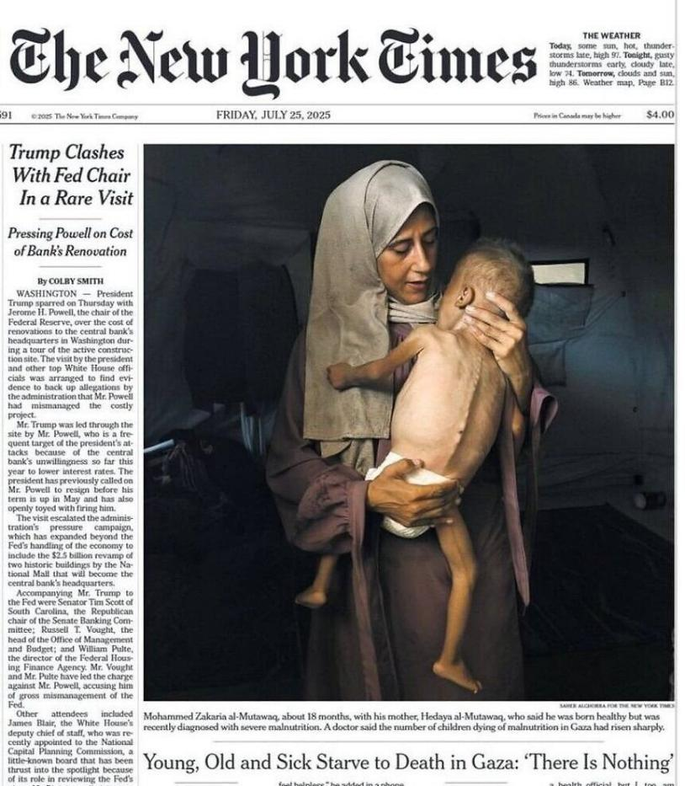
Authority
NY Times
BBC
CNN

Slide 23
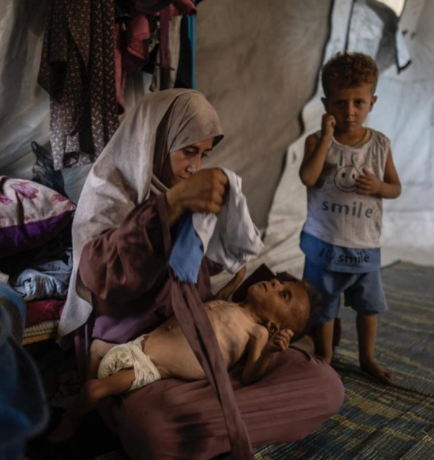
Authority?
Independent news media
Telegram

Slide 24
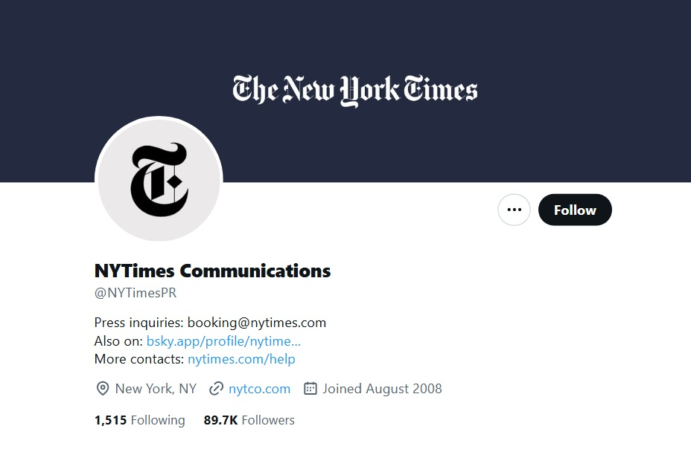

Slide 25
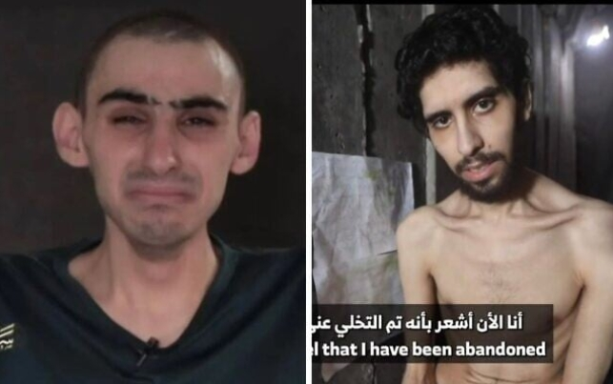
Rom Braslavski and Evyatar David
Images not published in NYT, BBC, etc

Slide 26
Paul was able to
Speak — and Write — with Authority
Because he Lived with Humility.
The Early Church Fathers were able to
Speak — and Write — with Authority
Because they Died with Humility.
Peter: Crucified upside down in Rome (c. AD 64–67)
Andrew: Crucified on an X-shaped cross in Patras, Greece
James (son of Zebedee): Beheaded in Jerusalem (c. AD 44)
Philip: Crucified or stoned in Hierapolis (c. AD 80)
Bartholomew (Nathanael): Flayed alive and/or beheaded in Armenia
Matthew (Levi): Stabbed to death in Ethiopia or Persia
Thomas (Didymus): Speared to death in India (c. AD 72)
James (son of Alphaeus): Stoned and clubbed to death in Jerusalem
Thaddaeus (Jude): Killed with an axe or club in Syria or Persia
Simon the Zealot: Sawn in half or crucified in Persia
Matthias: Stoned and beheaded in Jerusalem
Paul: Beheaded in Rome (c. AD 64–67)
John (son of Zebedee): Died of old age in Ephesus (c. AD 98)

Slide 27
Entrusted with the Mystery (1–6)
  The call of Paul to the mystery (1-4)
        Paul was able to Speak — and Write — with Authority, because he Lived with Humility.
  The plan of the mystery (5-6)
From Mystery to Manifest
Ephesians 3:1-13

Slide 28
⁵ which was not made known to the sons of men in other generations as it has now been revealed to his holy apostles and prophets by the Spirit.

Slide 29
⁵ which was not made known to the sons of men in other generations as it has now been revealed to his holy apostles and prophets by the Spirit.
Galatians 4:4-5 ⁴ But when the fullness of time had come, God sent forth his Son, born of woman, born under the law, ⁵ to redeem those who were under the law, so that we might receive adoption as sons.

Slide 30






Prophecy
New Heavens & New Earth
Christ’s
Second
Coming to
Reign in
Millennium
Christ’s
First
Coming
to Suffer
Exile & Return
Isaiah’s Own Time
Adapted significantly from Salem Kirban, Charts on Revelation (1979), 49

Slide 31
⁵ which was not made known to the sons of men in other generations as it has now been revealed to his holy apostles and prophets by the Spirit.
Paul and the other Early Church Fathers’ Authority
equals Old Testament Law and Prophets’ Authority

Slide 32

www.gotquestions.org
The New Apostolic Reformation, or NAR, is an unbiblical religious movement that emphasizes
experience over Scripture,
mysticism over doctrine,
and modern-day “apostles” over the plain text of the Bible.
The New Apostolic Reformation
What about authority of the Got Questions website?
Noted biased towards Calvinism and Reformed theology
Bias based on literal reading of the Bible

Slide 33
⁵ which was not made known to the sons of men in other generations as it has now been revealed to his holy apostles and prophets by the Spirit. ⁶ This mystery is that the Gentiles are fellow heirs, members of the same body, and partakers of the promise in Christ Jesus through the gospel.
The gospel was Veiled — or Hidden
— until God Chose to Reveal it.

Slide 34
⁶ This mystery is that the Gentiles
                are fellow heirs,
                members of the same body,
                and partakers of the promise in Christ Jesus through the gospel.

Slide 35
⁶ This mystery is that the Gentiles
                are fellow heirs,
                members of the same body,
                and partakers of the promise in Christ Jesus through the gospel.
NOT THE REVEALED MYSTERY

Slide 36
⁶ This mystery is that the Gentiles
                are fellow heirs,
                members of the same body,
                and partakers of the promise in Christ Jesus through the gospel.
THE REVEALED MYSTERY

Slide 37
Truth: The Gospel was God’s eternal plan and includes people of every background.
Implication: You are not
an afterthought in God’s story
—you are a recipient of the mystery.

Slide 38
Entrusted with the Mystery (1–6)
  The call of Paul to the mystery (1-4)
  The plan of the mystery (5-6)
Empowered for the Mission (7–9)
  The preaching of the mystery (7-9)
From Mystery to Manifest
Ephesians 3:1-13

Slide 39
Q: How do you begin to live out a purpose that was once hidden for ages, revealed through Christ, and now entrusted to the Church to display to the world?
From Mystery to Manifest
Ephesians 3:1-13

Slide 40
Entrusted with the Mystery (1–6)
  The call of Paul to the mystery (1-4)
  The plan of the mystery (5-6)
Empowered for the Mission (7–9)
  The preaching of the mystery (7-9)
We serve faithfully and with boldness because grace equips us.
From Mystery to Manifest
Ephesians 3:1-13

Slide 41
⁵ which was not made known to the sons of men in other generations as it has now been revealed to his holy apostles and prophets by the Spirit. ⁶ This mystery is that the Gentiles are fellow heirs, members of the same body, and partakers of the promise in Christ Jesus through the gospel.

Slide 42
⁷ Of this gospel I was made a minister according to the gift of God's grace, which was given me by the working of his power. ⁸ To me, though I am the very least of all the saints, this grace was given, to preach to the Gentiles the unsearchable riches of Christ, ⁹ and to bring to light for everyone what is the plan of the mystery hidden for ages in God, who created all things,

Slide 43
⁷ Of this gospel I was made a minister according to the gift of God's grace, which was given me by the working of his power. ⁸ To me, though I am the very least of all the saints, this grace was given, to preach to the Gentiles the unsearchable riches of Christ, ⁹ and to bring to light for everyone what is the plan of the mystery hidden for ages in God, who created all things,

Slide 44
⁷ Of this gospel I was made a minister according to the gift of God's grace, which was given me by the working of his power. ⁸ To me, though I am the very least of all the saints, this grace was given, to preach to the Gentiles the unsearchable riches of Christ, ⁹ and to bring to light for everyone what is the plan of the mystery hidden for ages in God, who created all things,

Slide 45
⁷ Of this gospel I was made a minister according to the gift of God's grace, which was given me by the working of his power. ⁸ To me, though I am the very least of all the saints, this grace was given, to preach to the Gentiles the unsearchable riches of Christ, ⁹ and to bring to light for everyone what is the plan of the mystery hidden for ages in God, who created all things,
Paul was Empowered by Grace
to Proclaim the Mystery

Slide 46
⁷ Of this gospel I was made a minister according to the gift of God's grace, which was given me by the working of his power. ⁸ To me, though I am the very least of all the saints, this grace was given, to preach to the Gentiles the unsearchable riches of Christ, ⁹ and to bring to light for everyone what is the plan of the mystery hidden for ages in God, who created all things,

Slide 47
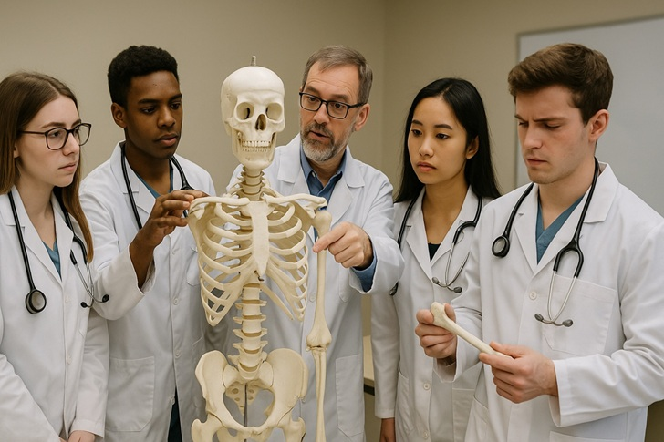

Slide 48
Entrusted with the Mystery (1–6)
  The call of Paul to the mystery (1-4)
  The plan of the mystery (5-6)
Empowered for the Mission (7–9)
  The preaching of the mystery (7-9)
        Paul was Empowered by Grace
        to Proclaim the Mystery.
From Mystery to Manifest
Ephesians 3:1-13

Slide 49
Truth: God uses weak people to
reveal an eternal purpose.
Implication: You
don’t have to be impressive
—just faithful to make the mystery visible.

Slide 50
Entrusted with the Mystery (1–6)
  The call of Paul to the mystery (1-4)
  The plan of the mystery (5-6)
Empowered for the Mission (7–9)
  The preaching of the mystery (7-9)
Established for Display (10–13)
  The purpose of the mystery (10-11)
  The privilege of the mystery (12-13)
From Mystery to Manifest
Ephesians 3:1-13

Slide 51
¹⁰ so that through the church the manifold wisdom of God might now be made known to the rulers and authorities in the heavenly places.
    AMP: multifaceted wisdom of God
    [in all its countless aspects]
    NLT: wisdom in its rich variety

Slide 52
¹⁰ so that through the church the manifold wisdom of God might now be made known to the rulers and authorities in the heavenly places.
1. much variegated, marked with a great variety of colours
a. of cloth or a painting
2. much varied, manifold

Slide 53
¹⁰ so that through the church the manifold wisdom of God might now be made known to the rulers and authorities in the heavenly places.
The Greek word translated “manifold” here was often used in the first century to describe the intricately embroidered patterns found on cloaks worn by the wealthy.
Divine wisdom is incredibly rich, even colorful, similar to the patterns found on these cloaks. Yet God’s glory is even richer, and evidencing it to other creatures displays His magnificence more fully.

Slide 54
¹⁰ so that through the church the manifold wisdom of God might now be made known to the rulers and authorities in the heavenly places.

Slide 55
⁷ So God can point to us in all future ages as examples of the incredible wealth
of his grace and kindness toward us, as shown in all he has done for us who are united with Christ Jesus. . . .
¹⁰ For we are his workmanship
Eph 2: 7, 10
NIV: handiwork
NLT: masterpiece

Slide 56
¹⁰ so that through the church the manifold wisdom of God might now be made known to the rulers and authorities in the heavenly places. ¹¹ This was according to the eternal purpose that he has realized in Christ Jesus our Lord,
The Church was Established
to Display God’s Wisdom

Slide 57
¹⁰ so that through the church the manifold wisdom of God might now be made known to the rulers and authorities in the heavenly places. ¹¹ This was according to the eternal purpose that he has realized in Christ Jesus our Lord, ¹² in whom we have boldness and access with confidence through our faith in him. ¹³ So I ask you not to lose heart over what I am suffering for you, which is your glory.
In Christ, We Have Bold
and Confident Access to God

Slide 58
Truth: Our unity, confidence, and perseverance are part of
God’s cosmic display
of His wisdom.
Implication: Don’t
lose heart—your role
matters in heaven’s story.

Slide 59
Q: How do you begin to live out a purpose that was once hidden for ages, revealed through Christ, and now entrusted to the Church to display to the world?
A: We live out God’s revealed purpose by receiving it humbly, serving it faithfully, and displaying it boldly through the Church
displaying it boldly

Slide 60
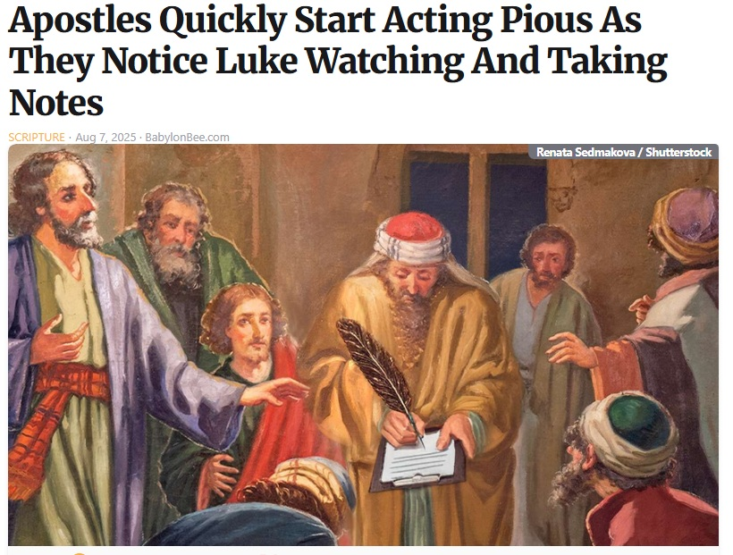
displaying it boldly

Slide 61
Matthew 23:1-5 (NLT)
¹ Then Jesus said to the crowds and to his disciples, ² “The teachers of religious law and the Pharisees are the official interpreters of the law of Moses. ³ So practice and obey whatever they tell you, but don’t
displaying it boldly

Slide 62
Matthew 23:1-5 (NLT)
¹ Then Jesus said to the crowds and to his disciples, ² “The teachers of religious law and the Pharisees are the official interpreters of the law of Moses. ³ So practice and obey whatever they tell you, but don’t follow their example. For they don’t practice what they teach. ⁴ They crush people with unbearable religious demands and never lift a finger to ease the burden. ⁵ “Everything they do is for show
displaying it boldly

Slide 63
displaying it boldly
“Bold display” is not about being louder
it’s about living truer.
in words, in love, in endurance,
in sacrifice, in community.

Slide 64
Speak the Gospel Clearly, Even When Unpopular
Share the truth of Christ with love and clarity, even if it challenges cultural norms or personal comfort.
Example: Initiating spiritual conversations at work, in your neighborhood, or with friends—not just when it’s “safe.”

Slide 65
Live in Unifying Love Across Boundaries
The “mystery” revealed in Ephesians includes Jew and Gentile together—bold display means intentionally crossing divides (ethnic, cultural, social, political) in visible fellowship.
Example: Show hospitality to people different from you, joining in service with believers from other backgrounds.

Slide 66
Demonstrate Grace in the Face of Opposition
Boldness is not aggression—it’s staying gracious and joyful under pressure.
Example: Responding with kindness when your faith is mocked or misunderstood.

Slide 67
Prioritize God’s Mission Over Personal Comfort
Paul’s chains in this passage didn’t silence him—they amplified the message.
Example: Choosing ministry, generosity, or service that costs you time, energy, or status.

Slide 68
Showcase God’s Wisdom Through the Church’s Life
Boldness is not just personal; it’s communal—the Church together displays God’s wisdom to the “rulers and authorities” (v. 10).
Example: Participating actively in church life so the world sees unity, mercy, and joy in action.
Participate in church activities (picnics, group studies, church retreat)
Join (or start) a small group
Invite friends and family to church and church events

Slide 69
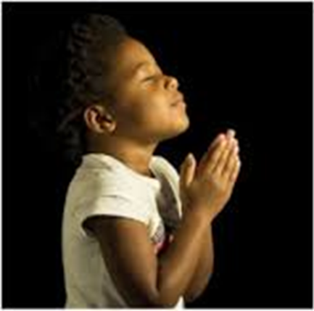
LET US PRAY….

