Slide 1
Ephesians
Inconceivable Blessings, Incredible Purpose.

Slide 2


Slide 3
¹¹ Therefore, remember that formerly you who are Gentiles by birth and called ‘uncircumcised’ by those who call themselves ‘the circumcision’ (which is done in the body by human hands) – ¹² remember that at that time you were separate from Christ, excluded from citizenship in Israel and foreigners to the covenants of the promise, without hope and without God in the world. ¹³ But now in Christ Jesus you who once were far away have been brought near by the blood of Christ.
¹⁴ For he himself is our peace, who has made the two groups one and has destroyed the barrier, the dividing wall of hostility, ¹⁵ by setting aside in his flesh the law with its commands and regulations. His purpose was to create in himself one new man out of the two, thus making peace, ¹⁶ and in one body to reconcile both of them to God through the cross, by which he put to death their hostility.

Slide 4
¹⁷ He came and preached peace to you who were far away and peace to those who were near.¹⁸ For through him we both have access to the Father by one Spirit.
¹⁹ Consequently, you are no longer foreigners and strangers, but fellow citizens with God’s people and also members of his household, ²⁰ built on the foundation of the apostles and prophets, with Christ Jesus himself as the chief cornerstone. ²¹ In him the whole building is joined together and rises to become a holy temple in the Lord. ²² And in him you too are being built together to become a dwelling in which God lives by his Spirit.

Slide 5
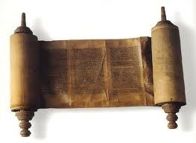
Ephesians – One New Man
Ephesians 2:1-10 is about the vertical relationship between people and God – saved by grace.
Ephesians 2:11-22 is about horizontal relationship between peoples – reconciled through Christ.

Slide 6

John Stott
“The grand theme of Ephesians 2 is that Jesus Christ has destroyed both enmities.”
John R. W. Stott, The Message of Ephesians, Leicester: Inter-varsity Press, 1979. page 92.

Slide 7
John 17:21
I pray that all of them may be one, Father, just as you are in me and I am in you.

Slide 8
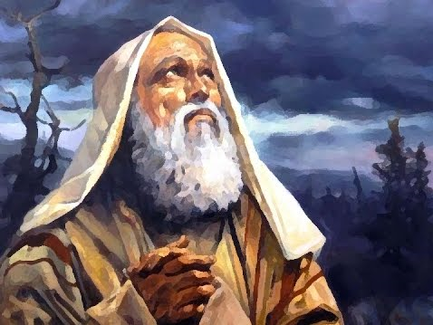

Slide 9
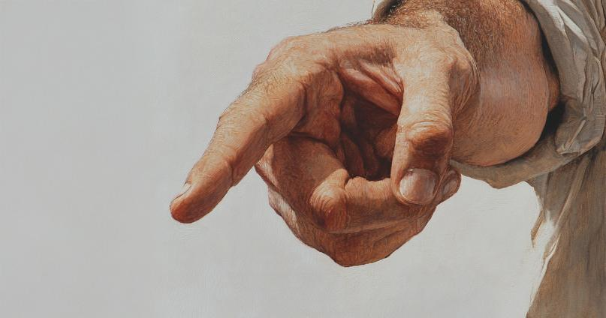
How odd of God
To choose the Jews.
(William Norman Ewer)

Slide 10
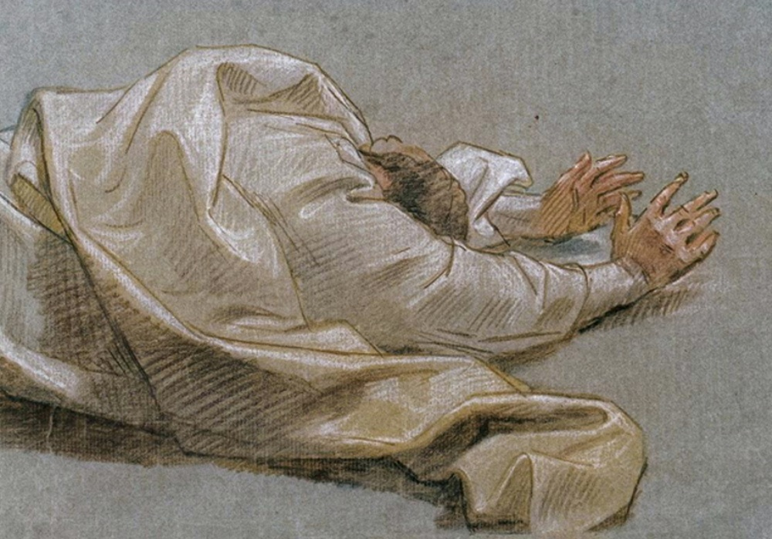
How odd of God
To choose the Jews.
But odder still are those who choose
The Jewish God, but hate the Jews.
(Leo Rosten)

Slide 11
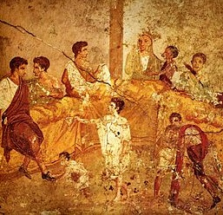
Ephesians – One New Man
Jews vs Gentiles

Slide 12
¹¹ Therefore, remember that formerly you who are Gentiles by birth and called ‘uncircumcised’ by those who call themselves ‘the circumcision’ (which is done in the body by human hands) – ¹² remember that at that time you were separate from Christ, excluded from citizenship in Israel and foreigners to the covenants of the promise, without hope and without God in the world. ¹³ But now in Christ Jesus you who once were far away have been brought near by the blood of Christ.

Slide 13
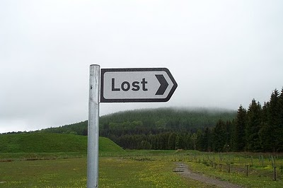
Ephesians – One New Man
5 things that were once true of all Gentiles (vs 12)
1) separate from Christ
2) non-citizens of Israel
3) foreigners to the covenants of the promise
4) without hope and
5) without God.

Slide 14
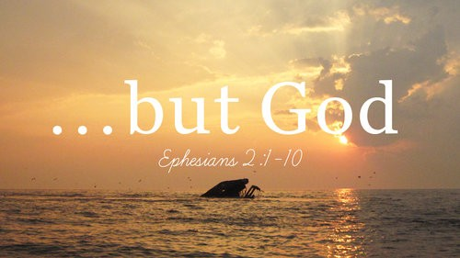
Ephesians – One New Man
Vs 13 – ‘But now…’ (cf vs 4 – ‘But God’)

Slide 15
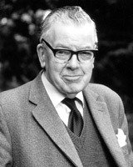
F. F. Bruce
“Nothing is so apt to promote gratitude as a retrospective glance fixed on the whole of the pit from whence we have been dug.”

Slide 16
¹⁴ For he himself is our peace, who has made the two groups one and has destroyed the barrier, the dividing wall of hostility, ¹⁵ by setting aside in his flesh the law with its commands and regulations. His purpose was to create in himself one new man out of the two, thus making peace, ¹⁶ and in one body to reconcile both of them to God through the cross, by which he put to death their hostility.

Slide 17
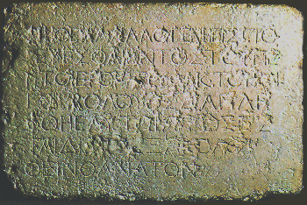

Slide 18
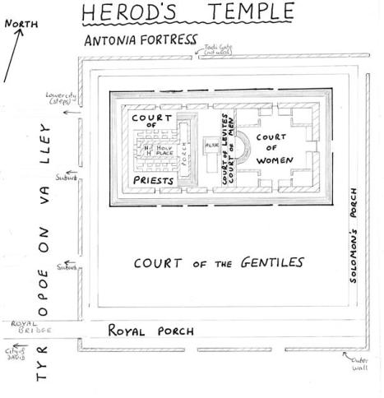

Slide 19
¹⁴ For he himself is our peace, who has made the two groups one and has destroyed the barrier, the dividing wall of hostility, ¹⁵ by setting aside in his flesh the law with its commands and regulations. His purpose was to create in himself one new man out of the two, thus making peace, ¹⁶ and in one body to reconcile both of them to God through the cross, by which he put to death their hostility.

Slide 20
¹⁷ He came and preached peace to you who were far away and peace to those who were near.¹⁸ For through him we both have access to the Father by one Spirit.
¹⁹ Consequently, you are no longer foreigners and strangers, but fellow citizens with God’s people and also members of his household, ²⁰ built on the foundation of the apostles and prophets, with Christ Jesus himself as the chief cornerstone.

Slide 21
John Stott
“The three stages are marked by the expressions ‘at one time’ (verse 11),
‘but now’ (verse 13) and ‘so then’ (verse 19.)”
John R. W. Stott, The Message of Ephesians, Leicester: Inter-varsity Press, 1979. page 94.

Slide 22
Ephesians – One New Man
Paul paints a picture of what we once were – an alienated humanity (vs 11-12),
what Christ has done to bring peace and end to our hostility (vs 13-18) and finally,
a picture of God’s new society, what we have become (vs 19-22).

Slide 23
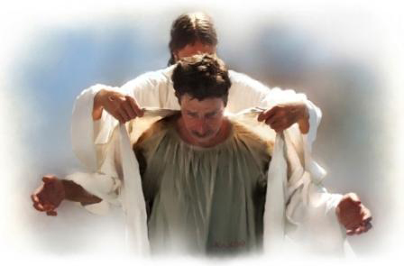
Ephesians – One New Man
2 Greek word for ‘new’ in one new man (vs 15):
καινός – ‘Kainos’ lit. new of a kind.
A new thing altogether.

Slide 24
¹⁸ For through him (Jesus) we both have access to the Father by one Spirit.

Slide 25
¹⁹ Consequently, you are no longer foreigners and strangers, but fellow citizens with God’s people and also members of his household, ²⁰ built on the foundation of the apostles and prophets, with Christ Jesus himself as the chief cornerstone. ²¹ In him the whole building is joined together and rises to become a holy temple in the Lord. ²² And in him you too are being built together to become a dwelling in which God lives by his Spirit.

Slide 26



Slide 27


Slide 28
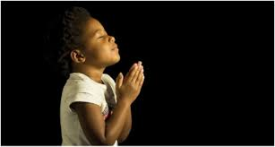
LET US PRAY….

