Slide 1


Slide 2


Slide 3


Slide 4
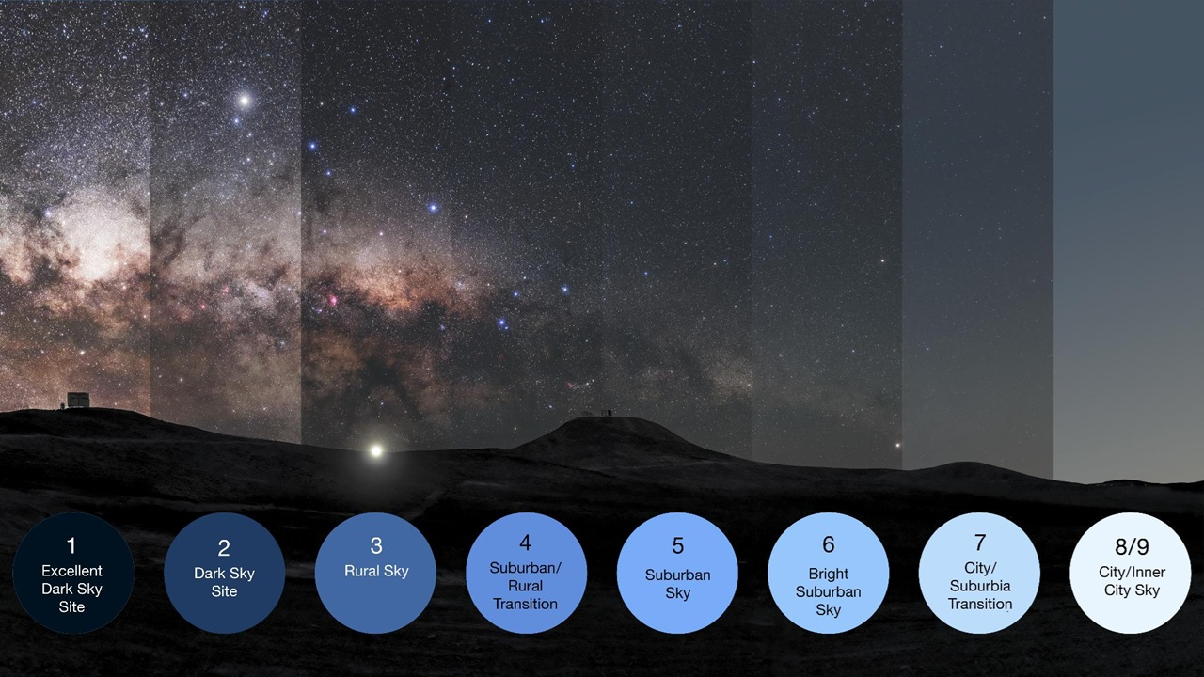
Notes:
https://en.wikipedia.org/wiki/Bortle_scale

Slide 5

Unfathomable Grace
Eph 2:1-10

Slide 6
How do you begin to grasp a salvation that
meets you at your worst,
changes you forever, and
showcases God’s kindness for eternity!
?

Slide 7
GRACE
meets you at your worst,
changes you forever, and
showcases God’s kindness for eternity!

Slide 8
Ephesians
Inconceivable Blessings, Incredible Purpose.

Slide 9


Paul Argues Against
Transactional Christianity
A belief system where One's relationship with God is viewed as a transaction, with an expectation of receiving blessings or favors in return for specific actions or adherence to religious practices

Slide 10
Ch 2 ¹ And you were dead in the trespasses and sins ² in which you once walked, following the course of this world, following the prince of the power of the air, the spirit that is now at work in the sons of disobedience— ³ among whom we all once lived in the passions of our flesh, carrying out the desires of the body and the mind, and were by nature children of wrath, like the rest of mankind.
⁴ But God, being rich in mercy, because of the great love with which he loved us, ⁵ even when we were dead in our trespasses, made us alive together with Christ—by grace you have been saved— ⁶ and raised us up with him and seated us with him in the heavenly places in Christ Jesus, ⁷ so that in the coming ages he might show the immeasurable riches of his grace in kindness toward us in Christ Jesus. ⁸ For by grace you have been saved through faith. And this is not your own doing; it is the gift of God, ⁹ not a result of works, so that no one may boast. ¹⁰ For we are his workmanship, created in Christ Jesus for good works, which God prepared beforehand, that we should walk in them.

Slide 11
Ch 2 ¹ And you were dead in the trespasses and sins ² in which you once walked, following the course of this world, following the prince of the power of the air, the spirit that is now at work in the sons of disobedience— ³ among whom we all once lived in the passions of our flesh, carrying out the desires of the body and the mind, and were by nature children of wrath, like the rest of mankind.
⁴ But God, being rich in mercy, because of the great love with which he loved us, ⁵ even when we were dead in our trespasses, made us alive together with Christ—by grace you have been saved— ⁶ and raised us up with him and seated us with him in the heavenly places in Christ Jesus,
⁷ so that in the coming ages he might show the immeasurable riches of his grace in kindness toward us in Christ Jesus. ⁸ For by grace you have been saved through faith. And this is not your own doing; it is the gift of God, ⁹ not a result of works, so that no one may boast. ¹⁰ For we are his workmanship, created in Christ Jesus for good works, which God prepared beforehand, that we should walk in them.
meets you at your worst
GRACE
changes you forever
showcases God’s kindness for eternity!

Slide 12
Ch 2 ¹ And you were dead in the trespasses and sins ² in which you once walked, following the course of this world, following the prince of the power of the air, the spirit that is now at work in the sons of disobedience— ³ among whom we all once lived in the passions of our flesh, carrying out the desires of the body and the mind, and were by nature children of wrath, like the rest of mankind.
⁴ But God, being rich in mercy, because of the great love with which he loved us, ⁵ even when we were dead in our trespasses, made us alive together with Christ—by grace you have been saved— ⁶ and raised us up with him and seated us with him in the heavenly places in Christ Jesus,
⁷ so that in the coming ages he might show the immeasurable riches of his grace in kindness toward us in Christ Jesus. ⁸ For by grace you have been saved through faith. And this is not your own doing; it is the gift of God, ⁹ not a result of works, so that no one may boast. ¹⁰ For we are his workmanship, created in Christ Jesus for good works, which God prepared beforehand, that we should walk in them.
Ruined by Sin
Ruined by Sin
Rescued by Mercy
Repurposed for Glory

Slide 13
Eph 2:1-10 -- Unfathomable Grace
1. Ruined by Sin (1-3)
• Grace Finds Us at Our Worst (1–3)
Ruined by Sin

Slide 14
¹ And you were dead in the trespasses and sins ² in which you once walked, following the course of this world, following the prince of the power of the air, the spirit that is now at work in the sons of disobedience— ³ among whom we all once lived in the passions of our flesh, carrying out the desires of the body and the mind, and were by nature children of wrath, like the rest of mankind.

Slide 15
¹ And you were dead in the trespasses and sins
Trespasses: missing the mark
Sins: slipping or falling from the way

Slide 16
¹ And you were dead in the trespasses and sins ² in which you once walked,
following the course of this world,
following the prince of the power of the air
Who is the prince of the power of the air
How is the course of the world different than the course we are called to?

Slide 17
¹ And you were dead in the trespasses and sins ² in which you once walked,
following the course of this world,
following the prince of the power of the air
    the spirit that is now at work in the sons of disobedience—
NLT: those who refuse to obey God.

Slide 18
¹ And you were dead in the trespasses and sins ² in which you once walked,
following the course of this world,
following the prince of the power of the air,
    the spirit that is now at work in the sons of disobedience—
³ among whom we all once lived in the passions of our flesh, carrying out the desires of the body and the mind, and were by nature children of wrath, like the rest of mankind.

Slide 19
¹ And you were dead in the trespasses and sins ² in which you once walked,
following the course of this world,
following the prince of the power of the air,
    the spirit that is now at work in the sons of disobedience—
³ among whom we all once lived in the passions of our flesh, carrying out the desires of the body and the mind,

Slide 20
¹ And you were dead in the trespasses and sins ² in which you once walked,
following the course of this world,
following the prince of the power of the air,
    the spirit that is now at work in the sons of disobedience—
³ among whom we all once lived in the passions of our flesh, carrying out the desires of the body and the mind, => and were by nature children of wrath, like the rest of mankind.
subject to God’s
anger

Slide 21
Are we sinful and deserving of death from the day we are born?
Age of Accountability (2 Sam 12:23 & Matt 19:14)
Romans 7:9-10
⁹ I was once alive apart from the law, but when the commandment came, sin came alive and I died. ¹⁰ The very commandment that promised life proved to be death to me.

Slide 22
¹ And you were dead in the trespasses and sins ² in which you once walked,
following the course of this world,
following the prince of the power of the air,
    the spirit that is now at work in the sons of disobedience—
³ among whom we all once lived in the passions of our flesh, carrying out the desires of the body and the mind, => and were by nature children of wrath, like the rest of mankind.
Where is Grace?
• Grace Finds Us at Our Worst

Slide 23
¹ And you were dead in the trespasses and sins ² in which you once walked,
following the course of this world,
following the prince of the power of the air,
the spirit that is now at work in the sons of disobedience—
³ among whom we all once lived in the passions of our flesh, carrying out the desires of the body and the mind, => and were by nature children of wrath, like the rest of mankind.
All these are past tense!

Slide 24
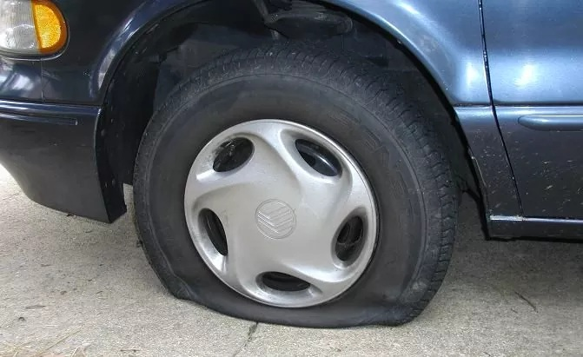
Cause (Root Condition) | Effects (Visible Outcomes)
Flat Tire
Unresponsive Steering
Thump-Thump-Thump sound

Slide 25
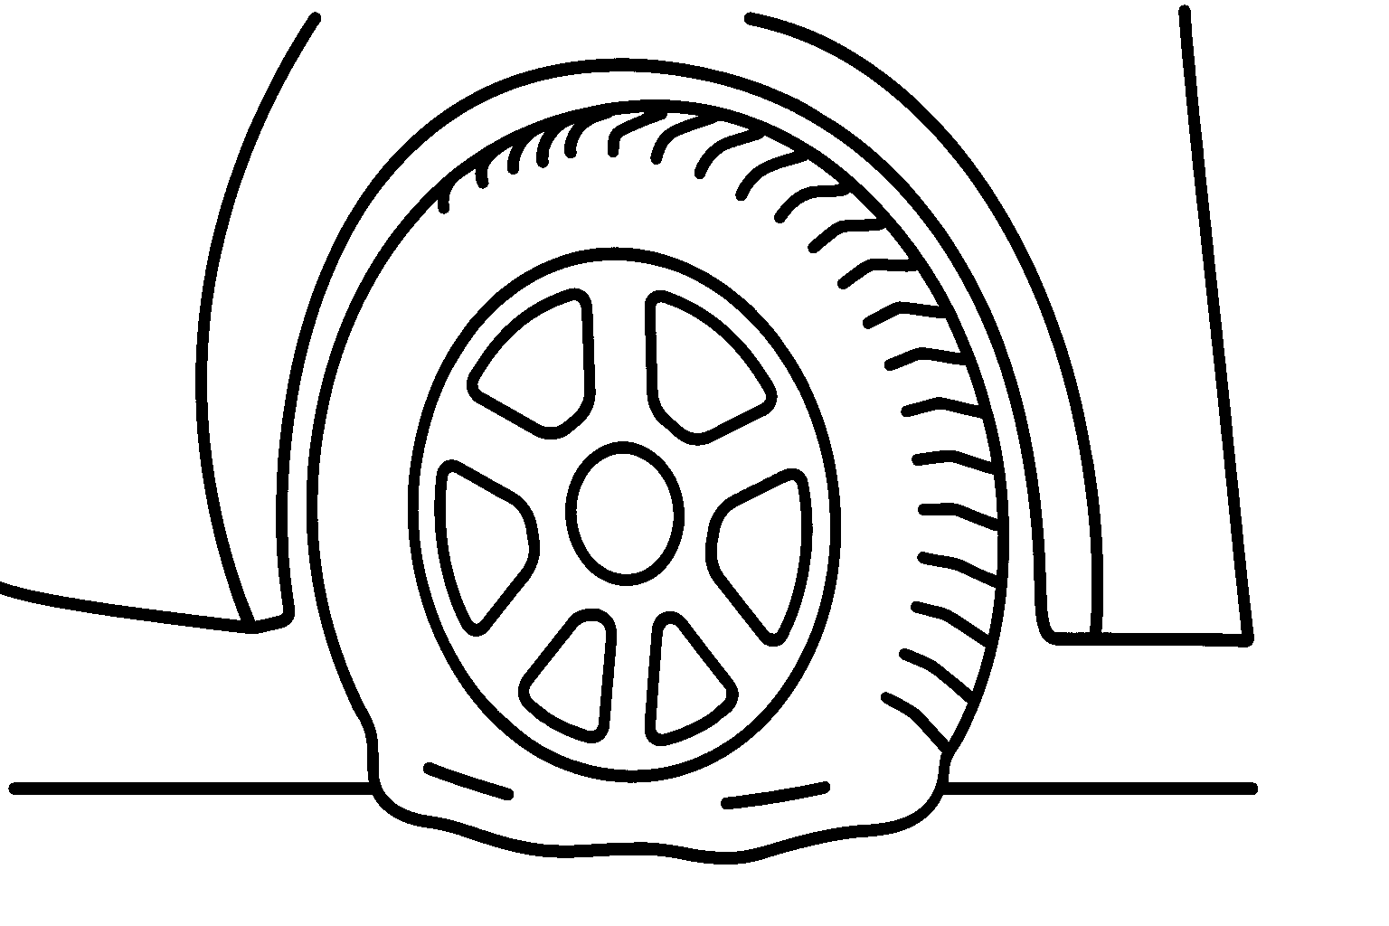
Cause (Root Condition) | Effects (Visible Outcomes)
Dead in Sin and Trespasses
Unresponsive Steering
Walking in lifestyle shaped by sin
Thump-thump-thump
Living under influence of the world,
The prince of the air
The passions of our flesh
A flat tire can easily be taken care of!

Slide 26
Unfathomable Grace was shown to us even when we were Ruined by Sin
Unfathomable Grace
Eph 2:1-10

Slide 27
Eph 2:1-10 -- Unfathomable Grace
1. Ruined by Sin (1-3)
• Grace Finds Us at Our Worst (1–3)
2. Rescued by Mercy (4-6)

Slide 28
⁴ But God, being rich in mercy, because of the great love with which he loved us, ⁵ even when we were dead in our trespasses, made us alive together with Christ—by grace you have been saved— ⁶ and raised us up with him and seated us with him in the heavenly places in Christ Jesus,
synezōopoiēsen
synēgeiren
synekathisen
- Christ's Resurrection
- Christ's Ascension
- Christ's Exaltation

Slide 29
⁴ But God, being rich in mercy, because of the great love with which he loved us, ⁵ even when we were dead in our trespasses, made us alive together with Christ—by grace you have been saved— ⁶ and raised us up with him and seated us with him in the heavenly places in Christ Jesus,
Jesus replaces your flat tire with a new one
Jesus doesn’t stop at one tire—He replaces all four.
He upgrades your wheels to never-flats—tires that never fail.

Slide 30
Eph 2:1-10 -- Unfathomable Grace
1. Ruined by Sin (1-3)
• Grace Finds Us at Our Worst (1–3)
2. Rescued by Mercy (4-6)
  • Grace Flows from God’s Character, Not Our Worth (4)
  • Grace Makes Us Alive in Christ (5–6)

Slide 31
⁴ But God, being rich in mercy, because of the great love with which he loved us, ⁵ even when we were dead in our trespasses, made us alive together with Christ—by grace you have been saved— ⁶ and raised us up with him and seated us with him in the heavenly places in Christ Jesus,
• Grace Flows from God’s Character, Not Our Worth

Slide 32
⁴ But God, being rich in mercy, because of the great love with which he loved us, ⁵ even when we were dead in our trespasses, made us alive together with Christ—by grace you have been saved— ⁶ and raised us up with him and seated us with him in the heavenly places in Christ Jesus,
• Grace Makes Us Alive in Christ

Slide 33
Eph 2:1-10 -- Unfathomable Grace
1. Ruined by Sin (1-3)
• Grace Finds Us at Our Worst (1–3)
2. Rescued by Mercy (4-6)
  • Grace Flows from God’s Character, Not Our Worth (4)
  • Grace Makes Us Alive in Christ (5–6)
3. Repurposed for Glory (7-10)

Slide 34
⁷ so that in the coming ages he might show the immeasurable riches of his grace in kindness toward us in Christ Jesus. ⁸ For by grace you have been saved through faith. And this is not your own doing; it is the gift of God, ⁹ not a result of works, so that no one may boast. ¹⁰ For we are his workmanship, created in Christ Jesus for good works, which God prepared beforehand, that we should walk in them.

Slide 35
Ch 2 ¹ And you were dead in the trespasses and sins ² in which you once walked, following the course of this world, following the prince of the power of the air, the spirit that is now at work in the sons of disobedience— ³ among whom we all once lived in the passions of our flesh, carrying out the desires of the body and the mind, and were by nature children of wrath, like the rest of mankind.
⁴ But God, being rich in mercy, because of the great love with which he loved us, ⁵ even when we were dead in our trespasses, made us alive together with Christ—by grace you have been saved— ⁶ and raised us up with him and seated us with him in the heavenly places in Christ Jesus,
⁷ so that in the coming ages he might show the immeasurable riches of his grace in kindness toward us in Christ Jesus. ⁸ For by grace you have been saved through faith. And this is not your own doing; it is the gift of God, ⁹ not a result of works, so that no one may boast. ¹⁰ For we are his workmanship, created in Christ Jesus for good works, which God prepared beforehand, that we should walk in them.

Slide 36
⁷ so that in the coming ages he might show the immeasurable riches of his grace in kindness toward us in Christ Jesus. ⁸ For by grace you have been saved through faith. And this is not your own doing; it is the gift of God, ⁹ not a result of works, so that no one may boast. ¹⁰ For we are his workmanship, created in Christ Jesus for good works, which God prepared beforehand, that we should walk in them.

Slide 37
⁷ so that in the coming ages he might show the immeasurable riches of his grace in kindness toward us in Christ Jesus.
(ESV)
⁷ So God can point to us in all future ages as examples of the incredible wealth of his grace and kindness toward us, as shown in all he has done for us who are united with Christ Jesus.
(NLT)

Slide 38
Eph 2:1-10 -- Unfathomable Grace
1. Ruined by Sin (1-3)
• Grace Finds Us at Our Worst (1–3)
2. Rescued by Mercy (4-6)
  • Grace Flows from God’s Character, Not Our Worth (4)
  • Grace Makes Us Alive in Christ (5–6)
3. Repurposed for Glory (7-10)
  • Grace Is a Demonstration of God’s Glory Forever (7)

Slide 39
⁷ so that in the coming ages he might show the immeasurable riches of his grace in kindness toward us in Christ Jesus. ⁸ For by grace you have been saved through faith. And this is not your own doing; it is the gift of God, ⁹ not a result of works, so that no one may boast. ¹⁰ For we are his workmanship, created in Christ Jesus for good works, which God prepared beforehand, that we should walk in them.

Slide 40
⁷ so that in the coming ages he might show the immeasurable riches of his grace in kindness toward us in Christ Jesus. ⁸ For by grace you have been saved through faith. And this is not your own doing; it is the gift of God, ⁹ not a result of works, so that no one may boast. ¹⁰ For we are his workmanship, created in Christ Jesus for good works, which God prepared beforehand, that we should walk in them.
NIV: handiwork
NLT: masterpiece

Slide 41
Eph 2:1-10 -- Unfathomable Grace
1. Ruined by Sin (1-3)
• Grace Finds Us at Our Worst (1–3)
2. Rescued by Mercy (4-6)
  • Grace Flows from God’s Character, Not Our Worth (4)
  • Grace Makes Us Alive in Christ (5–6)
3. Repurposed for Glory (7-10)
  • Grace Is a Demonstration of God’s Glory Forever (7)
  • Grace Is a Gift, Not a Reward (8–9)

Slide 42
⁷ so that in the coming ages he might show the immeasurable riches of his grace in kindness toward us in Christ Jesus. ⁸ For by grace you have been saved through faith. And this is not your own doing; it is the gift of God, ⁹ not a result of works, so that no one may boast. ¹⁰ For we are his workmanship, created in Christ Jesus for good works, which God prepared beforehand, that we should walk in them.
• Grace Is a Gift, Not a Reward

Slide 43
Ch 2 ¹ And you were dead in the trespasses and sins ² in which you once walked, following the course of this world, following the prince of the power of the air, the spirit that is now at work in the sons of disobedience— ³ among whom we all once lived in the passions of our flesh, carrying out the desires of the body and the mind, and were by nature children of wrath, like the rest of mankind.
⁴ But God, being rich in mercy, because of the great love with which he loved us, ⁵ even when we were dead in our trespasses, made us alive together with Christ—by grace you have been saved— ⁶ and raised us up with him and seated us with him in the heavenly places in Christ Jesus,
⁷ so that in the coming ages he might show the immeasurable riches of his grace in kindness toward us in Christ Jesus. ⁸ For by grace you have been saved through faith. And this is not your own doing; it is the gift of God, ⁹ not a result of works, so that no one may boast. ¹⁰ For we are his workmanship, created in Christ Jesus for good works, which God prepared beforehand, that we should walk in them.

Slide 44
⁸ For by grace you have been saved through faith. And this is not your own doing; it is the gift of God, ⁹ not a result of works, so that no one may boast.
(ESV)
⁸ God saved you by his grace when you believed. And you can’t take credit for this; it is a gift from God. ⁹ Salvation is not a reward for the good things we have done, so none of us can boast about it. (NLT)
• Grace Is a Gift, Not a Reward

Slide 45
Eph 2:1-10 -- Unfathomable Grace
1. Ruined by Sin (1-3)
• Grace Finds Us at Our Worst (1–3)
2. Rescued by Mercy (4-6)
  • Grace Flows from God’s Character, Not Our Worth (4)
  • Grace Makes Us Alive in Christ (5–6)
3. Repurposed for Glory (7-10)
  • Grace Is a Demonstration of God’s Glory Forever (7)
  • Grace Is a Gift, Not a Reward (8–9)
  • Grace Produces Good Works, Not Passive Faith (10)

Slide 46
⁷ so that in the coming ages he might show the immeasurable riches of his grace in kindness toward us in Christ Jesus. ⁸ For by grace you have been saved through faith. And this is not your own doing; it is the gift of God, ⁹ not a result of works, so that no one may boast. ¹⁰ For we are his workmanship, created in Christ Jesus for good works, which God prepared beforehand, that we should walk in them.

Slide 47
God Works as the Purpose and Result of Salvation
Ephesians 2:10 For we are his workmanship, created in Christ Jesus for good works, which God prepared beforehand, that we should walk in them.
Titus 2:14 ...who gave himself for us to redeem us from all lawlessness and to purify for himself a people for his own possession who are zealous for good works.
Hebrews 10:24 And let us consider how to stir up one another to love and good works.

Slide 48
God Works as the Purpose and Result of Salvation
Titus 3:8 The saying is trustworthy, and I want you to insist on these things, so that those who have believed in God may be careful to devote themselves to good works. These things are excellent and profitable for people.
Colossians 1:10 So as to walk in a manner worthy of the Lord, fully pleasing to him: bearing fruit in every good work and increasing in the knowledge of God.

Slide 49
Good Works as Evidence of True Faith
Acts 26:20 ...that they should repent and turn to God, performing deeds in keeping with their repentance.”
James 2:17 So also faith by itself, if it does not have works, is dead.”
James 2:26 For as the body apart from the spirit is dead, so also faith apart from works is dead.”

Slide 50
Good Works as a Witness to the World
Matthew 5:16 In the same way, let your light shine before others, so that they may see your good works and give glory to your Father who is in heaven.”
1 Peter 2:12 Keep your conduct among the Gentiles honorable, so that when they speak against you as evildoers, they may see your good deeds and glorify God on the day of visitation.

Slide 51
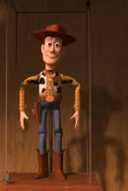
⁷ so that in the coming ages he might show the immeasurable riches of his grace in kindness
• Grace Is a Demonstration
of God’s Glory Forever

Slide 52
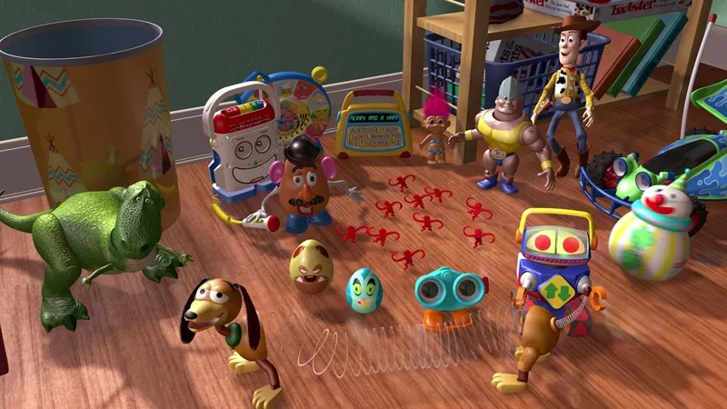
¹⁰ For we are his workmanship, created in Christ Jesus for good works, which God prepared beforehand, that we should walk in them.
• Grace Produces Good
Works, Not Passive Faith

Slide 53
Unfathomable Grace
Eph 2:1-10

Slide 54
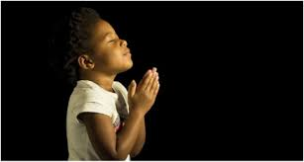
LET US PRAY….

