Slide 1
Inconceivable blessings, Incredible Purpose.

Slide 2
Inconceivable Blessings, Incredible Purpose.
Jew-Gentile Unity Shown in Love
Love as Equals |  |  |  | Love as Testimony
Chapters 1–3 |  |  |  | Chapters 4–6
Doctrine |  |  |  | Application
Position |  |  |  | Practice
Belief |  |  |  | Behaviour
Privileges |  |  |  | Responsibilities
Salutation | Position | Reconcil-iation | Unique-ness | Unity | Holiness | Submission | Reliance | Love
1:1-2 | 1:3-23 | 2 | 3 | 4:1-16 | 4:17–5:20 | 5:21–6:9 | 6:10-20 | 6:21-24

Slide 3
¹⁵ For this reason, ever since I heard about your faith in the Lord Jesus and your love for all God’s people, ¹⁶ I have not stopped giving thanks for you, remembering you in my prayers. ¹⁷ I keep asking that the God of our Lord Jesus Christ, the glorious Father, may give you the Spirit of wisdom and revelation, so that you may know him better. ¹⁸ I pray that the eyes of your heart may be enlightened in order that you may know the hope to which he has called you, the riches of his glorious inheritance in his holy people, ¹⁹ and his incomparably great power for us who believe. That power is the same as the mighty strength ²⁰ he exerted when he raised Christ from the dead and seated him at his right hand in the heavenly realms, ²¹ far above all rule and authority, power and dominion, and every name that is invoked, not only in the present age but also in the one to come. ²² And God placed all things under his feet and appointed him to be head over everything for the church, ²³ which is his body, the fullness of him who fills everything in every way.

Slide 4
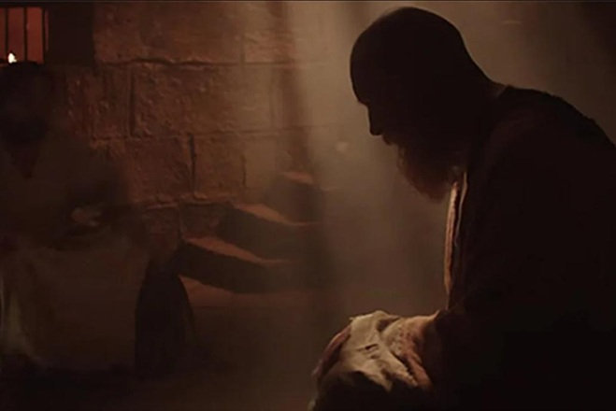
EPHESIANS 1:15-23 – Prayers for the people
The Great Benediction (vs 3-14) is followed by a Great Intercession (vs 15-23).

Slide 5
EPHESIANS 1:15-23 – Prayers for the people

Slide 6
EPHESIANS 1:15-23 – Prayers for the people
What drove Paul to pray here was not a particular problem; instead, it was his vision of the greatness of God.
Vs 15–16 – “Since I heard about your faith… and love…”, I gave both thanks, and lifted you up in my prayers.

Slide 7
¹⁵ For this reason, ever since I heard about your faith in the Lord Jesus and your love for all God’s people, ¹⁶ I have not stopped giving thanks for you, remembering you in my prayers. ¹⁷ I keep asking that the God of our Lord Jesus Christ, the glorious Father, may give you the Spirit of wisdom and revelation, so that you may know him better. ¹⁸ I pray that the eyes of your heart may be enlightened in order that you may know the hope to which he has called you, the riches of his glorious inheritance in his holy people, ¹⁹ and his incomparably great power for us who believe. That power is the same as the mighty strength ²⁰ he exerted when he raised Christ from the dead and seated him at his right hand in the heavenly realms, ²¹ far above all rule and authority, power and dominion, and every name that is invoked, not only in the present age but also in the one to come. ²² And God placed all things under his feet and appointed him to be head over everything for the church, ²³ which is his body, the fullness of him who fills everything in every way.

Slide 8
TIM KELLER
It is remarkable that in all of his writings Paul's prayers for his friends contain no appeals for changes in their circumstances.
Timothy Keller, Prayer, Westminster:Penguin, 2016, page 20.

Slide 9
EPHESIANS 1:15-23 – Prayers for the people
Hebraic understanding of knowledge is not just intellectual but experiential.

Slide 10
John Stott
“There is no higher knowledge that the knowledge of God …. Such knowledge is impossible without revelation.”
John R. W. Stott, The Message of Ephesians, Leicester: Inter-varsity Press, 1979. page 34.

Slide 11
¹⁵ For this reason, ever since I heard about your faith in the Lord Jesus and your love for all God’s people, ¹⁶ I have not stopped giving thanks for you, remembering you in my prayers. ¹⁷ I keep asking that the God of our Lord Jesus Christ, the glorious Father, may give you the Spirit of wisdom and revelation, so that you may know him better. ¹⁸ I pray that the eyes of your heart may be enlightened in order that you may know the hope to which he has called you, the riches of his glorious inheritance in his holy people, ¹⁹ and his incomparably great power for us who believe. That power is the same as the mighty strength ²⁰ he exerted when he raised Christ from the dead and seated him at his right hand in the heavenly realms, ²¹ far above all rule and authority, power and dominion, and every name that is invoked, not only in the present age but also in the one to come. ²² And God placed all things under his feet and appointed him to be head over everything for the church, ²³ which is his body, the fullness of him who fills everything in every way.

Slide 12
EPHESIANS 1:18-20
Paul then prays for 3 specific things for them:
1) the hope of God’s call,
2) the riches of his glory and
3) the greatness of his power.

Slide 13
¹⁵ For this reason, ever since I heard about your faith in the Lord Jesus and your love for all God’s people, ¹⁶ I have not stopped giving thanks for you, remembering you in my prayers. ¹⁷ I keep asking that the God of our Lord Jesus Christ, the glorious Father, may give you the Spirit of wisdom and revelation, so that you may know him better. ¹⁸ I pray that the eyes of your heart may be enlightened in order that you may know the hope to which he has called you, the riches of his glorious inheritance in his holy people .

Slide 14
EPHESIANS 1:18a
1) The Hope to which God has called us.
We are called to the hope of being His people, holy, righteous, full of joy, peace and love – a worshipping people, living together in unity with each other and on mission and witness in this world.

Slide 15
John Stott
“More simply, it was a call to an altogether new life in which we know, love, obey and serve Christ, enjoy fellowship with him and with each other, and look beyond our present suffering to the glory which will one day be revealed.”
John R. W. Stott, The Message of Ephesians, Leicester: Inter-varsity Press, 1979. page 56.

Slide 16
¹⁵ For this reason, ever since I heard about your faith in the Lord Jesus and your love for all God’s people, ¹⁶ I have not stopped giving thanks for you, remembering you in my prayers. ¹⁷ I keep asking that the God of our Lord Jesus Christ, the glorious Father, may give you the Spirit of wisdom and revelation, so that you may know him better. ¹⁸ I pray that the eyes of your heart may be enlightened in order that you may know …. the riches of his glorious inheritance in his holy people…

Slide 17
EPHESIANS 1:18B
2) God’s glorious inheritance for His saints.
1 Peter 1:4-5 – see also 1 Cor 2:9; Rom 8:18; 2 Cor 4:17-18.

Slide 18
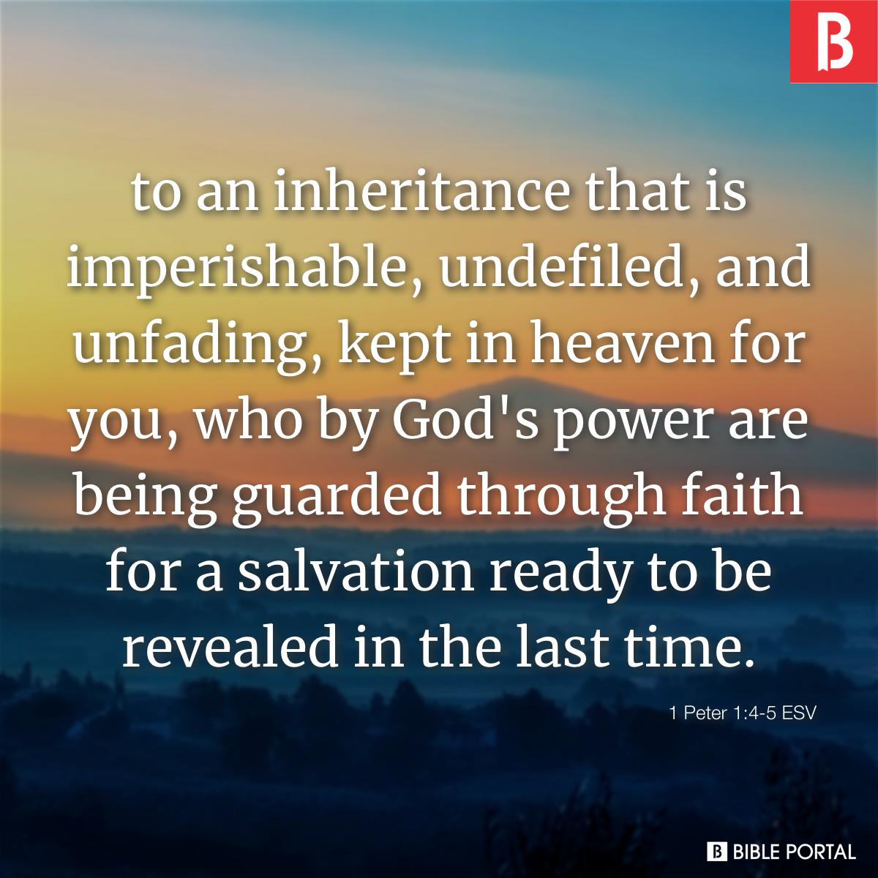

Slide 20
¹⁵ For this reason, ever since I heard about your faith in the Lord Jesus and your love for all God’s people, ¹⁶ I have not stopped giving thanks for you, remembering you in my prayers. ¹⁷ I keep asking that the God of our Lord Jesus Christ, the glorious Father, may give you the Spirit of wisdom and revelation, so that you may know him better. ¹⁸ I pray that the eyes of your heart may be enlightened in order that you may know ¹⁹ …. his incomparably great power for us who believe. That power is the same as the mighty strength ²⁰ he exerted when he raised Christ from the dead and seated him at his right hand in the heavenly realms.

Slide 21
EPHESIANS 1:19-20
3) God’s great power for us who believe.
The same power that both raised Jesus from the dead and exalted Him to the highest place in heaven.

Slide 22
EPHESIANS 1:15-23
Three historic events that the Scriptures attest to.
a. Resurrection of Jesus from the dead (vs 20a),
b) Placed him at God’s right hand in the heavenly places, putting all things under his feet (vs 20b-22a) and
c) Made Him head over all things for the church, which is his body (vs 22b, 23).

Slide 23
“Paul does not present an other-worldly, pie-in-the-sky theology, but he does view God’s work in the resurrection as a cosmic event that changed the course of history.”
Klyne Snodgrass, The NIV Application Commentary - Ephesians, (Grand Rapids: Zondervan, 2009).

Slide 24
¹⁸ I pray that the eyes of your heart may be enlightened in order that you may know the hope to which he has called you, the riches of his glorious inheritance in his holy people, ¹⁹ and his incomparably great power for us who believe. That power is the same as the mighty strength ²⁰ he exerted when he raised Christ from the dead and seated him at his right hand in the heavenly realms, ²¹ far above all rule and authority, power and dominion, and every name that is invoked, not only in the present age but also in the one to come. ²² And God placed all things under his feet and appointed him to be head over everything for the church, ²³ which is his body, the fullness of him who fills everything in every way.

Slide 25
¹⁸ I pray that the eyes of your heart may be enlightened in order that you may know the hope to which he has called you, the riches of his glorious inheritance in his holy people, ¹⁹ and his incomparably great power for us who believe. That power is the same as the mighty strength ²⁰ he exerted when he raised Christ from the dead and seated him at his right hand in the heavenly realms, ²¹ far above all rule and authority, power and dominion, and every name that is invoked, not only in the present age but also in the one to come. ²² And God placed all things under his feet and appointed him to be head over everything for the church, ²³ which is his body, the fullness of him who fills everything in every way.

Slide 26
Praying Ephesians 1:17-20
Glorious Father, I ask that you may give ________ the Spirit of wisdom and revelation, so that he/she may know you better. ¹⁸ I pray that the eyes of _____’s heart may be enlightened in order that he/she may know the hope to which You have called us, the riches of Your glorious inheritance in us, Your holy people, ¹⁹ and Your incomparably great power for us who believe. We thank you and we praise you in Jesus’ name. Amen.

