Slide 1
The Means of Mission
Philippians 4:1-13

Slide 2
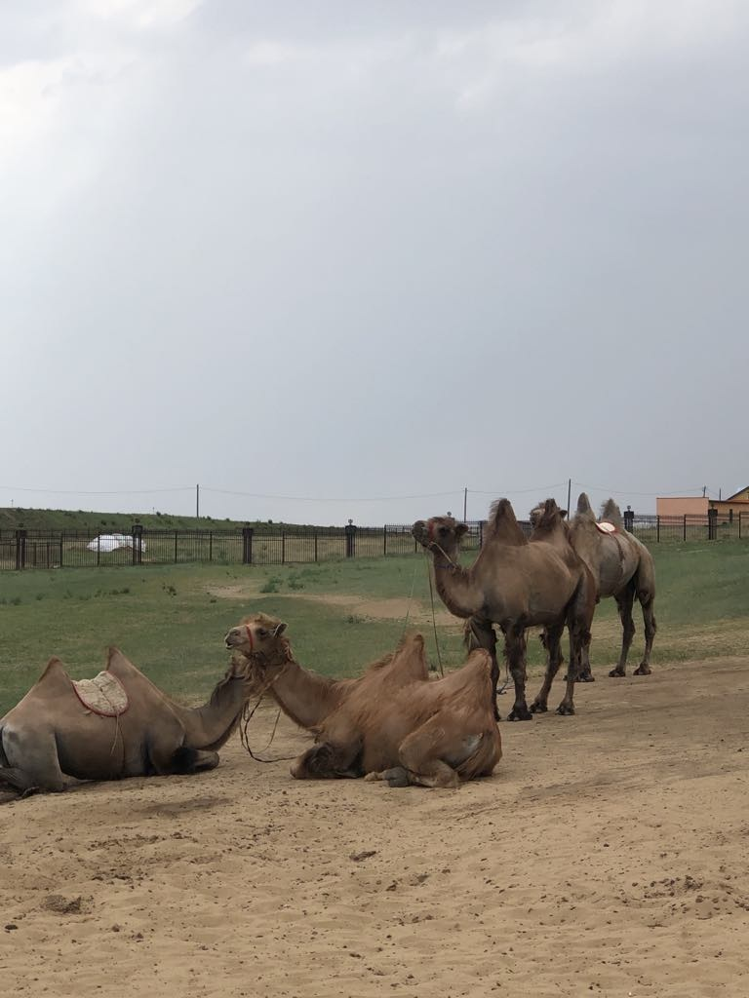
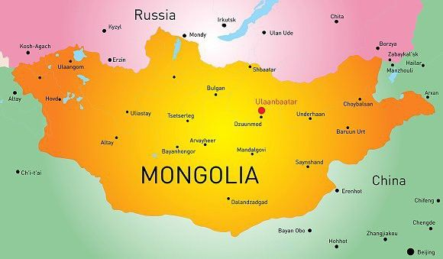
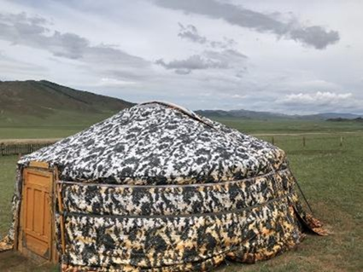

Slide 3
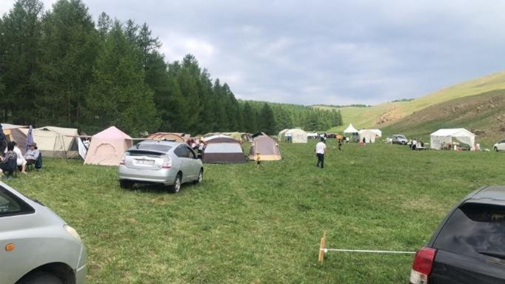

Slide 4
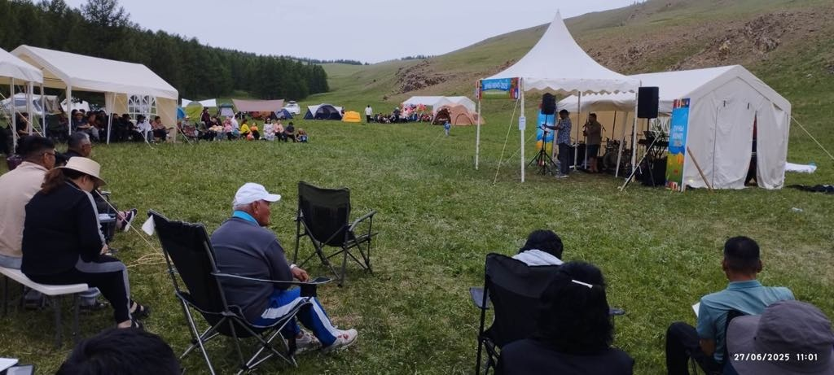

Slide 5
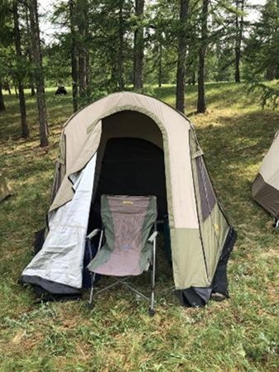
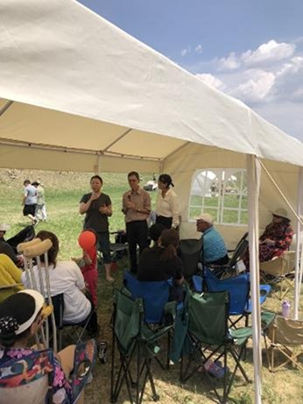

Slide 6
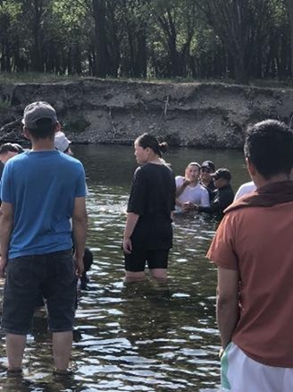
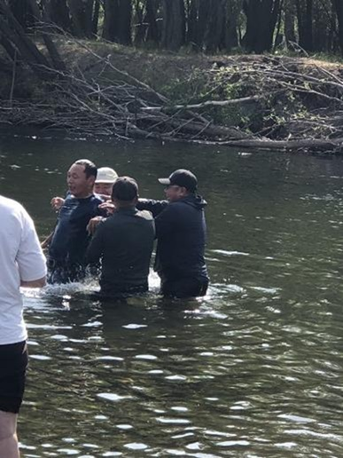

Slide 7
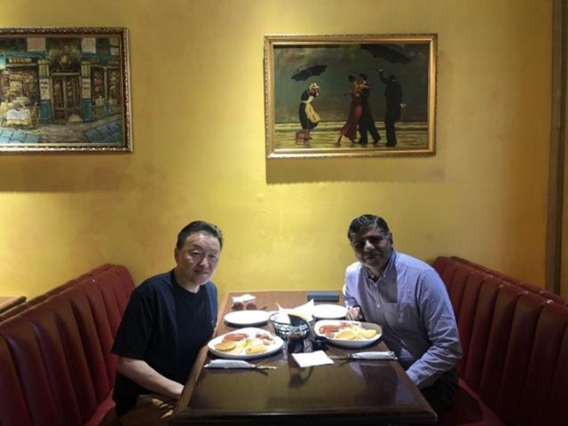

Slide 8
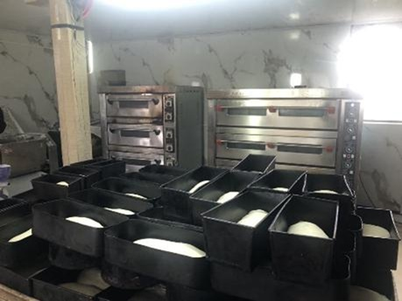
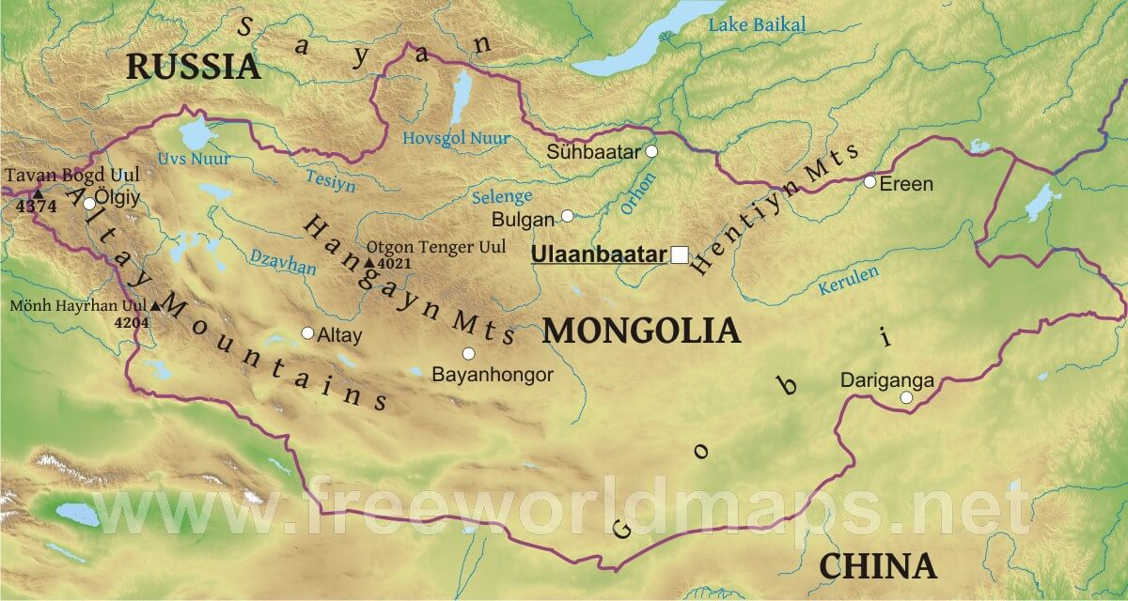

Slide 9
A Refresher….
The Model of Gospel Mission (Phil. 2:1-18) – Having the mind of Christ, we must live in humility, unity, obedience and purity before the world.

Slide 10
A Refresher….
The Mark of Gospel Mission (Phil. 3:1-14, 20,21) – Christ is the great treasure of our lives. We seek, like Paul, to know him more and to press on towards Him.

Slide 11
¹ Therefore, my brothers, whom I love and long for, my joy and crown, stand firm thus in the Lord, my beloved.
² I entreat Euodia and I entreat Syntyche to agree in the Lord. ³ Yes, I ask you also, true companion, help these women, who have laboured side by side with me in the gospel together with Clement and the rest of my fellow workers, whose names are in the book of life.
⁴ Rejoice in the Lord always; again I will say, rejoice. ⁵ Let your reasonableness be known to everyone. The Lord is at hand; ⁶ do not be anxious about anything, but in everything by prayer and supplication with thanksgiving let your requests be made known to God. ⁷ And the peace of God, which surpasses all understanding, will guard your hearts and your minds in Christ Jesus.

Slide 13
¹ Therefore, my brothers, whom I love and long for, my joy and crown, stand firm thus in the Lord, my beloved.
² I entreat Euodia and I entreat Syntyche to agree in the Lord. ³ Yes, I ask you also, true companion, help these women, who have laboured side by side with me in the gospel together with Clement and the rest of my fellow workers, whose names are in the book of life.
⁴ Rejoice in the Lord always; again I will say, rejoice. ⁵ Let your reasonableness be known to everyone. The Lord is at hand; ⁶ do not be anxious about anything, but in everything by prayer and supplication with thanksgiving let your requests be made known to God. ⁷ And the peace of God, which surpasses all understanding, will guard your hearts and your minds in Christ Jesus.

Slide 14
D. A. Carson
“The Kingdom of God may be entered through suffering (Acts 14:22), but it is characterised by joy.”
D. A. Carson, Basics For Believers, Leicester: Inter-varsity Press, 1995. page 106-107.

Slide 17
¹ Therefore, my brothers, whom I love and long for, my joy and crown, stand firm thus in the Lord, my beloved.
² I entreat Euodia and I entreat Syntyche to agree in the Lord. ³ Yes, I ask you also, true companion, help these women, who have laboured side by side with me in the gospel together with Clement and the rest of my fellow workers, whose names are in the book of life.
⁴ Rejoice in the Lord always; again I will say, rejoice. ⁵ Let your reasonableness be known to everyone. The Lord is at hand; ⁶ do not be anxious about anything, but in everything by prayer and supplication with thanksgiving let your requests be made known to God. ⁷ And the peace of God, which surpasses all understanding, will guard your hearts and your minds in Christ Jesus.

Slide 18
ἐπιεικής
epieikēs
Greek for
equitable, fair, mild, gentle.

Slide 19
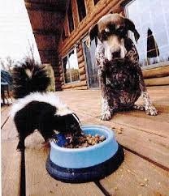
Two of the greatest qualities in life:
Wisdom and Patience.

Slide 20
¹ Therefore, my brothers, whom I love and long for, my joy and crown, stand firm thus in the Lord, my beloved.
² I entreat Euodia and I entreat Syntyche to agree in the Lord. ³ Yes, I ask you also, true companion, help these women, who have laboured side by side with me in the gospel together with Clement and the rest of my fellow workers, whose names are in the book of life.
⁴ Rejoice in the Lord always; again I will say, rejoice. ⁵ Let your reasonableness be known to everyone. The Lord is at hand; ⁶ do not be anxious about anything, but in everything by prayer and supplication with thanksgiving let your requests be made known to God. ⁷ And the peace of God, which surpasses all understanding, will guard your hearts and your minds in Christ Jesus.

Slide 21
Philippians 4:1-13
Vs 6-7
1. Do not be anxious about anything….
2. But in everything by prayer and supplication…. Let your requests be known to God.

Slide 23
Philippians 4:1-13
Vs 6-7
1. Do not be anxious about anything….
2. But in everything by prayer and supplication…. Let your requests be known to God.
3. With thanksgiving - see Colossians 3:17;
1 Thessalonians 5:18; 1 Timothy 4:4; Ephesians 5:20.

Slide 24
¹ Therefore, my brothers, whom I love and long for, my joy and crown, stand firm thus in the Lord, my beloved.
² I entreat Euodia and I entreat Syntyche to agree in the Lord. ³ Yes, I ask you also, true companion, help these women, who have laboured side by side with me in the gospel together with Clement and the rest of my fellow workers, whose names are in the book of life.
⁴ Rejoice in the Lord always; again I will say, rejoice. ⁵ Let your reasonableness be known to everyone. The Lord is at hand; ⁶ do not be anxious about anything, but in everything by prayer and supplication with thanksgiving let your requests be made known to God. ⁷ And the peace of God, which surpasses all understanding, will guard your hearts and your minds in Christ Jesus.

Slide 26
⁸ Finally, brothers, whatever is true, whatever is honourable, whatever is just, whatever is pure, whatever is lovely, whatever is commendable, if there is any excellence, if there is anything worthy of praise, think about these things. ⁹ What you have learned and received and heard and seen in me—practice these things, and the God of peace will be with you.

Slide 27
⁸ Finally, brothers, whatever is true, whatever is honourable, whatever is just, whatever is pure, whatever is lovely, whatever is commendable, if there is any excellence, if there is anything worthy of praise, think about these things. ⁹ What you have learned and received and heard and seen in me—practice these things, and the God of peace will be with you.

Slide 28
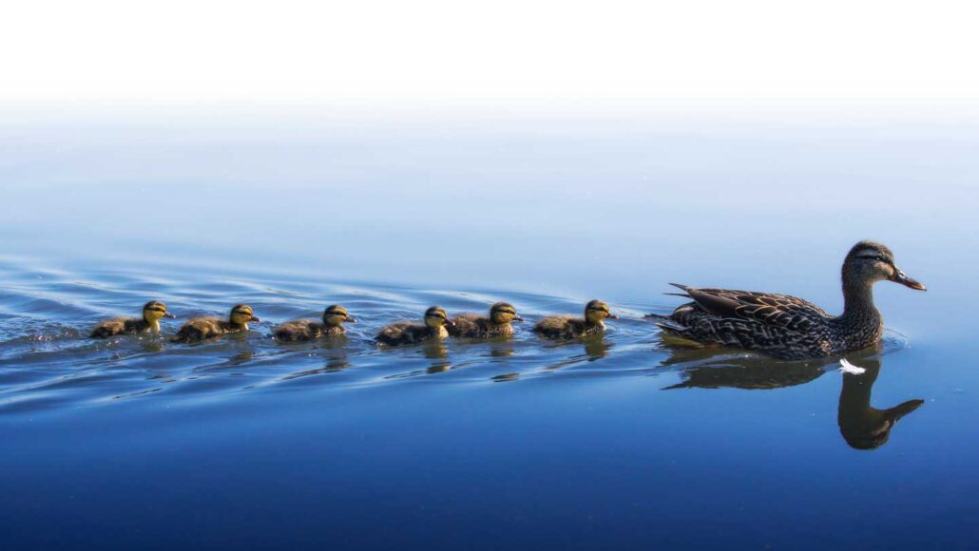

Slide 29
¹⁰ I rejoiced in the Lord greatly that now at length you have revived your concern for me. You were indeed concerned for me, but you had no opportunity. ¹¹ Not that I am speaking of being in need, for I have learned in whatever situation I am to be content. ¹² I know how to be brought low, and I know how to abound. In any and every circumstance, I have learned the secret of facing plenty and hunger, abundance and need. ¹³ I can do all things through him who strengthens me.

Slide 30
Philippians 4:1-13
Gospel Mission requires us to be:
Joyful,
United and reconciled,
Prayerful,
Meditating on the right things,
Discipled,
And finally, content with what God provides.

Slide 31
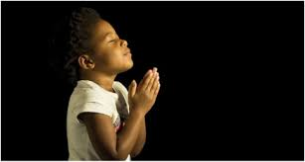
LET US PRAY….

