Slide 2
Members Only
trendy
sleek style
exclusive

Slide 3
33 Club
67 Pall Mall
The Tanglin Club
Mandala Club
The British Club
The American Club

Slide 5
3 Truths About Exclusivity
✅Exclusivity isn’t always bad – it can define purpose, identity, and belonging.
🛑The owner gets to set the terms – not the members, not the crowd.
📖Clear, consistent requirements matter – confusion creates conflict and exclusion

Slide 6
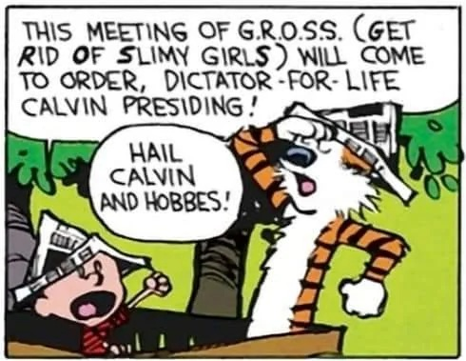
Owner sets terms:
NO GIRLS
Clear requirements
NO GIRLS
Purpose
TO BE MEAN

Slide 7
Members Only
Mark 9:38–10:16

Slide 8
In a world obsessed with
status
control
exclusivity
Jesus redefines
who belongs in His kingdom
how to get there.
Mark 9:38–10:16

Slide 9
M
A
R
K
The Gospel According to
COMPASSION
UNVEILED

Slide 12
Peter's Confession
Jesus' Confession
God’s Confession
Disciples’ Doubt
Disciples’ Confusion
Disciples’ Desire
8:27-30 Peter's Confession
8:31-9:1 Jesus Foretells his Death and Resurrection
9:2-13 Transfiguration
9:14-29 Disciples unable to heal a Boy with an Unclean Spirit
9:30-32 Jesus Foretells his Death and Resurrection a 2nd time
9:33-37 Disciples argue over Who is the Greatest
9:38-41 Not Against us is For Us
9:42-50 Stumbling / Temptation to Sin
10:1-12 On Divorce
10:13-16 Let Children Come to Me

Slide 13
8:22-26 Jesus Heals Blind Man at Bethsaida
10:46-52 Jesus Heals Blind Bartimaeus

Slide 14
8:22-26 Jesus Heals Blind Man at Bethsaida
8:27-30
8:31-9:1 Jesus Foretells his Death and Resurrection (Jesus' Confession)
9:2-13
9:14-29
9:30-32 Jesus Foretells his Death and Resurrection a 2nd time
9:33-37
9:38-41
9:42-50
10:1-12
10:13-16
10: 17-31
10:32-34 Jesus Foretells his Death and Resurrection a 3rd time
10:35-45
10:46-52 Jesus Heals Blind Bartimaeus

Slide 15
Jesus predicts His death 3x. Each time:
Jesus gives MORE DETAIL
Disciples show LESS UNDERSTANDING

Slide 16
8:22-26 Jesus Heals Blind Man at Bethsaida
8:27-30
8:31-9:1 Jesus Foretells his Death and Resurrection (Jesus' Confession)
9:2-13
9:14-29 Disciples unable to heal a Boy with an Unclean Spirit
9:30-32 Jesus Foretells his Death and Resurrection a 2nd time
9:33-37
9:38-41
9:42-50
10:1-12
10:13-16
10: 17-31
10:32-34 Jesus Foretells his Death and Resurrection a 3rd time
10:35-45
10:46-52 Jesus Heals Blind Bartimaeus
Disciples argue over Who is the Greatest
James and John request to . . .

Slide 17
8:22-26 Jesus Heals Blind Man at Bethsaida
8:27-30
8:31-9:1 Jesus Foretells his Death and Resurrection (Jesus' Confession)
9:2-13
9:14-29 Disciples unable to heal a Boy with an Unclean Spirit
9:30-32 Jesus Foretells his Death and Resurrection a 2nd time
9:33-37 Disciples argue over Who is the Greatest (children as example)
9:38-41
9:42-50
10:1-12
10:13-16
10: 17-31
10:32-34 Jesus Foretells his Death and Resurrection a 3rd time
10:35-45 James and John request to . . .
10:46-52 Jesus Heals Blind Bartimaeus
Stumbling / Temptation to Sin the little ones
Let Children Come to Me

Slide 18
8:22-26 Jesus Heals Blind Man at Bethsaida
8:27-30
8:31-9:1 Jesus Foretells his Death and Resurrection (Jesus' Confession)
9:2-13
9:14-29 Disciples unable to heal a Boy with an Unclean Spirit
9:30-32 Jesus Foretells his Death and Resurrection a 2nd time
9:33-37 Disciples argue over Who is the Greatest
9:38-41 Not Against us is For Us
9:42-50 Stumbling / Temptation to Sin
10:1-12 On Divorce
10:13-16 Let Children Come to Me
10: 17-31 Rich Young Man
10:32-34 Jesus Foretells his Death and Resurrection a 3rd time
10:35-45 James and John request to . . .
10:46-52 Jesus Heals Blind Bartimaeus
Members Only
Mark 9:38-10:16

Slide 19
The disciples struggled to understand Jesus’ vision of the Kingdom.
Instead of embracing Humility,
they Pursued Status;
instead of Welcoming Outsiders,
they Drew Lines;
instead of Childlike Trust,
they Argued Over Greatness.

Slide 20
Story 1
An Outsider was Casting out Demons
Mark 9:38-41
Who gets to represent Jesus?

Slide 21
Anyone Not Against Us Is for Us
³⁸ John said to him, “Teacher, we saw someone casting out demons in your name, and we tried to stop him, because he was not following us.”
He was not following us!
Disciples were jealous
Sectarian attitudes were common
Sectarian attitudes were common

Slide 22
Sectarian attitudes were common
1. Pharisees
2. Sadducees
3. Essenes
4. Zealots
5. Herodians
People's Front of Judea
Judean People’s Front
Judean Popular People’s Front
Campaign for a Free Galilee
The Popular Front of Judea
intragroup rivalry was so pronounced that it became ripe for satire as brilliantly mocked by Monty Python

Slide 23
Anyone Not Against Us Is for Us
³⁸ John said to him, “Teacher, we saw someone casting out demons in your name, and we tried to stop him, because he was not following us.”
He was not following us!
We don’t know him!
What are his credentials?
Is he qualified?

Slide 24
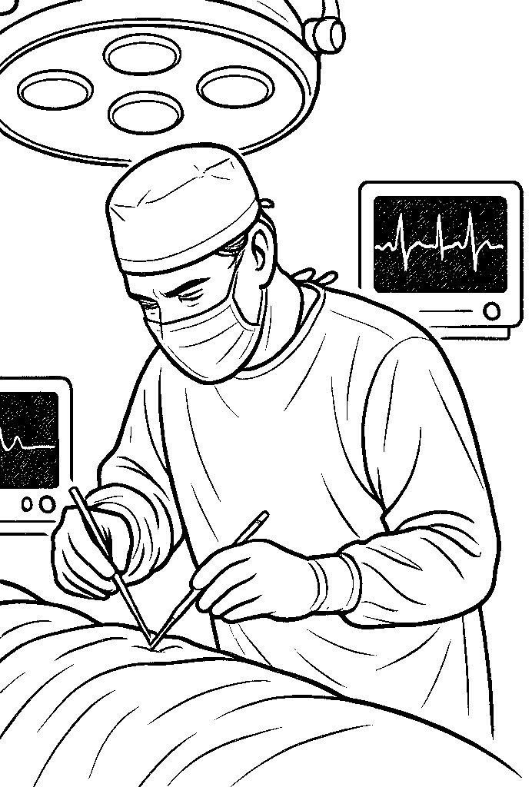

Slide 25
Acts 19:13-16 (NLT)
¹³ A group of Jews was traveling from town to town casting out evil spirits. They tried to use the name of the Lord Jesus in their incantation, saying, “I command you in the
name of Jesus, whom Paul preaches, to come out!” ¹⁴ …
¹⁵ But one time when they tried it, the evil spirit replied, “I know Jesus, and I know Paul, but who are you?” ¹⁶ Then the man with the evil spirit leaped on them, overpowered them, and attacked them with such violence that they fled from the house, naked and battered.

Slide 26
When do Christian need “credentials”?
What is the work of Christ?

Slide 27
Anyone Not Against Us Is for Us
³⁸ John said to him, “Teacher, we saw someone casting out demons in your name, and we tried to stop him, because he was not following us.” ³⁹ But Jesus said, “Do not stop him, for no one who does a mighty work in my name will be able soon afterward to speak evil of me. ⁴⁰ For the one who is not against us is for us.

Slide 28
When do Christian need “credentials”?
Do Christians need credentials to do the work of Christ?
What is the work of Christ?
Mark 9:39 Do not stop him, for no one who does a mighty work in my name will be able soon afterward to speak evil of me

Slide 29
When do Christian need “credentials”?
Do Christians need credentials to do the work of Christ?
What is the work of Christ?

Slide 30
What is the work of Christ?
John 6:28–29 ²⁸ Then they said to him, “What must we do, to be doing the works of God?” ²⁹ Jesus answered them, “This is the work of God, that you believe in him whom he has sent.”
The primary "work" is faith in Jesus — trusting, receiving, following.

Slide 31
Anyone Not Against Us Is for Us
³⁸ John said to him, “Teacher, we saw someone casting out demons in your name, and we tried to stop him, because he was not following us.” ³⁹ But Jesus said, “Do not stop him, for no one who does a mighty work in my name will be able soon afterward to speak evil of me. ⁴⁰ For the one who is not against us is for us. ⁴¹ For truly, I say to you, whoever gives you a cup of water to drink because you belong to Christ will by no means lose his reward.

Slide 32
Anyone Not Against Us Is for Us
³⁸ John said to him, “Teacher, we saw someone casting out demons in your name, and we tried to stop him, because he was not following us.” ³⁹ But Jesus said, “Do not stop him, for no one who does a mighty work in my name will be able soon afterward to speak evil of me. ⁴⁰ For the one who is not against us is for us. ⁴¹ If anyone gives you even a cup of water because you belong to the Messiah, I tell you the truth, that person will surely be rewarded. (NLT)

Slide 33
Anyone Not Against Us Is for Us
³⁸ John said to him, “Teacher, we saw someone casting out demons in your name, and we tried to stop him, because he was not following us.” ³⁹ But Jesus said, “Do not stop him, for no one who does a mighty work in my name will be able soon afterward to speak evil of me. ⁴⁰ For the one who is not against us is for us. ⁴¹ If anyone gives you even a cup of water because you belong to the Messiah, I tell you the truth, that person will surely be rewarded. (NLT)

Slide 34
Matthew 10:42
And whoever gives
one of these little ones
even a cup of cold water
because he is a disciple,
truly, I say to you, he will by no means lose his reward.”
Mark 9:41
…whoever gives
you
a cup of water to drink
because you belong to Christ
will by no means lose his reward.
small things matter

Slide 35
What should NOT
be done in the NAME of Christ?
Anything not in the NATURE of Christ!

Slide 36
1 John 4:1 Beloved, do not believe every spirit, but test the spirits to see whether they are from God, for many false prophets have gone out into the world."
Galatians 1:8-9 But even if we or an angel from heaven should preach to you a gospel contrary to the one we preached to you, let him be accursed. As we have said before, so now I say again: If anyone is preaching to you a gospel contrary to the one you received, let him be accursed.

Slide 37
1 John 4:1 Beloved, do not believe every spirit, but test the spirits to see whether they are from God, for many false prophets have gone out into the world."
Galatians 1:8-9 But even if we or an angel from heaven should preach to you a gospel contrary to the one we preached to you, let him be accursed. As we have said before, so now I say again: If anyone is preaching to you a gospel contrary to the one you received, let him be accursed.
The Kingdom is not a private club! It’s open to all who act in Jesus’ name AND NATURE.

Slide 38
Story 2
Temptations to Sin
Mark 9:42-50
What keeps us out ?

Slide 39
Temptations to Sin
⁴² “Whoever causes one of these little ones who believe in me to sin, it would be better for him if a great millstone were hung around his neck and he were thrown into the sea.
μικρός
mikros

Slide 40
Temptations to Sin
⁴³ And if your hand causes you to sin, cut it off. It is better for you to enter life crippled than with two hands to go to hell, to the unquenchable fire.

Slide 41
Temptations to Sin
⁴³ And if your hand causes you to sin, cut it off. It is better for you to enter life crippled than with two hands to go to hell, to the unquenchable fire. ⁴⁵ And if your foot causes you to sin, cut it off. It is better for you to enter life lame than with two feet to be thrown into hell.

Slide 42
Temptations to Sin
⁴³ And if your hand causes you to sin, cut it off. It is better for you to enter life crippled than with two hands to go to hell, to the unquenchable fire. ⁴⁵ And if your foot causes you to sin, cut it off. It is better for you to enter life lame than with two feet to be thrown into hell. ⁴⁷ And if your eye causes you to sin, tear it out. It is better for you to enter the kingdom of God with one eye than with two eyes to be thrown into hell,

Slide 43
Temptations to Sin
⁴³ And if your hand causes you to sin, cut it off. It is better for you to enter life crippled than with two hands to go to hell, to the unquenchable fire. ⁴⁵ And if your foot causes you to sin, cut it off. It is better for you to enter life lame than with two feet to be thrown into hell. ⁴⁷ And if your eye causes you to sin, tear it out. It is better for you to enter the kingdom of God with one eye than with two eyes to be thrown into hell, ⁴⁸ ‘where their worm does not die and the fire is not quenched.’
Isaiah 66:24 And they shall go out and look on the dead bodies of the men who have rebelled against me. For their worm shall not die, their fire shall not be quenched, and they shall be an abhorrence to all flesh.”

Slide 44
Temptations to Sin
⁴³ And if your hand causes you to sin, cut it off. It is better for you to enter life crippled than with two hands to go to hell, to the unquenchable fire. ⁴⁵ And if your foot causes you to sin, cut it off. It is better for you to enter life lame than with two feet to be thrown into hell. ⁴⁷ And if your eye causes you to sin, tear it out. It is better for you to enter the kingdom of God with one eye than with two eyes to be thrown into hell, ⁴⁸ ‘where their worm does not die and the fire is not quenched.’

Slide 45
Hyperbole
Intentional exaggeration for emphasis—is used to make truths more vivid or memorable.
Truths from our passage:
Hell is real
Sin is serious
Cut sin off before it costs you

Slide 46
Three core categories of temptation
1 John 2:16“For all that is in the world
the lust of the flesh,
the lust of the eyes,
and the pride of life
—is not from the Father but is from the world
Genesis 3:6“So when the woman saw that the tree
was good for food,
… a delight to the eyes,
and that the tree was to be desired to make one wise,
she took of its fruit and ate

Slide 47
Three core categories of temptation
1 John 2:16“For all that is in the world
the lust of the flesh,
the lust of the eyes,
and the pride of life
—is not from the Father but is from the world
v43: Hand (what you do)
V47: Eye (what you desire)
V45: Foot (where you go)
Appetite (feels good)
Attraction (looks good)
Ambition (feel powerful)

Slide 48
Temptations to Sin
⁴⁹ For everyone will be salted with fire. ⁵⁰ Salt is good, but if the salt has lost its saltiness, how will you make it salty again? Have salt in yourselves, and be at peace with one another.”
Fire = testing, purification, or judgment
Salt = preservation, distinctiveness but only if pure
Be at peace = avoid sectarian attitudes
Everyone will be tested, true disciples pursue holiness (salt) rather than harbor sin.

Slide 49
Story 3
Teaching About Divorce
Mark 10:1-12
Who defines commitment?

Slide 50
Teaching About Divorce
Ch 10 ¹ And he left there and went to the region of Judea and beyond the Jordan, and crowds gathered to him again. And again, as was his custom, he taught them.
² And Pharisees came up and in order to test him asked, “Is it lawful for a man to divorce his wife?”

Slide 51
Teaching About Divorce
Ch 10 ¹ And he left there and went to the region of Judea and beyond the Jordan, and crowds gathered to him again. And again, as was his custom, he taught them.
² And Pharisees came up and in order to test him asked, “Is it lawful for a man to divorce his wife?”
³ He answered them, “What did Moses command you?” ⁴ They said, “Moses allowed a man to write a certificate of divorce and to send her away.”

Slide 52
Teaching About Divorce
⁵ And Jesus said to them, “Because of your hardness of heart he wrote you this commandment. ⁶ But from the beginning of creation, ‘God made them male and female.’ ⁷ ‘Therefore a man shall leave his father and mother and hold fast to his wife, ⁸ and the two shall become one flesh.’ So they are no longer two but one flesh. ⁹ What therefore God has joined together, let not man separate.”

Slide 53
A Perfect Creation
God’s Design
Covenant Commitment
One-Flesh Union
Reflects Christ & the Church
An Imperfect World
People’s Desire
Conditional Convenience
Loopholes for Separation
Shaped by Self-Interest
Jesus affirms God’s design
over cultural loopholes

Slide 54
Teaching About Divorce
¹⁰ And in the house the disciples asked him again about this matter. ¹¹ And he said to them, “Whoever divorces his wife and marries another commits adultery against her,

Slide 55
Teaching About Divorce
¹⁰ And in the house the disciples asked him again about this matter. ¹¹ And he said to them, “Whoever divorces his wife and marries another commits adultery against her, ¹² and if she divorces her husband and marries another, she commits adultery.”
Even while passing judgement on sin,
Jesus promotes equality

Slide 56
Can a Christian divorce and remarry?
²⁷ “You have heard that it was said, ‘You shall not commit adultery.’ ²⁸ But I say to you that everyone who looks at a woman with lustful intent has already committed adultery with her in his heart. ²⁹ If your right eye causes you to sin, tear it out and throw it away
³¹ “It was also said, ‘Whoever divorces his wife, let him give her a certificate of divorce.’ ³² But I say to you that everyone who divorces his wife, except on the ground of sexual immorality, makes her commit adultery, and whoever marries a divorced woman commits adultery.

Slide 57
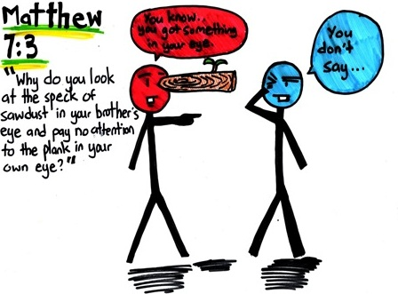
What sin is worse?
My Sin
Someone else’s sin
Notes:
Image from https://catherineandmorgan.blogspot.com/2012/01/plank-in-my-eye.html

Slide 58
Is adultery the unpardonable sin?
Matthew 12:31-32
³¹ Therefore I tell you, every sin and blasphemy will be forgiven people, but the blasphemy against the Spirit will not be forgiven.

Slide 59
Is adultery the unpardonable sin?
1 John 1:9
⁹ If we confess our sins, he is faithful and just to forgive us our sins and to cleanse us from all unrighteousness.

Slide 60
Is adultery the unpardonable sin?
The World
If we celebrate our sins, he is faithful and just to forgive us our sins and to cleanse us from all unrighteousness.

Slide 61
Jesus affirms the law more strictly
and fulfills it completely
lust = adultery
hate = murder,
divorce + remarriage = adultery
exposes our need for grace, not perfection.

Slide 62
Story 4
Let the Children Come
Mark 10:13-16
Who belongs with Jesus?

Slide 63
Let the Children Come to Me
¹³ And they were bringing children to him that he might touch them, and the disciples rebuked them.

Slide 64
Let the Children Come to Me
¹³ And they were bringing children to him that he might touch them, and the disciples rebuked them. ¹⁴ But when Jesus saw it, he was indignant and said to them, “Let the children come to me; do not hinder them, for to such belongs the kingdom of God. ¹⁵ Truly, I say to you, whoever does not receive the kingdom of God like a child shall not enter it.” ¹⁶ And he took them in his arms and blessed them, laying his hands on them.

Slide 65
Children
9:37 “Whoever receives one such child in my name receives me, and whoever receives me, receives not me but him who sent me.”
9:42 Whoever causes one of these little ones who believe in me to sin . . .
10:15 Truly, I say to you, whoever does not receive the kingdom of God like a child shall not enter it.”

Slide 66
Children
9:37 “Whoever receives one such child in my name receives me, and whoever receives me, receives not me but him who sent me.”
9:42 Whoever causes one of these little ones who believe in me to sin . . .
10:15 Truly, I say to you, whoever does not receive the kingdom of God like a child shall not enter it.”
Kingdom entry isn’t earned
it’s received with childlike trust.

Slide 67
3 Truths About Exclusivity
✅Exclusivity isn’t always bad – it can define purpose, identity, and belonging.
🛑The owner gets to set the terms – not the members, not the crowd.
📖Clear, consistent requirements matter – confusion creates conflict and exclusion

Slide 68
3 Truths About Exclusivity
✅Entrance into the Kingdom of God is exclusive
– but not by status, strength, or success.
🛑God sets the requirements
– humility, repentance, childlike trust.
📖God gave His Son
– so that the requirements could be fulfilled in Him

Slide 69
Jesus is the only one who met all the requirements —yet He laid down His membership so that we, the outsiders, could be welcomed in.

Slide 70
THE KINGDOM ISN’T EARNED— IT’S RECEIVED WITH TRUST!”
All exalt the One who let us in!

Slide 71
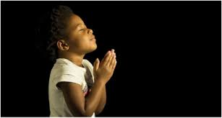
LET US PRAY….

