Slide 1
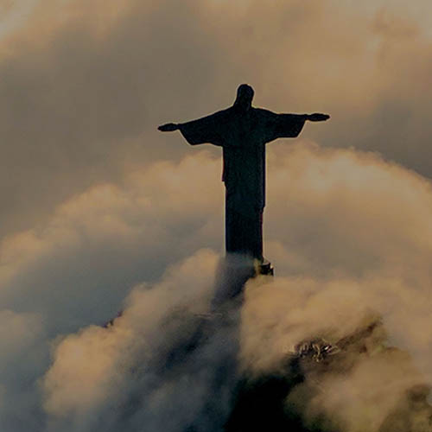
The Mark of Mission
Philippians 3:1-14, 20-21

Slide 3
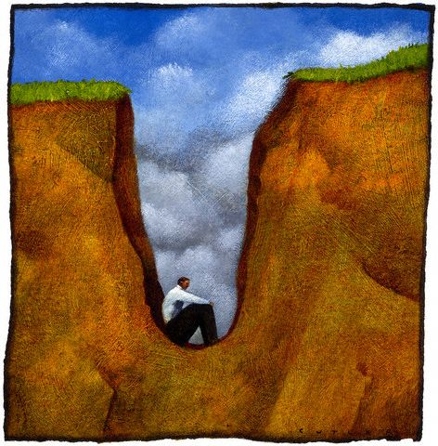

Slide 4
¹ Finally, my brothers, rejoice in the Lord. To write the same things to you is no trouble to me and is safe for you.
² Look out for the dogs, look out for the evildoers, look out for those who mutilate the flesh. ³ For we are the circumcision, who worship by the Spirit of God and glory in Christ Jesus and put no confidence in the flesh— ⁴ though I myself have reason for confidence in the flesh also.

Slide 5
Philippians 3:1-4
Vs 1a – “Finally” = “So then”

Slide 6
Philippians 3:1-4
Vs 1a – “Finally” = “So then”
Vs 1b – “rejoice in the Lord” – a theme in the letter. Connects to 2:17-18.

Slide 7
¹ Finally, my brothers, rejoice in the Lord. To write the same things to you is no trouble to me and is safe for you.
² Look out for the dogs, look out for the evildoers, look out for those who mutilate the flesh. ³ For we are the circumcision, who worship by the Spirit of God and glory in Christ Jesus and put no confidence in the flesh— ⁴ though I myself have reason for confidence in the flesh also.

Slide 8
Philippians 3:1-4
Paul is adamant - Christians don’t need to become Jews.
The temple at Jerusalem replaced by the temple of Christ (John 2:18-22)
The high-priesthood of Aaron replaced by the high-priesthood of Jesus, after Melchizedek (Hebrews 5-7).
Old Testament Sacrifices replaced by the once-for-all perfect sacrifice of Jesus (Hebrews 9:11-28).

Slide 9
Philippians 3:1-4
Vs 3 – It is we who are the true circumcision, i.e. Jews and Gentiles who worship by the Holy Spirit, and who glory and trust in Jesus alone and have no confidence in the flesh (Gk. sarx or sinful nature).

Slide 10
If anyone else thinks he has reason for confidence in the flesh, I have more: ⁵ circumcised on the eighth day, of the people of Israel, of the tribe of Benjamin, a Hebrew of Hebrews; as to the law, a Pharisee; ⁶ as to zeal, a persecutor of the church; as to righteousness under the law, blameless. ⁷ But whatever gain I had, I counted as loss for the sake of Christ. ⁸ Indeed, I count everything as loss because of the surpassing worth of knowing Christ Jesus my Lord. For his sake I have suffered the loss of all things and count them as rubbish, in order that I may gain Christ ⁹ and be found in him, not having a righteousness of my own that comes from the law, but that which comes through faith in Christ, the righteousness from God that depends on faith— ¹⁰ that I may know him and the power of his resurrection, and may share his sufferings, becoming like him in his death, ¹¹ that by any means possible I may attain the resurrection from the dead.

Slide 11
Philippians 3:4-11
Paul says he was:
a) RELIGIOUS
b) A NATIONAL OF ISRAEL
c) OF THE RIGHT TRIBE
d) A TRUE JEW
e) EDUCATED BY THE BEST
f) ZEALOUS
g) FAULTLESS

Slide 12
If anyone else thinks he has reason for confidence in the flesh, I have more: ⁵ circumcised on the eighth day, of the people of Israel, of the tribe of Benjamin, a Hebrew of Hebrews; as to the law, a Pharisee; ⁶ as to zeal, a persecutor of the church; as to righteousness under the law, blameless. ⁷ But whatever gain I had, I counted as loss for the sake of Christ. ⁸ Indeed, I count everything as loss because of the surpassing worth of knowing Christ Jesus my Lord.

Slide 13
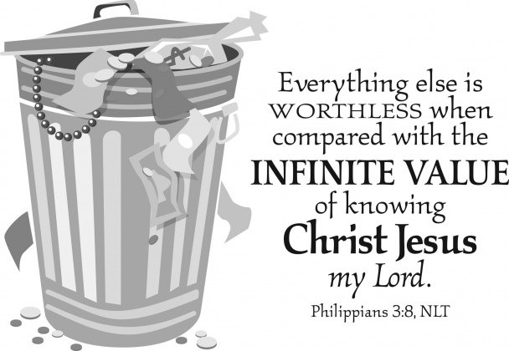

Slide 14
D. A. Carson
Everything that is coming to us from God comes through Christ Jesus. Christ Jesus has won our pardon; He has reconciled us to God; He has cancelled our sin; He has secured the gifts of the Spirit for us; He has granted eternal life to us and promised us the life of the consummation; He has made us children of the new covenant; His righteousness has been accounted as ours; He has risen from the dead; and all of God’s sovereignty is mediated through Him and directed to our good and to God’s glory….All the blessings God has for us are tied up with the work of Christ.
D. A. Carson, A Call to Spiritual Reformation: Priorities for Paul and His Prayers, Grand Rapids: Baker, 1992, page 189.

Slide 16
⁸ For his sake I have suffered the loss of all things and count them as rubbish, in order that I may gain Christ ⁹ and be found in him, not having a righteousness of my own that comes from the law, but that which comes through faith in Christ, the righteousness from God that depends on faith— ¹⁰ that I may know him and the power of his resurrection, and may share his sufferings, becoming like him in his death, ¹¹ that by any means possible I may attain the resurrection from the dead.

Slide 17
Philippians 3:4-11
Vs 10 – “that I may know Him” – Gk. ginōskō lit. personal knowledge (cf Hebrew yāḏaʿ in Genesis 4:1).

Slide 18
William Barclay
“Again and again Paul returns to the thought that when the Christian has to suffer, he is in some strange way sharing the very suffering of Christ and is even filling up that suffering (2 Corinthians 1:4; 4:10,11; Galatians 6:17; Colossians 1:24). To suffer for the faith is not a penalty, it is a privilege, for thereby we share the very work of Christ.”
Williams Barclay, The Letters to the Philippians, Colossians and Thessalonians – The Daily Study Bible, Edinburgh: The St Andrew Press, 1975, page 64.

Slide 19
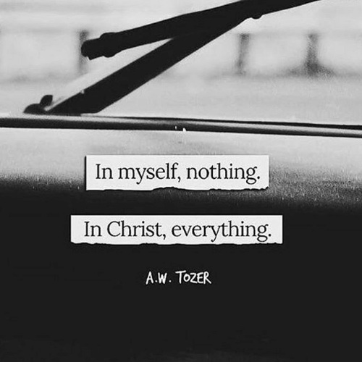

Slide 20
¹² Not that I have already obtained this or am already perfect, but I press on to make it my own, because Christ Jesus has made me his own. ¹³ Brothers, I do not consider that I have made it my own. But one thing I do: forgetting what lies behind and straining forward to what lies ahead, ¹⁴ I press on toward the goal for the prize of the upward call of God in Christ Jesus….
²⁰ But our citizenship is in heaven, and from it we await a Savior, the Lord Jesus Christ, ²¹ who will transform our lowly body to be like his glorious body, by the power that enables him even to subject all things to himself.

Slide 21
How to Bear the Mark of Gospel Mission?

Slide 22
How to Bear the Mark of Gospel Mission?
1. Give up everything for Christ!
“…without surrender, nothing we do leads us to grow deep in God…A surrendered life is the key to intimacy with God.”
Edmund Chan, Growing Deep in God (Singapore: Covenant Evangelical Free Church, 2002), 209-210.

Slide 23
How to Bear the Mark of Gospel Mission?
2. Press on towards Christ with all that you are.
“Remember Lot’s wife.” (Luke 17:32 cf 9:62)

Slide 24
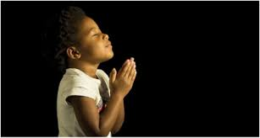
LET US PRAY….

