Slide 1
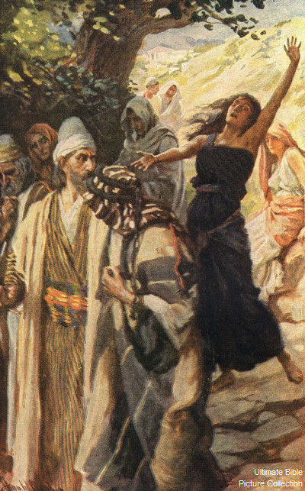
The Model of Mission
Philippians 2:1-18

Slide 2
In Christ, On Mission
Today: The Model of Mission (Philippians 2:1-18)
Sunday 22nd June: The Mark of Mission
(Philippians 3:1-14)
Sunday 6th July: The Means of Mission
(Philippians 4:1-13)

Slide 3
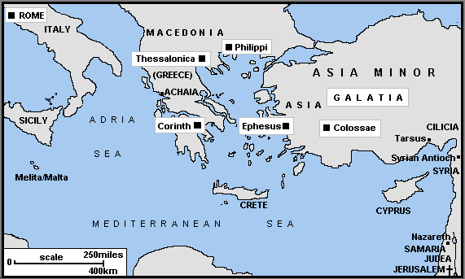

Slide 4
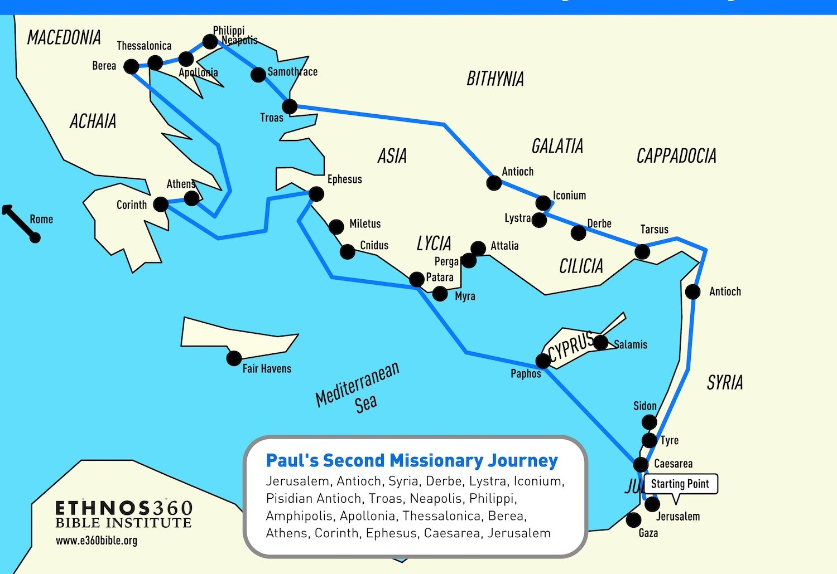

Slide 5
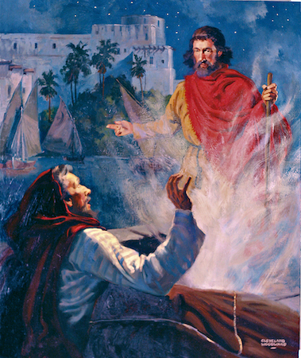

Slide 6
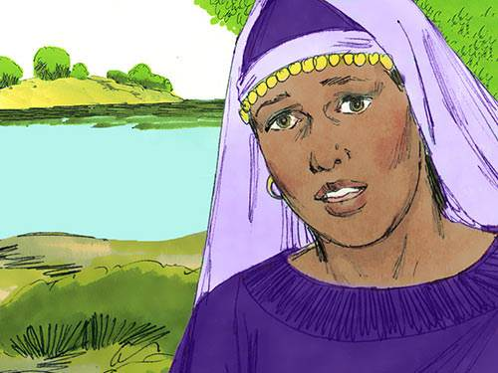

Slide 7
Main Structures | Paul’s circumstances 1:1-26 | Paul’s appeal 1:27-2:30 | Paul’s example 3:1-21 | Paul’s exhortations 4:1-23
Key Theme | True Koinonia | True Humility, Obedience | True Righteousness | True Joy and Contentment
Specific Implication | Suffering | Submission | Salvation | Sanctification
Framework | Experience | Explication | Encouragement
OUTCOME | Christ our Life | Christ our Mind | Christ our Goal | Christ our Strength
Key verse: | “For to me to live is Christ, and to die is gain.” (1:21) | “Have this mind among yourselves, which is yours in Christ Jesus,…” (2:5) | “Indeed, I count everything as lost because of the surpassing worth of knowing Christ Jesus my Lord.” (3:8) | “I can do all things through him who strengthens me.” (4:13)

Slide 8
Philippians – Key Themes
1. Koinonia – lit. partnership, fellowship, communion or participation (Philippians 1:5, 2:1 and 3:10).

Slide 10
Philippians – Key Themes
1. Koinonia – lit. partnership, fellowship, communion or participation (Philippians 1:5, 2:1 and 3:10).
Unity affects the church and her mission (Phil. 4:2-3. See John 17:20-23)

Slide 11
Philippians – Key Themes
1. Koinonia – lit. partnership, fellowship, communion or participation (Philippians 1:5, 2:1 and 3:10).
2. Joy - Philippians 1:3, 1:25, 2:2, 2:17-18; 2:28, 2:29, 3:1, 4:1 and 4:4.

Slide 12
²⁷ Only let your manner of life be worthy of the gospel of Christ, so that whether I come and see you or am absent, I may hear of you that you are standing firm in one spirit, with one mind striving side by side for the faith of the gospel, ²⁸ and not frightened in anything by your opponents. This is a clear sign to them of their destruction, but of your salvation, and that from God. ²⁹ For it has been granted to you that for the sake of Christ you should not only believe in him but also suffer for his sake, ³⁰ engaged in the same conflict that you saw I had and now hear that I still have.

Slide 13
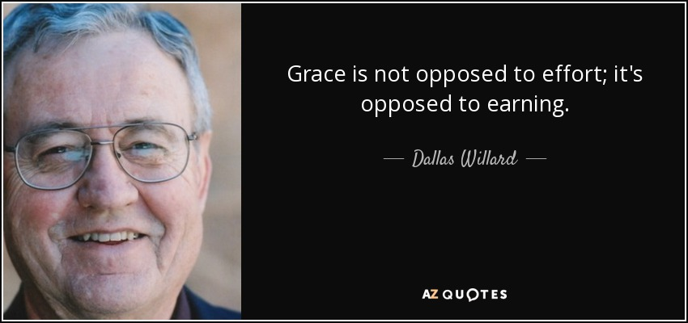

Slide 14
²⁷ Only let your manner of life be worthy of the gospel of Christ, so that whether I come and see you or am absent, I may hear of you that you are standing firm in one spirit, with one mind striving side by side for the faith of the gospel, ²⁸ and not frightened in anything by your opponents. This is a clear sign to them of their destruction, but of your salvation, and that from God. ²⁹ For it has been granted to you that for the sake of Christ you should not only believe in him but also suffer for his sake, ³⁰ engaged in the same conflict that you saw I had and now hear that I still have.

Slide 15
D. A. Carson
“If their salvation has been secured by the suffering of another on their behalf, their discipleship is to be demonstrated in their suffering on his behalf.”
D. A. Carson, Basics For Believers, Leicester: Inter-varsity Press, 1995. page 53.

Slide 16
Philippians 2:1-4 – THE CAUSE
Vs 1-2: Complete Paul’s joy by being united in mind, love and one accord.

Slide 17
Philippians 2:1-4 – THE CAUSE
Vs 1-2: Complete Paul’s joy by being united in mind, love and one accord.
Vs 3 – do not allow selfish ambition or conceit to prosper.

Slide 19
Philippians 2:1-4 – THE CAUSE
Vs 1-2: Complete Paul’s joy by being united in mind, love and one accord.
Vs 3 – do not allow selfish ambition or conceit to prosper.
Vs 4 - look to ourselves but to the interests of others.

Slide 20
⁵ Have this mind among yourselves, which is yours in Christ Jesus, ⁶ who, though he was in the form of God, did not count equality with God a thing to be grasped, ⁷ but emptied himself, by taking the form of a servant, being born in the likeness of men. ⁸ And being found in human form, he humbled himself by becoming obedient to the point of death, even death on a cross. ⁹ Therefore God has highly exalted him and bestowed on him the name that is above every name, ¹⁰ so that at the name of Jesus every knee should bow, in heaven and on earth and under the earth, ¹¹ and every tongue confess that Jesus Christ is Lord, to the glory of God the Father.

Slide 21
Philippians 2:5-11 – THE Christ
Vs 6-7: His Incarnation – he left his divine privileges to become a man in lowly servanthood.

Slide 22
Philippians 2:5-11 – THE Christ
Vs 6-7: His Incarnation – he left his divine privileges to become a man in lowly servanthood.
Vs 8: His Passion – he humbly became obedient to death on a terrible cross.

Slide 23
Philippians 2:5-11 – THE Christ
Vs 9-11: His Exaltation – God gave him the highest name, so that all will bow and call him Lord.

Slide 24
Philippians 2:12-18 – THE Call
Vs 12-13: “Therefore, my beloved…”
“work out your salvation…for ... God ... works in you, both to will and to work for his good pleasure.”

Slide 25
Philippians 2:12-18 – THE Call
Firstly, vs 14 – no grumbling or complaining.
Second, vs 15-16a – be blameless and people of integrity in your witness in a dark world, as you hold to the word of life.

Slide 26
Raplh P Martin
The church’s influence as a witnessing community is described in the language of the influence of light in a dark place (cf. 2 Pet. 1:19).
Tyndale New Testament Commentaries – Philippians, Illonois:IVP Academic, 2008, page 88.

Slide 27
Philippians 2:12-18 – THE Call
Thirdly, vs 16b-18. Paul would not have laboured in vain and would be proud of them on the day of Jesus’ return. He would be a drink offering to their sacrificial offering of faith (see Numbers 15:1-10, 28:1-8).

Slide 28
What Kind of Church in Missions will we Be?

