Slide 1
Macedonian Call
Sam George, PhD
Wheaton College | Lausanne Movement

Slide 2
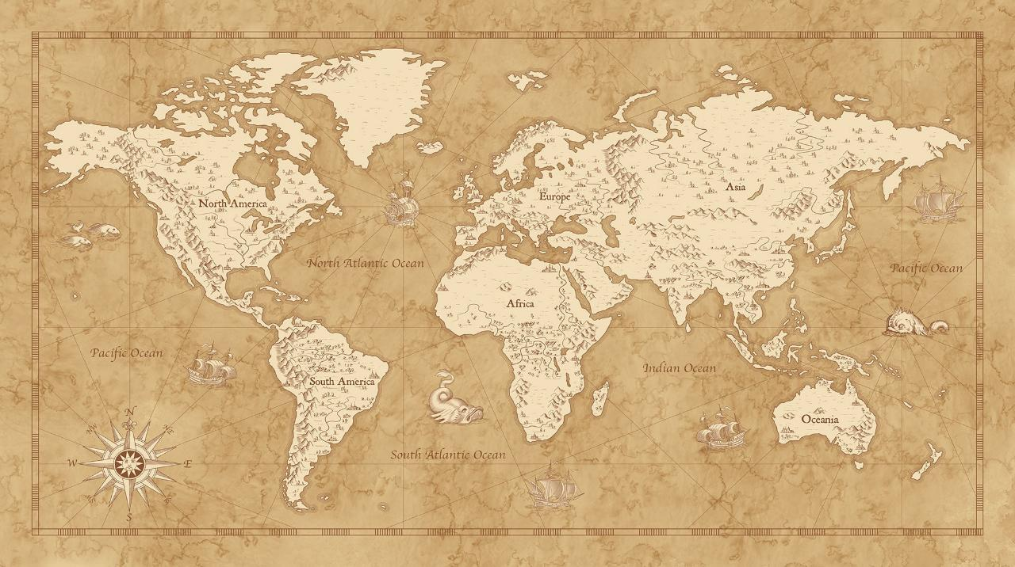
Acts 16:6-15
2
And they went through the region of Phrygia and Galatia, having been forbidden by the Holy Spirit to speak the word in Asia. And when they had come up to Mysia, they attempted to go into Bithynia, but the Spirit of Jesus did not allow them. So, passing by Mysia, they went down to Troas. And a vision appeared to Paul in the night: a man of Macedonia was standing there, urging him and saying, “Come over to Macedonia and help us.” And when Paul had seen the vision, immediately we sought to go on into Macedonia, concluding that God had called us to preach the gospel to them.
So, setting sail from Troas, we made a direct voyage to Samothrace, and the following day to Neapolis, and from there to Philippi, which is a leading city of the district of Macedonia and a Roman colony. We remained in this city some days. And on the Sabbath day we went outside the gate to the riverside, where we supposed there was a place of prayer, and we sat down and spoke to the women who had come together. One who heard us was a woman named Lydia, from the city of Thyatira, a seller of purple goods, who was a worshiper of God. The Lord opened her heart to pay attention to what was said by Paul. And after she was baptized, and her household as well, she urged us, saying, “If you have judged me to be faithful to the Lord, come to my house and stay.” And she prevailed upon us.

Slide 3
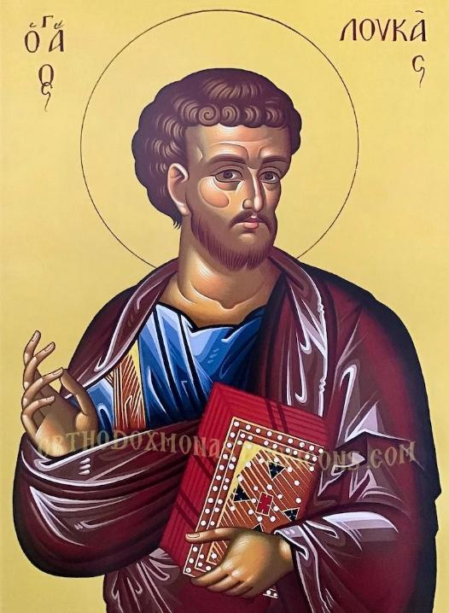
Author Luke
Physician turned missionary
Wrote Luke and Acts
Historian of Early Christianity
Travel companion of Paul
Only non-Jewish author in the NT

Slide 4
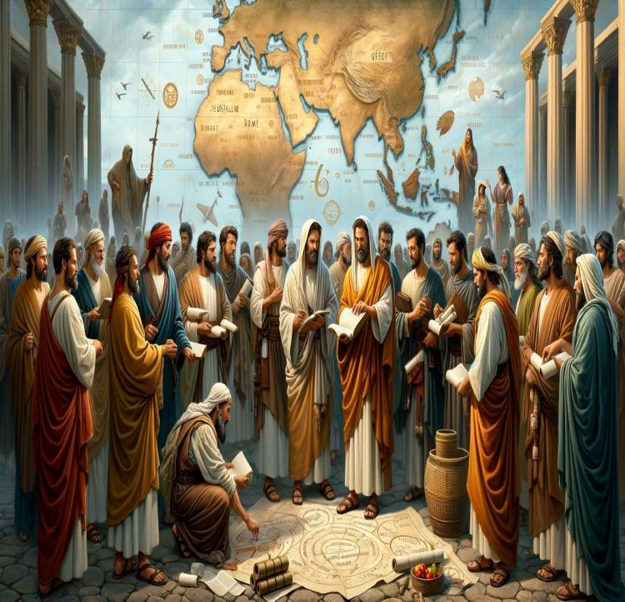
Background
Acts of the Holy Spirit
Growth and Spread of Christianity
Promise of the Holy Spirit (Acts 1:8)
Pentecost & Birth of the Church (2)
Persecution (8) & Paul’s Conversion (9)
Cornelius family saved (10)
First Christians (11)
First missionary journey (13)
Jerusalem Council (15)
Second Missionary Journey (16-18)

Slide 5
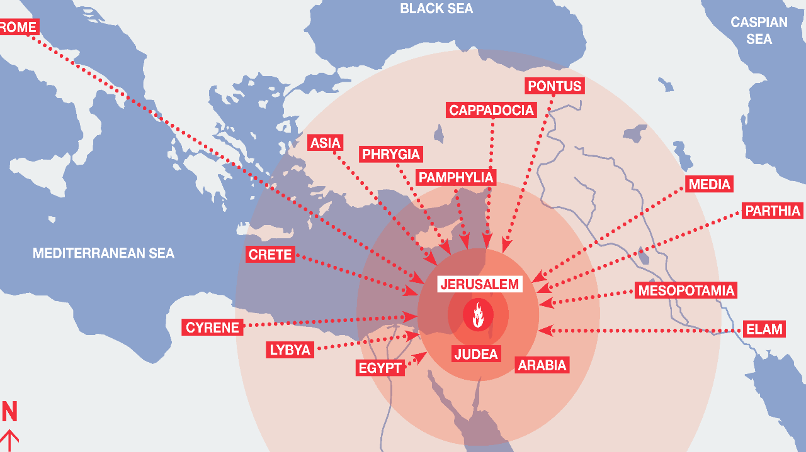
Nations of the First Pentecost (Acts 2:9-11)
Notes:
At the birth of church.. The disciples were in Jerusalem and Jews from many nations had gathered there for the feast of Pentecost.
Verses 9-11 mention several places and if you locate them geographically, we see people have come from all those places.
Jewish diaspora had come to Jerusalem for the feast. Since Babylonian exile, Jews were scattered all over the Mediterranean world and all the way to India.

Slide 6
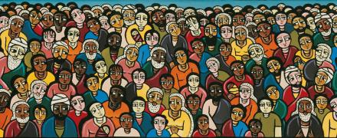
New Face of Christianity
Christians in every country of the world
The Gospel has reached the Ends of the Earth
A radical Shift in the cultural and demographic composition of the global church
Mission is from everywhere to everywhere
Notes:
We are living in an unprecedented time in the history of Christianity. The decisive shift of the center of gravity of Christianity has huge implications for African Christianity and its mission engagements globally.
Now there are Christians in every geopolitical entity in the world. At the beginning of the 21st century, Christianity is more global, diverse and dispersed than ever before. But also divided and disconnected. Every country is both a mission field and a mission force. It requires us to reimagine the world of mission for our changing times.
We are now in a new era in missions what some have called the ends of the earth missiology. The rise of the rest and an example is - Argentinian is the Pope, and the Vatican has a different feel now. A South African of Indian descent is heading WCC and a Korean American who was a missionary in Japan is heading Lausanne. Closer to home, a Korean American now leads NAE – National Association of Evangelicals.

Slide 7
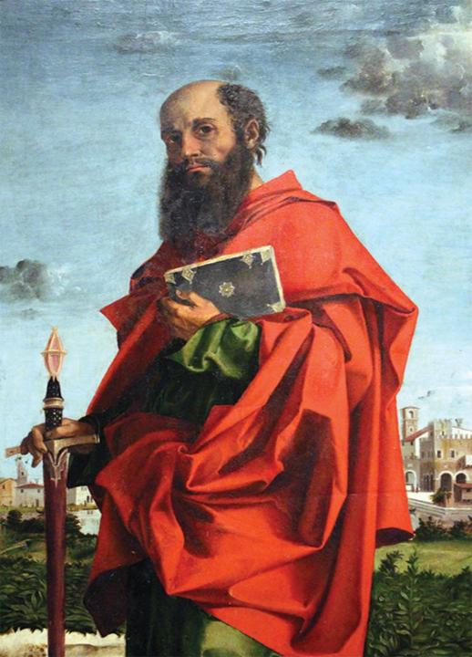
Apostle Paul
Born in Tarsus of Cilicia as Saul (~AD 10)
Part of the Jewish Diaspora and a Roman citizen
Zealous Pharisee who Persecuted Christians
Dramatic encounter with Jesus
Apostle to Gentiles
Imprisoned and executed in Rome (AD 62)
Changed the trajectory of Christianity

Slide 8
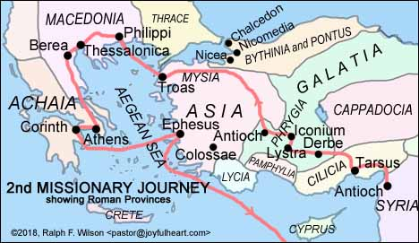

Slide 9
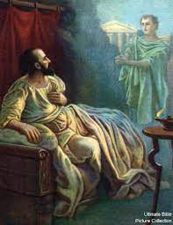
The CALL
Forbidden by the Holy Spirit
Prevented from going North
Went westward to Troas
Paul’s Vision & Call to help
Invitation to Europe

Slide 10
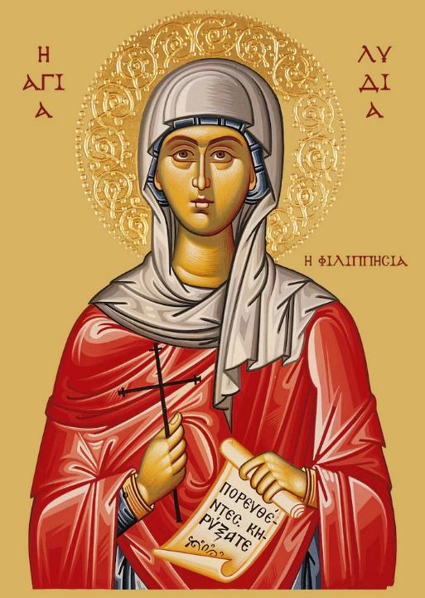
Lydia
From Thyatira
Seller of purple goods
Worshipper of God
Listens to Paul’s preaching
Entire household baptized
Urges Paul to stay with them
First convert in Europe

Slide 11
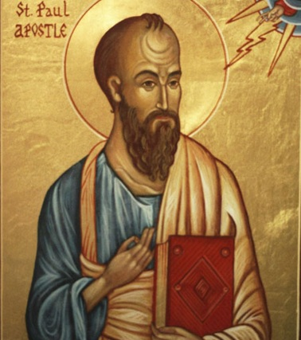
Diaspora Advantages
A Jew born and raised in a foreign land
Good learning, exposure & competency
Roman Citizen, widely travelled, multilingual
Leadership in diverse contexts
Preached and planted churches all over
Wrote many NT letters in Greek

Slide 12
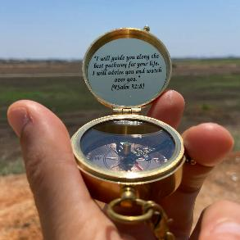
Some Life Lessons
Stay eager to share the Gospel with anyone, anywhere and anytime
Closed doors are not the end of the story
God redirects our paths to open doors
Only in Troas do we receive a Macedonian call (not in Antiochs-Syrian/Psidian)
“They” to “We” of mission (16:10)
Transcontinental border crossing (a new season in life and ministry)
Going to Ephesus later from the West

Slide 13
Conclusion
Paul’s second missionary journey
Dynamic redirection
Entering new arenas
Expanding kingdom impact
Joining in the mission of God

