Slide 1
Who is he?
Mark 8:27–9:13

Slide 4
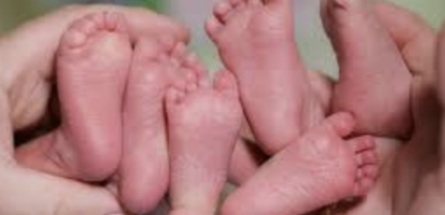
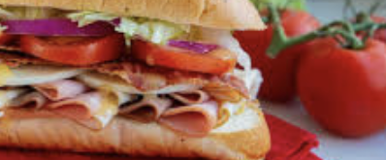
Structure
Triplets presented like a sandwich structure.

Slide 5
Today’s Triplets
Story 1 – Peter’s Confession, 8:27–30
Story 2 – Jesus’s Confession, 8:31–9:1
Story 3 – The Father’s Confession, 9:2–13

Slide 6
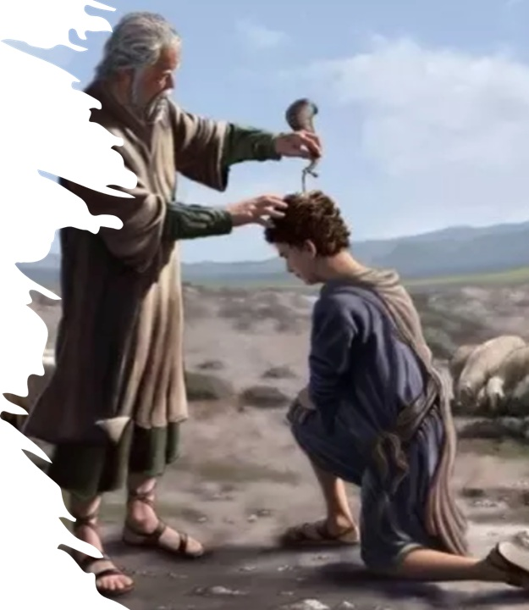
Story #1 – Peter’s Confession (8:27–30)
The anointed one–Christos
Son of God (1:1), Son of David (12:35), Son of the Blessed (14:61), the King of Israel (15:32)
2 Samuel 7:12–16

Slide 7
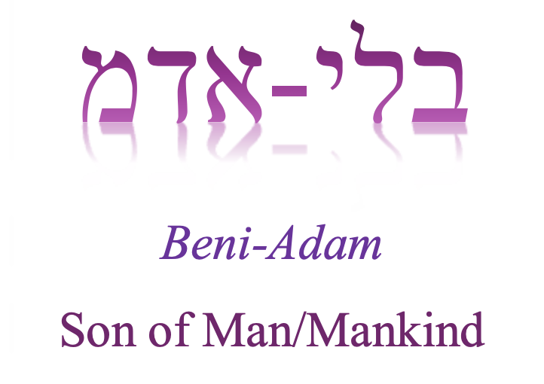
Story #2 – Jesus’s Confession (8:31–9:1)
Son of Man
Forgives sin (2:10), is Lord over Sabbath (2:28), suffers, is handed over, killed, and raised from the dead (8:30), serves (10:45), sits at the right hand of the Mighty One (14:62), and will return in power (13:26).

Slide 8
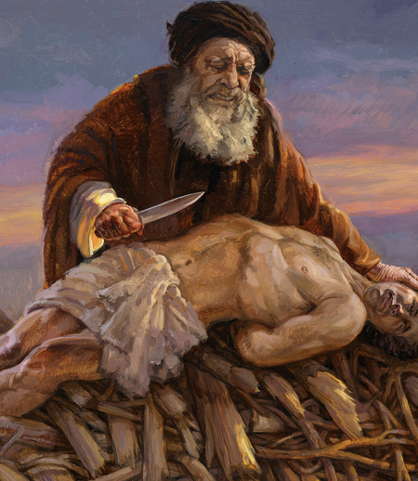
Story #3 – The Father’s Confession (9:2–13)
The beloved Son, or Son whom I love (1:11; 9:7)
Genesis 22:2

Slide 9
Lessons we’ve learned today
Jesus is the anointed one – Son of David, Son of God, the King of Israel.
He is the Son of Man – Lord over Sabbath, serves, forgives, suffers, dies, and resurrects, sits at the right hand of the Almighty, and returns in glory.
The beloved Son of the Father, the sacrifice.

Slide 10
Question for us
What’s our confession?
“What gain is there to save the whole world and lose one’s soul?” (8:36)

