Slide 1
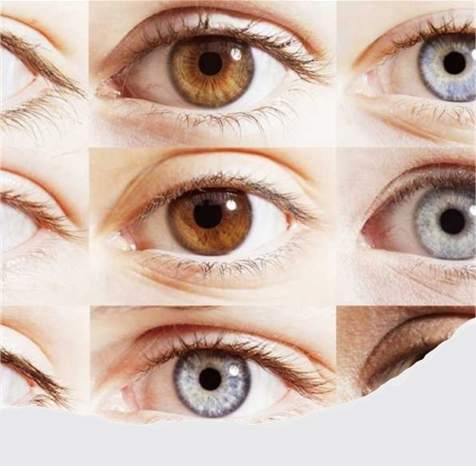

Clear Vision
Mark 8:1–26

Slide 2


Slide 3
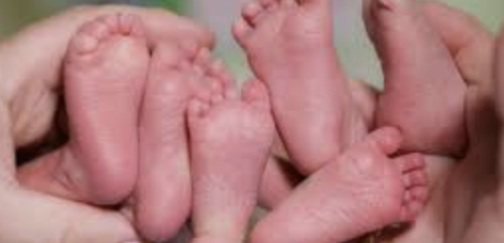
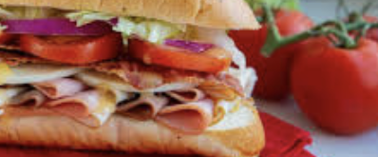
Structure
Triplets presented like a sandwich structure.

Slide 4
Today’s Triplets
Story 1 – Divine Vision, 8:1–10
Story 2 – Unclear Visions, 8:11–21
Story 3 – Progressive Vision, 8:22–26

Slide 5
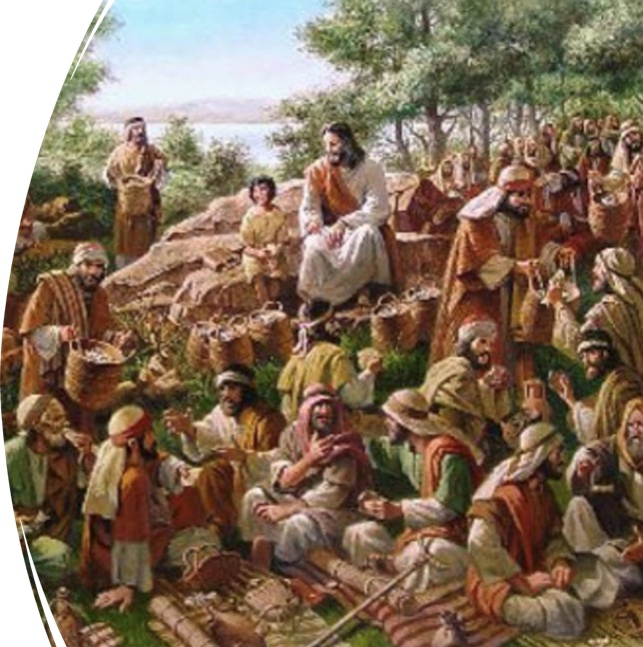
Story #1 – Divine Vision (8:1–10)
Compassion (splanknome) upon the crowd, v. 1–3
Human vision or solution, v. 4
Divine provision, v. 5–10

Slide 6
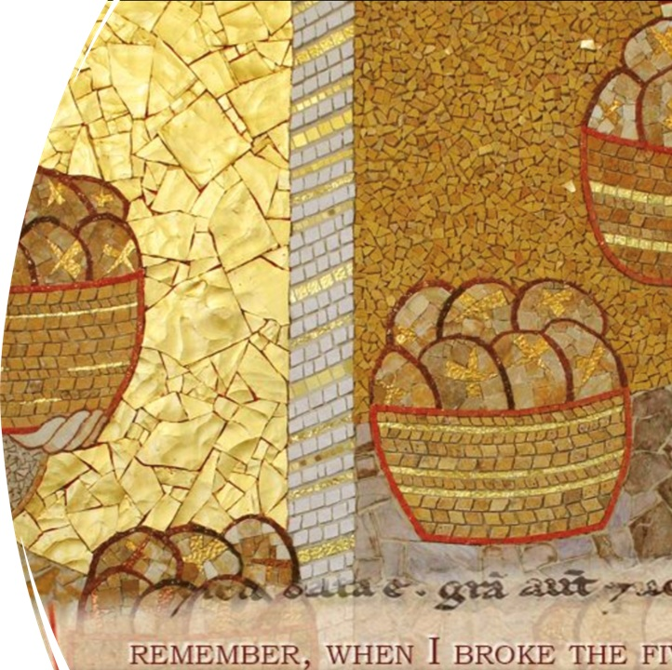
Story #2 – Unclear Visions (8:11–21)
Pharisees’ need for a sign, v. 11–13
Disciples’ need for an explanation, v. 14–21

Slide 7

Story #3 – Progressive Visions (8:22–26)
First stage, v. 22–24
Second stage, v. 25–26

Slide 8

Lessons we’ve learned today
A person may have a divine vision like Jesus’s that is compassionate and caring (8:1–10).
Another vision is a learner’s or unclear vision, which requires evidence, signs, and explanations (8:11–21).
Ultimately, a person can have a progressive vision based on faith, which may not be perfect but continues to evolve (8:22–26).

Slide 9

Question for us
What kind of a vision we have?
“Our mission is your vision” – St. Luke’s Medical Center, Manila, the Philippines

