Slide 5
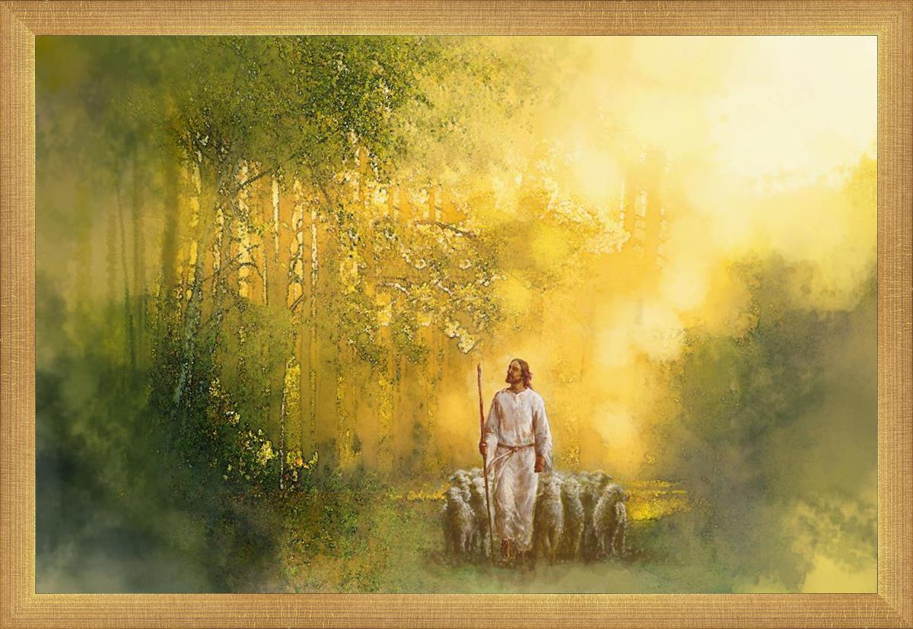
Psalm 23 – HE knows my name.

Slide 7
6 Lessons from Psalm 23
1. Vs 1: 'The Lord is my shepherd'. God is personal (John 10:3-4, 14).

Slide 8
6 Lessons from Psalm 23
2. Vs 1-2: The Lord is our provider.

Slide 10
6 Lessons from Psalm 23
2. Vs 1-2: The Lord is our provider.
To worry is to question God’s
provision (Matthew 6:25-34).

Slide 11
6 Lessons from Psalm 23
3. Vs 3: The Lord is our restorer.

Slide 12
6 Lessons from Psalm 23
3. Vs 3: The Lord is our restorer.
He guides me along right paths.
Lit. in Hebrew: “paths that are
right and good in God’s sight.”
Sheep need to be rescued and
restored.

Slide 13
6 Lessons from Psalm 23
4. Vs 4: The Lord is our comfort and
guide.

Slide 14
6 Lessons from Psalm 23
4. Vs 4: The Lord is our comfort and
guide.
Trials have a purpose (Romans 5:4)

Slide 16
6 Lessons from Psalm 23
4. Vs 4: The Lord is our comfort and
guide.
Trials have a purpose (Romans 5:4)
The psalmist says God's rod and staff give us comfort.

Slide 17
Don’t look down or around – look up!

Slide 18
6 Lessons from Psalm 23
5. Vs 5: The Lord is exalter.

Slide 19
6 Lessons from Psalm 23
5. Vs 5: The Lord is exalter.
God has blessed us with
overflowing abundance.

Slide 20
6 Lessons from Psalm 23
Vs 6 - The Lord is our home.

Slide 22
6 Lessons from Psalm 23
Vs 6 - The Lord is our home.
God’s love and goodness are
constant in life and eternity.

Slide 23
APPLICATION
1) We need to trust God’s way
and timing.

Slide 25
APPLICATION
1) We need to trust God’s way
and timing.
2) We need obey and follow Him
on His paths, because they lead
us home to Him.

