Slide 1
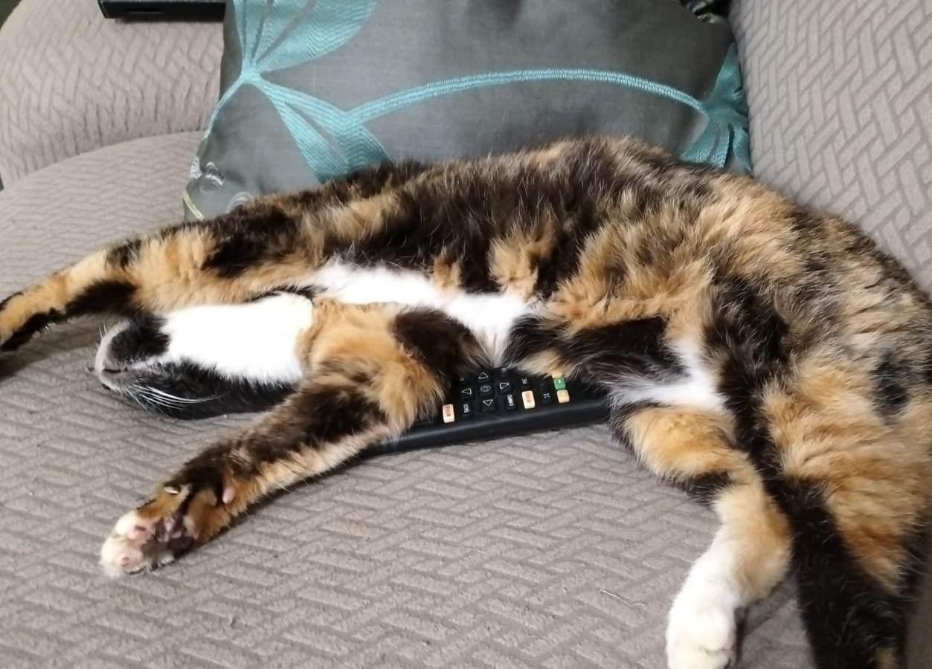
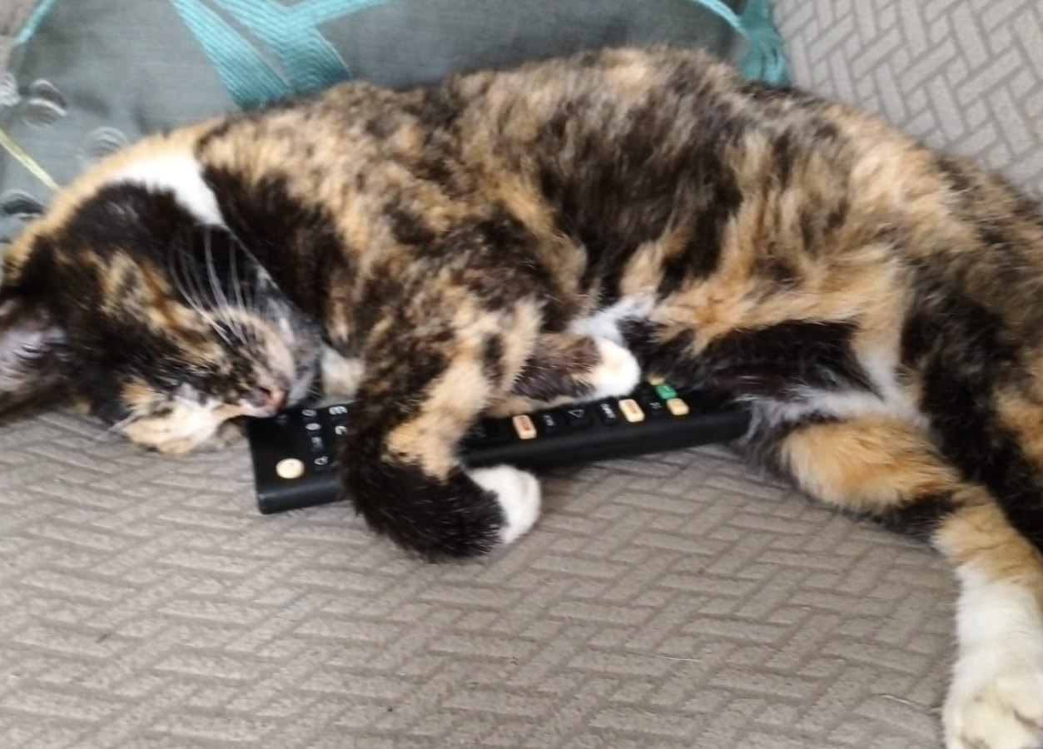

Slide 3
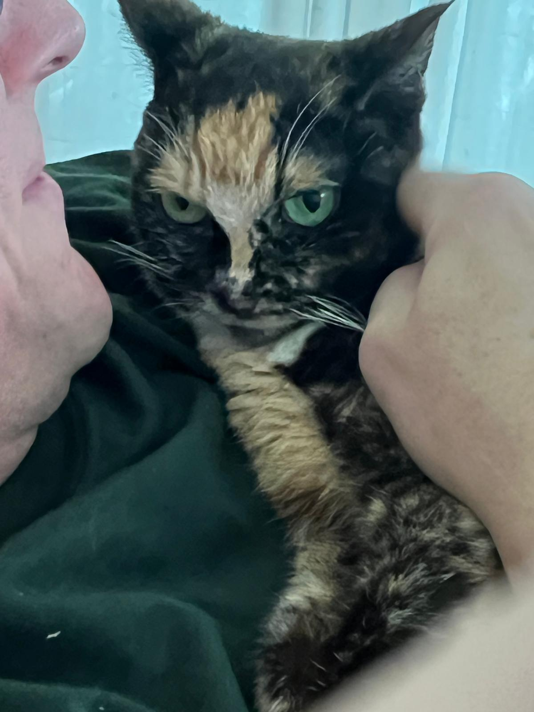
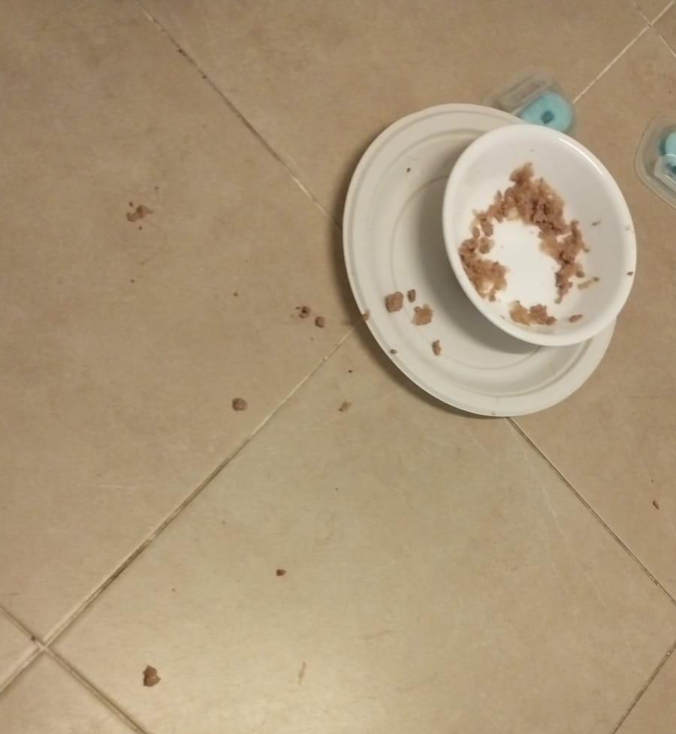

Slide 6
Isaiah 11 ⁶ The wolf will live with the lamb, the leopard will lie down with the goat, the calf and the lion and the yearling together; and a little child will lead them. ⁷ The cow will feed with the bear, their young will lie down together, and the lion will eat straw like the ox. ⁸ The infant will play near the cobra’s den, and the young child will put its hand into the viper’s nest. ⁹ They will neither harm nor destroy on all my holy mountain, for the earth will be filled with the knowledge of the Lord as the waters cover the sea.
6

Slide 7
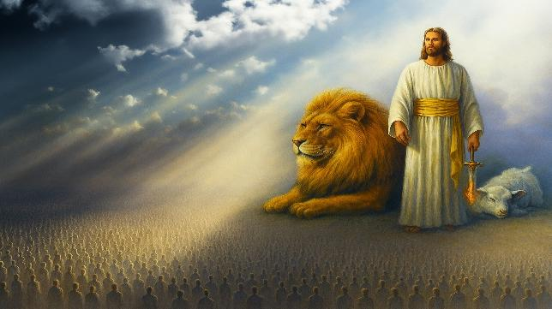
Millennial Kingdom
7

Slide 8
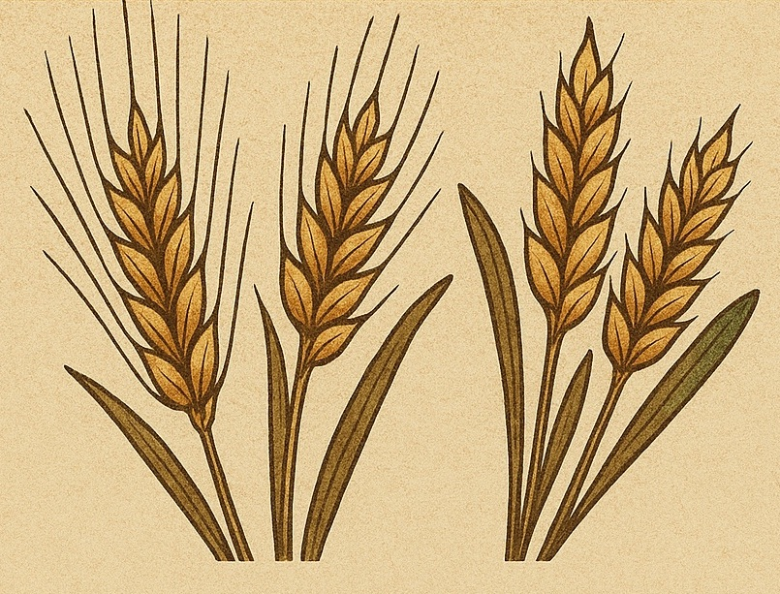
The Spring Feasts
Leviticus 23:1-22
8

Slide 9
Sabbath => Rest & Gathering
Passover => Deliverance
Unleavened Bread => Purity
Firstfruits => Trust
Feast of Weeks => Generosity
9

Slide 10
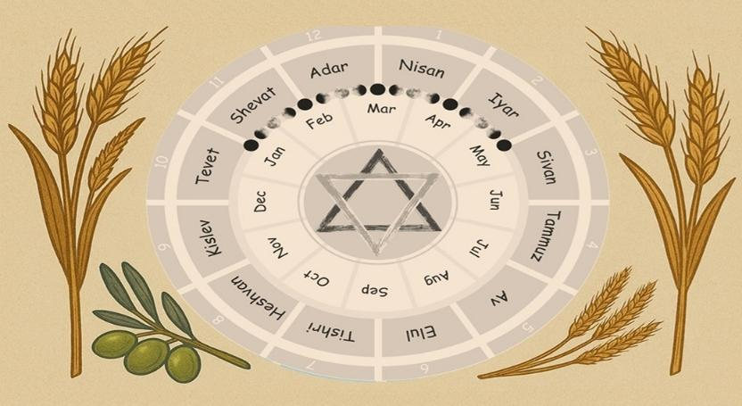
God’s Checklist of Remembrance
Leviticus 23
God’s Calendar of Redemption
Leviticus 23
10

Slide 11
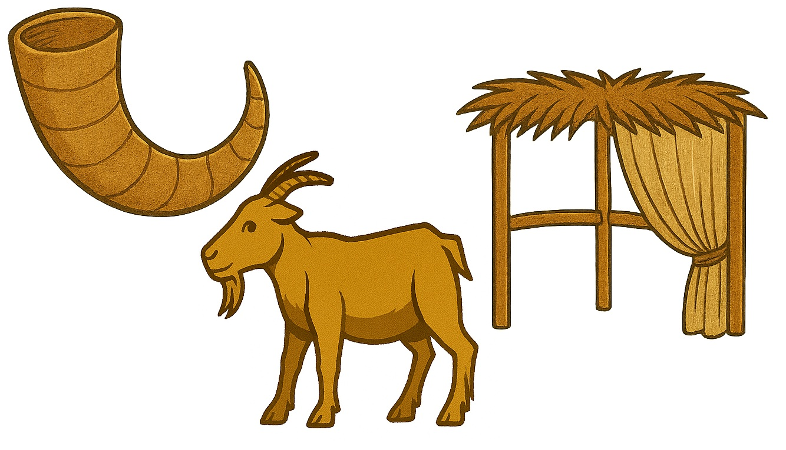
The Fall Feasts
Leviticus 23:23-44
11

Slide 12
²³ And the Lord spoke to Moses, saying, ²⁴ “Speak to the people of Israel, saying, In the seventh month, on the first day of the month, you shall observe a day of solemn rest, a memorial proclaimed with blast of trumpets, a holy convocation. ²⁵ You shall not do any ordinary work, and you shall present a food offering to the Lord.”
12

Slide 13
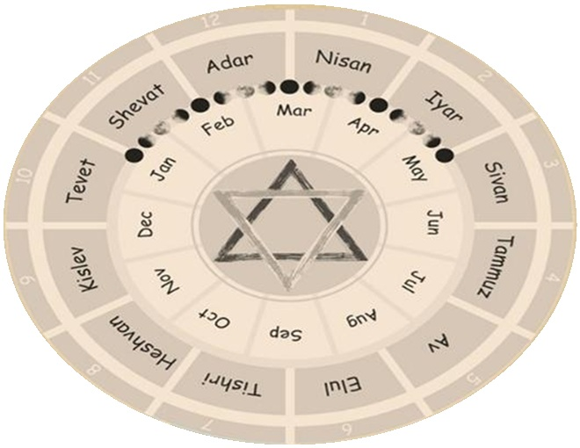
SPRING
FEASTS
FALL
FEASTS
13

Slide 14
²³ And the Lord spoke to Moses, saying, ²⁴ “Speak to the people of Israel, saying, In the seventh month, on the first day of the month, you shall observe a day of solemn rest, a memorial proclaimed with blast of trumpets, a holy convocation. ²⁵ You shall not do any ordinary work, and you shall present a food offering to the Lord.”
14

Slide 15
Exodus 19: Israel at Mt. Sinai

Slide 16
¹⁶ On the morning of the third day there were thunders and lightnings and a thick cloud on the mountain and a very loud trumpet blast, so that all the people in the camp trembled.

Slide 17
¹⁷ Then Moses brought the people out of the camp to meet God, and they took their stand at the foot of the mountain. ¹⁸ Now Mount Sinai was wrapped in smoke because the Lord had descended on it in fire. The smoke of it went up like the smoke of a kiln, and the whole mountain trembled greatly.

Slide 18
¹⁹ And as the sound of the trumpet grew louder and louder, Moses spoke, and God answered him in thunder. ²⁰ The Lord came down on Mount Sinai, to the top of the mountain.

Slide 19
Exodus 19 is the first time the people as a whole directly experience God’s presence and voice, fulfilling God's promise to make Himself known not just through Moses, but to the nation.
Exodus 19
שׁוֹפָר (shofar)
Ram’s horn, trumpet (object)
Explicit – shofar
Signaled God’s Presence
Leviticus 23:24
תְּרוּעָה (teru‘ah)
Blast/shout (sound)
Implied – shofar
Call to remembrance

Slide 20
Experience God’s Presence

Slide 21
Today, the Feast of Trumpets is called Rosh Hashanah marks the beginning of the civil year, according to the teachings of Judaism, and is the traditional anniversary of the creation of Adam and Eve

Slide 22
²⁶ And the Lord spoke to Moses, saying, ²⁷ “Now on the tenth day of this seventh month is the Day of Atonement. It shall be for you a time of holy convocation, and you shall afflict yourselves and present a food offering to the Lord. ²⁸ And you shall not do any work on that very day, for it is a Day of Atonement, to make atonement for you before the Lord your God.

Slide 23
²⁹ For whoever is not afflicted on that very day shall be cut off from his people. ³⁰ And whoever does any work on that very day, that person I will destroy from among his people. ³¹ You shall not do any work. It is a statute forever throughout your generations in all your dwelling places. ³² It shall be to you a Sabbath of solemn rest, and you shall afflict yourselves. On the ninth day of the month beginning at evening, from evening to evening shall you keep your Sabbath.”

Slide 25
Holy convocation (gather)
Not work
Offering
Afflict yourselves

Slide 26
Lev 23 Sabbath + Feasts | Gather | Not Work | Offering
Sabbath | Yes | Yes | Yes
Passover | No | No | Yes
Unleavened Bread (1st Day) | Yes | Yes | Yes
Unleavened Bread (7th Day) | Yes | Yes | Yes
Feast of Weeks (Pentecost) | Yes | Yes | Yes
Feast of Trumpets | Yes | Yes | Yes
Day of Atonement | Yes | Yes | Yes
Feast of Booths (1st Day) | Yes | Yes | Yes
Feast of Booths (8th Day) | Yes | Yes | Yes

Slide 27
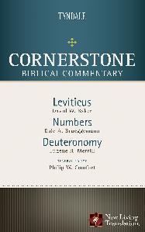
Lev 23 Sabbath + Feasts | Afflict Yourselves
Sabbath | No
Passover | No
Unleavened Bread (1st Day) | No
Unleavened Bread (7th Day) | No
Feast of Weeks (Pentecost) | No
Feast of Trumpets | No
Day of Atonement | Yes
Feast of Booths (1st Day) | No
Feast of Booths (8th Day) | No
The self-denial of food and other elements of life such as sexual intimacy (cf. Num 30:13; Ps 35:13; Isa 58:3, 5)

Slide 28
²⁹ For whoever is not afflicted on that very day shall be cut off from his people.
Verse | Offense | Reason for Being “Cut Off”
Gen 17:14 | Not circumcised | Covenant violation
Exo 30:33 | Misusing sacred anointing oil | Treating holy things as common
Exo 30:38 | Making the sacred incense as perfume | Profaning sacred worship
Lev 7:20–21 | Eating peace offering while unclean | Violating ritual purity
Lev 7:25 | Eating sacrificial fat | Disrespecting God’s portion
Lev 7:27 | Eating blood | Defiling the sacred life-blood
Lev 17:9 | Sacrificing outside the tabernacle | Rejecting God’s ordained worship
Lev 19:8 | Eating a holy offering improperly | Disregarding holiness
Num 9:13 | Failing to keep the Passover | Neglecting God’s appointed time

Slide 29
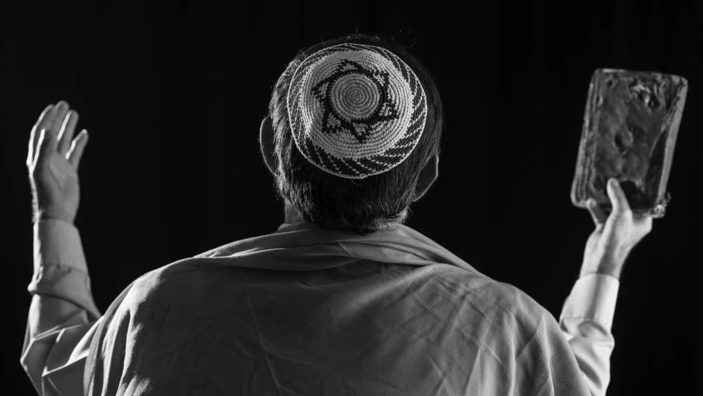
Yōm Kippūr is the holiest day of the year in Judaism.

Slide 30
https://bibleproject.com/videos/leviticus/
https://www.youtube.com/@bibleproject

Slide 31
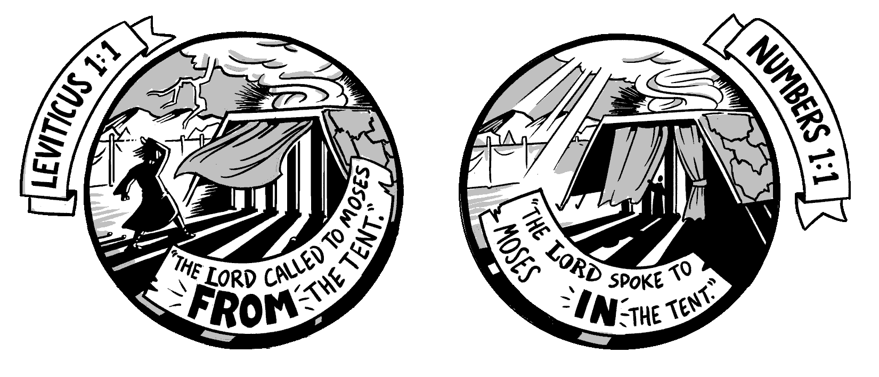
"How can Israel, in their sin and selfishness,
be reconciled to a holy God?

Slide 32
Experience God’s Presence
Escape God’s Punishment

Slide 33
Experience God’s Presence
Escape God’s Punishment
Enjoying God’s Provision

Slide 34
³³ And the Lord spoke to Moses, saying, ³⁴ “Speak to the people of Israel, saying, On the fifteenth day of this seventh month and for seven days is the Feast of Booths to the Lord. ³⁵ On the first day shall be a holy convocation; you shall not do any ordinary work. ³⁶ For seven days you shall present food offerings to the Lord. . . .

Slide 35
⁴² You shall dwell in booths for seven days. All native Israelites shall dwell in booths, ⁴³ that your generations may know that I made the people of Israel dwell in booths when I brought them out of the land of Egypt: I am the Lord your God.”
⁴⁴ Thus Moses declared to the people of Israel the appointed feasts of the Lord.

Slide 36
⁴² You shall dwell in booths for seven days. All native Israelites shall dwell in booths, ⁴³ that your generations may know that I made the people of Israel dwell in booths when I brought them out of the land of Egypt: I am the Lord your God.”
⁴⁴ Thus Moses declared to the people of Israel the appointed feasts of the Lord.

Slide 37
Enjoying God’s Provision
1. Daily Provision of Food
Manna – Bread from heaven (Exodus 16:4, 31–35)
Quail – Meat when they complained of hunger (Exodus 16:12–13; Numbers 11:31–32)
Water from the rock – At Horeb and again at Meribah (Exodus 17:6; Numbers 20:11)

Slide 38
Enjoying God’s Provision
2. Preservation of Clothing and Health
Clothes did not wear out (Deuteronomy 8:4; 29:5)
Feet did not swell – A sign of divine protection and health (Deuteronomy 8:4; Nehemiah 9:21)

Slide 39
Enjoying God’s Provision
3. Guidance and Protection
Pillar of cloud by day – Led them and gave shade (Exodus 13:21–22; Numbers 9:15–23)
Pillar of fire by night – Gave light and direction (same passages)
Angel of the Lord – Went before them (Exodus 23:20–23)

Slide 40
Enjoying God’s Provision
4. Victory Over Enemies
Defeated attacking nations like the Amalekites, Sihon king of the Amorites, Og king of Bashan (Exodus 17; Numbers 21)
Protection from curses – God turned Balaam’s curse into blessing (Numbers 22–24; Deuteronomy 23:5)

Slide 41
Enjoying God’s Provision
5. The Law and Covenant
Ten Commandments and Torah – Given at Mount Sinai (Exodus 20; Deuteronomy 5)
The Tabernacle – God's dwelling among them (Exodus 25–40)
Priesthood and sacrifices – For atonement and worship (Leviticus)

Slide 42
Enjoying God’s Provision
6. Order and Structure
Tribal organization – Camp arrangement and leadership (Numbers 2–4)
Judges and elders – To help govern (Exodus 18; Numbers 11)

Slide 43
Enjoying God’s Provision
7. Mercy and Forgiveness
Despite rebellion, idolatry, and complaining, God:
Did not destroy them completely (Exodus 32–34)
Continued to dwell with them through the Tabernacle
Renewed the covenant multiple times (Deuteronomy 9–10)

Slide 44
Experience God’s Presence
1 Cor 15:52 in a moment, in the twinkling of an eye, at the last trumpet. For the trumpet will sound, and the dead will be raised imperishable, and we shall be changed.
1 Thess 4:16 For the Lord himself will descend from heaven with a cry of command, with the voice of an archangel, and with the sound of the trumpet of God. And the dead in Christ will rise first.

Slide 45
Escape God’s Punishment
Rom 3:25 God presented Christ as a sacrifice of atonement, through the shedding of his blood—to be received by faith.
1 John 2:2 He is the atoning sacrifice for our sins, and not only for ours but also for the sins of the whole world.
1 John 4:10 This is love: not that we loved God, but that he loved us and sent his Son as an atoning sacrifice for our sins.

Slide 46
Enjoying God’s Provision
1. Spiritual Food and Drink
Jesus, the Bread of Life (John 6:35)
Living Water through the Spirit (John 4:14; 7:38–39)
2. Sustaining Grace
God's grace is sufficient in weakness (2 Corinthians 12:9)
Renewed strength for the journey (Isaiah 40:31; Philippians 4:13)

Slide 47
Enjoying God’s Provision
3. Divine Guidance
The Holy Spirit leads us into all truth (John 16:13; Romans 8:14)
4. Victory Over the Enemy
Spiritual armor for battle (Ephesians 6:10–18)
Christ’s triumph over sin and death (Colossians 2:15)

Slide 48
Enjoying God’s Provision
5. A New Covenant
Jesus mediates a better covenant (Heb 8:6)
The law written on our hearts (Heb 10:16)
6. The Church Community
The body of Christ for support and order (Romans 12:4–5; 1 Cor 12)
Gifts and leadership for building up (Eph 4:11–16)

Slide 49
Enjoying God’s Provision
7. Mercy and Forgiveness
Continual access to grace and forgiveness through Christ (1 John 1:9; Hebrews 4:16)
No condemnation in Christ (Romans 8:1)

Slide 50
Experience God’s Presence
Escape God’s Punishment
Enjoying God’s Provision

