Slide 1
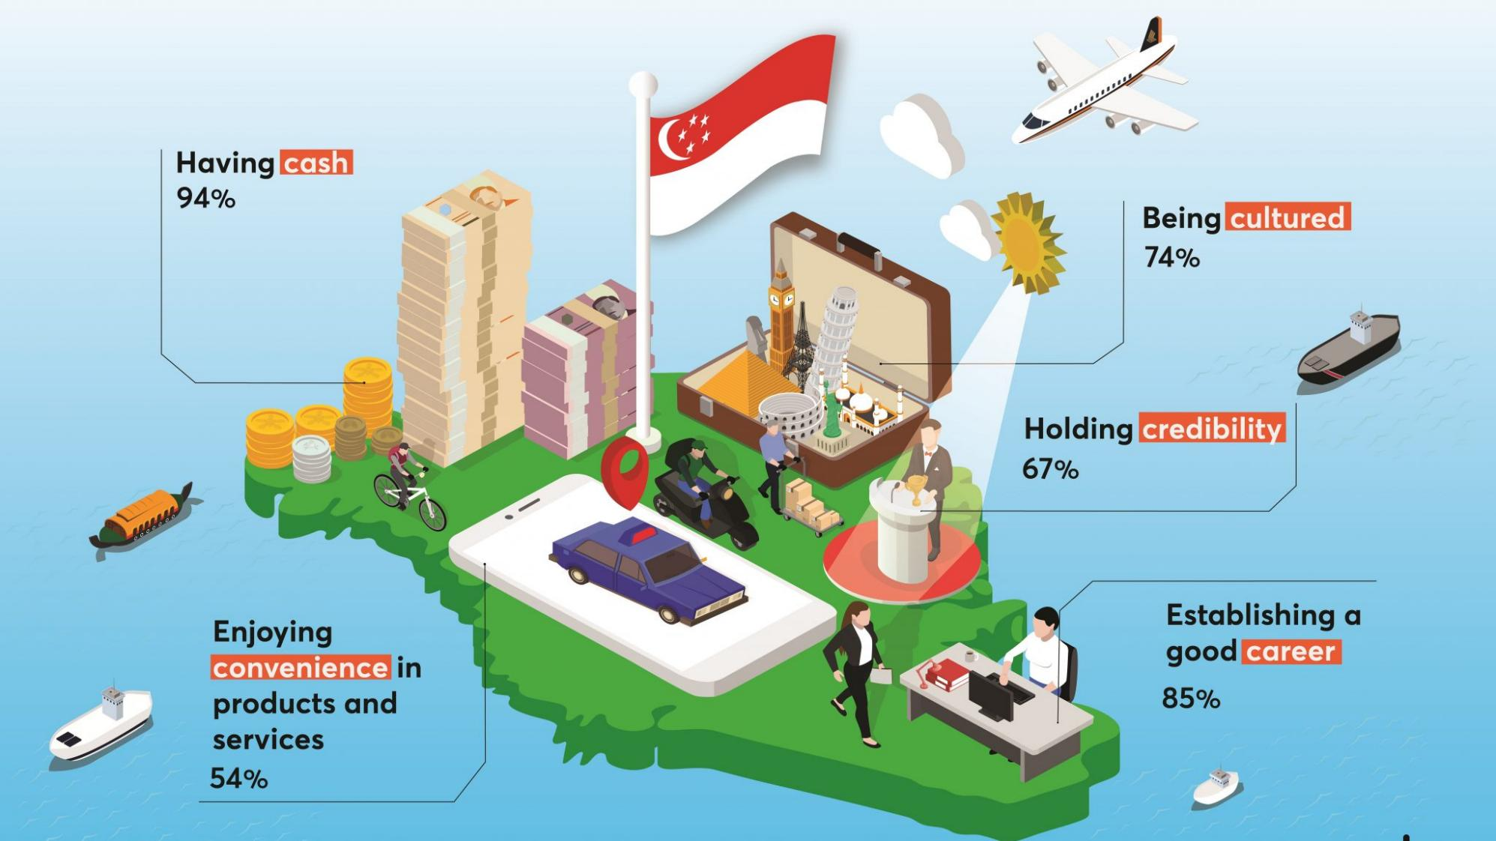
Notes:
https://hr.asia/featured-news/the-evolving-definition-of-the-five-cs-of-singapore/

Slide 2
CASH
CREDIT CARD
CAR
CONDO
COUNTRY CLUB
Notes:
https://hr.asia/featured-news/the-evolving-definition-of-the-five-cs-of-singapore/

Slide 3
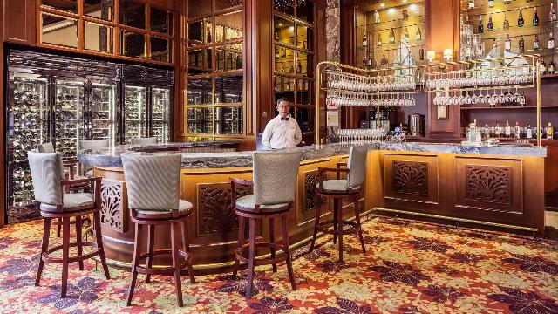
Tanglin Club
3
Notes:
https://www.tatlerasia.com/power-purpose/business/exclusive-private-clubs-in-singapore

Slide 4
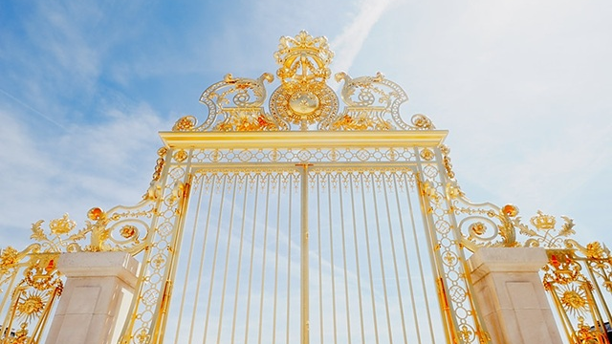
4
Notes:
https://www.flickr.com/photos/andyandorla/3852828218

Slide 5
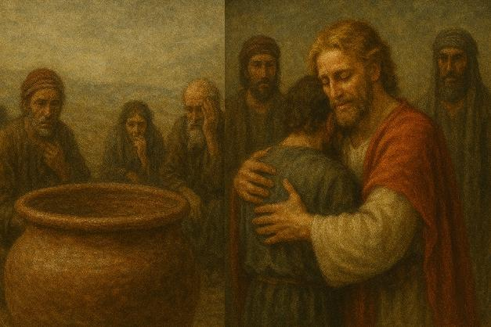
A Story of Redemption:
From Crisis to Compassion
Gen 42-45:15
5

Slide 6
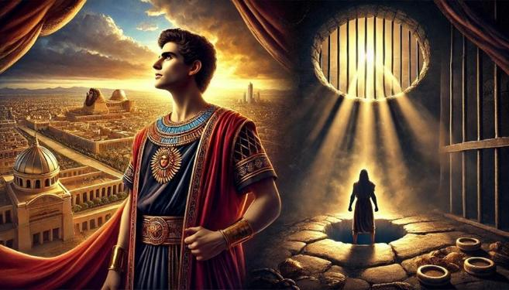
Joseph: From Pit to Prison to Palace
6

Slide 7
7

Slide 8
8

Slide 9
9

Slide 10
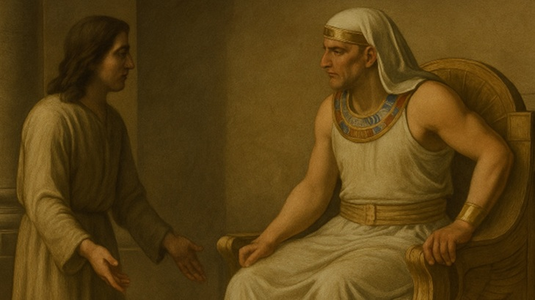
Joseph in Charge
Gen 41
10

Slide 11
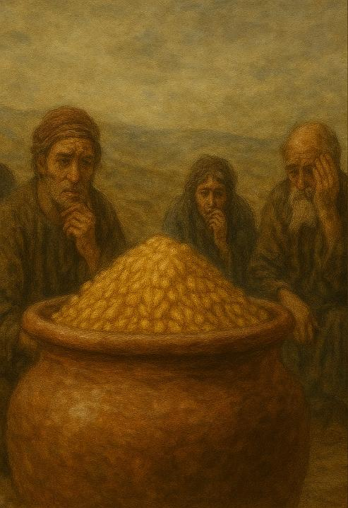
11

Slide 12
A Story of Redemption:
From Crisis to Compassion
Gen 42-45:15
12

Slide 13
Ch 42 ¹ When Jacob learned that there was grain for sale in Egypt, he said to his sons, “Why do you look at one another?” ² And he said, “Behold, I have heard that there is grain for sale in Egypt. Go down and buy grain for us there, that we may live and not die.”
³ So ten of Joseph's brothers went down to buy grain in Egypt. ⁴ But Jacob did not send Benjamin, Joseph's brother, with his brothers, for he feared that harm might happen to him. ⁵ Thus the sons of Israel came to buy among the others who came, for the famine was in the land of Canaan
13

Slide 14
A Story of Redemption: From Crisis to Compassion
Redemption Required (Gen 42:1–5)
A crisis exposes a deeper need they haven’t recognized yet.
14

Slide 15
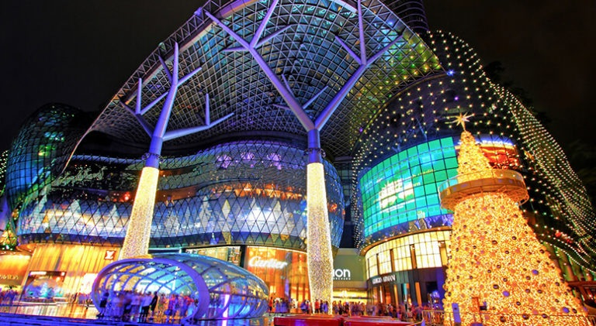
Redemption starts with recognizing our lack—our need.
We can’t be filled until we admit we’re empty.
15
Notes:
https://www.tourmyindia.com/blog/best-singapore-shopping-places/

Slide 16
 | Reuben | 1
 | Simeon | 2
 | Levi | 3
 | Judah | 4
BILHAH (Rachel's Handmaid) | Dan | 5
 | Naphtali | 6
ZILPAH (Leah's Handmaid) | Gad | 7
 | Asher | 8
LEAH | Issachar | 9
 | Zebulun | 10
RACHEL | Joseph | 11
 | Benjamin | 12
LEAH
Joseph’s Brothers
RACHEL
16

Slide 17
LEAH | Reuben | 1
 | Simeon | 2
 | Levi | 3
 | Judah | 4
BILHAH (Rachel's Handmaid) | Dan | 5
 | Naphtali | 6
ZILPAH (Leah's Handmaid) | Gad | 7
 | Asher | 8
LEAH | Issachar | 9
 | Zebulun | 10
RACHEL | Joseph | 11
 | Benjamin | 12
17

Slide 18
LEAH | Reuben | 1
 | Simeon | 2
 | Levi | 3
 | Judah | 4
BILHAH (Rachel's Handmaid) | Dan | 5
 | Naphtali | 6
ZILPAH (Leah's Handmaid) | Gad | 7
 | Asher | 8
LEAH | Issachar | 9
 | Zebulun | 10
RACHEL | Joseph | 11
 | Benjamin | 12
18

Slide 19
LEAH | Reuben | 1
 | Simeon | 2
 | Levi | 3
 | Judah | 4
BILHAH (Rachel's Handmaid) | Dan | 5
 | Naphtali | 6
ZILPAH (Leah's Handmaid) | Gad | 7
 | Asher | 8
LEAH | Issachar | 9
 | Zebulun | 10
RACHEL | Joseph | 11
 | Benjamin | 12
19

Slide 20
Ch 42 ¹ When Jacob learned that there was grain for sale in Egypt, he said to his sons, “Why do you look at one another?” ² And he said, “Behold, I have heard that there is grain for sale in Egypt. Go down and buy grain for us there, that we may live and not die.”
³ So ten of Joseph's brothers went down to buy grain in Egypt. ⁴ But Jacob did not send Benjamin, Joseph's brother, with his brothers, for he feared that harm might happen to him. ⁵ Thus the sons of Israel came to buy among the others who came, for the famine was in the land of Canaan
20

Slide 21
Ch 42 ¹ When Jacob learned that there was grain for sale in Egypt, he said to his sons, “Why do you look at one another?” ² And he said, “Behold, I have heard that there is grain for sale in Egypt. Go down and buy grain for us there, that we may live and not die.”
³ So ten of Joseph's brothers went down to buy grain in Egypt. ⁴ But Jacob did not send Benjamin, Joseph's brother, with his brothers, for he feared that harm might happen to him. ⁵ Thus the sons of Israel came to buy among the others who came, for the famine was in the land of Canaan
21

Slide 22
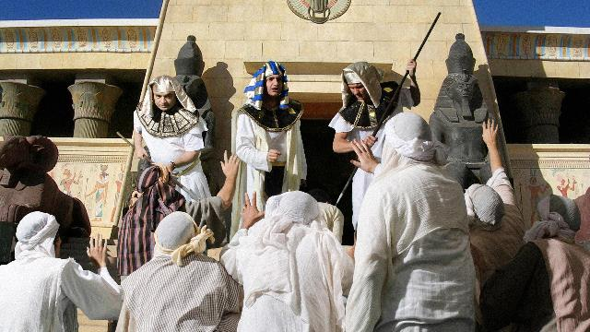
Joseph’s Brothers bow before him
22
Notes:
These images are the copyright of the LUMO project (Big Book Media) and distributed for free download, under license exclusively by FreeBibleimages for teaching purposes only. All rights reserved.
Images can be used in educational presentations, blogs and social media with attribution to www.LumoProject.com.
These images are not licensed for re-use in video, publishing or other media and cannot be sold under any circumstances or used in any format for commercial gain. As the LUMO project produces its own publishing, photos cannot be licensed to other clients outside of FreeBibleimages.org.
You cannot redistribute this set of images online but you can create a link to the relevant page on FreeBibleimages.org to allow others to download these images under the same Terms of Download.
Downloaded pictures can be used in the retelling of Bible stories and narrative that are faithful to the Biblical account. They are not to be used in any context where the accompanying message is undermining of the Christian faith and gospel.

Slide 23
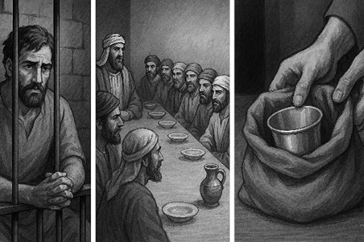
23

Slide 24
DESCRIPTIVE
describes what happened
PRESCRIPTIVE
shows what we should do
24

Slide 25
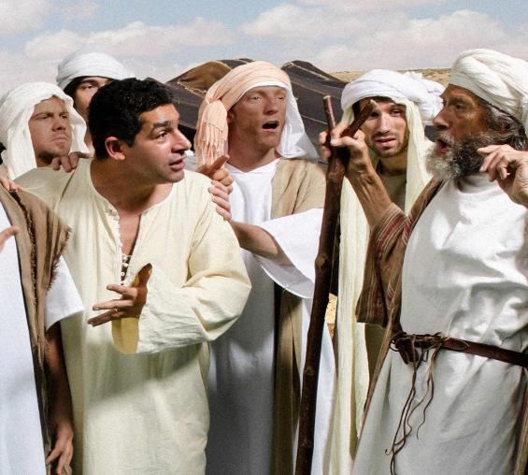
Joseph’s Revenge
Brother’s Response
25

Slide 26
Conscience – Recognizing Guilt
Gen 42:21
Then they said to one another, “In truth we are guilty concerning our brother, in that we saw the distress of his soul, when he begged us and we did not listen. That is why this distress has come upon us.”
26

Slide 27
Conviction – Owning Their Guilt
Gen 44:16
What shall we say to my lord? What shall we speak? Or how can we clear ourselves? God has found out the guilt of your servants; behold, we are my lord's servants, both we and he also in whose hand the cup has been found.
27

Slide 28
Change – True Transformation
Gen 44:33
Now therefore, please let your servant remain instead of the boy as a servant to my lord, and let the boy go back with his brothers.
28

Slide 29
A Story of Redemption: From Crisis to Compassion
Redemption Required (Gen 42:1–5)
Redemption’s Requirements (Gen 42:6–44)
29

Slide 30
Redefining the 5 C’s
Crisis
Conscience
Conviction
Change
Compassion
30

Slide 31
A Story of Redemption: From Crisis to Compassion
Redemption Required (Gen 42:1–5)
Redemption’s Requirements (Gen 42:6–44)
Redemption Realized (Gen 45:1–15)
31

Slide 32
The Power of Grace!
Genesis 45:5
⁵ And now do not be distressed or angry with yourselves because you sold me here, for God sent me before you to preserve life.
32

Slide 34
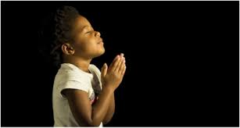
THE OPEN INVITATION

