Slide 1
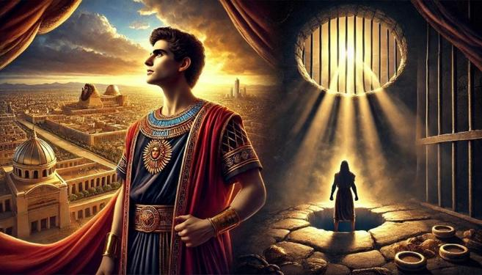
Joseph: From Pit to Prison to Palace

Slide 2
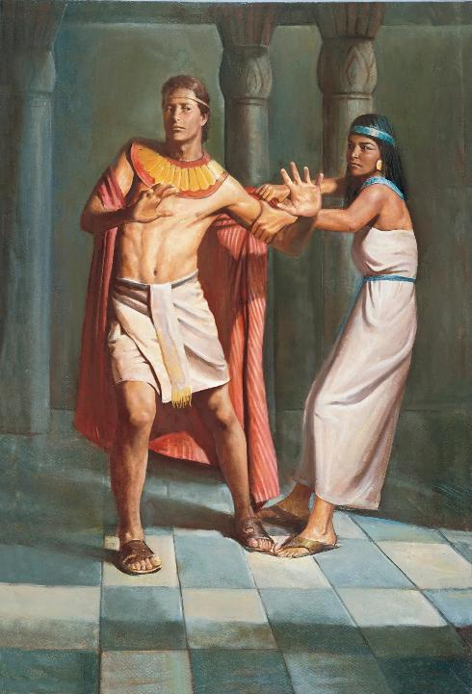

Slide 3
²¹ But the Lord was with Joseph and showed him steadfast love and gave him favor in the sight of the keeper of the prison. ²² And the keeper of the prison put Joseph in charge of all the prisoners who were in the prison. Whatever was done there, he was the one who did it. ²³ The keeper of the prison paid no attention to anything that was in Joseph's charge, because the Lord was with him. And whatever he did, the Lord made it succeed.

Slide 4
Genesis 39:21-40:23 Successful But Forgotten
Again, Joseph has favour from the Lord (vs 21).

Slide 5
²¹ But the Lord was with Joseph and showed him steadfast love and gave him favor in the sight of the keeper of the prison. ²² And the keeper of the prison put Joseph in charge of all the prisoners who were in the prison. Whatever was done there, he was the one who did it. ²³ The keeper of the prison paid no attention to anything that was in Joseph's charge, because the Lord was with him. And whatever he did, the Lord made it succeed.

Slide 6
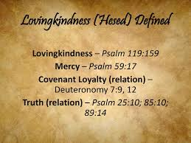

Slide 7
Genesis 39:21-40:23 Successful But Forgotten
Again, Joseph has favour from the Lord (vs 21).
Joseph once more is appointed a leader over the prisoners (vs 22).
Again, the author notes that this was because the “Lord was with him” and made all he did succeed.

Slide 8
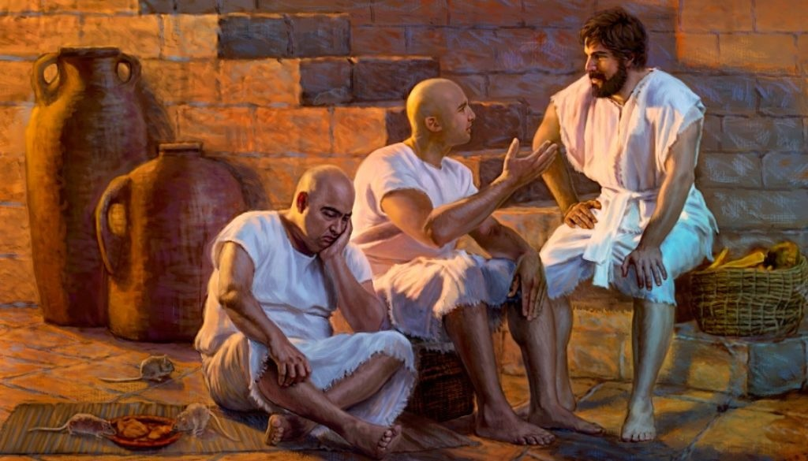

Slide 9
¹ Some time after this, the cupbearer of the king of Egypt and his baker committed an offense against their lord the king of Egypt. ² And Pharaoh was angry with his two officers, the chief cupbearer and the chief baker, ³ and he put them in custody in the house of the captain of the guard, in the prison where Joseph was confined. ⁴ The captain of the guard appointed Joseph to be with them, and he attended them. They continued for some time in custody.
⁵ And one night they both dreamed—the cupbearer and the baker of the king of Egypt, who were confined in the prison—each his own dream, and each dream with its own interpretation. ⁶ When Joseph came to them in the morning, he saw that they were troubled.

Slide 10
⁷ So he asked Pharaoh's officers who were with him in custody in his master's house, “Why are your faces downcast today?” ⁸ They said to him, “We have had dreams, and there is no one to interpret them.” And Joseph said to them, “Do not interpretations belong to God? Please tell them to me.”

Slide 11
Genesis 39:21-40:23 Successful But Forgotten
Vs 5-8 – In Scripture, God occasionally communicates through dreams, whether:
- with his people (Joseph) – Gen 37:5-11 - Solomon – 1 Kings 3:5-9
- Joseph in the NT – Matt 1:20; 2:19
- or with others
- Abilemech (Gen 20:6-7;
- the Pharaoh (Gen 41:1-8)
- Nebuchadnezzar (Dan 2:1ff)

Slide 13
Testing dreams
Joseph emphasises that dreams and their interpretations come from God (Genesis 40:8).
However, not every dream and its interpretation is from the Lord. We need to be aware that test dreams against what the Scripture teaches and what God has clearly said (Deut. 13:1-5).

Slide 14
Testing dreams
Ultimately, we should never ascribe guidance by God singularly to a dream. We should examine all things with God’s word (1 Thess 5:21; 2 Tim 3:16-17), seek the counsel of the saints – those over you in the Lord - and look for corroborating evidence that God is indeed speaking.
“Let the prophet who has a dream tell the dream, but let him who has my word speak my word faithfully. What has straw in common with wheat? declares the LORD.”(Jeremiah 23:28).

Slide 15
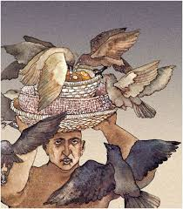
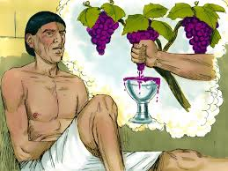

Slide 16
⁹ So the chief cupbearer told his dream to Joseph and said to him, “In my dream there was a vine before me, ¹⁰ and on the vine there were three branches. As soon as it budded, its blossoms shot forth, and the clusters ripened into grapes. ¹¹ Pharaoh's cup was in my hand, and I took the grapes and pressed them into Pharaoh's cup and placed the cup in Pharaoh's hand.” ¹² Then Joseph said to him,

Slide 17
“This is its interpretation: the three branches are three days. ¹³ In three days Pharaoh will lift up your head and restore you to your office, and you shall place Pharaoh's cup in his hand as formerly, when you were his cupbearer. ¹⁴ Only remember me, when it is well with you, and please do me the kindness to mention me to Pharaoh, and so get me out of this house. ¹⁵ For I was indeed stolen out of the land of the Hebrews, and here also I have done nothing that they should put me into the pit.”

Slide 18
¹⁶ When the chief baker saw that the interpretation was favorable, he said to Joseph, “I also had a dream: there were three cake baskets on my head, ¹⁷ and in the uppermost basket there were all sorts of baked food for Pharaoh, but the birds were eating it out of the basket on my head.” ¹⁸ And Joseph answered and said, “This is its interpretation: the three baskets are three days. ¹⁹ In three days Pharaoh will lift up your head—from you!—and hang you on a tree. And the birds will eat the flesh from you.”

Slide 19
²⁰ On the third day, which was Pharaoh's birthday, he made a feast for all his servants and lifted up the head of the chief cupbearer and the head of the chief baker among his servants. ²¹ He restored the chief cupbearer to his position, and he placed the cup in Pharaoh's hand. ²² But he hanged the chief baker, as Joseph had interpreted to them. ²³ Yet the chief cupbearer did not remember Joseph, but forgot him.

Slide 20
Genesis 39:21-40:23 Successful But Forgotten
The Lord was with Joseph (Gen 39:21,23).
Yet, Joseph was languishing in prison, seemingly forgotten (Gen 40:21).
God’s timing may seem slow compared with ours, but He is interested in our maturing, not simply our pleasing. His glory and plans matter the most!

Slide 21
“Love has its speed. It is a spiritual speed. It is a different kind of speed from the technological speed to which we are accustomed. It goes on in the depth of our life, whether we notice or not, at three miles an hour. It is the speed we walk and therefore the speed the love of God walks.”

Slide 22
The Test of Time
(Joseph’s) strangely long wait for the answer to his prayers was a severe test of patience and faith. It was as if he alone had been abandoned by God. But experiences like this were often part of the training of those whom God was going to use in outstanding roles.
Joyce G. Baldwin, The Message of Genesis 12-50, Intervarsity, 1986, page 171.

Slide 23
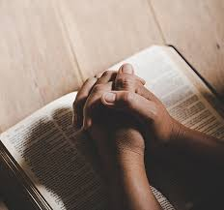
TWO QUESTIONS FOR REFLECTION
1. How do you know that the Lord’s favour and steadfast love is with you? Is it a matter of feeling or faith? How can we grow in this?

Slide 24
TWO QUESTIONS FOR REFLECTION
See Matthew 6:1-18 – Jesus taught us to give, pray and fast, all in secret. God-ward acts of devotion.

Slide 25
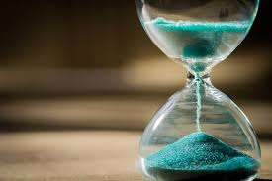
TWO QUESTIONS FOR REFLECTION
2. How patient are we with the will and promises of God? Do we demand instant answers only? Can we trust God to grow us in our endurance through trials?

Slide 26
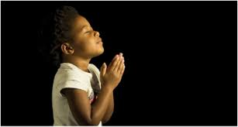
LET US PRAY….

