Slide 1
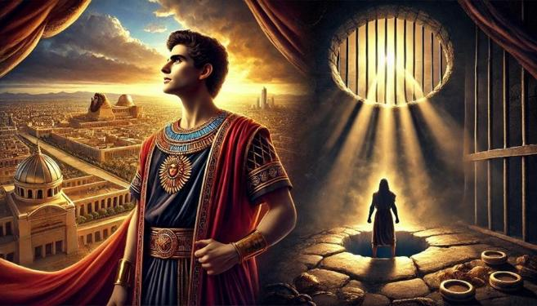
Joseph: From Pit to Prison to Palace

Slide 2
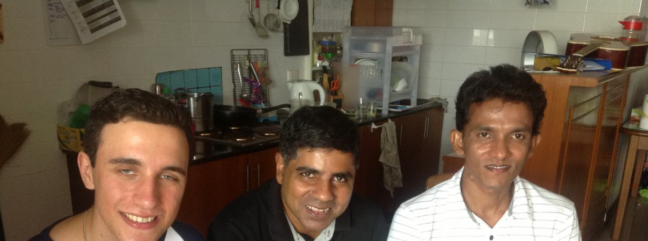
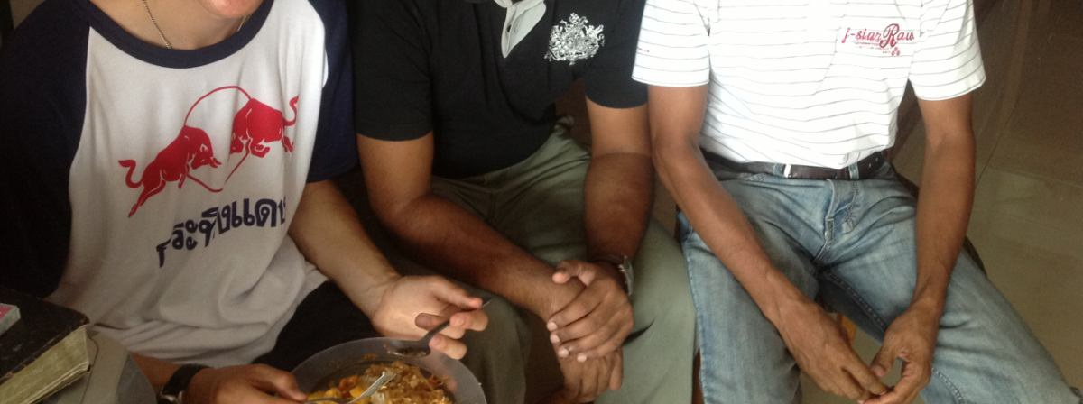
Selva’s Story

Slide 3
Now Joseph had been brought down to Egypt, and Potiphar, an officer of Pharaoh, the captain of the guard, an Egyptian, had bought him from the Ishmaelites who had brought him down there. ² The Lord was with Joseph, and he became a successful man, and he was in the house of his Egyptian master. ³ His master saw that the Lord was with him and that the Lord caused all that he did to succeed in his hands.

Slide 4
⁴ So Joseph found favour in his sight and attended him, and he made him overseer of his house and put him in charge of all that he had. ⁵ From the time that he made him overseer in his house and over all that he had, the Lord blessed the Egyptian's house for Joseph's sake; the blessing of the Lord was on all that he had, in house and field. ⁶ So he left all that he had in Joseph's charge, and because of him he had no concern about anything but the food he ate.

Slide 5
Genesis 39:1-6 – Running From Sin
Verse 2 - The Lord was with Joseph – see also verses 3, 21 and 23.
Vs 3-4 – His Master Potiphar saw that God was with Joseph and gave him the highest appointment as overseer of his household.
Vs 5-6 - God's blessing overflows from Joseph to bless those around him.

Slide 6
Blessed to be a blessing
As in the relationship between Jacob and Laban where Laban recognized that the Lord’s favor was with Jacob (30:27), Potiphar sees the same in Joseph and trusts him with responsibility. As a result, the blessing side of the covenant continues to be realized on a small scale as Potiphar and his house are blessed through Joseph (39:5–6).
John Walton, The NIV Application Commentary – Genesis, Zondervan, 2001, page 706.

Slide 7
Now Joseph was handsome in form and appearance. ⁷ And after a time his master's wife cast her eyes on Joseph and said, “Lie with me.” ⁸ But he refused and said to his master's wife, “Behold, because of me my master has no concern about anything in the house, and he has put everything that he has in my charge. ⁹ He is not greater in this house than I am, nor has he kept back anything from me except you, because you are his wife. How then can I do this great wickedness and sin against God?” ¹⁰ And as she spoke to Joseph day after day, he would not listen to her, to lie beside her or to be with her.

Slide 8
¹¹ But one day, when he went into the house to do his work and none of the men of the house was there in the house, ¹² she caught him by his garment, saying, “Lie with me.” But he left his garment in her hand and fled and got out of the house. ¹³ And as soon as she saw that he had left his garment in her hand and had fled out of the house, ¹⁴ she called to the men of her household and said to them, “See, he has brought among us a Hebrew to laugh at us. He came in to me to lie with me, and I cried out with a loud voice. ¹⁵ And as soon as he heard that I lifted up my voice and cried out, he left his garment beside me and fled and got out of the house.”

Slide 9
¹⁶ Then she laid up his garment by her until his master came home, ¹⁷ and she told him the same story, saying, “The Hebrew servant, whom you have brought among us, came in to me to laugh at me. ¹⁸ But as soon as I lifted up my voice and cried, he left his garment beside me and fled out of the house.”

Slide 10
Genesis 39:6-18 – Running From Sin
Verse 6-10. TWO things that Joseph does to keep from sinning.
1) He states his decision with 3 reasons (vs 8-9):
a) He cannot betray his master's trust.
b) She belongs to her husband.
c) He will not sin against God.

Slide 11
Genesis 39:6-18 – Running From Sin
2) Joseph refuses to listen to her entreaties and physically avoids being with Potiphar’s wife.

Slide 13
1 Corinthians 6:18
Φεύγω – pheugō lit. “to flee away, to escape safely out of danger.”

Slide 14
Flee Sexual Temptation And Run to Christ!

Slide 15
¹⁹ As soon as his master heard the words that his wife spoke to him, “This is the way your servant treated me,” his anger was kindled. ²⁰ And Joseph's master took him and put him into the prison, the place where the king's prisoners were confined, and he was there in prison.

Slide 16
Genesis 39:19-20 – Running From Sin
Verse 19 – Potiphar burns with anger. Joseph has no chance to defend himself.
Verse 20 – He is put in the King’s prison. But there is more twists and turns in the story to come.

Slide 17
God at Work.
It .... appears that the prison is on Potiphar’s premises, for 40:3 identifies it as “in the house of the captain of the guard,” using the same title previously given to Potiphar (39:1). The end result of this incarceration is that it puts Joseph in a place where he will become acquainted with members of Pharaoh’s court. It also offers another opportunity for the text to draw attention to the favor that Joseph enjoys with everyone he encounters despite his hardships.
John Walton, The NIV Application Commentary – Genesis, Zondervan, 2001, page 707.

Slide 18
APPLICATION
Like Joseph, we don’t know how our today or tomorrow will turn out. But can we trust our lives and ways into God’s hand?

Slide 19
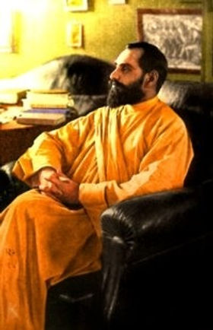
Sadhu Sundar Singh (1889-1929)

Slide 20
Many Christians cannot realise His precious, life-giving presence, because for them Christ lives in their heads or in their Bibles, not in their hearts. Only when a man gives his heart shall he find Him. The heart is the throne for the King of Kings.
Sadhu Sundar Singh (1889-1929)

Slide 21
APPLICATION
Like Joseph, we don’t know how our today or tomorrow will turn out. But can we trust our lives and ways into God’s hand?
We must endure trials so that God, who is faithful, can bring us through.

Slide 22
Hebrews 10:32-36
³² But recall the former days when, after you were enlightened, you endured a hard struggle with sufferings, ³³ sometimes being publicly exposed to reproach and affliction, and sometimes being partners with those so treated. ³⁴ For you had compassion on those in prison, and you joyfully accepted the plundering of your property, since you knew that you yourselves had a better possession and an abiding one. ³⁵ Therefore do not throw away your confidence, which has a great reward. ³⁶ For you have need of endurance, so that when you have done the will of God you may receive what is promised.

Slide 23
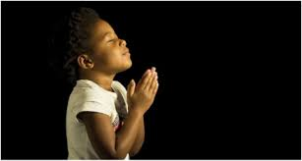
LET US PRAY….

