Slide 1
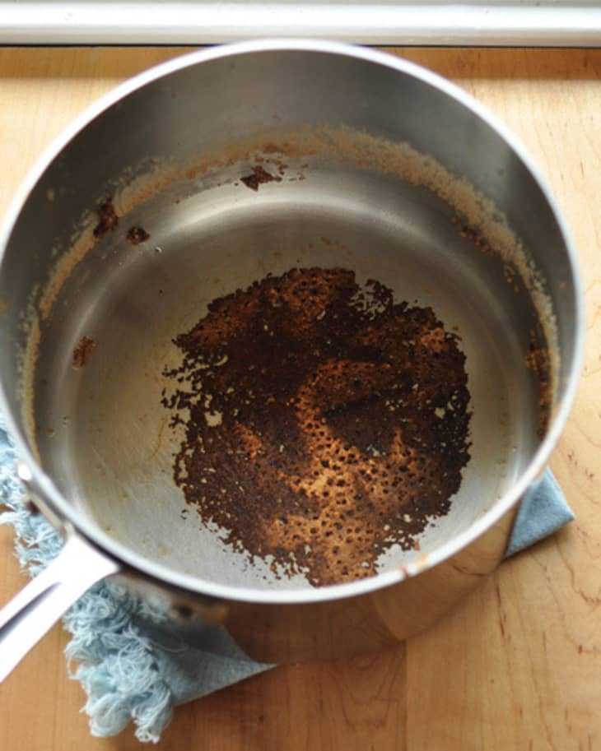

Slide 2
Handling Unresolved Conflict
When dreams become nightmares
Genesis 37:12-24

Slide 3
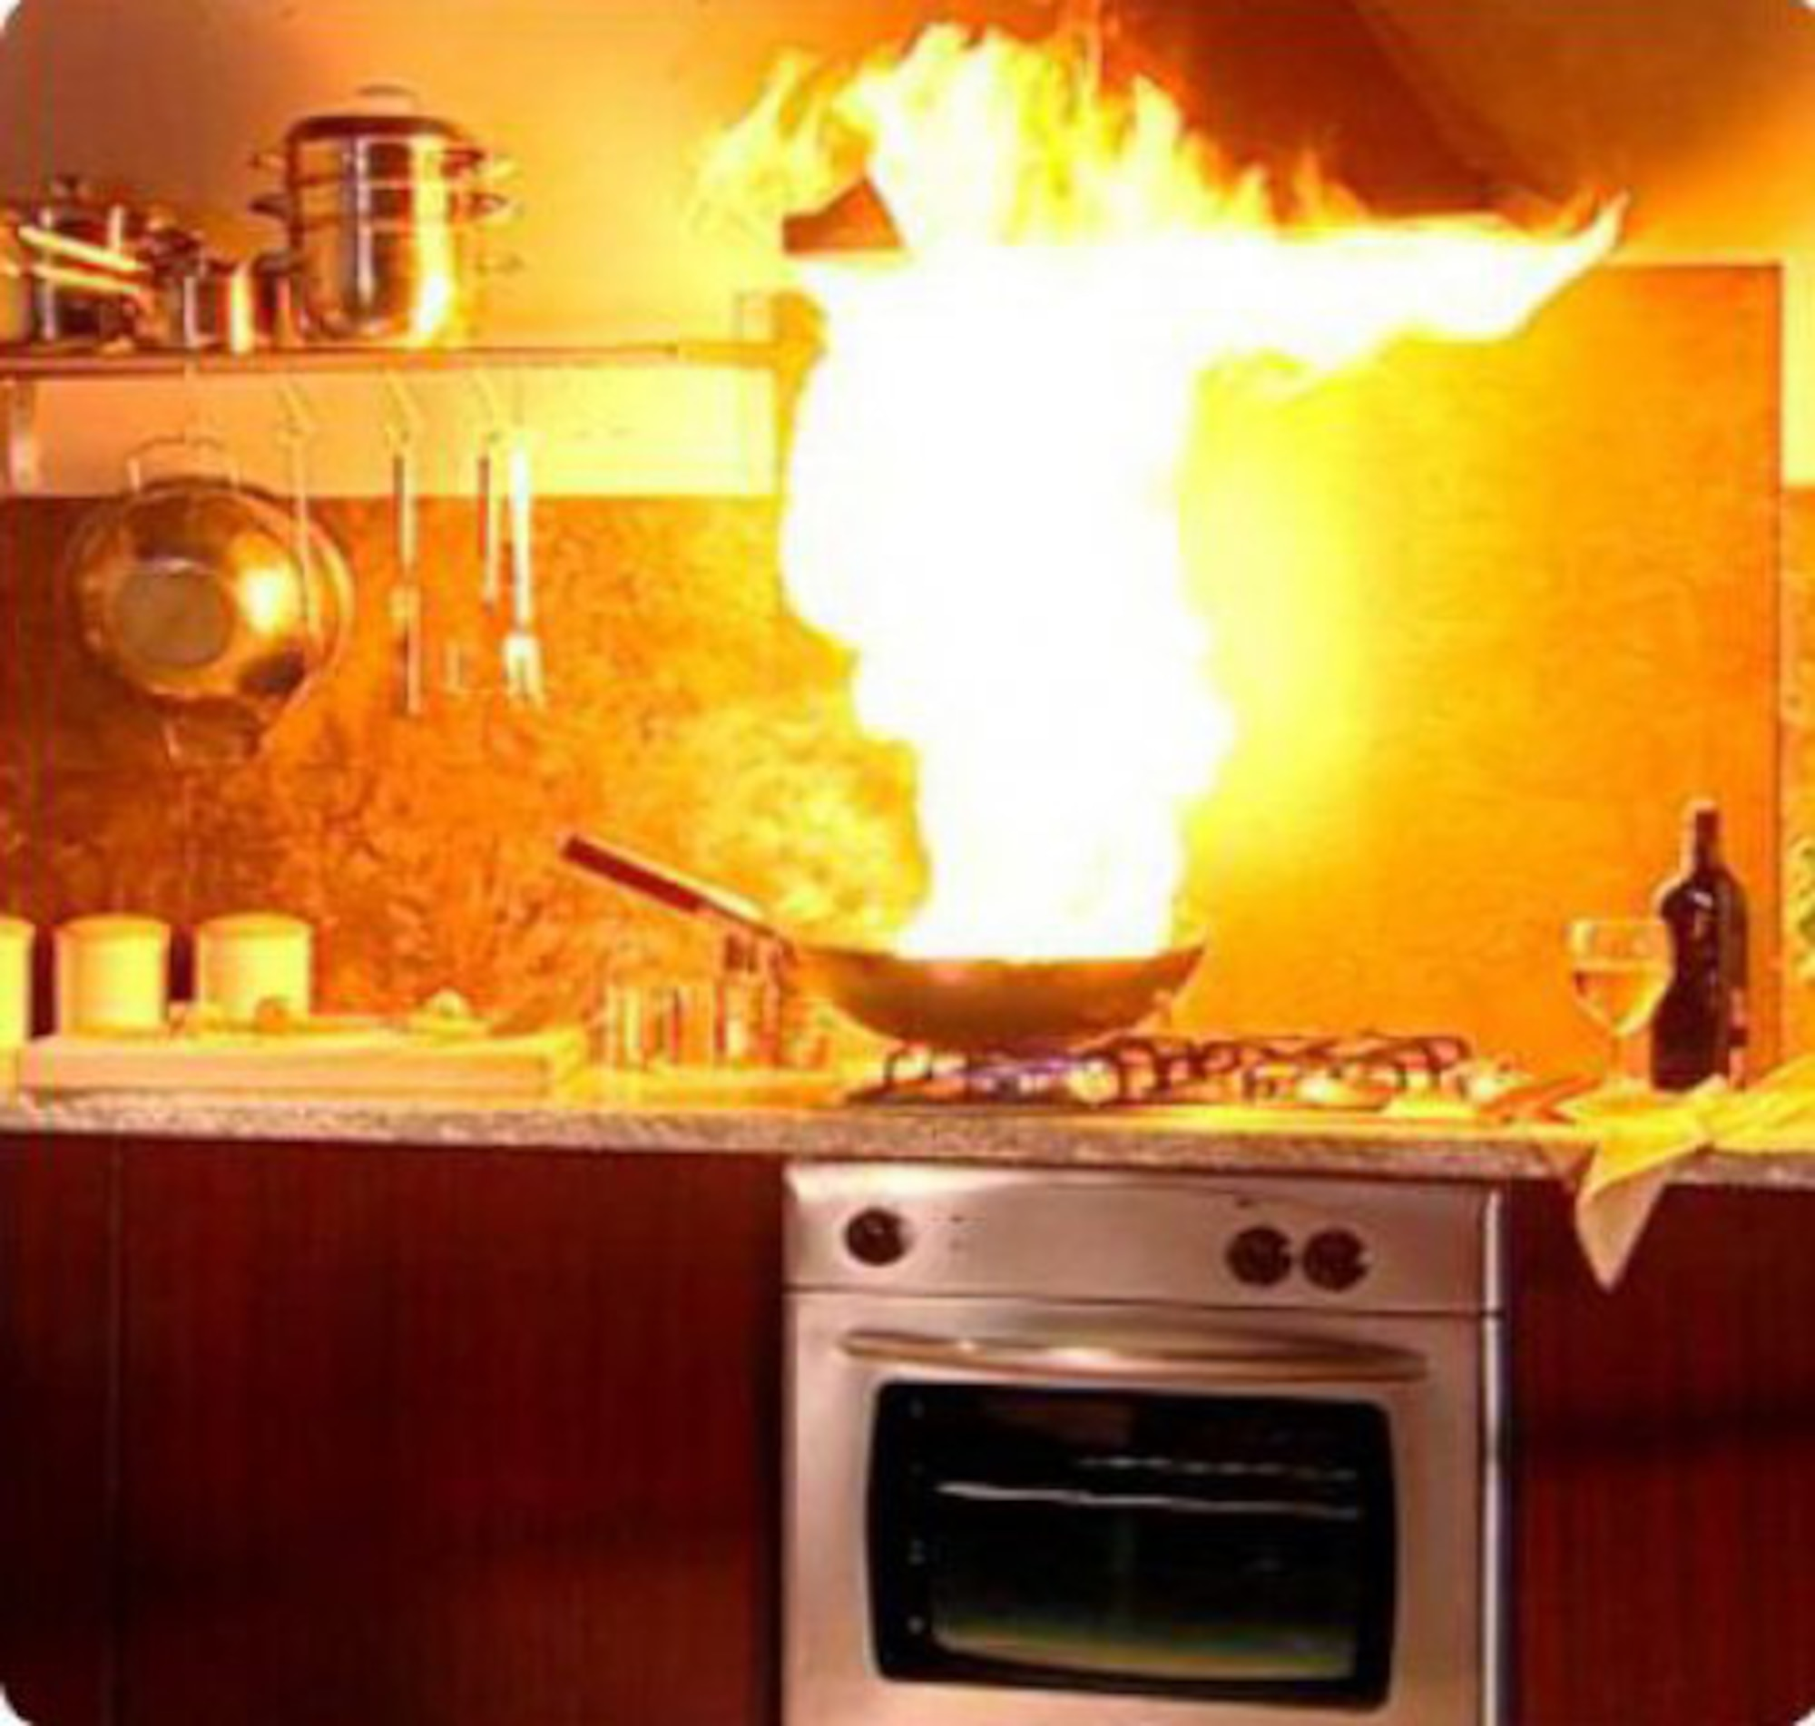
Trust in God’s sovereign control
Stop and consider the causes of division
Guilt: punishment for past deeds
Threat: permanent loss of promotion
Threat: permanent loss of promotion
Threat: permanent loss of promotion
Resentment: prejudice and slander
Fear: God works against you
Rebellion: reject divine authority

Slide 4
Trust in God’s sovereign control
Stop and consider the causes of division
Guard against sinful revenge
Threat: permanent loss of promotion
Threat: permanent loss of promotion
Murder
Abuse
Manipulation
Trafficking
Deception

Slide 5
Trust in God’s sovereign control
Stop and consider the causes of division
Guard against sinful revenge
Threat: permanent loss of promotion
Threat: permanent loss of promotion
Hope in God's purpose

