Slide 2
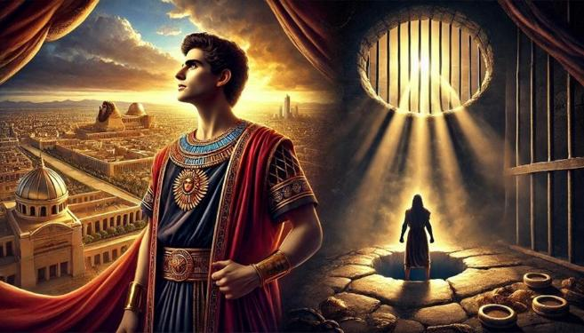
Joseph: From Pit to Prison to Palace

Slide 3
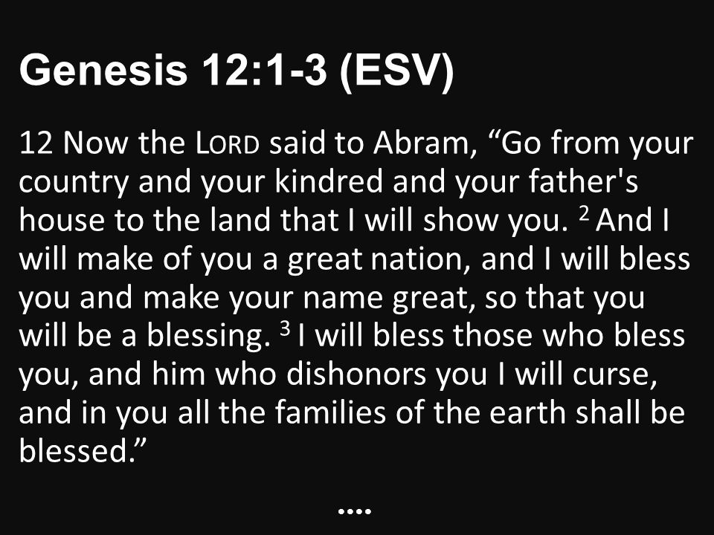

Slide 5
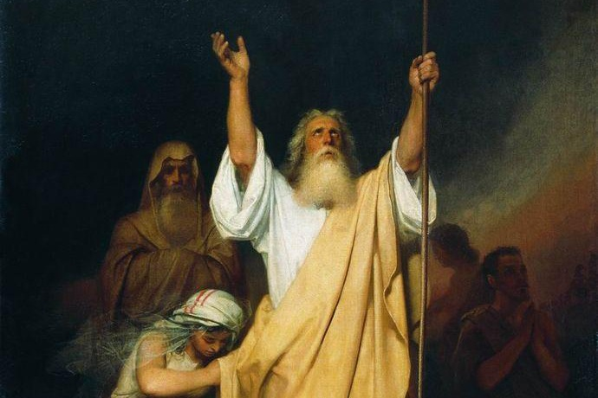
The Story of Joseph
We are children of Abraham by faith (Galatians 3:7)
The Bible traces God’s redemptive work through the Patriarchs – Abraham, Isaac and Jacob, that will eventually lead to the Messiah, our Lord Jesus Christ.

Slide 6
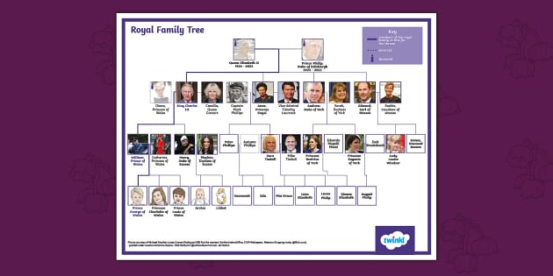
The Story of Joseph
Genesis 36 is an account of the lineage of Jacob, but the next 10 chapters focus in on Joseph.

Slide 7
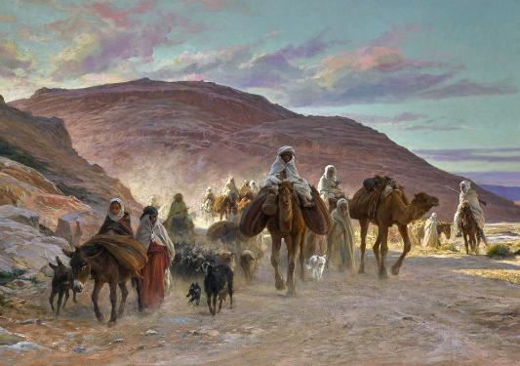
The Story of Joseph
Through Joseph, Jacob and his family of 70 move to Egypt. It is where God had told Abraham earlier that they would be oppressed for 400 years until he brought them back to the promised land of Canaan (see Genesis 15:13-16).

Slide 9
READING NARRATIVES in SCRIPTURE
1. Enter the story – Who are the characters? What actions/words are involved? What motivates or causes the story line? What results?
2. Interpret the story – What is its main point? What is the Gospel content or truth about God and people revealed in the story?
3. Apply the story – how is this story relevant today?

Slide 10
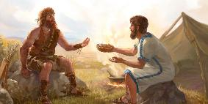
ESAU & JACOB – Unidentical Twins
Esau despised his birthright (Genesis 25:29-34, esp. 34) and married Canaanite women who made life bitter for Isaac and Rebekah (Genesis 26:34-35).
God shows himself to Jacob and promises to bless the world through his offspring (Genesis 28:13-15).

Slide 11
1. Joseph the Favourite.
¹ Jacob lived in the land of his father's sojournings, in the land of Canaan.
² These are the generations of Jacob.
Joseph, being seventeen years old, was pasturing the flock with his brothers. He was a boy with the sons of Bilhah and Zilpah, his father's wives. And Joseph brought a bad report of them to their father. ³ Now Israel loved Joseph more than any other of his sons, because he was the son of his old age. And he made him a robe of many colours. ⁴ But when his brothers saw that their father loved him more than all his brothers, they hated him and could not speak peacefully to him.

Slide 12
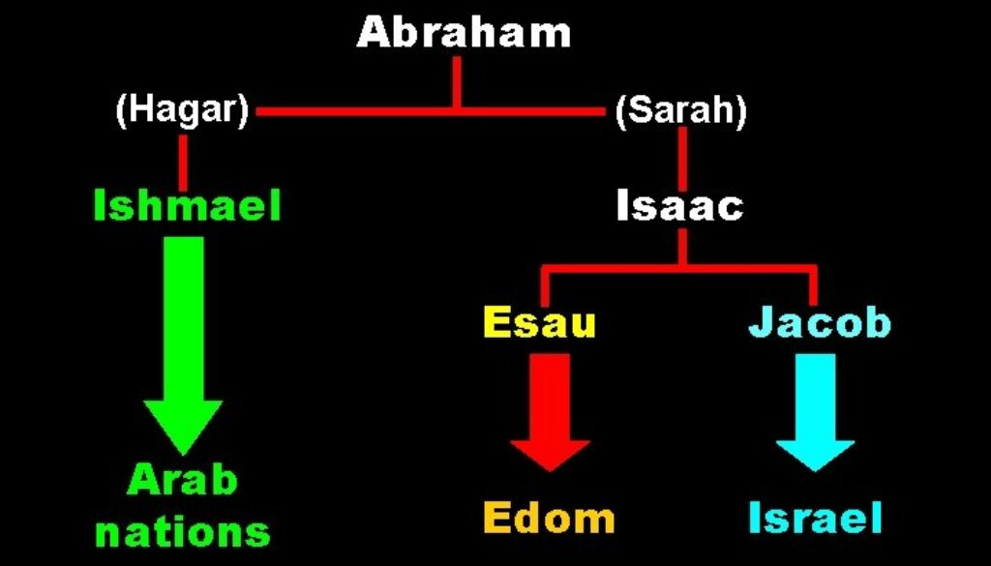

Slide 14
2. Joseph the Dreamer.
⁵ Now Joseph had a dream, and when he told it to his brothers they hated him even more. ⁶ He said to them, “Hear this dream that I have dreamed: ⁷ Behold, we were binding sheaves in the field, and behold, my sheaf arose and stood upright. And behold, your sheaves gathered around it and bowed down to my sheaf.” ⁸ His brothers said to him, “Are you indeed to reign over us? Or are you indeed to rule over us?” So they hated him even more for his dreams and for his words.

Slide 15
GOD IS SOVEREIGN
This divine election is one of the themes of Genesis (cf. Rom. 9:11 ff.) .... The account of the dreams, coming at the outset, makes God, not Joseph, the ‘hero’ of the story: it is not a tale of human success but of divine sovereignty.
Derek Kidner, Genesis, Downers Grove:IVP, 1967, page 133.

Slide 16
2. Joseph the Dreamer.
⁵ Now Joseph had a dream, and when he told it to his brothers they hated him even more. ⁶ He said to them, “Hear this dream that I have dreamed: ⁷ Behold, we were binding sheaves in the field, and behold, my sheaf arose and stood upright. And behold, your sheaves gathered around it and bowed down to my sheaf.” ⁸ His brothers said to him, “Are you indeed to reign over us? Or are you indeed to rule over us?” So they hated him even more for his dreams and for his words.

Slide 18
3. Joseph the Mystery.
⁹ Then he dreamed another dream and told it to his brothers and said, “Behold, I have dreamed another dream. Behold, the sun, the moon, and eleven stars were bowing down to me.” ¹⁰ But when he told it to his father and to his brothers, his father rebuked him and said to him, “What is this dream that you have dreamed? Shall I and your mother and your brothers indeed come to bow ourselves to the ground before you?” ¹¹ And his brothers were jealous of him, but his father kept the saying in mind.

Slide 19
Two Lessons for today
1. Joseph is a type (or prefigure) of our Lord Jesus Christ.

Slide 20
Joseph and Jesus
As our Lord Jesus, Joseph is the object of his father’s special love.
As our Lord Jesus, he was mocked by his family.
As our Lord Jesus, he was sold for pieces of silver, and stripped of his robe.
Joseph was also falsely accused.
Joseph also stood before rulers.
Joseph also saved his rebellious brothers from death when they realised who he was.
He was exalted after and through humiliation.
He embraced God’s purpose even though it brought him intense physical harm.
Finally, people come and bow their knee before him.

Slide 21
Two Lessons for today
1. Joseph is a type (or prefigure) of our Lord Jesus Christ.
2. Like Joseph, we must be ready to suffer and not lose faith in God.

Slide 23
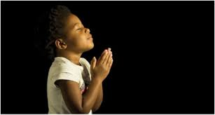
LET US PRAY….

