Slide 1
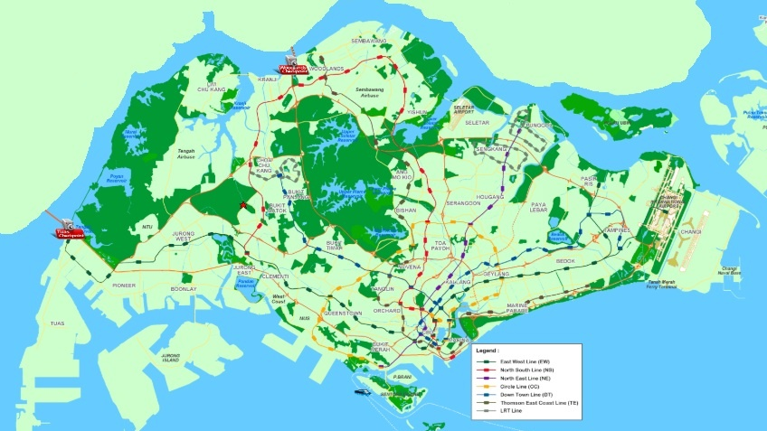
142
Notes:
Six Lines
187 Stations (142 + 45 still under construction
Screenshot copy from https://www.streetdirectory.com/

Slide 2
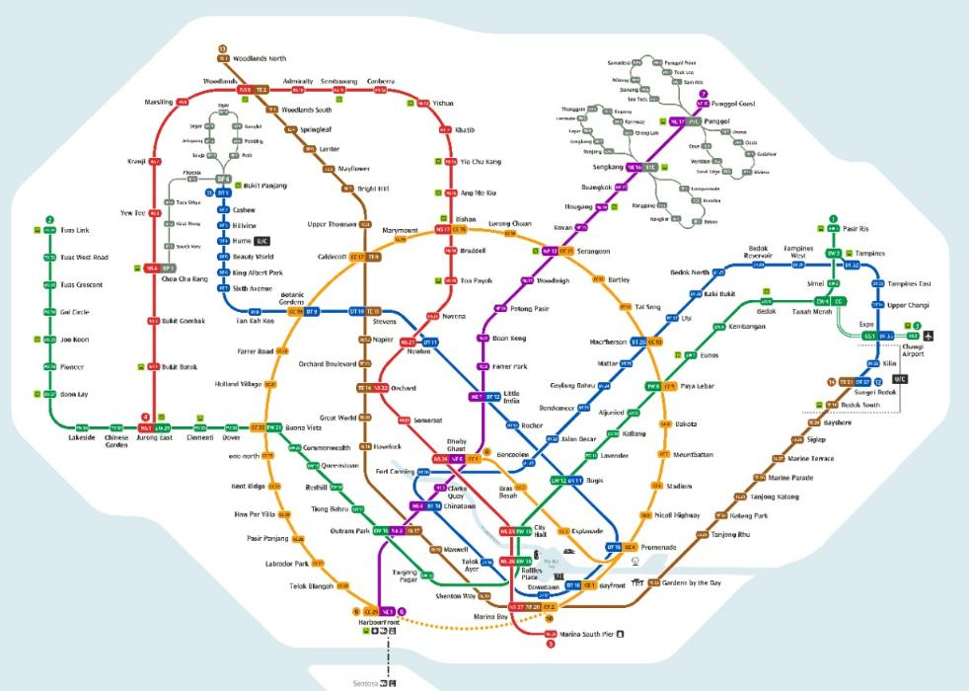

Slide 3
Learning Mandarin
> 50,000
Mandarin characters in existence
~ 10,000
known by linguistics & teachers
~ 6,000
known by most educated
~ 3,000
needed to read 95% modern written Mandarin
~ 1,000
needed to read 80% modern written Mandarin
Notes:
https://goeastmandarin.com/all-about-chinese-characters/

Slide 4
Understanding the Bible
2,930
People
1,551
Places
1,189
Chapters
~ 700
Events
66
Books in the Bible
Notes:
https://goeastmandarin.com/all-about-chinese-characters/

Slide 5
Is it possible to create a transit map
to understanding the Bible
----------------“big picture”

Slide 6
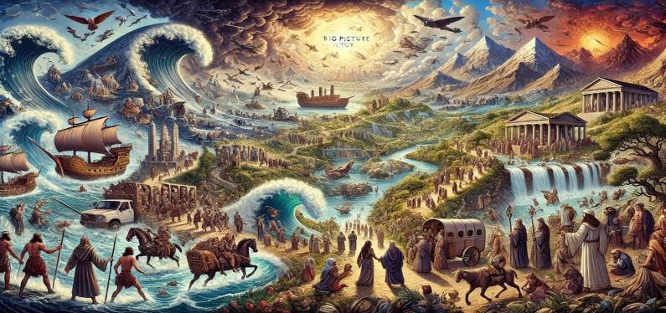
Can AI create a “big picture”
to help understand the Bible?
Notes:
OpenAI. The Big Picture of the Bible. AI-generated image, 2025. ChatGPT.
Using the prompt: create a 16x9 image with the theme of "the big picture" of the bible taking into account the following list: creation, fall of man, flood of Noah, Biblical Patriarchs, Moses and the Exodus, cycle of judges, kingdom united and divided, captivity, nation returns from captivity, Christ on Earth, Christ's 2nd coming, 1000 year reign

Slide 7
Ludamus: An Exploration of Musical Improv and Spirituality in Christian Theology and Praxis
Finding God in a Latte: A Sacramental Theology of Third-Wave Coffee Shops
Taste and See . . .: The Eucharist as Immersive Theatre
The Kingdom of God Is a Group Chat: Ecclesiology in the Age of Emojis”
Can theological dissertations create a “big picture”
to help understand the Bible?

Slide 8
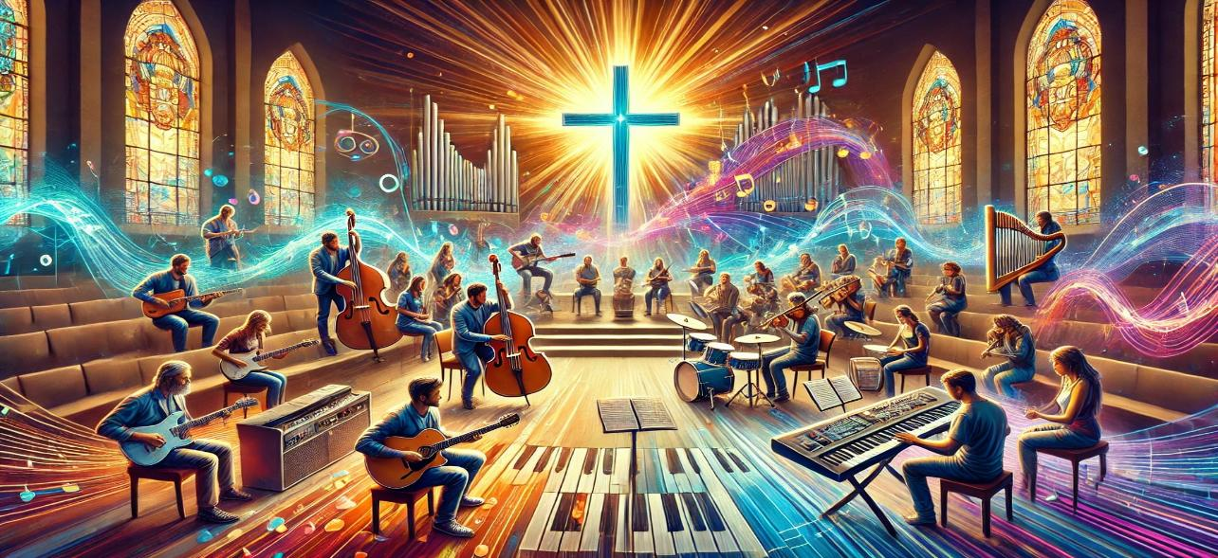
Ludamus: An Exploration of Musical Improv and Spirituality in Christian Theology and Praxis
Notes:
"Ludamus: An Exploration of Musical Improv and Spirituality in Christian Theology and Praxis" by Will Parker (2024) Yale Divinity School
OpenAI. AI-generated image, 2025. ChatGPT.
Using the prompt create a 16x9 image for Ludamus: An Exploration of Musical Improv and Spirituality in Christian Theology and Praxis

Slide 9
Finding God in a Latte: A Sacramental Theology of Third-Wave Coffee Shops
Notes:
Title created using ChatGPT using the prompt “provide a list of 15 humorous liberal doctor theological dissertation titles “
OpenAI.. AI-generated image, 2025. ChatGPT.
Using the prompt create a 16x9 image for "Finding God in a Latte: A Sacramental Theology of Third-Wave Coffee Shops"

Slide 10
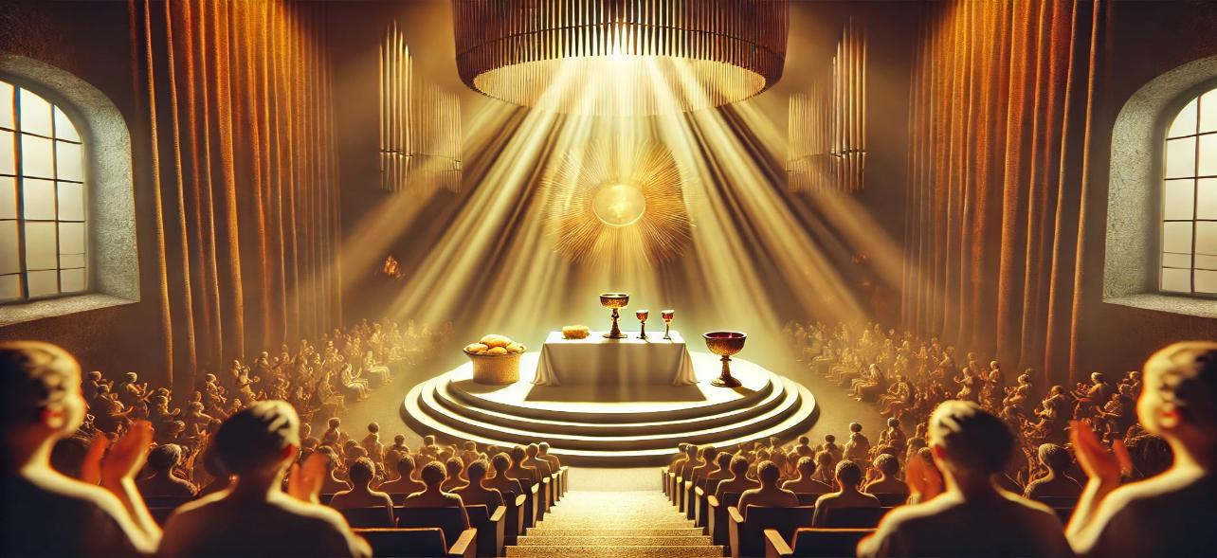
Taste and See . . .: The Eucharist as Immersive Theatre
Notes:
Taste and See . . .: The Eucharist as Immersive Theatre" by Vincent Lin (2024) Yale Divinity School
OpenAI. AI-generated image, 2025. ChatGPT.
Using the prompt create a 16x9 image for "Taste and See . . .: The Eucharist as Immersive Theatre"

Slide 11
The Kingdom of God Is a Group Chat: Ecclesiology in the Age of Emojis”
Notes:
Title created using ChatGPT using the prompt “provide a list of 15 humorous liberal doctor theological dissertation titles “
OpenAI. AI-generated image, 2025. ChatGPT.
Using the prompt “create a 16x9 image for "The Kingdom of God Is a Group Chat: Ecclesiology in the Age of Emojis"

Slide 12
At CIC, we also have our own “PIE”:
Passionate, International, and Expository.
Expository: A style of preaching that explains the meaning of a specific passage of the Bible.
Can expository preaching give us a “big picture”
to help understand the Bible?
Notes:
Photo by Alaric Sim on Unsplash

Slide 13
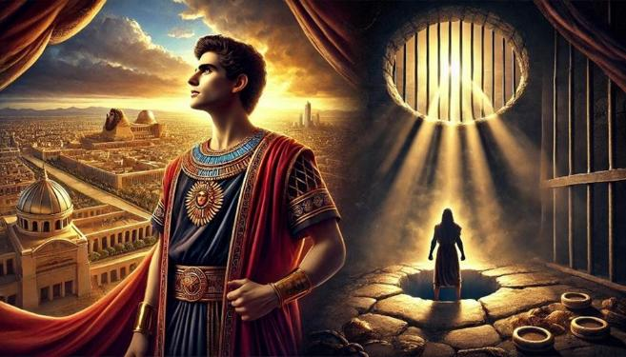
Joseph: From Pit to Prison to Palace

Slide 14
At CIC, we also have our own “PIE”:
Passionate, International, and Expository.
Expository: A style of preaching that explains the meaning of a specific passage of the Bible.
Aug 13, 2023 John 1:1-18
Aug 25, 2024 John 15:15-25
Can expository preaching give us a “big picture”
to help understand the Bible?
Notes:
Photo by Alaric Sim on Unsplash

Slide 15
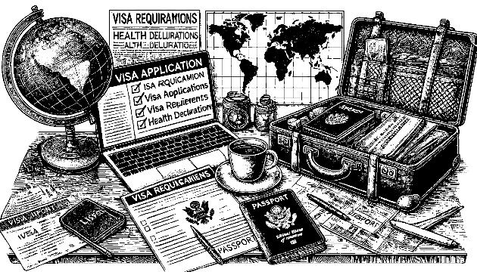
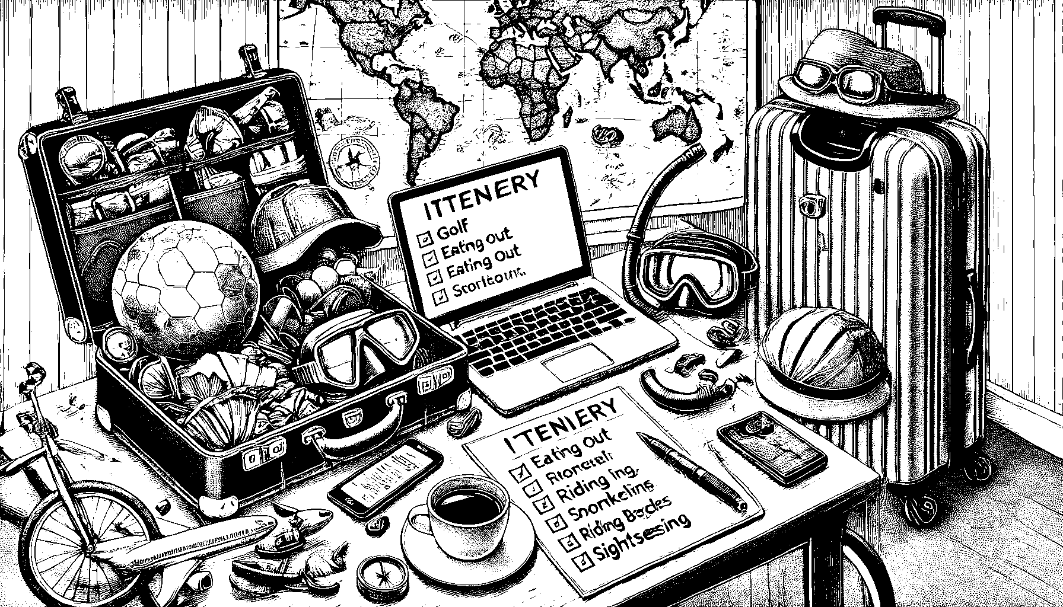
Visa / Health Declarations
How to Study the Bible
What to do for fun
What the Bible means
Are courses available that teach “big picture”
to help understand the Bible?
Notes:
OpenAI. 2025. A Detailed Black and White Line Drawing of a Traveler Preparing for a Journey. AI-generated image. ChatGPT. Using the prompt “create a 16x9 black and white line drawing showing preparing for a journey to a foreign country and determining visa requirements and health declarations”
OpenAI. 2025. A Detailed Black and White Line Drawing of a Traveler Preparing for Various Activities on a Vacation. AI-generated image. ChatGPT. Using the prompt “create a 16x9 black and white line drawing showing preparing for activities such as golf, eating out, snorkeling, riding bicycles, and sight seeing”

Slide 16
10 hours
15 ppt slideshows
100 pg student guide
400 pg teacher guide
948 slides
slide
Notes:
Complete “The Bible Basically” course available at https://biblestudydownloads.org/resources/the-bible-basically/

Slide 17
1
slide
CAN give us a “big picture”
to help understand the Bible!
Big Picture
Creation
Canon
Feasts
Israel
Prophecy
Notes:
Complete “The Bible Basically” course available at https://biblestudydownloads.org/resources/the-bible-basically/

Slide 18
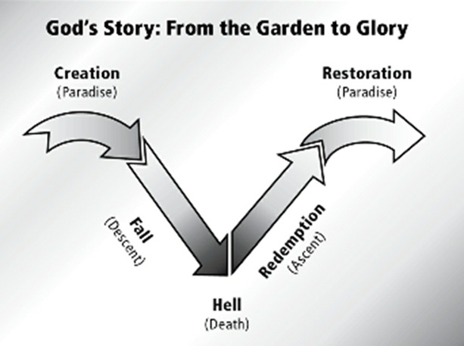
1 slide can be too basic (but is a good start)
Notes:
Image from Holsteen. Exploring Christian Theology : Volume 1: Revelation, Scripture, and the Triune God (p. 15). Baker Publishing Group. Kindle Edition.

Slide 19
OT Theme
The tragic fall
of a perfect creation
followed by judgment
and the promise of final redemption.
Gen 3a
Gen 1 & 2
Gen 3b –
Mal 4
Gen 4 – Mal 4 = 926 chapters
a good start
Notes:
OT Theme: Holsteen. Exploring Christian Theology : Volume 1: Revelation, Scripture, and the Triune God (p. 16). Baker Publishing Group. Kindle Edition.

Slide 20
NT Theme
The long-awaited redemption of a fallen creation followed by the restoration
and fulfillment of all God’s promises and purposes.
a good start
Notes:
NT Theme: Holsteen. Exploring Christian Theology : Volume 1: Revelation, Scripture, and the Triune God (p. 17). Baker Publishing Group. Kindle Edition.

Slide 22
--------------------------------------------------------------------------1 & 2 Chronicles ----------------------------------------------------------
Deuteronomy
1 Samuel
Leviticus
2 Samuel
Nehemiah
Genesis 1-11
Genesis 12-50
Exodus
Numbers
Joshua
Judges
1 Kings
2 Kings
Ruth
Ezra
Esther
Moses
Cycles
S • D • S
Z • E • N
1st Coming
Eternity
Creation
Joshua
J (R) & I (J)
Eternity
Fall
Babel
J (B) & I (A)
Flood
P • G • H • R
2nd Coming
Abraham
Joseph
Isaac
Jacob
1000
1990+
Exodus
Judges
Church
Kingdom
Patriarchs
Conquests
Silent Years
Beginnings
Restoration
United Kingdom
Captivity
Divided Kingdom
Max Anders, Dallas Theological Seminary

Slide 23
--------------------------------------------------------------------------1 & 2 Chronicles ----------------------------------------------------------
Deuteronomy
1 Samuel
Leviticus
2 Samuel
Nehemiah
Genesis 1-11
Genesis 12-50
Exodus
Numbers
Joshua
Judges
1 Kings
2 Kings
Ruth
Ezra
Esther
1000
1990+
Exodus
Judges
Church
Kingdom
Patriarchs
Conquests
Silent Years
Beginnings
Restoration
United Kingdom
Captivity
Divided Kingdom
Max Anders, Dallas Theological Seminary

Slide 24
--------------------------------------------------------------------------1 & 2 Chronicles ----------------------------------------------------------
Deuteronomy
1 Samuel
Leviticus
2 Samuel
Nehemiah
Genesis 1-11
Genesis 12-50
Exodus
Numbers
Joshua
Judges
1 Kings
2 Kings
Ruth
Ezra
Esther
Creation
Eternity
Eternity
Fall
Babel
Flood
Beginnings
Max Anders, Dallas Theological Seminary

Slide 25
Big Picture => 2 Feb
Creation => 23 Feb
Canon
Feasts
Israel
Prophecy
Notes:
Complete “The Bible Basically” course available at https://biblestudydownloads.org/resources/the-bible-basically/

Slide 26
OT Theme
The tragic fall
of a perfect creation
followed by judgment
and the promise of final redemption.
Notes:
OT Theme: Holsteen. Exploring Christian Theology : Volume 1: Revelation, Scripture, and the Triune God (p. 16). Baker Publishing Group. Kindle Edition.

Slide 27
--------------------------------------------------------------------------1 & 2 Chronicles ----------------------------------------------------------
Deuteronomy
1 Samuel
Leviticus
2 Samuel
Nehemiah
Genesis 1-11
Genesis 12-50
Exodus
Numbers
Joshua
Judges
1 Kings
2 Kings
Ruth
Ezra
Esther
Creation
Eternity
Eternity
Fall
Babel
Flood
Abraham
Joseph
Isaac
Jacob
Patriarchs
Beginnings
Max Anders, Dallas Theological Seminary

Slide 28
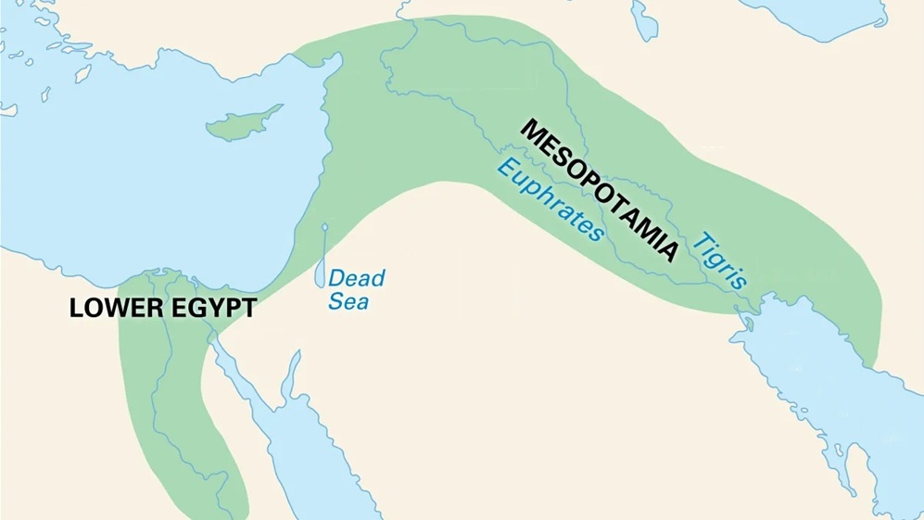

Slide 29
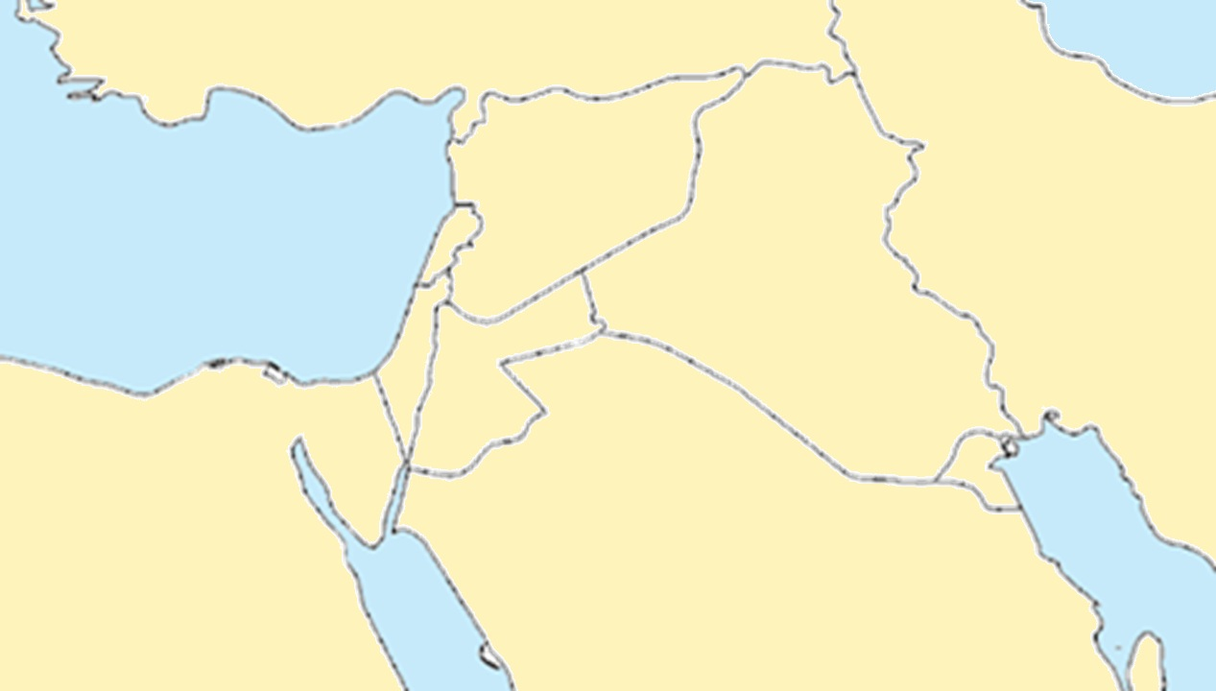
Turkey
Syria
Lebanon
Iran
Israel
Iraq
Jordan
Egypt
Saudi Arabia

Slide 30
Turkey
Syria
Lebanon
Iran
Israel
Iraq
Jordan
Egypt
Saudi Arabia

Slide 31
12 The Lord had said to Abram,
“Go from your country, your people
and your father’s household
to the land I will show you.

Slide 32
OT Theme
The tragic fall
of a perfect creation
followed by judgment
and the promise of final
redemption.
Notes:
OT Theme: Holsteen. Exploring Christian Theology : Volume 1: Revelation, Scripture, and the Triune God (p. 16). Baker Publishing Group. Kindle Edition.

Slide 33
--------------------------------------------------------------------------1 & 2 Chronicles ----------------------------------------------------------
Deuteronomy
1 Samuel
Leviticus
2 Samuel
Nehemiah
Genesis 1-11
Genesis 12-50
Exodus
Numbers
Joshua
Judges
1 Kings
2 Kings
Ruth
Ezra
Esther
² “I will make you into a great nation, and I will bless you; I will make your name great, and you will be a blessing. ³ I will bless those who bless you, and whoever curses you I will curse; and all peoples on earth will be blessed through you.”
Creation
Eternity
Eternity
Fall
Babel
Flood
Abraham
Joseph
Isaac
Jacob
Patriarchs
Beginnings
Max Anders, Dallas Theological Seminary

Slide 34
--------------------------------------------------------------------------1 & 2 Chronicles ----------------------------------------------------------
Deuteronomy
1 Samuel
Leviticus
2 Samuel
Nehemiah
Genesis 1-11
Genesis 12-50
Exodus
Numbers
Joshua
Judges
1 Kings
2 Kings
Ruth
Ezra
Esther
Creation
Moses
Joshua
Cycles
Eternity
Eternity
Fall
Babel
Flood
Abraham
Joseph
Isaac
Jacob
Exodus
Judges
Patriarchs
Conquests
Beginnings
Max Anders, Dallas Theological Seminary

Slide 35
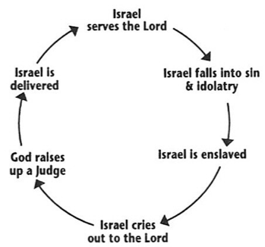
7x the Israelites did evil in the eyes of the Lord
Cycle of Judges

Slide 36
OT Theme
The tragic fall
of a perfect creation
followed by judgment
and the promise of final redemption.
Notes:
OT Theme: Holsteen. Exploring Christian Theology : Volume 1: Revelation, Scripture, and the Triune God (p. 16). Baker Publishing Group. Kindle Edition.

Slide 37
--------------------------------------------------------------------------1 & 2 Chronicles ----------------------------------------------------------
Deuteronomy
1 Samuel
Leviticus
2 Samuel
Nehemiah
Genesis 1-11
Genesis 12-50
Exodus
Numbers
Joshua
Judges
1 Kings
2 Kings
Ruth
Ezra
Esther
Creation
Moses
Joshua
Cycles
Eternity
Eternity
Fall
Babel
Flood
Abraham
Joseph
Isaac
Jacob
Exodus
Judges
Judges 21:25 In those days there was no king in Israel. Everyone did what was right in his own eyes.
Patriarchs
Conquests
Beginnings
Max Anders, Dallas Theological Seminary

Slide 38
--------------------------------------------------------------------------1 & 2 Chronicles ----------------------------------------------------------
Deuteronomy
1 Samuel
Leviticus
2 Samuel
Nehemiah
Genesis 1-11
Genesis 12-50
Exodus
Numbers
Joshua
Judges
1 Kings
2 Kings
Ruth
Ezra
Esther
Saul
David
Solomon
Creation
Moses
Joshua
Cycles
S • D • S
Eternity
Eternity
Fall
Babel
Flood
Abraham
Joseph
Isaac
Jacob
Exodus
Judges
Patriarchs
Conquests
Beginnings
United Kingdom
Max Anders, Dallas Theological Seminary

Slide 39
--------------------------------------------------------------------------1 & 2 Chronicles ----------------------------------------------------------
Deuteronomy
1 Samuel
Leviticus
2 Samuel
Nehemiah
Genesis 1-11
Genesis 12-50
Exodus
Numbers
Joshua
Judges
1 Kings
2 Kings
Ruth
Ezra
Esther
Moses
Cycles
S • D • S
Eternity
Creation
Joshua
J (R) & I (J)
Eternity
Fall
Babel
Flood
Abraham
Joseph
Isaac
Jacob
Exodus
Judges
Patriarchs
Conquests
Beginnings
United Kingdom
Divided Kingdom
Max Anders, Dallas Theological Seminary

Slide 40
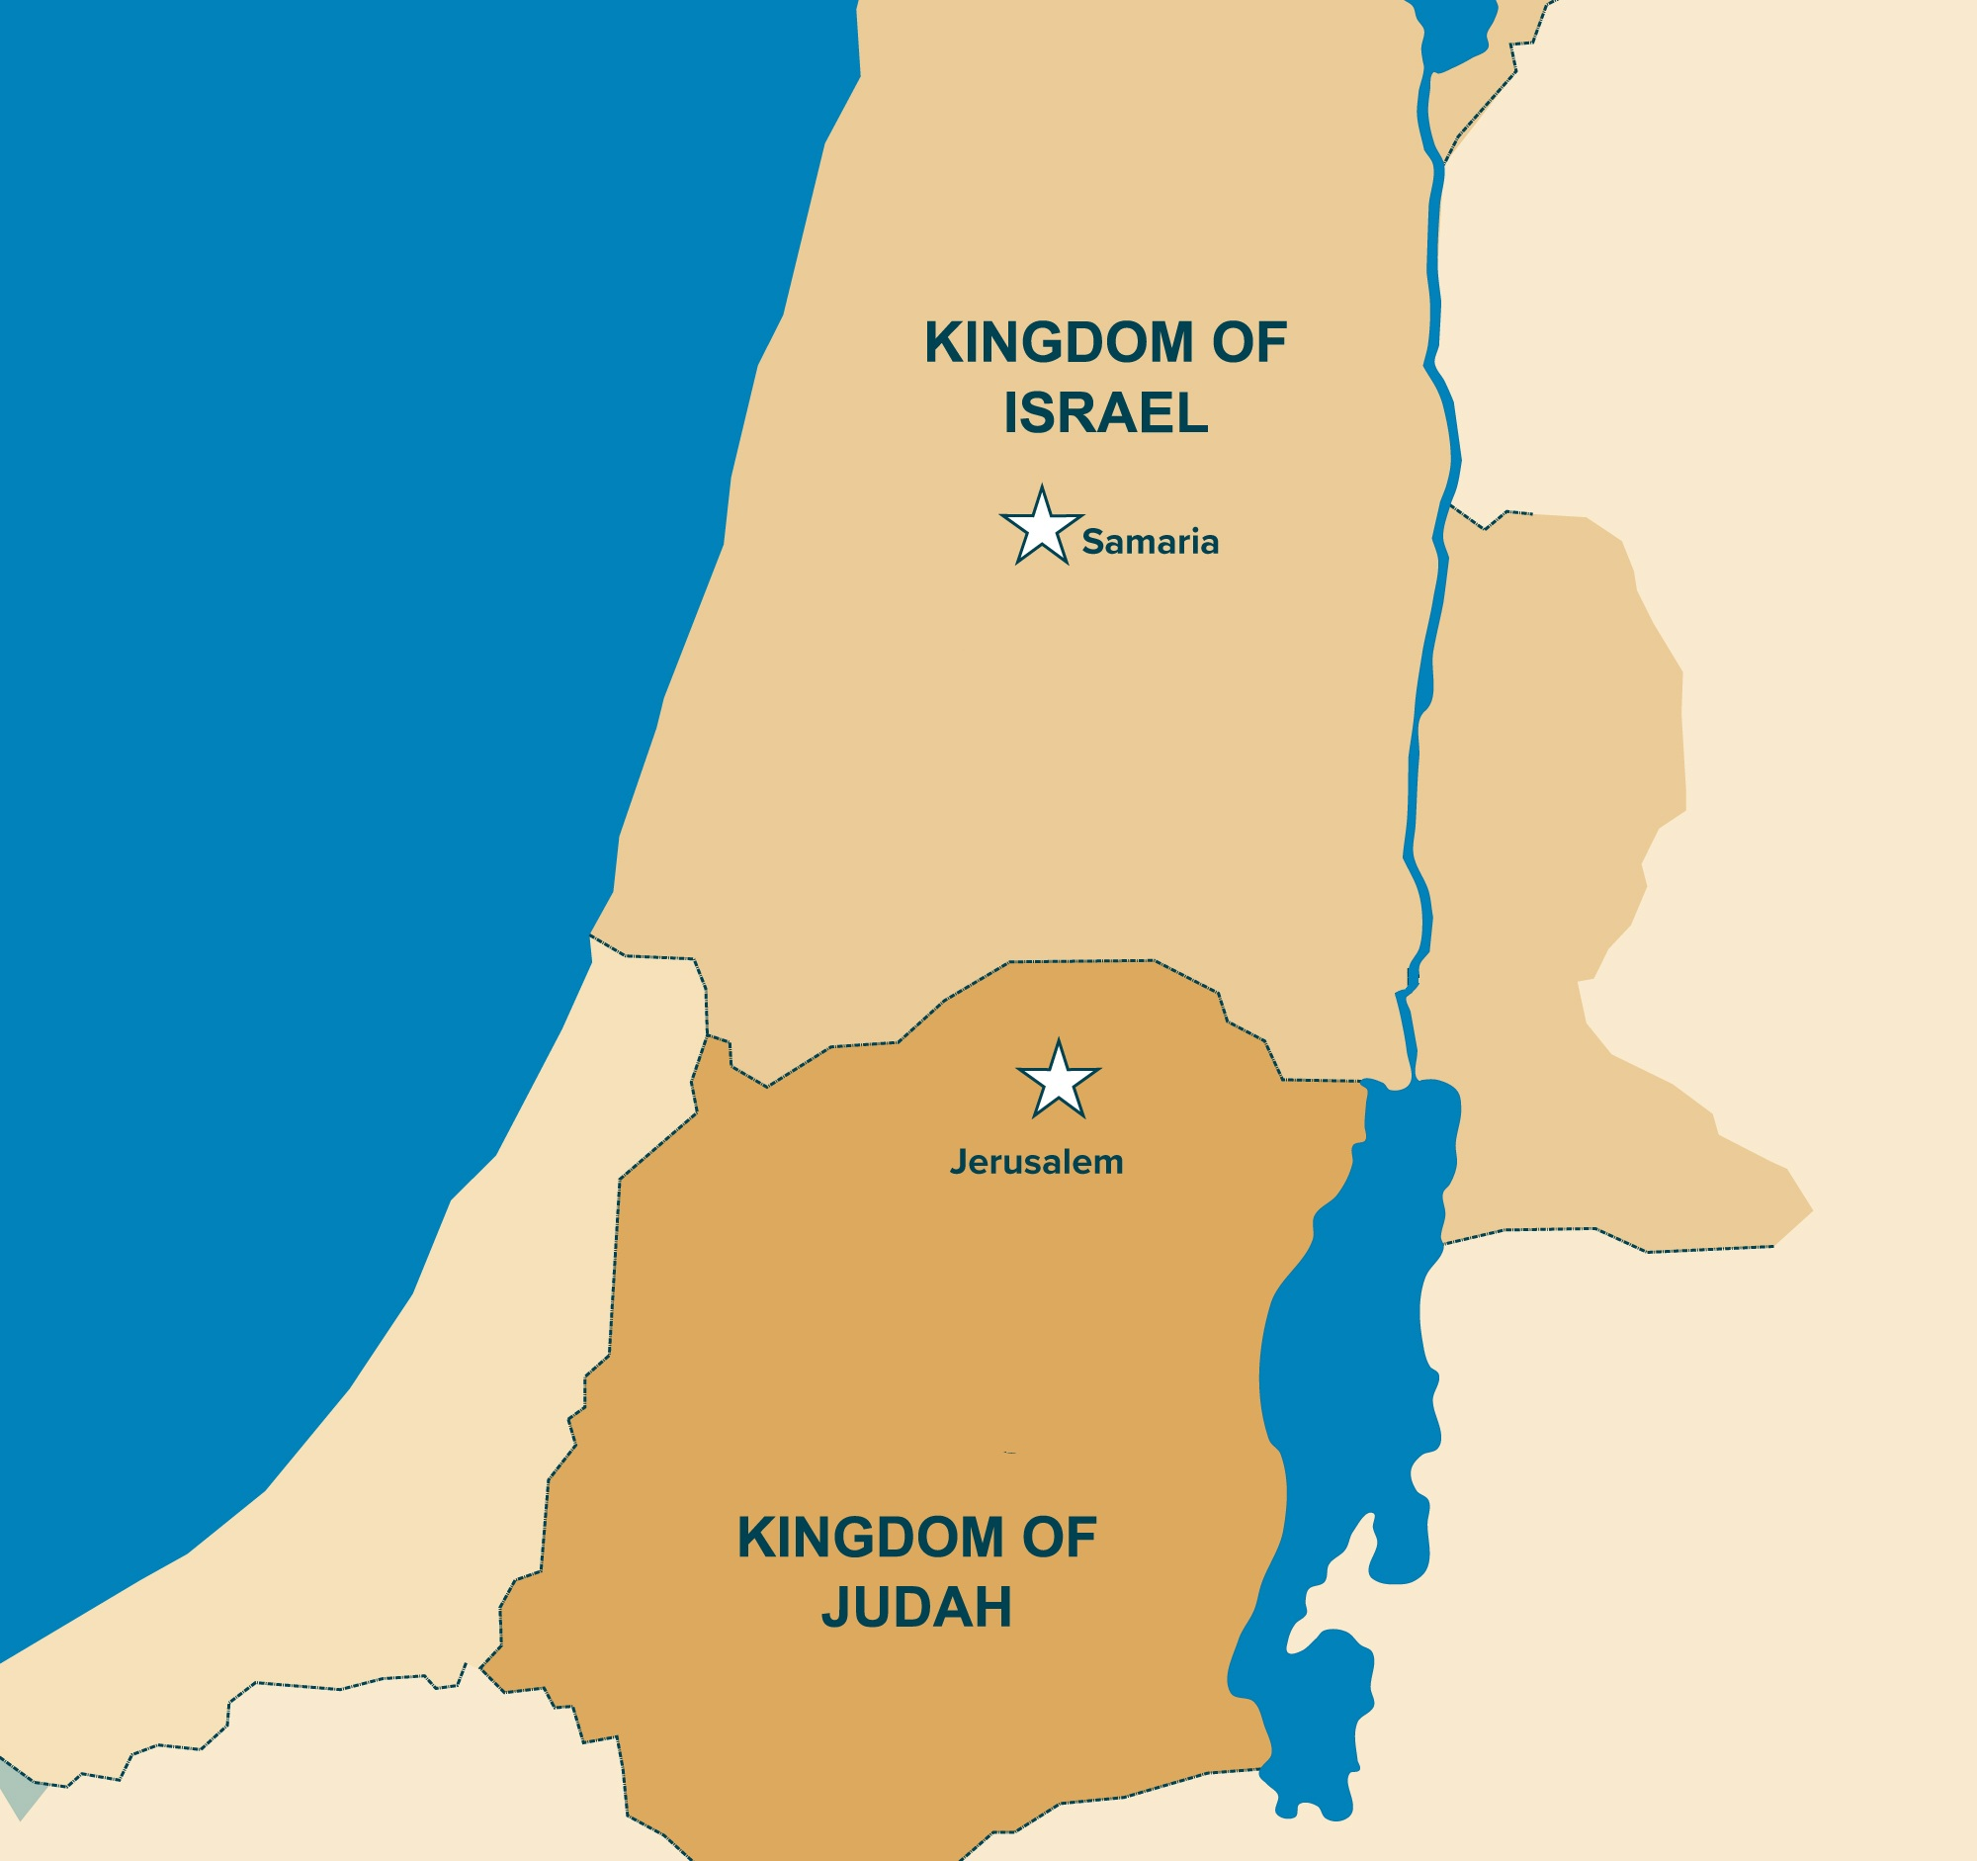
Turkey
Syria
Lebanon
Iran
Israel
Iraq
Jordan
Egypt
Saudi Arabia

Slide 41
Turkey
Syria
Lebanon
Iran
Israel
Iraq
Jordan
Egypt
Saudi Arabia

Slide 42
Divided Kingdom
Country | King
Israel | Jeroboam
Judah | Rehoboam
J (R) & I (J)

Slide 43
Jeroboam
JER-uh-boh-uhm (English)
The first king of the northern kingdom of Israel,
best known for being the OG of bad kings—the guy who set the gold standard (literally, golden calves) for leading people away from God. If being a terrible king was an Olympic sport, Jeroboam would have been the world record holder. In fact, every bad king after him was compared to him, as in "He did evil in the eyes of the Lord, just like Jeroboam." (1 Kings 15:34, 16:26, 22:52… the list goes on). Basically, if your name becomes shorthand for rebellion and idolatry, you're doing something very wrong.

Slide 44
OT Theme
The tragic fall
of a perfect creation
followed by judgment
and the promise of final redemption.
Notes:
OT Theme: Holsteen. Exploring Christian Theology : Volume 1: Revelation, Scripture, and the Triune God (p. 16). Baker Publishing Group. Kindle Edition.

Slide 45
--------------------------------------------------------------------------1 & 2 Chronicles ----------------------------------------------------------
Deuteronomy
1 Samuel
Leviticus
2 Samuel
Nehemiah
Genesis 1-11
Genesis 12-50
Exodus
Numbers
Joshua
Judges
1 Kings
2 Kings
Ruth
Ezra
Esther
Moses
Cycles
S • D • S
Eternity
Creation
Joshua
J (R) & I (J)
Eternity
Fall
Babel
J (B) & I (A)
Flood
Abraham
Joseph
Isaac
Jacob
Exodus
Judges
Patriarchs
Conquests
Beginnings
United Kingdom
Captivity
Divided Kingdom
Max Anders, Dallas Theological Seminary

Slide 46
Captivity
Country | Conqueror | Date
Israel | Assyria | 722 BC
Judah | Babylon | 586 BC
J (B) & I (A)

Slide 47
--------------------------------------------------------------------------1 & 2 Chronicles ----------------------------------------------------------
Deuteronomy
1 Samuel
Leviticus
2 Samuel
Nehemiah
Genesis 1-11
Genesis 12-50
Exodus
Numbers
Joshua
Judges
1 Kings
2 Kings
Ruth
Ezra
Esther
Moses
Cycles
S • D • S
Z • E • N
Eternity
Creation
Joshua
J (R) & I (J)
Eternity
Fall
Babel
J (B) & I (A)
Flood
Abraham
Joseph
Isaac
Jacob
Exodus
Judges
Patriarchs
Conquests
Beginnings
Restoration
United Kingdom
Captivity
Divided Kingdom
Max Anders, Dallas Theological Seminary

Slide 48
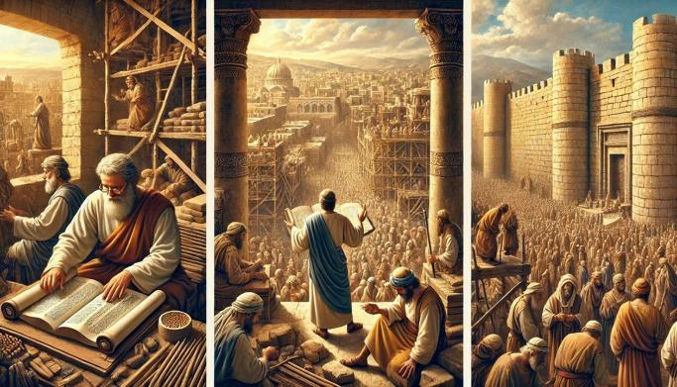
Zerubbabel
The Governor & Temple Rebuilder
Ezra
The Scribe & Spiritual Reformer
Nehemiah
The Wall Builder & Political Leader

Slide 49
--------------------------------------------------------------------------1 & 2 Chronicles ----------------------------------------------------------
Deuteronomy
1 Samuel
Leviticus
2 Samuel
Nehemiah
Genesis 1-11
Genesis 12-50
Exodus
Numbers
Joshua
Judges
1 Kings
2 Kings
Ruth
Ezra
Esther
Moses
Cycles
S • D • S
Z • E • N
Eternity
Creation
Joshua
J (R) & I (J)
Eternity
Fall
Babel
J (B) & I (A)
Flood
P • G • H • R
Abraham
Joseph
Isaac
Jacob
Exodus
Judges
Silent Years
Patriarchs
Conquests
Beginnings
Restoration
United Kingdom
Captivity
Divided Kingdom
Max Anders, Dallas Theological Seminary

Slide 50
Greece
Persia
Israel
Persian
Greek
Hasmonean
Roman

Slide 51
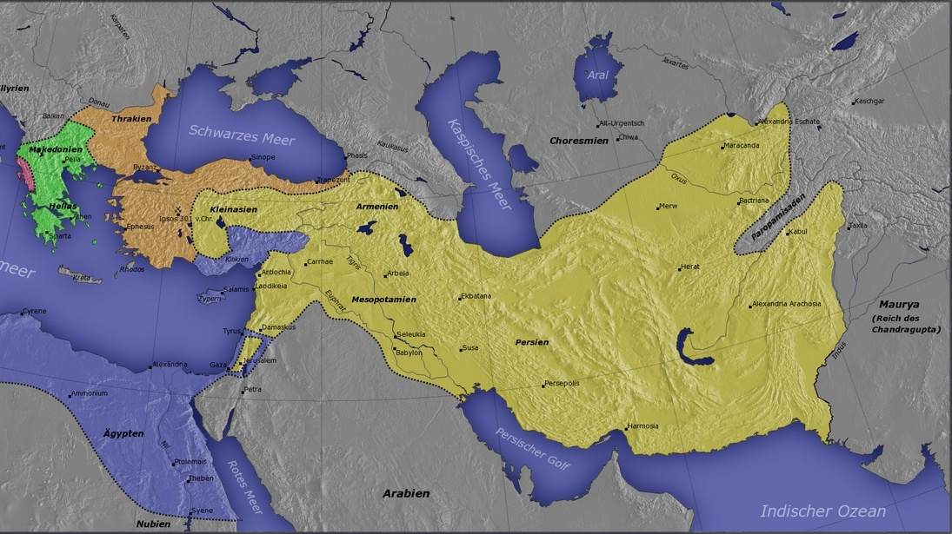
Persia
Persian Empire

Slide 52
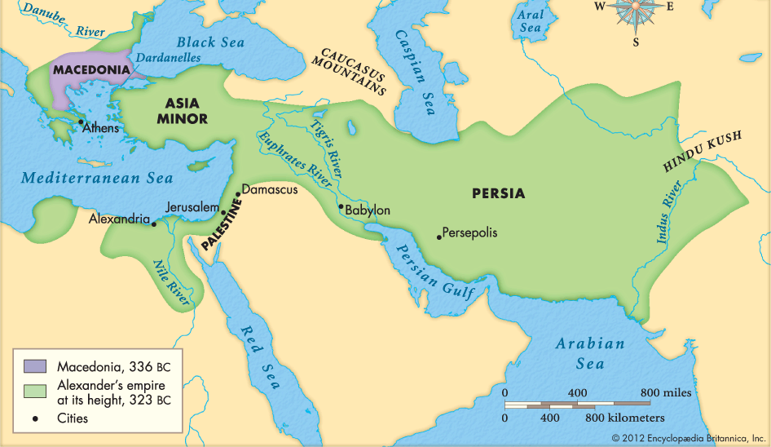
Greek Empire

Slide 53
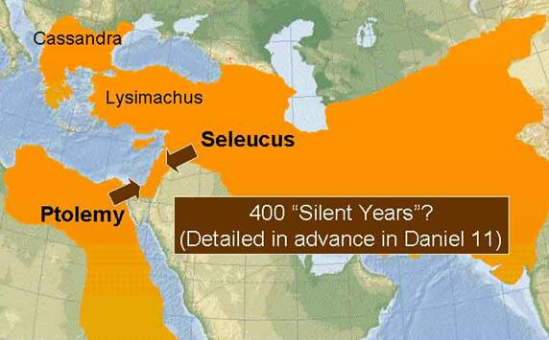
Greek Empire
(divided)
=> Seleuecid Empire

Slide 54
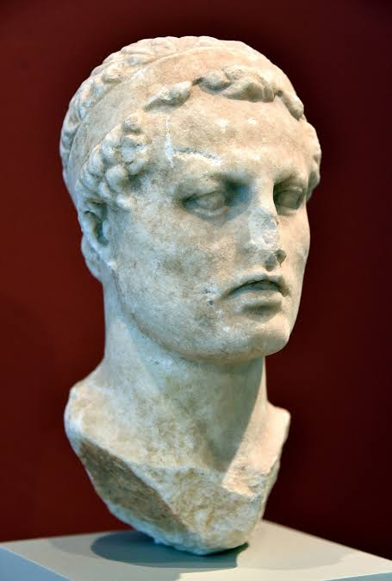
Antiochus IV
Epiphanes- God Given
Epimanes – the Madman

Slide 55
Antiochus IV
He forced Hellenization on the Jews, outlawing their religious practices.
He desecrated the Temple, sacrificing a pig and setting up a statue of Zeus.
Led to Maccabean Rebellion
Hannukah (Festival of Dedication John 10:22-23)
Established the Hasmonean Dynasty

Slide 56
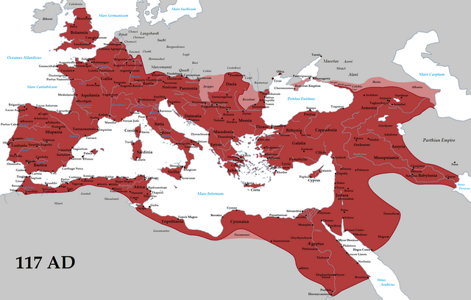
Roman Empire
Notes:
By Tataryn - Own work, CC BY-SA 3.0, https://commons.wikimedia.org/w/index.php?curid=19625326

Slide 57
Galatians 4:4 NIV
“But when the time had fully come,
God sent his Son, born of a woman,
born under law, to redeem those under law, that we might receive the full rights of sons.”

Slide 58
--------------------------------------------------------------------------1 & 2 Chronicles ----------------------------------------------------------
Deuteronomy
1 Samuel
Leviticus
2 Samuel
Nehemiah
Genesis 1-11
Genesis 12-50
Exodus
Numbers
Joshua
Judges
1 Kings
2 Kings
Ruth
Ezra
Esther
Moses
Cycles
S • D • S
Z • E • N
1st Coming
Eternity
Creation
Joshua
J (R) & I (J)
Eternity
Fall
Babel
J (B) & I (A)
Flood
P • G • H • R
Abraham
Joseph
Isaac
Jacob
Exodus
Judges
Silent Years
Patriarchs
Conquests
Beginnings
Restoration
United Kingdom
Captivity
Divided Kingdom
Max Anders, Dallas Theological Seminary

Slide 59
NT Theme
The long-awaited redemption
of a fallen creation followed by the restoration
and fulfillment of all God’s promises and purposes.
Notes:
NT Theme: Holsteen. Exploring Christian Theology : Volume 1: Revelation, Scripture, and the Triune God (p. 17). Baker Publishing Group. Kindle Edition.

Slide 60
--------------------------------------------------------------------------1 & 2 Chronicles ----------------------------------------------------------
Deuteronomy
1 Samuel
Leviticus
2 Samuel
Nehemiah
Genesis 1-11
Genesis 12-50
Exodus
Numbers
Joshua
Judges
1 Kings
2 Kings
Ruth
Ezra
Esther
Moses
Cycles
S • D • S
Z • E • N
1st Coming
Eternity
Creation
Joshua
J (R) & I (J)
Eternity
Fall
Babel
J (B) & I (A)
Flood
P • G • H • R
Abraham
Joseph
Isaac
Jacob
1990+
Exodus
Judges
Church
Patriarchs
Conquests
Silent Years
Beginnings
Restoration
United Kingdom
Captivity
Divided Kingdom
Max Anders, Dallas Theological Seminary

Slide 61
--------------------------------------------------------------------------1 & 2 Chronicles ----------------------------------------------------------
Deuteronomy
1 Samuel
Leviticus
2 Samuel
Nehemiah
Genesis 1-11
Genesis 12-50
Exodus
Numbers
Joshua
Judges
1 Kings
2 Kings
Ruth
Ezra
Esther
Moses
Cycles
S • D • S
Z • E • N
1st Coming
Eternity
Creation
Joshua
J (R) & I (J)
Eternity
Fall
Babel
J (B) & I (A)
Flood
P • G • H • R
2nd Coming
Abraham
Joseph
Isaac
Jacob
1990+
Exodus
Judges
Church
Patriarchs
Conquests
Silent Years
Beginnings
Restoration
United Kingdom
Captivity
Divided Kingdom
Max Anders, Dallas Theological Seminary

Slide 62
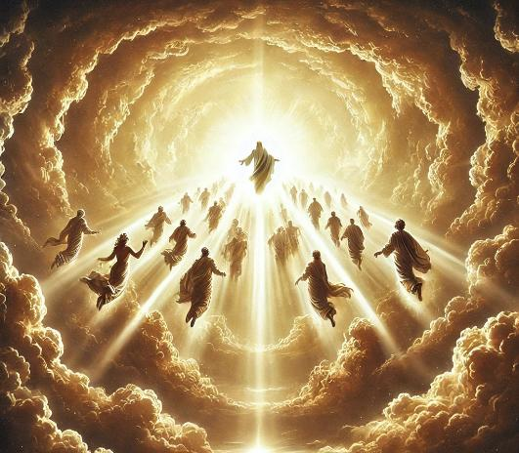
Acts1:10-11
"They were looking intently up into the sky as he was going, when suddenly two men dressed in white stood beside them. ‘Men of Galilee,’ they said, ‘why do you stand here looking into the sky? This same Jesus, who has been taken from you into heaven, will come back in the same way you have seen him go into heaven.’"

Slide 63
1 Thessalonians 4:16-17
“For the Lord himself will come down from heaven, with a loud command, with the voice of the archangel and with the trumpet call of God, and the dead in Christ will rise first. After that, we who are still alive and are left will be caught up together with them in the clouds to meet the Lord in the air. And so we will be with the Lord forever."

Slide 64
1 Corinthians 15:51-52
"Listen, I tell you a mystery: We will not all sleep, but we will all be changed—in a flash, in the twinkling of an eye, at the last trumpet. For the trumpet will sound, the dead will be raised imperishable, and we will be changed."

Slide 65
--------------------------------------------------------------------------1 & 2 Chronicles ----------------------------------------------------------
Deuteronomy
1 Samuel
Leviticus
2 Samuel
Nehemiah
Genesis 1-11
Genesis 12-50
Exodus
Numbers
Joshua
Judges
1 Kings
2 Kings
Ruth
Ezra
Esther
Moses
Cycles
S • D • S
Z • E • N
1st Coming
Eternity
Creation
Joshua
J (R) & I (J)
Eternity
Fall
Babel
J (B) & I (A)
Flood
P • G • H • R
2nd Coming
Abraham
Joseph
Isaac
Jacob
1000
1990+
Exodus
Judges
Church
Kingdom
Patriarchs
Conquests
Silent Years
Beginnings
Restoration
United Kingdom
Captivity
Divided Kingdom
Max Anders, Dallas Theological Seminary

Slide 66
When we all get to heaven
What a day of rejoicing that will be
When we all see Jesus
We'll sing and shout the victory

