Slide 1

Families: Love them Regardless
Mark 6.1–31

Slide 2

Mark’s Gospel
Mark is a Gospel of action; Jesus is like a Marvel comic character.

Slide 3
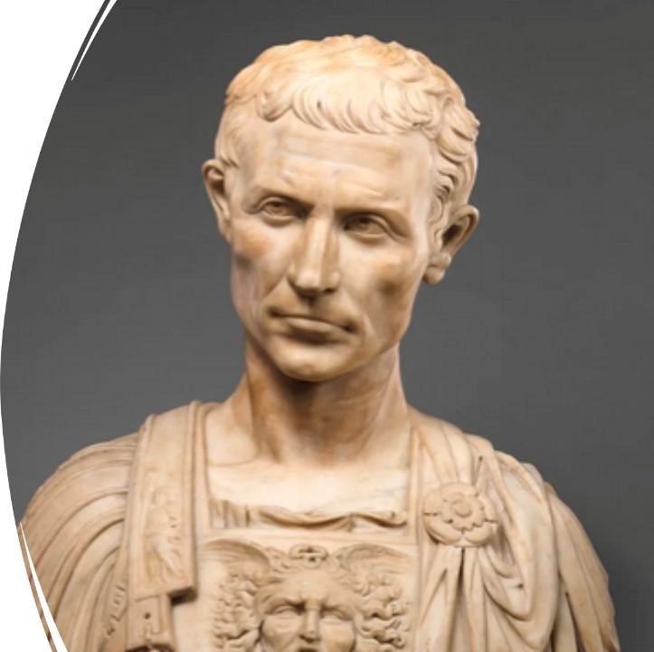
Purpose
To present Jesus as God’s anointed king (Messiah and Son of God) in opposition to Caesar, the other Son of God.
1:1; 8:29; 12:35; 14:61; 15:32, 39.

Slide 4
Families: Love them Regardless
Jesus’s family (6:1–13)
Herod’s family (6:14–29)
Jesus’s spiritual family (6:30–31)

Slide 5
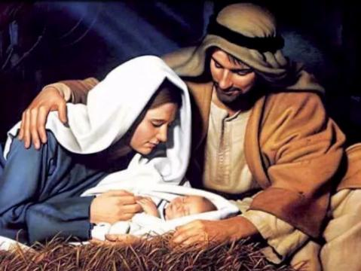
Story #1 – Jesus’s Family (6:1–13)
At hometown, Jesus wasn’t accepted.
“He marveled at their unbelief” (v. 6)
But he plodded on!

Slide 6
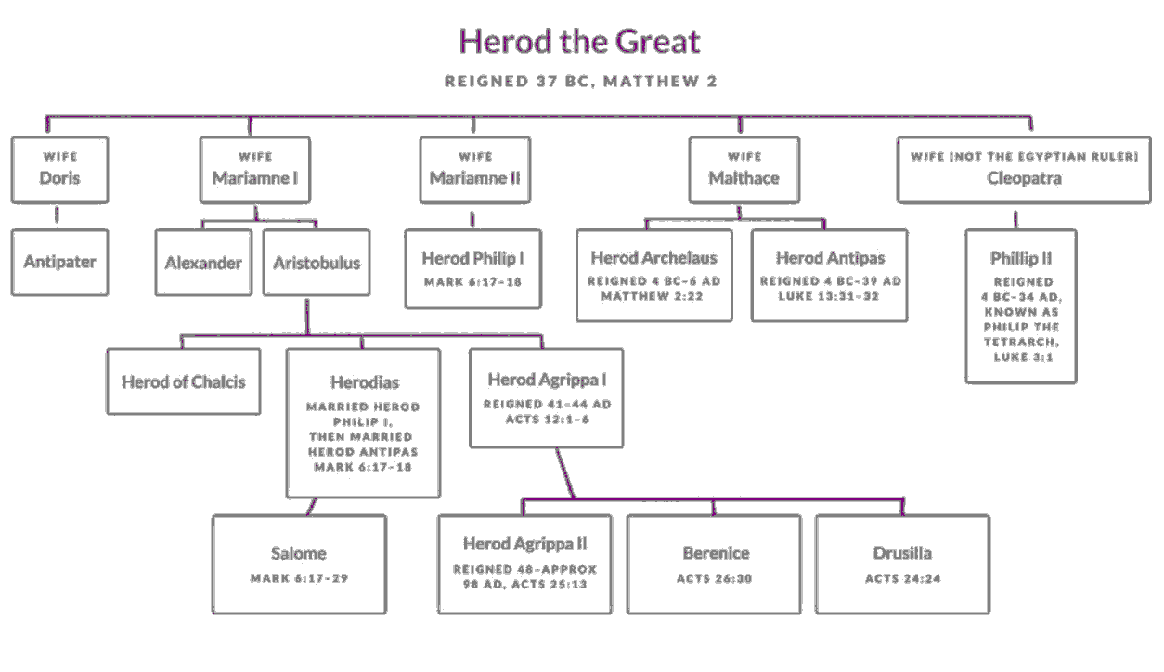
Story #2 – Herod’s Family (6:14–)
Very dysfunctional.
John was killed; the next chapter in ministry.

Slide 7
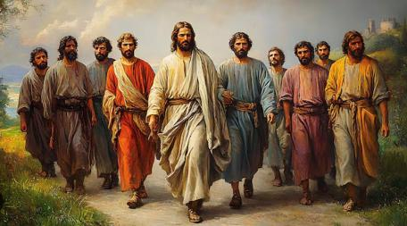
Story #3 – Jesus’s Spiritual Family (6:30–31)
Successful but unrested.
Jesus invites them to rest.

Slide 8

Lessons we’ve learned today
We plod on with our families, while loving them . . . Many of Jesus’s family became believers and wrote books in the Bible (James and Jude).
When families are dysfunctional, we don’t compromise on our beliefs as did Herod. Yet, if we fail, we grieve and know God is in control.
With families . . . Rest! (Put away phones!)

Slide 9

Question for us
What have we decided to do with our families today?
How will we show God to them with our lives and actions?

