Slide 1
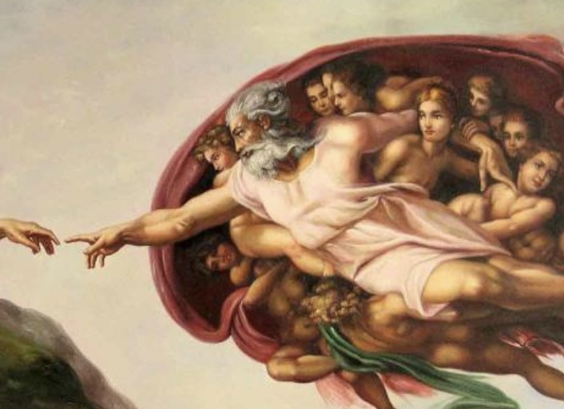
Power over Creation
Mark 4:35–5:43

Slide 2
Mark’s Gospel
Mark is a Gospel of action; Jesus is like a Marvel comic character.

Slide 3
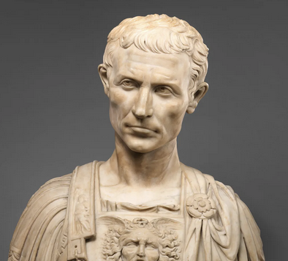
Purpose
To present Jesus as God’s anointed king (Messiah and Son of God) in opposition to Caesar, the other Son of God.
1:1; 8:29; 12:35; 14:61; 15:32, 39.

Slide 4
Today’s Triplet – Power over Creation
Calming the storm (4:35–41)
Commanding the spirits (5:1–20)
Confronting deaths (5:21–43)

Slide 6
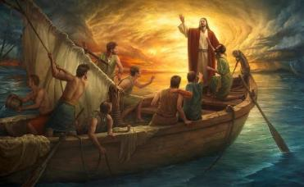
Miracle #1 – Calming the Storm (4:35–41)
The storm in the sea
Jesus’s question, “Why are you awed, alarmed, or afraid? Don’t you yet have faith?” (4:40)
Deos [awed, alarmed) = theos [God]

Slide 7
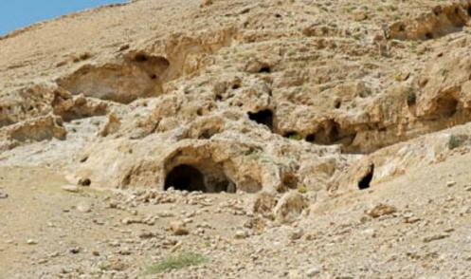
Miracle #2 – Commanding Spirits (5:1–20)
The demoniac
The legion’s confession: “Why me, Jesus the Son of the highest God? Are you going to torture me?” (5:7)
Jesus: “Go to your house and your people and tell them how much the Lord did for you and how much mercy he had shown you” (5:19)

Slide 8
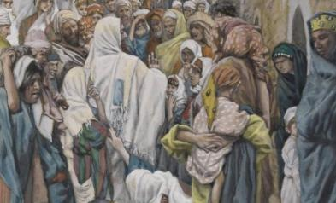
Miracle #3 – Confronting Deaths (5:21–43)
Double miracles
A woman with an unceasing blood flow
A child who has died
Jesus: “Daughter, your faith has saved you. Go in peace and be healed from your torment” (5:34)
Jesus: “Do not fear, only believe” (5:36)

Slide 9
Lessons we’ve learned today
Jesus is powerful over his earthly creation.
Jesus is powerful over his heavenly creatures.
Jesus is powerful over the enemy of his creation.
Faith alone draws people to understand Jesus as this supreme creator and savior.

Slide 10
Question for us
What’s our biggest enemy – nature (e.g., natural disasters, prejudice), spiritual (depression, anxiety), or physical (poor health, constant pain)?
He is powerful over them to deliver us or to enable us to endure them.

