Slide 1
Psalm 103 – Wisdom for the New Year

Slide 2
¹ Bless the Lord, O my soul, and all that is within me, bless his holy name! ² Bless the Lord, O my soul, and forget not all his benefits, ³ who forgives all your iniquity, who heals all your diseases, ⁴ who redeems your life from the pit, who crowns you with steadfast love and mercy, ⁵ who satisfies you with good so that your youth is renewed like the eagle's.

Slide 3
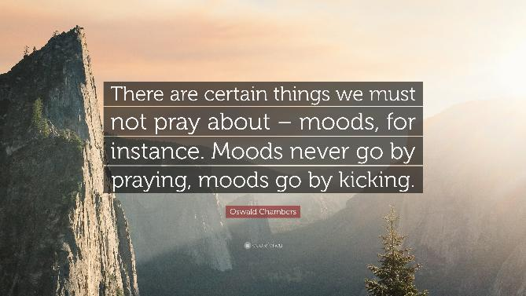

Slide 4
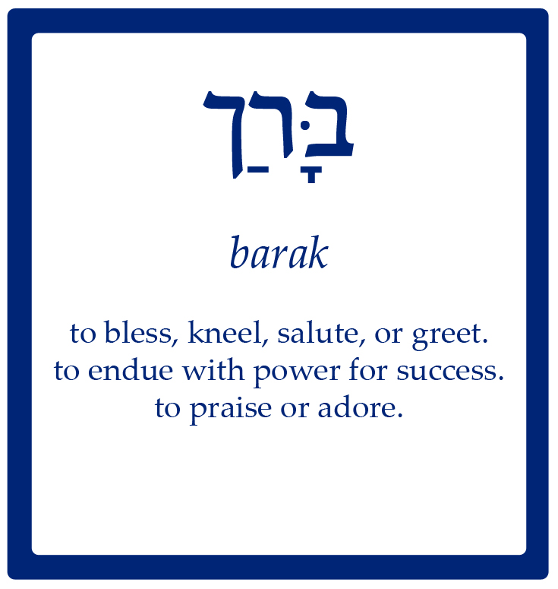
¹ Bless the Lord, O my soul, and all that is within me, bless his holy name!

Slide 5
Psalm 103:1-5
“…forget not all his benefits.” (Vs 2)
Vs 3a – He FORGIVES

Slide 6
Psalm 103:1-5
“…forget not all his benefits.” (Vs 2)
Vs 3a – He FORGIVES
Vs 3b – He HEALS (sometimes sickness and sin are related – Psalm 38:1-8)

Slide 7
Psalm 103:1-5
“…forget not all his benefits.” (Vs 2)
Vs 3a – He FORGIVES
Vs 3b – He HEALS (sometimes sickness and sin are related – Psalm 38:1-8)
Vs 4 – He REDEEMS and RESTORES

Slide 8
Psalm 103:1-5
“…forget not all his benefits.” (Vs 2)
Vs 3a – He FORGIVES
Vs 3b – He HEALS (sometimes sickness and sin are related – Psalm 38:1-8)
Vs 4 – He REDEEMS and RESTORES
Vs 5 – He RENEWS and SATISFIES – strength and vitality like the eagle (see Isaiah 40:31)

Slide 9
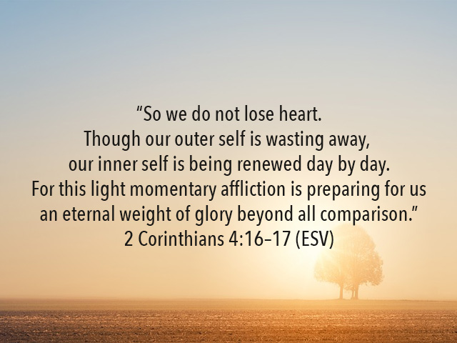

Slide 10
⁶ The Lord works righteousness and justice for all who are oppressed. ⁷ He made known his ways to Moses, his acts to the people of Israel. ⁸ The Lord is merciful and gracious, slow to anger and abounding in steadfast love. ⁹ He will not always chide, nor will he keep his anger forever. ¹⁰ He does not deal with us according to our sins, nor repay us according to our iniquities. ¹¹ For as high as the heavens are above the earth, so great is his steadfast love toward those who fear him; ¹² as far as the east is from the west, so far does he remove our transgressions from us.

Slide 11
⁶ The Lord works righteousness and justice for all who are oppressed. ⁷ He made known his ways to Moses, his acts to the people of Israel. ⁸ The Lord is merciful and gracious, slow to anger and abounding in steadfast love. ⁹ He will not always chide, nor will he keep his anger forever. ¹⁰ He does not deal with us according to our sins, nor repay us according to our iniquities. ¹¹ For as high as the heavens are above the earth, so great is his steadfast love toward those who fear him; ¹² as far as the east is from the west, so far does he remove our transgressions from us.

Slide 12
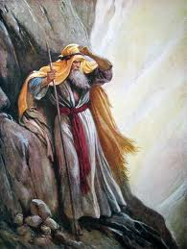
Exodus 33:28 – 34:9
The Lord Passed before Moses

Slide 14
Psalm 103:6-16
“The Lord is merciful and gracious, slow to anger and abounding in steadfast love.”
Vs 8 is based on Exodus 34:6.
This same description often repeated in Scripture in Scripture – see Numbers 14:17-19; Psalm 86:5, 15; Psalm 145:8; Joel 2:13; Jonah 4:2.

Slide 15
Psalm 103:6-16
“The Lord is merciful and gracious, slow to anger and abounding in steadfast love.”
Vs 8 is based on Exodus 34:6.
This same description often repeated in Scripture in Scripture – see Numbers 14:17-19; Psalm 86:5, 15; Psalm 145:8; Joel 2:13; Jonah 4:2.

Slide 17
Notes:
https://bibleproject.com/explore/video/loyal-love/

Slide 18
⁶ The Lord works righteousness and justice for all who are oppressed. ⁷ He made known his ways to Moses, his acts to the people of Israel. ⁸ The Lord is merciful and gracious, slow to anger and abounding in steadfast love. ⁹ He will not always chide, nor will he keep his anger forever. ¹⁰ He does not deal with us according to our sins, nor repay us according to our iniquities. ¹¹ For as high as the heavens are above the earth, so great is his steadfast love toward those who fear him; ¹² as far as the east is from the west, so far does he remove our transgressions from us.

Slide 19
¹³ As a father shows compassion to his children, so the Lord shows compassion to those who fear him. ¹⁴ For he knows our frame; he remembers that we are dust.
¹⁵ As for man, his days are like grass; he flourishes like a flower of the field; ¹⁶ for the wind passes over it, and it is gone, and its place knows it no more.

Slide 20
¹⁷ But the steadfast love of the Lord is from everlasting to everlasting on those who fear him, and his righteousness to children's children, ¹⁸ to those who keep his covenant and remember to do his commandments. ¹⁹ The Lord has established his throne in the heavens, and his kingdom rules over all.

Slide 21
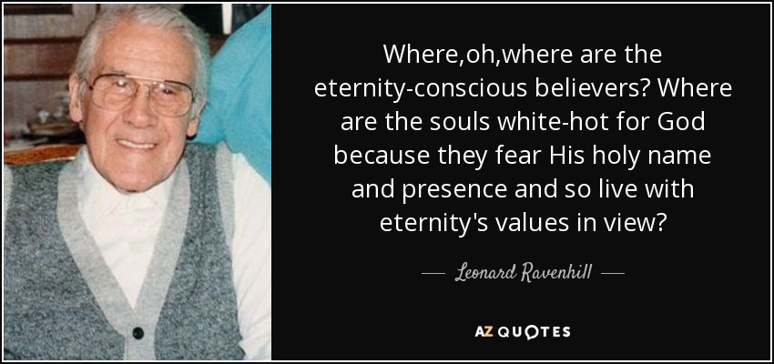

Slide 22
²⁰ Bless the Lord, O you his angels, you mighty ones who do his word, obeying the voice of his word! ²¹ Bless the Lord, all his hosts, his ministers, who do his will! ²² Bless the Lord, all his works, in all places of his dominion. Bless the Lord, O my soul!

Slide 23
John Wesley’s Covenant Prayer
I am no longer my own, but yours. Put me to what you will; place me with whom you will. Put me to doing; put me to suffering. Let me be put to work for you or set aside for you; praised for you or criticized for you. Let me be full; let me be empty. Let me have all things; let me have nothing. I freely and fully surrender all things to your glory and service.
And now, O glorious and blessed God, Father, Son and Holy Spirit - you are mine, and I am yours. So be it. Amen.

