Slide 1
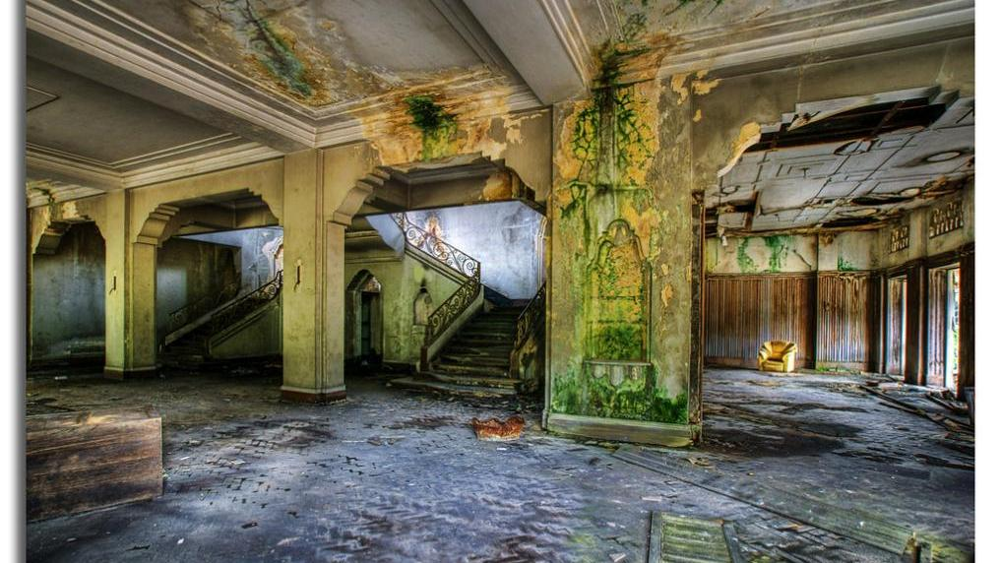
Istana Woodneuk

Slide 2


Slide 3
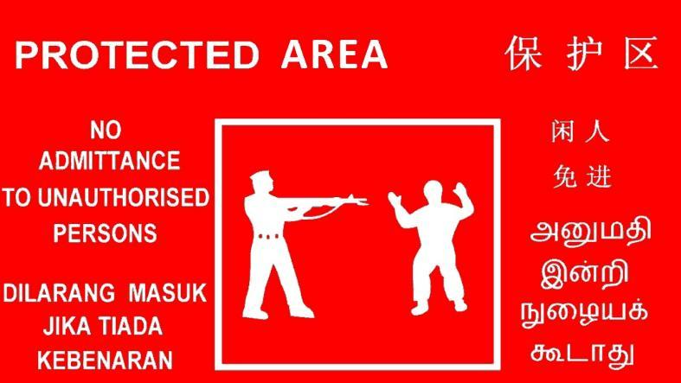

Slide 4

Warning about
Presumptuous Arrogance and Oppressive Greed
James 4:13 – 5:6

Slide 5


Slide 6
 | Obeys the Word | Avoids Favor-itism | Produces Works |  | Produces Humility | Triumphs
 | 1:19-27 | 2:1-13 | 2:14-26 |  | 4:1–5:6 | 5:7-20
Salutation Trials Temptations | Prepare Obey | Discrimination Materialism Egalitarianism | Meeting Needs Validation | Influence Untamable Be Wise | Conflict Judging Presumption | Suffering Prayer Confrontation
Faith in Action . . .
Rejoices in Difficulty
Speaks Wisely
1:1-18
3:1-18
A book summary chart of all the books of the New Testament can be found at
https://biblestudydownloads.org/resources/new-testament-survey/

Slide 7
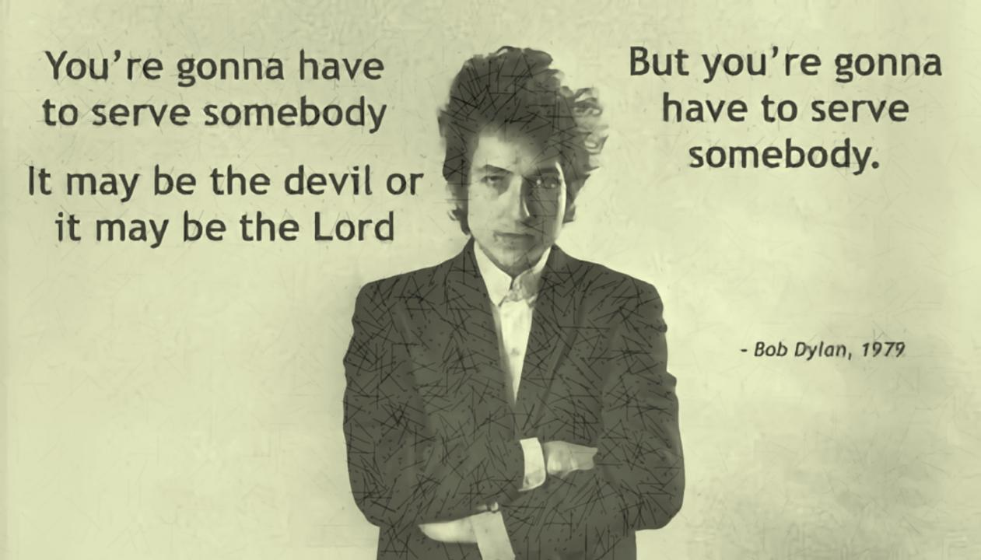
James 4:1-12 - Gotta Serve Somebody

Slide 8
James 4:1-12
4 things we must do:
Submit to God (vs 7a).
“Submit” in Greek hypotassō - "be subject, to yield".
2) Resist the devil (vs 7b) - cf Matt. 4:1-10.
3) Draw near to God (vs 8a)
4) Weep and mourn over our sins (vs 8b-9)

Slide 9
Where do you stand with God today?

Slide 10

Here Today; Gone Tomorrow
James 4:13 – 5:6

Slide 11
Come
¹³ Come now, you who say, “Today or tomorrow we will go into such and such a town and spend a year there and trade and make a profit”—

Slide 12
Come
¹³ Come now, you who say,
ἄγε ag’-eh
ἄγω: 45x: bring
12x: lead
7x: go
2x: bring forth

Slide 13
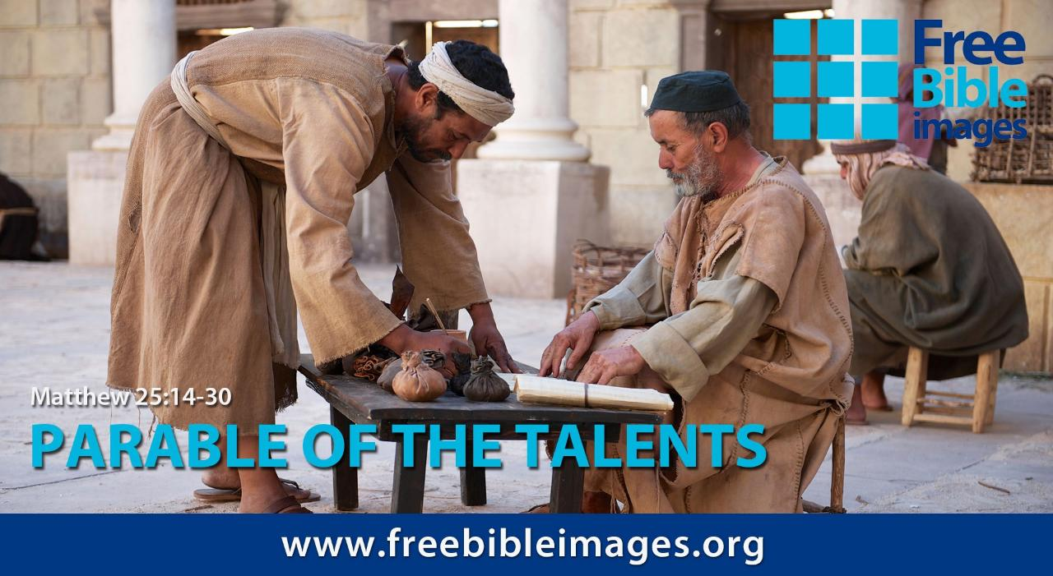
images are the copyright of the LUMO project www.LumoProject.com and are available for download at FreeBibleimages.org

Slide 14
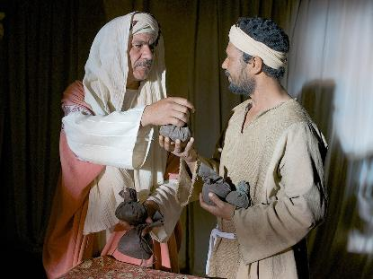
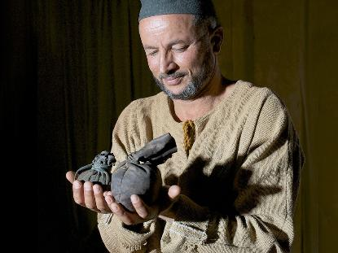
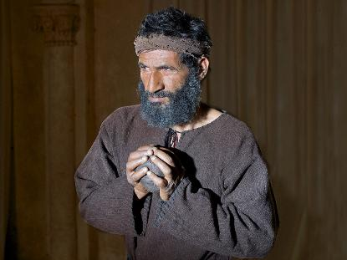
Before going on a long trip, the master entrusted three of his servants with bags of silver (5, 2, 1) according to their abilities
5 bags
2 bags
1 bag
images are the copyright of the LUMO project www.LumoProject.com and are available for download at FreeBibleimages.org

Slide 15
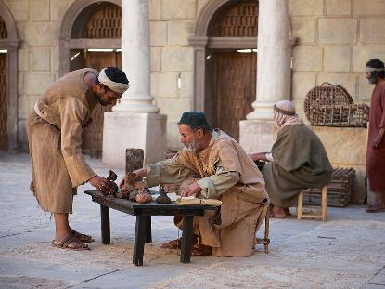
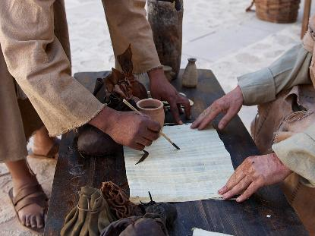
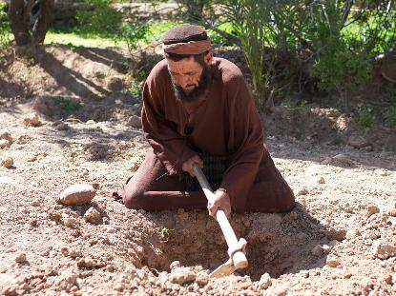
The first two servants worked and doubled their money
The third servant buried his money
10 bags
4 bags
1 bag
images are the copyright of the LUMO project www.LumoProject.com and are available for download at FreeBibleimages.org

Slide 16
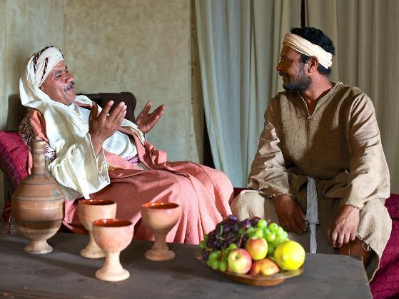
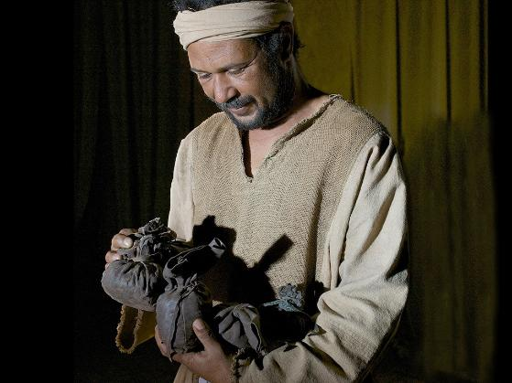
When the master returned, he praised the first two servants
Well done, my good and faithful servant
images are the copyright of the LUMO project www.LumoProject.com and are available for download at FreeBibleimages.org

Slide 17
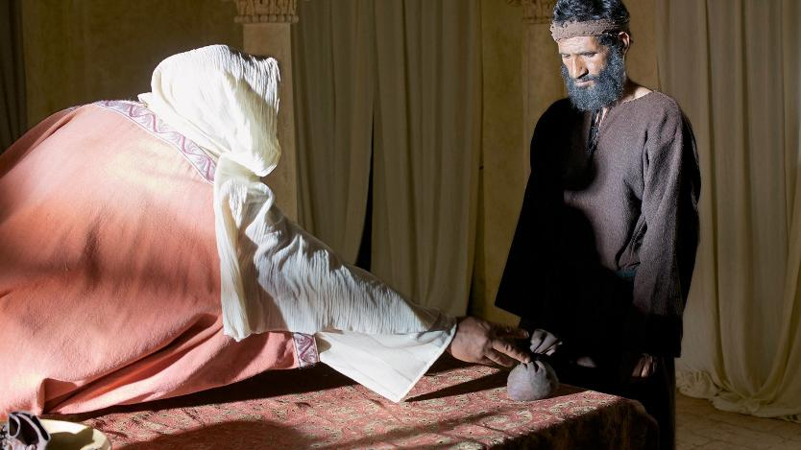
But the third . . .
You wicked and lazy servant!
images are the copyright of the LUMO project www.LumoProject.com and are available for download at FreeBibleimages.org

Slide 18
Wise stewardship and using resources productively is commended
images are the copyright of the LUMO project www.LumoProject.com and are available for download at FreeBibleimages.org

Slide 19
¹³ Come now, you who say, “Today or tomorrow we will go into such and such a town and spend a year there and trade and make a profit”— ¹⁴ yet you do not know what tomorrow will bring.

Slide 20

Insurance is a means of protection from financial
loss in which, in exchange for a fee, a party agrees
to compensate another party in the event of a
certain loss, damage, or injury. It is a form of risk management, primarily used to protect against the risk of a contingent or uncertain loss.
Notes:
https://en.wikipedia.org/wiki/Insurance

Slide 21
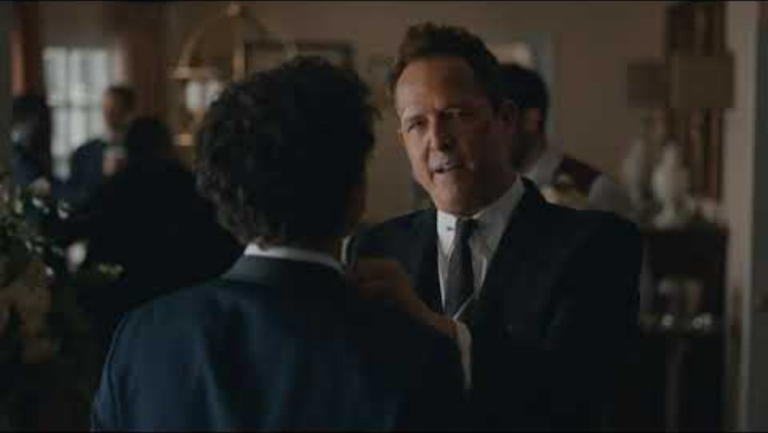
Notes:
https://www.youtube.com/watch?v=fCVSCOOznRs

Slide 22
Insurance is a means of protection from financial
loss in which, in exchange for a fee, a party agrees
to compensate another party in the event of a
certain loss, damage, or injury. It is a form of risk management, primarily used to protect against the risk of a contingent or uncertain loss.
Wise stewardship includes carrying appropriate levels of insurance because it is a means of saving for future needs, a principle emphasized in the Bible
Notes:
https://en.wikipedia.org/wiki/Insurance

Slide 23
¹³ Come now, you who say, “Today or tomorrow we will go into such and such a town and spend a year there and trade and make a profit”— ¹⁴ yet you do not know what tomorrow will bring. What is your life? For you are a mist that appears for a little time and then vanishes.

Slide 24




100%
90%
For you are a mist that appears for a little time and then vanishes.
25%
5%
0.1%
2.5%
Being Alive

Slide 25
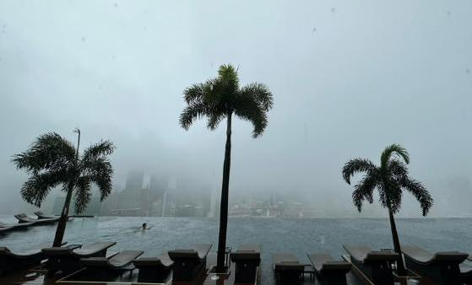
Notes:
https://mothership.sg/2023/01/singapore-cbd-foggy-like-genting/

Slide 26
Time’s Paces
When I was a babe and wept and slept,
                Time crept;
When I was a boy and laughed and talked,
                Time walked.
Then when the years saw me a man,
                Time ran.
But as I older grew,
                Time flew.
Soon, as I journey on,
                I'll find time gone.
Notes:
Time's Paces written by Henry Twells (1823–1900) and published in his book Hymns and Other Stray Verses (1901). The poem was popularised by Guy Pentreath (version shown here) and can be found at https://en.wikipedia.org/wiki/Time%27s_Paces

Slide 27
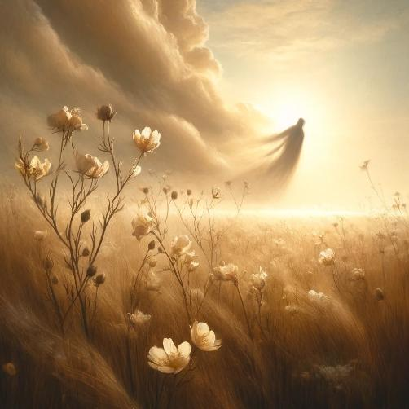
Psalm 103:15-16
¹⁵ Our days on earth are like grass;
like wildflowers, we bloom and die.
¹⁶ The wind blows, and we are gone—
as though we had never been here.
Notes:
DALL·E 2024-12-12 10.29.25 - A serene, contemplative image illustrating Psalm 103_15-16. The scene features a field of delicate wildflowers in full bloom under a soft, golden ligh

Slide 28
Planning for the future => Wise stewardship
Preparing for Uncertainty => Wise Stewardship
Perceiving Life’s Transience => Spiritual Wisdom

Slide 29
¹³ Come now, you who say, “Today or tomorrow we will go into such and such a town and spend a year there and trade and make a profit”— ¹⁴ yet you do not know what tomorrow will bring. What is your life? For you are a mist that appears for a little time and then vanishes. ¹⁵ Instead you ought to say, “If the Lord wills, we will live and do this or that.”

Slide 30
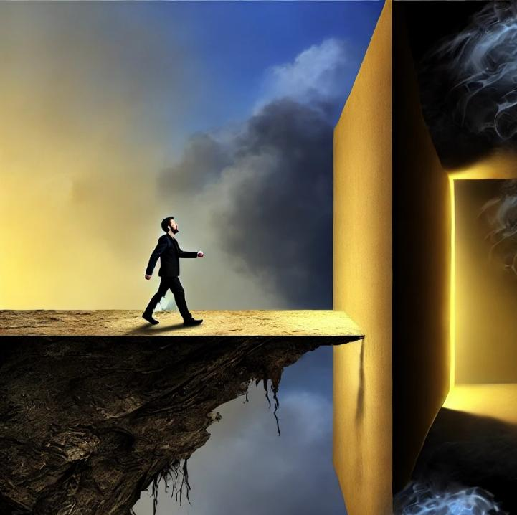
Peril for the Presumptuous
James 4:13-17
Notes:
Image created using ChatGPT with the prompt “create an image based on "Peril for the Presumptuous “”
DALL·E 2024-12-13 21.26.15 - An artistic square image inspired by the concept of 'Peril for the Presumptuous.' The scene features a precarious cliff edge where a confident figure,

Slide 31
Peril for the Presumptuous
/pruh·zuhmp·tyoo·uhs/
Failing to observe the limits of what is permitted or appropriate.
Not showing due respect for God and overstepping one's bounds.
Notes:
Image created using ChatGPT with the prompt “create an image based on "Peril for the Presumptuous “”
DALL·E 2024-12-13 21.26.15 - An artistic square image inspired by the concept of 'Peril for the Presumptuous.' The scene features a precarious cliff edge where a confident figure,

Slide 32
Worldly living does not always show itself
in hatred for God.
Sometimes it appears in the form of
disregarding God
as we plan life’s daily activities.
Lea, T. D. (1999). Hebrews, James (Vol. 10, p. 323). Broadman & Holman Publishers.

Slide 33
¹³ Come now, you who say, “Today or tomorrow we will go into such and such a town and spend a year there and trade and make a profit”— ¹⁴ yet you do not know what tomorrow will bring. What is your life? For you are a mist that appears for a little time and then vanishes. ¹⁵ Instead you ought to say, “If the Lord wills, we will live and do this or that.” ¹⁶ As it is, you boast in your arrogance. All such boasting is evil.
Boasting

Slide 34
 | Produces Humility
 | 4:1–5:6
 | Conflict Judging Presumption
Faith in Action . . .
Turn Hatred into Humility (4:1-6)
Turn Judgment into Justice (4:7-12)
Turn Boasting into Belief (4:13-17)
  Statement of Boasting (13)
  Sentence on Boasting (14)
  Solution for Boasting (15-17)
Boasting
Blue, J. R. (1985). James. In J. F. Walvoord & R. B. Zuck (Eds.), The Bible Knowledge Commentary: An Exposition of the Scriptures (Vol. 2, p. 831). Victor Books.

Slide 35
¹³ Come now, you who say, “Today or tomorrow we will go into such and such a town and spend a year there and trade and make a profit”— ¹⁴ yet you do not know what tomorrow will bring. What is your life? For you are a mist that appears for a little time and then vanishes. ¹⁵ Instead you ought to say, “If the Lord wills, we will live and do this or that.” ¹⁶ As it is, you boast in your arrogance. All such boasting is evil. ¹⁷ So whoever knows the right thing to do and fails to do it, for him it is sin.
¹⁷ So whoever knows the right thing to do and fails to do it, for him it is sin.

Slide 36
^{1:22} But be doers of the word, and not hearers only, deceiving yourselves.
^{2:17} So also faith by itself, if it does not have works, is dead.
^{3:13} Who is wise and understanding among you? By his good conduct let him show his works in the meekness of wisdom.
¹⁷ So whoever knows the right thing to do and fails to do it, for him it is sin.
^{4:}

Slide 37
Time’s Paces
When I was a babe and wept and slept,
                Time crept;
When I was a boy and laughed and talked,
                Time walked.
Then when the years saw me a man,
                Time ran.
But as I older grew,
                Time flew.
Soon, as I journey on,
                I'll find time gone.
May Christ have saved my soul, by then.
Notes:
Time's Paces written by Henry Twells (1823–1900) and published in his book Hymns and Other Stray Verses (1901). The poem was popularised by Guy Pentreath (version shown here) and can be found at https://en.wikipedia.org/wiki/Time%27s_Paces

Slide 38
There is nothing evil or wrong per se about anything God has made and put at our disposal.
But God is not at our disposal.
Richardson, K. A. (1997). James (Vol. 36, p. 201). Broadman & Holman Publishers.

Slide 39


Slide 40
¹ Come now, you rich,

Slide 41
4:13 Come now, you who say, “Today
5:1 Come now, you rich,
ἄγε ag’-eh

Slide 42
 | Obeys the Word | Avoids Favor-itism | Produces Works |  | Produces Humility | Triumphs
 | 1:19-27 | 2:1-13 | 2:14-26 |  | 4:1–5:6 | 5:7-20
Salutation Trials Temptations | Prepare Obey | Discrimination Materialism Egalitarianism | Meeting Needs Validation | Influence Untamable Be Wise | Conflict Judging Presumption | Suffering Prayer Confrontation
Faith in Action . . .
Rejoices in Difficulty
Speaks Wisely
1:1-18
3:1-18
A book summary chart of all the books of the New Testament can be found at
https://biblestudydownloads.org/resources/new-testament-survey/

Slide 43
Ch 4: Submit with Contrition
Turn Hatred into Humility (1-6)
Turn Judgment into Justice (7-12)
Turn Boasting into Belief (13-17)
Statement of Boasting (13)
Sentence on Boasting (14)
Solution for Boasting (15-17)
Ch 5: Share with Concern
Share in Possessions (1-6)
Share in Patience (7-12)
Share in Prayer (13-20)
Consternation from Wealth (1)
Corrosion of Wealth (2-3)
Condemnation of Wealth (4-6)
Blue, J. R. (1985). James. In J. F. Walvoord & R. B. Zuck (Eds.), The Bible Knowledge Commentary: An Exposition of the Scriptures (Vol. 2, p. 831). Victor Books.

Slide 44
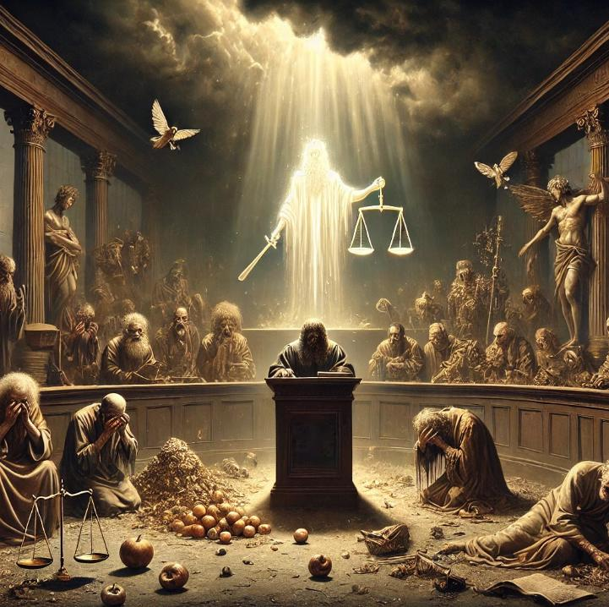
Ruin for the Rich
James 5:1-6
Notes:
Image created using ChatGPT with the prompt “create a 16x9 image reflecting the courtroom-like scenario that also captures the essence of James 5:1-6 “
DALL·E 2024-12-14 10.33.34 - A dramatic courtroom scene in a dark and moody setting, reflecting the essence of James 5_1-6. The room is filled with an ethereal, divine light break

Slide 45
¹ Come now, you rich,
Who are “the rich”

Slide 46
¹ Come now, you rich, weep and howl for the miseries that are coming upon you.
Judgment Pronounced

Slide 47
¹ Come now, you rich, weep and howl for the miseries that are coming upon you.
● ² Your riches have rotted and
● your garments are moth-eaten.
● ³ Your gold and silver have corroded,
Evidence Presented

Slide 48
¹ Come now, you rich, weep and howl for the miseries that are coming upon you.
● ² Your riches have rotted and
● your garments are moth-eaten.
● ³ Your gold and silver have corroded,
Matt. 6:19
“Do not lay up for yourselves treasures on earth, where moth and rust destroy
and where thieves break in and steal,
Evidence Presented
evidence

Slide 49
¹ Come now, you rich, weep and howl for the miseries that are coming upon you.
● ² Your riches have rotted and
● your garments are moth-eaten.
● ³ Your gold and silver have corroded,
and their corrosion will be evidence against you and will eat your flesh like fire. You have laid up treasure in the last days.
corrosion
evidence
Evidence Presented

Slide 50
3:8 but no human being can tame the tongue.
It is a restless evil, full of deadly
5:3 Your gold and silver have corroded, and their
will be evidence against you
Rom 3:13 “Their throat is an open grave;
they use their tongues to deceive.” “The
of asps is under their lips.”
poison
Κατιόω (rusted)
corrosion
venom
ἰός ee-os'

Slide 51
Your gold and silver have corroded, and their corrosion will be evidence against you and will eat your flesh like fire. You have laid up treasure in the last days. (ESV)
Your gold and silver are corroded. The very wealth you were counting on will eat away your flesh like fire. This corroded treasure you have hoarded will testify against you on the day of judgment. (NLT)
Evidence Presented

Slide 52
⁴ Behold, the wages of the laborers who mowed your fields,
  which you kept back by fraud,
  are crying out against you,
            and the cries of the harvesters have reached the ears of the Lord of hosts.
Testimony Provided

Slide 53
⁴ Behold, the wages of the laborers who mowed your fields,
  which you kept back by fraud,
  are crying out against you,
            and the cries of the harvesters have reached the ears of the Lord of hosts.
● ⁵ You have lived on the earth in luxury and in self-indulgence.
● You have fattened your hearts in a day of slaughter.
● ⁶ You have condemned and murdered the righteous person.
He does not resist you.
Charges Posed

Slide 54
Peril for the Presumptuous 4:13-17
¹⁵ Instead you ought to say, “If the Lord wills, we will live and do this or that.”
Ruin for the Rich 5:1-6
Matthew Ch 6: ¹⁹ “Do not lay up for yourselves treasures on earth, where moth and rust destroy and where thieves break in and steal,
²⁰ but lay up for yourselves treasures in heaven, where neither moth nor rust destroys and where thieves do not break in and steal. ²¹ For where your treasure is, there your heart will be also.
Alternative Implied

Slide 55
