Slide 1
James
FAITH
In action
James 2:14-26
Two Legs Walking

Slide 2


Slide 3
James
FAITH
In action
James 2:14-26
Two Legs Walking

Slide 4


Slide 5
James 2:14-26
“For by grace you have been saved through faith. And this is not your own doing; it is the gift of God, not a result of works, so that no one may boast.” (Ephesians 2:8-9).

Slide 6
James 2:14-26
“For by grace you have been saved through faith. And this is not your own doing; it is the gift of God, not a result of works, so that no one may boast.” (Ephesians 2:8-9).
‘We have been saved, we are being saved and we will be saved.’
Salvation is a future expectation - Matt 24:13; Luke18:8; Philippians 3:20; 1 Timothy 4:16; Hebrews 9:28

Slide 7
¹⁴ What good is it, my brothers, if someone says he has faith but does not have works? Can that faith save him? ¹⁵ If a brother or sister is poorly clothed and lacking in daily food, ¹⁶ and one of you says to them, “Go in peace, be warmed and filled,” without giving them the things needed for the body, what good is that? ¹⁷ So also faith by itself, if it does not have works, is dead.

Slide 8
¹⁸ But someone will say, “You have faith and I have works.” Show me your faith apart from your works, and I will show you my faith by my works. ¹⁹ You believe that God is one; you do well. Even the demons believe—and shudder! ²⁰ Do you want to be shown, you foolish person, that faith apart from works is useless? ²¹ Was not Abraham our father justified by works when he offered up his son Isaac on the altar? ²² You see that faith was active along with his works, and faith was completed by his works; ²³ and the Scripture was fulfilled that says, “Abraham believed God, and it was counted to him as righteousness”—and he was called a friend of God. ²⁴ You see that a person is justified by works and not by faith alone.

Slide 9
²⁵ And in the same way was not also Rahab the prostitute justified by works when she received the messengers and sent them out by another way? ²⁶ For as the body apart from the spirit is dead, so also faith apart from works is dead.

Slide 10
James 2:14-26
1. Each illustration ends with a summary statement of what James was trying to teach and emphasise (vs 17, 20, 24 and 26).
Vs 17: So also faith by itself, if it does not have works, is dead.
Vs 26: For as the body apart from the spirit is dead, so also faith apart from works is dead.

Slide 11
James 2:14-26
1. Each illustration ends with a summary statement of what James was trying to teach and emphasise (vs 17, 20, 24 and 26).
2. The first and last illustration have to do with our behaviour towards people - while the second and third have to do with our attitude towards God - where we have real relationship and obedience towards him.

Slide 12


Slide 13
¹⁷ So also faith by itself, if it does not have works, is dead.

Slide 14
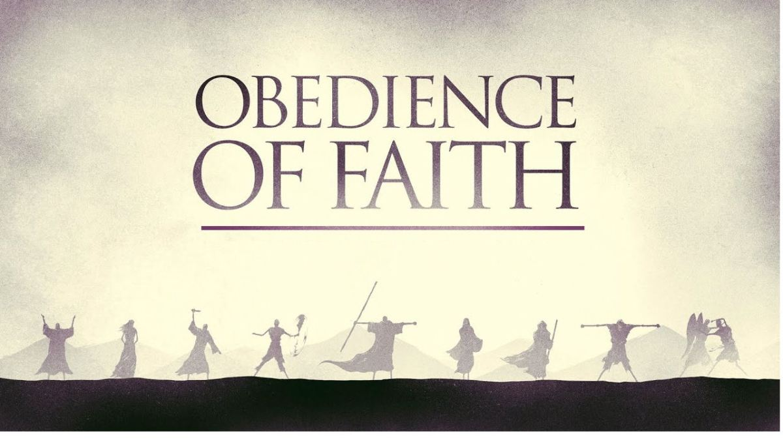

Slide 15
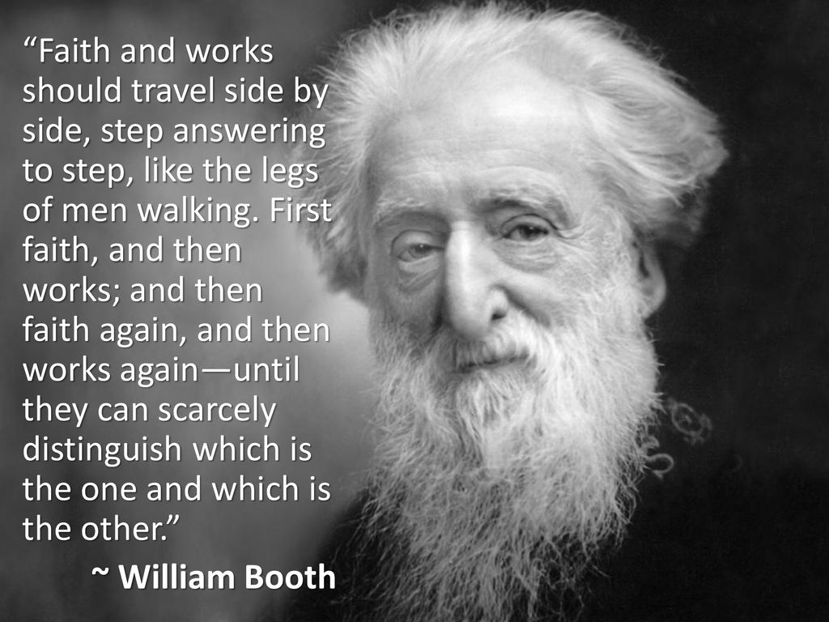

Slide 16
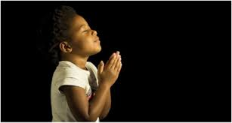
LET US PRAY….

