Slide 1
James
FAITH
In action
James 2:1-13

Slide 3
James 1:26-27
3-fold duty towards self, neighbour and God.
We must control our tongue - that's self-control (vs 26).
We must care for orphans and widows (vs 27a).
And finally, keep from being polluted by the world, in love and worship due alone to God (vs 27b).

Slide 4
My brothers, show no partiality as you hold the faith in our Lord Jesus Christ, the Lord of glory. ² For if a man wearing a gold ring and fine clothing comes into your assembly, and a poor man in shabby clothing also comes in, ³ and if you pay attention to the one who wears the fine clothing and say, “You sit here in a good place,” while you say to the poor man, “You stand over there,” or, “Sit down at my feet,” ⁴ have you not then made distinctions among yourselves and become judges with evil thoughts? ⁵ Listen, my beloved brothers, has not God chosen those who are poor in the world to be rich in faith and heirs of the kingdom, which he has promised to those who love him? ⁶ But you have dishonored the poor man. Are not the rich the ones who oppress you, and the ones who drag you into court? ⁷ Are they not the ones who blaspheme the honorable name by which you were called?

Slide 6
My brothers, show no partiality as you hold the faith in our Lord Jesus Christ, the Lord of glory. ² For if a man wearing a gold ring and fine clothing comes into your assembly, and a poor man in shabby clothing also comes in, ³ and if you pay attention to the one who wears the fine clothing and say, “You sit here in a good place,” while you say to the poor man, “You stand over there,” or, “Sit down at my feet,” ⁴ have you not then made distinctions among yourselves and become judges with evil thoughts? ⁵ Listen, my beloved brothers, has not God chosen those who are poor in the world to be rich in faith and heirs of the kingdom, which he has promised to those who love him? ⁶ But you have dishonored the poor man. Are not the rich the ones who oppress you, and the ones who drag you into court? ⁷ Are they not the ones who blaspheme the honorable name by which you were called?

Slide 7
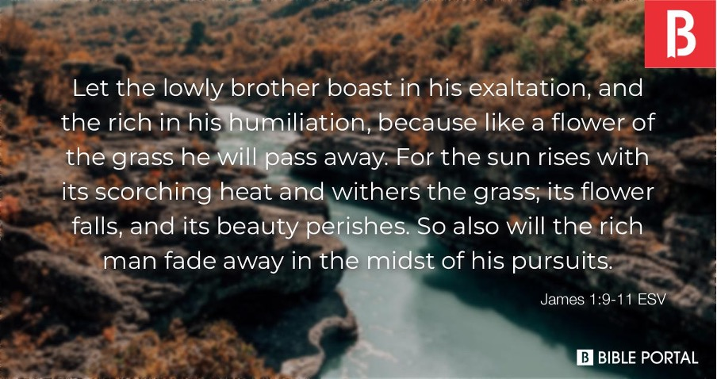

Slide 8
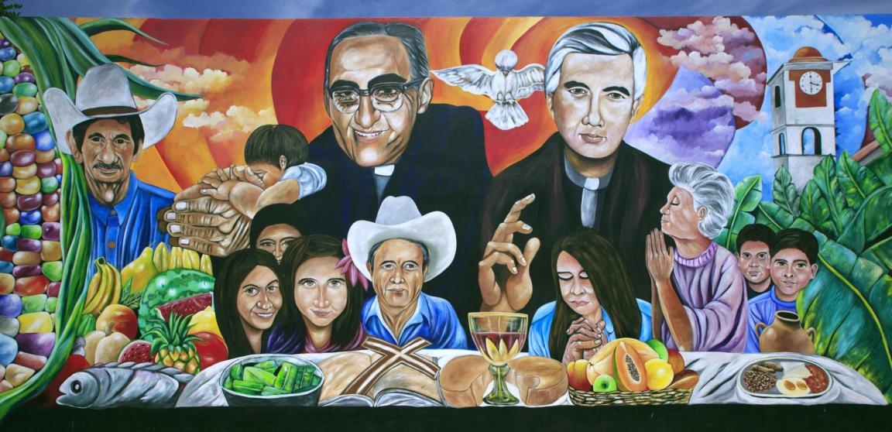
Liberation theology

Slide 9
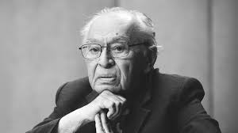
“God demonstrates a special predilection toward those who have been excluded from the banquet of life.”
Gustavo Gutiérrez
1924-2024

Slide 11
“Wealth, and the power that typically travels with it, often deceive and corrupt (Matt. 13:22; Mark 4:9; 1 Tim. 6:9-10), making it harder for the rich and powerful to humble themselves in dependence on God (Mark 10:22-25). The poor, by contrast, are far more conscious of their need and thus more willing to entrust themselves to God.”

Slide 12
⁸ If you really fulfill the royal law according to the Scripture, “You shall love your neighbor as yourself,” you are doing well. ⁹ But if you show partiality, you are committing sin and are convicted by the law as transgressors. ¹⁰ For whoever keeps the whole law but fails in one point has become guilty of all of it. ¹¹ For he who said, “Do not commit adultery,” also said, “Do not murder.” If you do not commit adultery but do murder, you have become a transgressor of the law. ¹² So speak and so act as those who are to be judged under the law of liberty. ¹³ For judgment is without mercy to one who has shown no mercy. Mercy triumphs over judgment.

Slide 13
James 2:8-13
Vs 8 - The Royal Law – as interpreted by Jesus, the Lord of glory (see vs 1).
For the Jews, neighbour referred only to fellow Israelites.
Jesus expanded it to include foreigners (Luke 10:25-37) and enemies (Matthew 5:44).

Slide 14
James 2:8-13
Vs 8 - The Royal Law – as interpreted by Jesus, the Lord of glory (see vs 1).
For the Jews, neighbour referred only to fellow Israelites.
Jesus expanded it to include foreigners (Luke 10:25-37) and enemies (Matthew 5:44).
Vs 9-11 – Breaking a part of the law = breaking all of it.

Slide 15
⁸ If you really fulfill the royal law according to the Scripture, “You shall love your neighbor as yourself,” you are doing well. ⁹ But if you show partiality, you are committing sin and are convicted by the law as transgressors. ¹⁰ For whoever keeps the whole law but fails in one point has become guilty of all of it. ¹¹ For he who said, “Do not commit adultery,” also said, “Do not murder.” If you do not commit adultery but do murder, you have become a transgressor of the law. ¹² So speak and so act as those who are to be judged under the law of liberty. ¹³ For judgment is without mercy to one who has shown no mercy. Mercy triumphs over judgment.

Slide 16
James 2:8-13
Vs 12 – Both speaking and acting in the light of the law of liberty – of Christ.
Vs 13 – God is merciful (Exodus 34:5-6) and that we ought to also show mercy to each other (Hosea 6:6, as Jesus taught in Matthew 5:7; Luke 6:36).

Slide 17
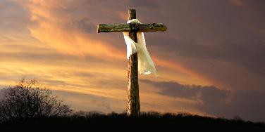
James 2:8-13
Vs 12 – Both speaking and acting in the light of the law of liberty – of Christ.
Vs 13 – God is merciful (Exodus 34:5-6) and that we ought to also show mercy to each other (Hosea 6:6, as Jesus taught in Matthew 5:7; Luke 6:36).
“Mercy triumphs over judgement” – particularly on the cross.

Slide 18
Do nothing from selfish ambition or conceit, but in humility count others more significant than yourselves. ⁴ Let each of you look not only to his own interests, but also to the interests of others. ⁵ Have this mind among yourselves, which is yours in Christ Jesus ⁶ who, though he was in the form of God, did not count equality with God a thing to be grasped, ⁷ but emptied himself, by taking the form of a servant, being born in the likeness of men. ⁸ And being found in human form, he humbled himself by becoming obedient to the point of death, even death on a cross. ⁹ Therefore God has highly exalted him and bestowed on him the name that is above every name, ¹⁰ so that at the name of Jesus every knee should bow, in heaven and on earth and under the earth, ¹¹ and every tongue confess that Jesus Christ is Lord, to the glory of God the Father.
Philippians 2:3-11

