Slide 1
James
FAITH
In action
James 1:19-27

Slide 2
At the 4th Lausanne Congress in Seoul, Korea

Slide 4
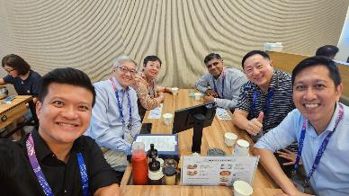
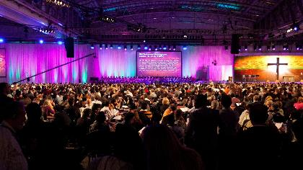
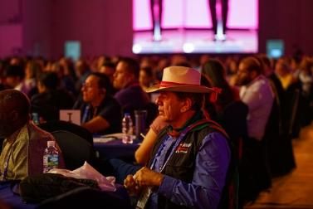
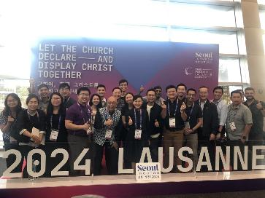
The 4th Lausanne Congress in Seoul, South Korea

Slide 5
My Table Group

Slide 6
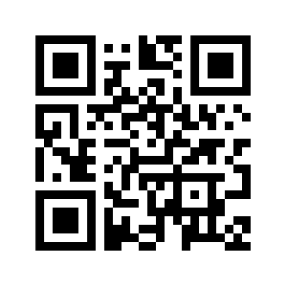
Two Key Documents from the L4 Congress
1. State of the Great Commission Report
https://lausanne.org/report

Slide 7
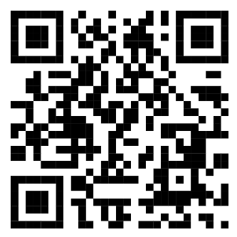
Two Key Documents from the L4 Congress
2. The Seoul Statement
https://lausanne.org/statement/the-seoul-statement

Slide 8
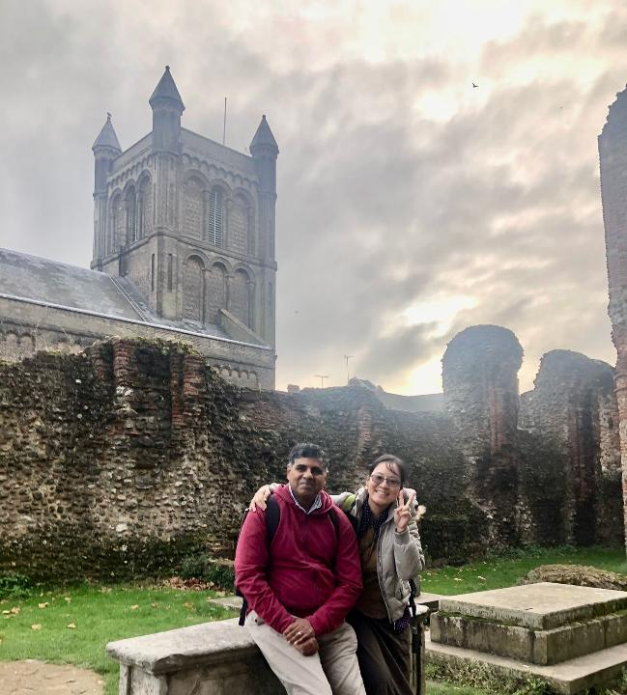

Slide 9
How can we demonstrate faith when faced with trials?
It takes lifetime
of trusting God, seeking wisdom,
living humbly, and avoiding temptation

Slide 10
James
FAITH
In action
James 1:19-27

Slide 11
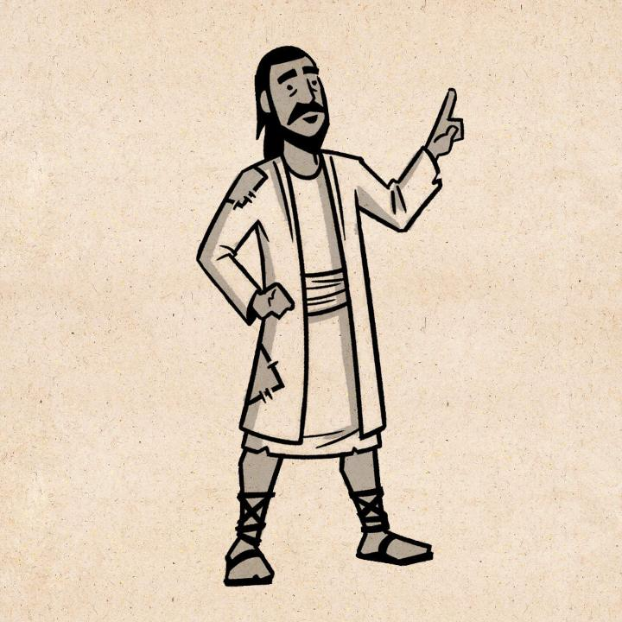
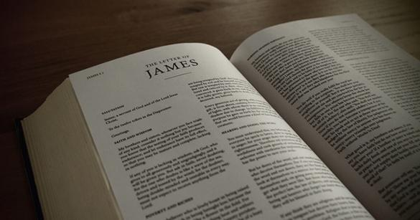
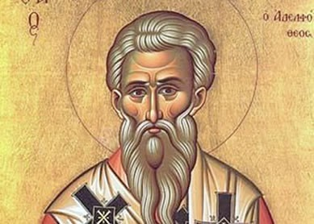

Slide 13
¹⁹ Know this, my beloved brothers: let every person be quick to hear, slow to speak, slow to anger; ²⁰ for the anger of man does not produce the righteousness of God. ²¹ Therefore put away all filthiness and rampant wickedness and receive with meekness the implanted word, which is able to save your souls.

Slide 14
James 1:19-21
Last week, from 1:16-18 – By God’s gift, we are made new as a kind of first-fruits. Therefore, let us remain “steadfast under trial” (vs 12).
Now he says, “be quick to hear, slow to speaks, slow to anger.”

Slide 15
Notes:
Why can’t we be like that wise old owl?

Slide 16
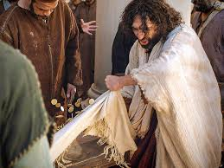
God’s righteous anger versus the anger of man.

Slide 17
James 1:19-21
Last week, from 1:16-18 – By God’s gift, we are made new as a kind of first-fruits. Therefore, let us remain “steadfast under trial” (vs 12).
Now he says, “be quick to hear, slow to speaks, slow to anger.” (vs 19).
Put away “all filthiness and rampant wickedness.” (vs 21).

Slide 18
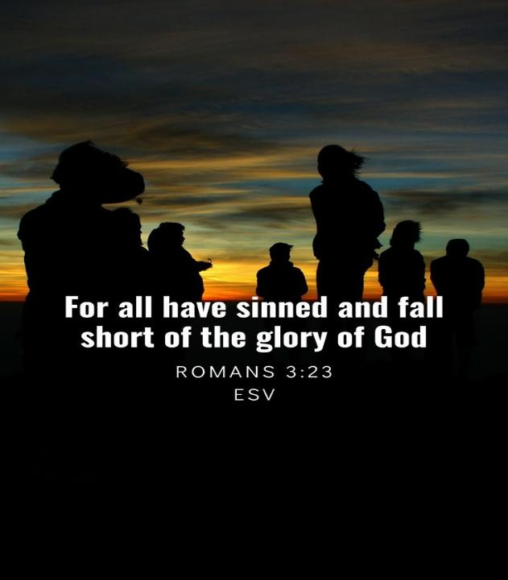

Slide 19
²² But be doers of the word, and not hearers only, deceiving yourselves. ²³ For if anyone is a hearer of the word and not a doer, he is like a man who looks intently at his natural face in a mirror. ²⁴ For he looks at himself and goes away and at once forgets what he was like. ²⁵ But the one who looks into the perfect law, the law of liberty, and perseveres, being no hearer who forgets but a doer who acts, he will be blessed in his doing.

Slide 20
What is a Discple?
A Disciple is one who lives his life hearing, believing and obeying all of Jesus' words for all his life.

Slide 21
What is a Discple?
4 stages of becoming a true disciple:
1. An intellectual reception.
2. An emotional response.
3. A volitional decision.

Slide 22
What is a Discple?
4 stages of becoming a true disciple:
1. An intellectual reception.
2. An emotional response.
3. A volitional decision.
4. A practical outcome - we obey and we do.

Slide 24
James 1:22-25
Talks about looking into the mirror and forgetting it immediately (vs 23-24).
If we look into God’s word – the mirror of God’s perfect law that bring true freedom, and continues or ‘perseveres’

Slide 26
DOES JAMES contradict paul on faith & works?
Paul - "For we hold that one is justified by faith apart from works of the law." (Romans 3:28).
James - "You see that a person is justified by works and not by faith alone." (James 2:24).
Both of them used the example of Abraham to prove their point (Romans 4:1-15, James 2:21-23).

Slide 27
DOES JAMES contradict paul on faith & works?
NO! Just a difference in emphasis, not in core belief.
Paul was opposed to Jewish legalists who claimed salvation was a matter of works – i.e what you did.
James was opposed to Jewish aristocrats who claimed salvation was only a matter of faith – i.e. what you professed.

Slide 28
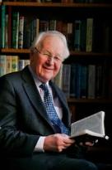
John Stott
"To the legalists Paul argues that we are justified not by our own good works but through faith in Christ. To the aristocrats James argues that we are justified not by a barren orthodoxy (which even the demons possess—“and shudder,” 2:19), but by works, especially care for the needy."
Basic Introduction to the New Testament, Grand Rapids, Michigan : Eerdmans, 2017, page 75.

Slide 29
DOES JAMES contradict paul on faith & works?
Paul does also teach that our faith in Christ will result inevitably in good works (Ephesians 2:8–10; Galatians 5:6).
Similarly, James affirms that our good works spring naturally from true faith (James 2:15), and if we are all talk and no action, we don’t have true faith (James 2:17).
Neither dead faith (James 2:17) nor dead works (Hebrews 6:1, 9:14) are of any use, but a true faith will result in "love and good deeds" as Hebrews 10:24 tells us.

Slide 30
We are saved not by good works, but for good works.

Slide 31
²⁶ If anyone thinks he is religious and does not bridle his tongue but deceives his heart, this person's religion is worthless. ²⁷ Religion that is pure and undefiled before God the Father is this: to visit orphans and widows in their affliction, and to keep oneself unstained from the world.

Slide 32
James 1:26-27
3-fold duty towards self, neighbour and God.
We must control our tongue - that's self-control (vs 26).
We must care for orphans and widows (vs 27a).
And finally, keep from being polluted by the world, in love and worship due alone to God (vs 27b).

Slide 33
application

Slide 34
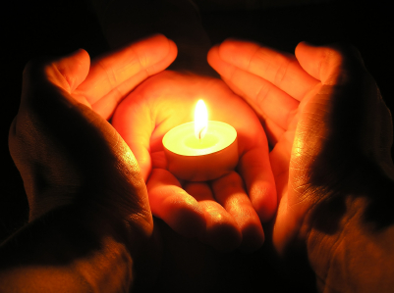
application
1) Let your Faith show in the way you live – be a disciple.

Slide 35
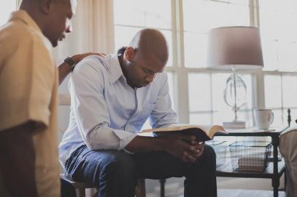
application
1) Let your Faith show in the way you live – be a disciple.
2) Let your Faith be shared with someone else – make another disciple.

Slide 36
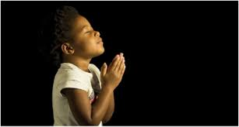
LET US PRAY….

