Slide 1
Notes:
Singapore is famous for its fusion cuisine.
Fusion cuisine is where you blend diverse culinary traditions into unique, innovative dishes.
Some examples would be Laksa Pasta, Chilli Crab Pizza, beef Rendang Tacos, and Salted Egg Yolk Croissants.
Now that you are nice and hungry, I’m gonna stop talking about food.
Instead of fusion cuisine, imagine a fusion Bible.

Slide 2
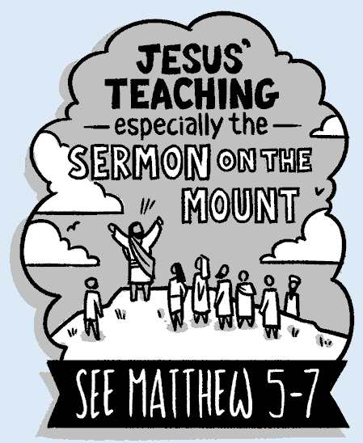
Notes:
Images from the Bible Project
https://bibleproject.com/explore/video/james/
https://bibleproject.com/view-resource/267/

Slide 3
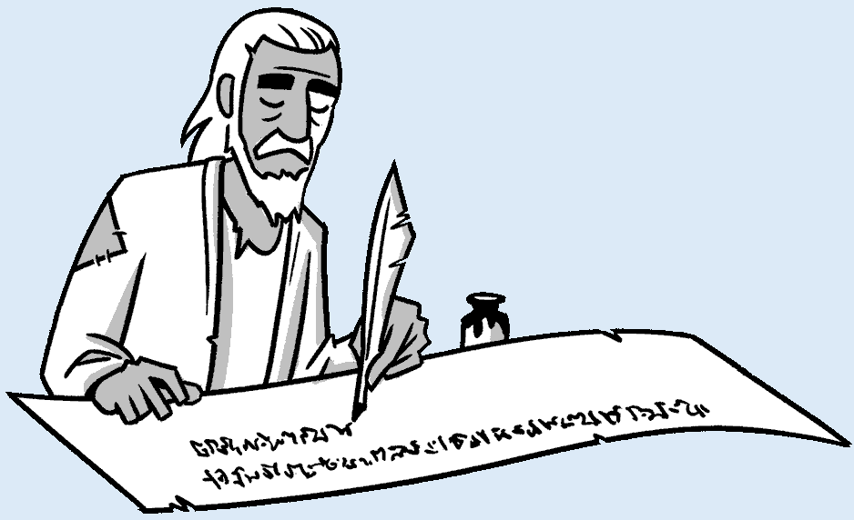
James
Short Wisdom Speeches
full of Metaphors
& One-liners
www.bibleproject.com
Notes:
Image and text from the Bible Project
https://bibleproject.com/explore/video/james/
https://bibleproject.com/view-resource/267/

Slide 4
James
FAITH
In action

Slide 5
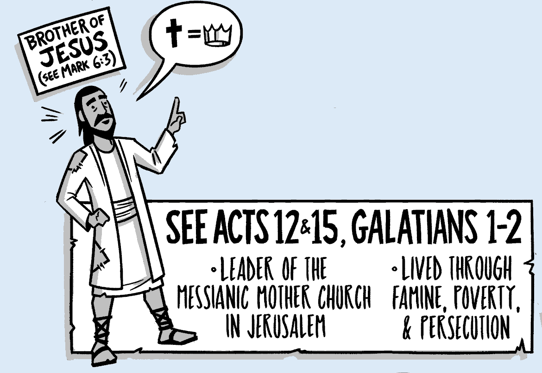
WHO?
James 1:1
James, a servant of God and of the Lord Jesus Christ,
James
www.bibleproject.com

Slide 6
WHY?
PROBLEMS
in the Church

Slide 7
WHY?
NT Overview
Gospels
4BC
30-33
Repent and Turn to God
KINGDOM
Love God, love others
https://biblestudydownloads.org/resources/new-testament-survey/

Slide 8
WHY?
NT Overview
Gospels
"To the remotest part of the earth" (Acts 1:8)
1 9 13 14 15 16 18 21 27 28
But as the believers rapidly multiplied,
there were rumblings of discontent. The Greek-speaking believers complained about the Hebrew-speaking believers, saying that their widows were being discriminated against in the daily distribution of food.
Acts 6:1 NLT
4BC
30-33
35
48 49 50
52 53 57 60 62
67 68 95
James
https://biblestudydownloads.org/resources/new-testament-survey/

Slide 9
WHY?
NT Overview
Gospels
"To the remotest part of the earth" (Acts 1:8)
1 9 13 14 15 16 18 21 27 28
4BC
30-33
35
48 49 50
52 53 57 60 62
67 68 95
Matt
Luke
Acts
Mark
John
James
Gospels & Acts
https://biblestudydownloads.org/resources/new-testament-survey/

Slide 10
WHY?
NT Overview
Gospels
"To the remotest part of the earth" (Acts 1:8)
1 9 13 14 15 16 18 21 27 28
Apr 48- Sep 49
1 Galatia
Apr 50- Sep 52
2 Aegean
Spr 53- May 57
3 Asia
Feb 60- Mar 62
Rome
4BC
30-33
35
48 49 50
52 53 57 60 62
67 68 95
Matt
Luke
Acts
Mark
John
Gal
1 Thess
1 Cor
Eph
1 Tim
2 Tim
James
2 Thess
2 Cor
Col
Titus
Romans
Philem
Gospels & Acts
Phil
Pauline Epistles
https://biblestudydownloads.org/resources/new-testament-survey/

Slide 11
WHY?
NT Overview
Gospels
"To the remotest part of the earth" (Acts 1:8)
1 9 13 14 15 16 18 21 27 28
Apr 48- Sep 49
1 Galatia
Apr 50- Sep 52
2 Aegean
Spr 53- May 57
3 Asia
Feb 60- Mar 62
Rome
4BC
30-33
35
48 49 50
52 53 57 60 62
67 68 95
Matt
Luke
Acts
Mark
John
Gal
1 Thess
1 Cor
Eph
1 Tim
2 Tim
Jude
James
2 Thess
2 Cor
Col
Titus
Heb
1 John
Romans
Philem
1 Pet
2 John
Gospels & Acts
Phil
2 Pet
3 John
Pauline Epistles
Rev
General Epistles
https://biblestudydownloads.org/resources/new-testament-survey/

Slide 12
WHAT?
From: James, a servant of God and of the Lord Jesus Christ,
To: The twelve tribes in the Dispersion:
Greetings!
Short Wisdom Speeches
full of Metaphors & One-liners
Faith and Wisdom 1:2–8
Poverty and Riches 1:9-11
Trial and Temptation 1:12–18
Hearing and Doing the Word 1:19–27
Warning against Partiality 2:1–13
Faith and Works 2:14–26
The Tongue 3:1–12
The Wisdom from Above 3:13–18
Friendship with the World 4:1–10
Judging a Brother 4:11–12
Warning against Boasting 4:13–17
Warning to the Rich 5:1–6
Patience and Prayer 5:7–20

Slide 13
WHAT?
From: James, a servant of God and of the Lord Jesus Christ,
To: The twelve tribes in the Dispersion:
Subj: FAITH in Action
Introduction: Ch 1 sums up book’s main ideas & key words
Faith and Wisdom 1:2–8
Poverty and Riches 1:9-11
Trial and Temptation 1:12–18
Hearing and Doing the Word 1:19–27
Warning against Partiality 2:1–13
Faith and Works 2:14–26
The Tongue 3:1–12
The Wisdom from Above 3:13–18
Friendship with the World 4:1–10
Judging a Brother 4:11–12
Warning against Boasting 4:13–17
Warning to the Rich 5:1–6
Patience and Prayer 5:7–20

Slide 14
worditout.com
Notes:
Word cloud created by https://worditout.com

Slide 15
19x Brother
19x One
17x God
16x Faith
15x Lord
14x Works
14x Works
worditout.com

Slide 16
19x Brother
19x One
17x God
16x faith
15x Lord
14x works
14x Works
worditout.com

Slide 17
19x
19x one
17x God
16x faith
15x Lord
14x works
14x Works
brother
brother
worditout.com

Slide 18
brother
² Count it all joy, my brothers,
when you meet trials of various kinds,
⁹ Let the lowly brother boast in his exaltation,
brother
⁶ But let him ask in faith, with no doubting,
for the one who doubts is like a wave of the sea
that is driven and tossed by the wind.
Ch 4 ¹¹ Do not speak evil against one another, brothers. The one who speaks against a brother …

Slide 19
 | Obeys the Word | Avoids Favor-itism | Produces Works | Speaks Wisely | Produces Humility | Triumphs
 | 1:19-27 | 2:1-13 | 2:14-26 | 3 | 4:1–5:6 | 5:7-20
Salutation Trials Temptations | Prepare Obey | Discrimination Materialism Egalitarianism | Meeting Needs Validation | Influence Untamable Be Wise | Conflict Judging Presumption | Suffering Prayer Confrontation
Rejoices in Difficulty
1:1-18
A book summary chart of all the books of the New Testament can be found at
https://biblestudydownloads.org/resources/new-testament-survey/
Notes:
A book summary chart of all the books of the New Testament can be found at
https://biblestudydownloads.org/resources/new-testament-survey/
Download can be found under “An Overview of the Books of the New Testament”
https://biblestudydownloads.org/files/eng/ns/00-NT_Book_Overviews-542_27a-f_eng_ns_7609_v12.pptx

Slide 20
Faith is Revealed through Works Because Faith… FAITH In action . . .
 | Obeys the Word | Avoids Favor-itism | Produces Works | Speaks Wisely | Produces Humility | Triumphs
 | 1:19-27 | 2:1-13 | 2:14-26 | 3 | 4:1–5:6 | 5:7-20
Salutation Trials Temptations | Prepare Obey | Discrimination Materialism Egalitarianism | Meeting Needs Validation | Influence Untamable Be Wise | Conflict Judging Presumption | Suffering Prayer Confrontation
Rejoices in Difficulty
1:1-18
A book summary chart of all the books of the New Testament can be found at
https://biblestudydownloads.org/resources/new-testament-survey/
Notes:
A book summary chart of all the books of the New Testament can be found at
https://biblestudydownloads.org/resources/new-testament-survey/
Download can be found under “An Overview of the Books of the New Testament”
https://biblestudydownloads.org/files/eng/ns/00-NT_Book_Overviews-542_27a-f_eng_ns_7609_v12.pptx

Slide 21
James
1:1-18
Rejoices in Difficulty
How can we demonstrate faith when faced with trials?
Notes:
Image created using Microsoft copilot with the prompt “create a line drawing of a many in a hospital bed praying”
Yes, there was a typo in the prompt, but the AI figured it out anyway

Slide 22
The Journey to Joyful Endurance
James
1:1-18
How can we demonstrate faith when faced with trials?
Notes:
Image created using ChatGPT with the prompt “create a black and white drawing of a person going on a journey and only carrying a bible, show a winding path with one or two forks ahead”

Slide 23
The Path to Perfection (1-4)

Slide 24
¹ James, a servant of God and of the Lord Jesus Christ,
To the twelve tribes in the Dispersion:
Greetings.
² Count it all joy, my brothers, when you meet trials of various kinds,
The Command
James 1:1-4

Slide 25
Matthew 5:3-9
³ Blessed are the poor in spirit…
⁴ Blessed are those who mourn …
⁵ Blessed are the meek …
⁶ Blessed are those who hunger and thirst for righteousness...
⁷ Blessed are the merciful …
⁸ Blessed are the pure in heart, for they shall see God.
⁹ Blessed are the peacemakers…
¹ James, a servant of God and of the Lord Jesus Christ,
To the twelve tribes in the Dispersion:
Greetings.
² Count it all joy, my brothers, when you meet trials of various kinds,
The Command
James 1:1-4

Slide 26
¹ James, a servant of God and of the Lord Jesus Christ,
To the twelve tribes in the Dispersion:
Greetings.
² Count it all joy, my brothers, when you meet trials of various kinds, ³ for you know that the testing of your faith produces steadfastness.
The Purpose
James 1:1-4

Slide 27
Romans 5:3-5
³ . . . we rejoice in our sufferings, knowing that suffering produces endurance,
¹ James, a servant of God and of the Lord Jesus Christ,
To the twelve tribes in the Dispersion:
Greetings.
² Count it all joy, my brothers, when you meet trials of various kinds, ³ for you know that the testing of your faith produces steadfastness.
⁴ and endurance produces character, and character produces hope, ⁵ and hope does not put us to shame, . . .
Rom 5:3-5 suffering => endurance => character => hope
The Purpose
James 1:1-4

Slide 28
¹ James, a servant of God and of the Lord Jesus Christ,
To the twelve tribes in the Dispersion:
Greetings.
² Count it all joy, my brothers, when you meet trials of various kinds, ³ for you know that the testing of your faith produces steadfastness. ⁴ And let steadfastness have its full effect, that you may be perfect and complete, lacking in nothing.
full
perfect
perfect
perfect
perfect
The Result
James 1:1-4

Slide 29
1:4 let steadfastness have its effect, that you
1:5 may be and complete, …
1:17 Every good gift and every gift is from above,
1:22 …one who looks into the law, the law of…
2:8 …If you really fulfill the royal law…
2:22 and faith was completed by his works;
3:2 …what he says, he is a man, able also…
full
perfect
perfect
perfect
perfect
Rom 5:3-5 suffering => endurance => character => hope
τέλειος
teleios
1:4,5,17,23
3:2
τελέω
Teleō
2:8
τελειόω
Teleioō
2:22

Slide 30
The Path to Perfection (1-4)

Slide 31
The Path to Perfection (1-4)

Slide 32
The Path to Perfection (1-4)
The Clue for Completeness (5-8)

Slide 33
⁵ If any of you lacks wisdom, let him ask God, who gives generously to all without reproach, and it will be given him.
Matthew 7:7-8
⁷ “Ask, and it will be given to you; seek, and you will find; knock, and it will be opened to you. ⁸ For everyone who asks receives, and the one who seeks finds, and to the one who knocks it will be opened.
James 1:5-8

Slide 34
The Path to Perfection (1-4)
The Clue for Completeness (5-8)
Our Condition: need wisdom
Our Hope: God’s Grace

Slide 35
⁵ If any of you lacks wisdom, let him ask God, who gives generously to all without reproach, and it will be given him. ⁶ But let him ask in faith, with no doubting, for the one who doubts is like a wave of the sea that is driven and tossed by the wind. ⁷ For that person must not suppose that he will receive anything from the Lord; ⁸ he is a double-minded man, unstable in all his ways.
James 1:5-8

Slide 36
The Path to Perfection (1-4)
The Clue for Completeness (5-8)
Our Condition: need wisdom
Our Hope: God’s Grace
Our Challenge: Disregard Doubt and follow God’s will

Slide 37
The Path to Perfection (1-4)
The Clue for Completeness (5-8)
The Hurdle for Humility (9-11)

Slide 38
⁹ Let the lowly brother boast in his exaltation ¹⁰ and the rich in his humiliation,
The What
James 1:9-11

Slide 39
⁹ Let the lowly brother boast in his exaltation ¹⁰ and the rich in his humiliation, because like a flower of the grass he will pass away. ¹¹ For the sun rises with its scorching heat and withers the grass; its flower falls, and its beauty perishes. So also will the rich man fade away in the midst of his pursuits.
The Why
James 1:9-11

Slide 40
The Path to Perfection (1-4)
The Clue for Completeness (5-8)
The Hurdle for Humility (9-11)
The Crown for Commitment (12-18)

Slide 41
¹² Blessed is the man who remains steadfast under trial, for when he has stood the test he will receive the crown of life, which God has promised to those who love him.
Rom 8:28 And we know that God causes all things to work together for good to those who love God, to those who are called according to His purpose.
Phil 1:6 And I am sure of this, that he who began a good work in you will bring it to completion at the day of Jesus Christ.
James 1:12-18
James 1:12-18

Slide 42
¹³ Let no one say when he is tempted, “I am being tempted by God,” for God cannot be tempted with evil, and he himself tempts no one. ¹⁴ But each person is tempted when he is lured and enticed by his own desire. ¹⁵ Then desire when it has conceived gives birth to sin, and sin when it is fully grown brings forth death.
James 1:14-15 temptation => desire => sin => death
Rom 5:3-5 suffering => endurance => character => hope
James 1:12-18

Slide 43
Gen 3
¹² The man said, “The woman whom you gave to be with me, she gave me fruit of the tree, and I ate.”
Disobedience => Guilt => Shame => Fear =>
Hiding => Blaming others.
Notes:
“Temptation” image created using Microsoft CoPilot with the prompt “create a black and white icon for temptation”

Slide 44
tempted
¹³ Let no one say when he is tempted, “I am being tempted by God,” for God cannot be tempted with evil, and he himself tempts no one. ¹⁴ But each person is tempted when he is lured and enticed by his own desire. ¹⁵ Then desire when it has conceived gives birth to sin, and sin when it is fully grown brings forth death.
tempted
tempts
tempted
James 1:12-18

Slide 45
¹³ Let no one say when he is
“I am being by God,”
with evil, and he himself no one.
¹⁴ But each person is when
tempted
tempted
tempts
tempted
πειράζω
peirazō
Notes:
peirasmos

Slide 46
Mat 6 ¹³ Lead us not into temptation, but ….
Jas 1 ² …joy when you meet trials of …
¹² remains steadfast under trial, for when…
¹³ Let no one say when he is
“I am being by God,”
God cannot be tempted
with evil, and he himself no one.
¹⁴ But each person is when
tempted
tempted
tempts
tempted
πειράζω
peirazō
πειρασμός
peirasmos
ἀπείραστος
apeirastos
Notes:
peirasmos

Slide 47
Trials Temptation
Notes:
“Trials” Image created using Microsoft CoPilot with the prompt “create a black and white icon for losing job and health issues”

Slide 48
Trials Temptation
Trials are tests allowed by God to strengthen and refine faith
When we endure trials faithfully, we grow closer to God,
Temptations are not sent by God but arise from within us
When we give in to temptation, we drift away from God
God sends the trial and Satan turns it into a temptation.
¹⁷ Every good gift and every perfect gift

Slide 49
¹⁶ Do not be deceived, my beloved brothers. ¹⁷ Every good gift and every perfect gift is from above, coming down from the Father of lights, with whom there is no variation or shadow due to change. ¹⁸ Of his own will he brought us forth by the word of truth, that we should be a kind of firstfruits of his creatures.
¹⁷ Every good gift and every perfect gift
Remember God’s Love, Goodness, and Grace
James 1:12-18

Slide 50
KINGDOM
Repent and Turn to God
Love God, love others
The Journey to Joyful Endurance

Slide 51
The Journey to Joyful Endurance
James 1:1-18
How can we demonstrate faith when faced with trials?

Slide 52
How can we demonstrate faith when faced with trials?
There is no simple answer!
It takes lifetime
of trusting God, seeking wisdom,
living humbly, and avoiding temptation

