Slide 1
Sabbath, huh, yeah. What is it good for?
Mark 1:23–28; 2:23–28; 3:1–6

Slide 2
Mark’s Gospel
Mark is a Gospel of action; Jesus is like a Marvel comic character.

Slide 3
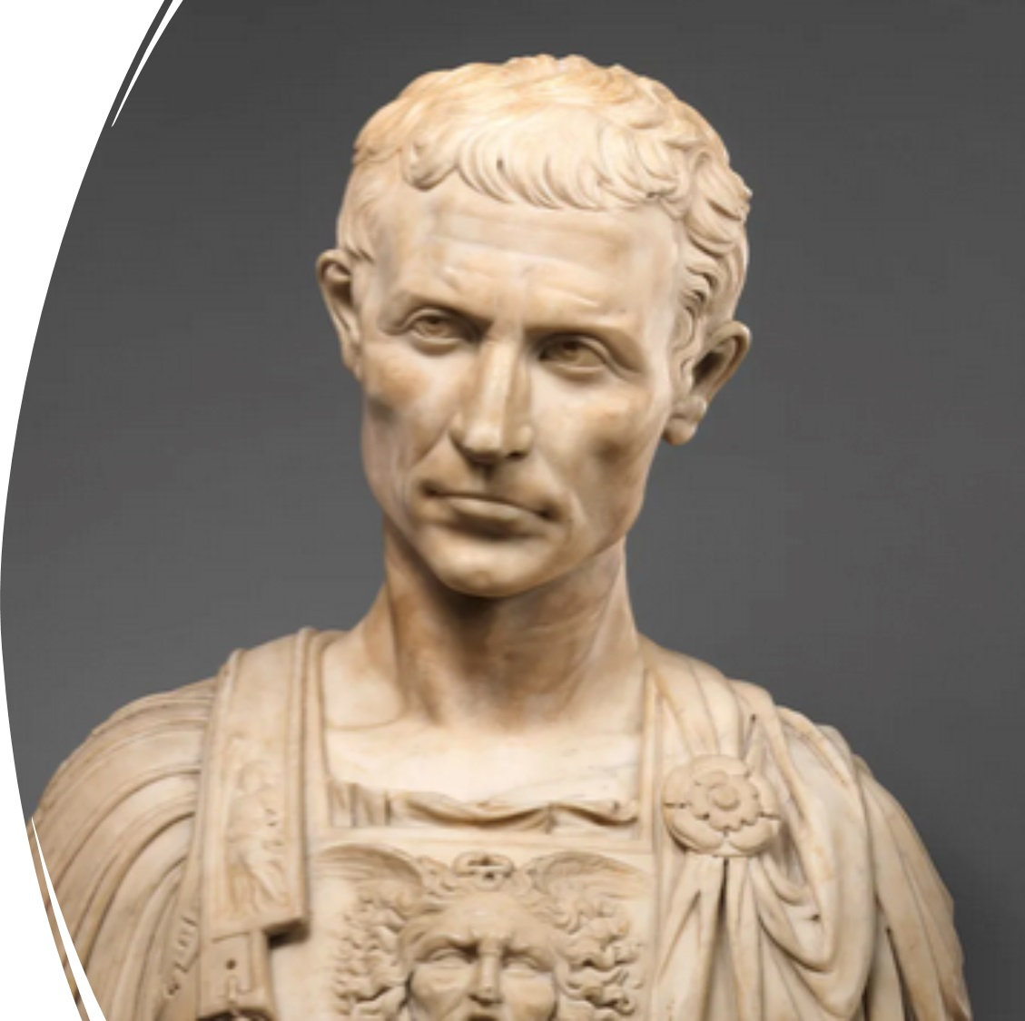
Purpose
To present Jesus as God’s anointed king (Messiah and Son of God) in opposition to Caesar, the other Son of God.
1:1; 8:29; 12:35; 14:61; 15:32, 39.

Slide 4
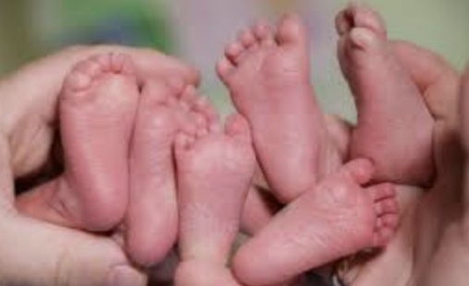
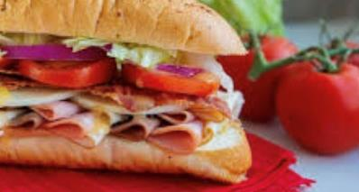
Structure
Triplets presented like a sandwich structure

Slide 5
Structure
Story 1 – Going to heal Jairus’s daughter
Story 2 – Healing the woman with a blood disorder
Story 1 – Healing Jairus’s daughter
A Story Within A Story or Bracketed Stories

Slide 6
Today’s Triplet
Healing a man with an unclean spirit, on a Sabbath in a synagogue (1:23–28).
Stories about sin, sinners, and saints
Plucking the grains and eating them on a Sabbath (2:23–28).
Healing a man with a withered hand, on a Sabbath in a synagogue (3:1–6).

Slide 7
4th Commandment (Deuteronomy 5:12–15)
Observe the Sabbath day, to keep it holy, as the LORD your God commanded you. Six days you shall labor and do all your work, but the seventh day is a Sabbath to the LORD your God. On it you shall not do any work, you or your son or your daughter or your male servant or your female servant, or your ox or your donkey or any of your livestock, or the sojourner who is within your gates, that your male servant and your female servant may rest as well as you. You shall remember that you were a slave in the land of Egypt, and the LORD your God brought you out from there with a mighty hand and an outstretched arm. Therefore the LORD your God commanded you to keep the Sabbath day (ESV).

Slide 8
Traditions
The Israelites had commentaries on this law: Shabbat in Mishnah and Talmud – containing 24 chapters totaling 138 paragraphs.
That listed Melakah (creative works that are forbidden), Shevat (how to “rest” on a sabbath), Muktzeh (items that can be carried and moved around), Hotzaah (activities allowed to be done inside and outside the house), and Techum Sabbat (restrictions on travel—how far they can travel)

Slide 9
Melkah – 39 forbidden works
Plowing, planting, reaping, gathering, threshing, winnowing, sorting, grinding, sifting, kneading, cooking
Shearing, washing, combing wool, dyeing, spinning, weaving, threading, warping (a form of weaving), separating two threads, tying, untying, sewing, tearing
Trapping, killing, skinning, curing, smoothing, scoring, cutting
Writing, erasing, construction, demolition, igniting a fire, extinguishing a fire, transporting, or traveling.

Slide 10
Exception
Saving a human or animal life!

Slide 11
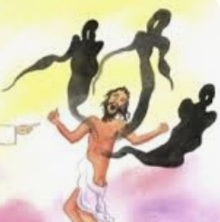
Story #1 (1:21–28)
Capernaum = a “village of consolation”
His teaching had authority (exousia)
A man with an unclean spirit
Jesus of Nazareth, the Holy One of God

Slide 12
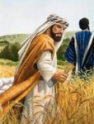
Story #2 (2:23–28)
Walking on a road and through a grainfield (violation 1)
Began to “work” and “pluck” grains (violations 2 and 3)
Pharisees say, “See, what your disciples are working, which is unlawful on a sabbath” (ouk exestin)
Jesus cites David (1 Samuel 21:1–7), how he ate unlawful to eat bread (ouk exestin)

Slide 13
Story #2 (2:23–28)
The Sabbath was made for people, not the other way around (Shevat—how to “rest”)
Matthew and Luke: “Son of man is the Lord of the Sabbath” (Mt 12:8; Lk 6:5)
Mark: “The Son is Lord of people and of the Sabbath” (by adding a small word ke)

Slide 14
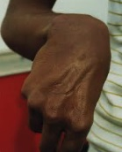
Story #3 (3:1–6)
In a synagogue
A man with a shrunken or paralyzed hand
Will he heal him on a Sabbath?
He asked, “Is it lawful (exestin) to work good on a Sabbath or work evil on a Sabbath—to save life or kill it?”
Jesus sillipeo (a synonym for splaknizo)

Slide 15
What are the lessons?
Jesus has the authority to cleanse people (emotionally, socially, or spiritually).
God’s laws were meant for our benefit, not for us to slavishly use them to harm us or others.
It’s always acceptable to do good and save lives, not do bad and hurt or kill others.

Slide 16
Questions for us
Sabbath, huh, yeah. What is it good for?
What must we do differently to be like Jesus — one with compassion?

