Slide 1
Sin, Sinners, and Saints
Mark 2:1–22

Slide 2
Mark’s Gospel
Mark is a Gospel of action; Jesus is like a Marvel comic character.

Slide 3
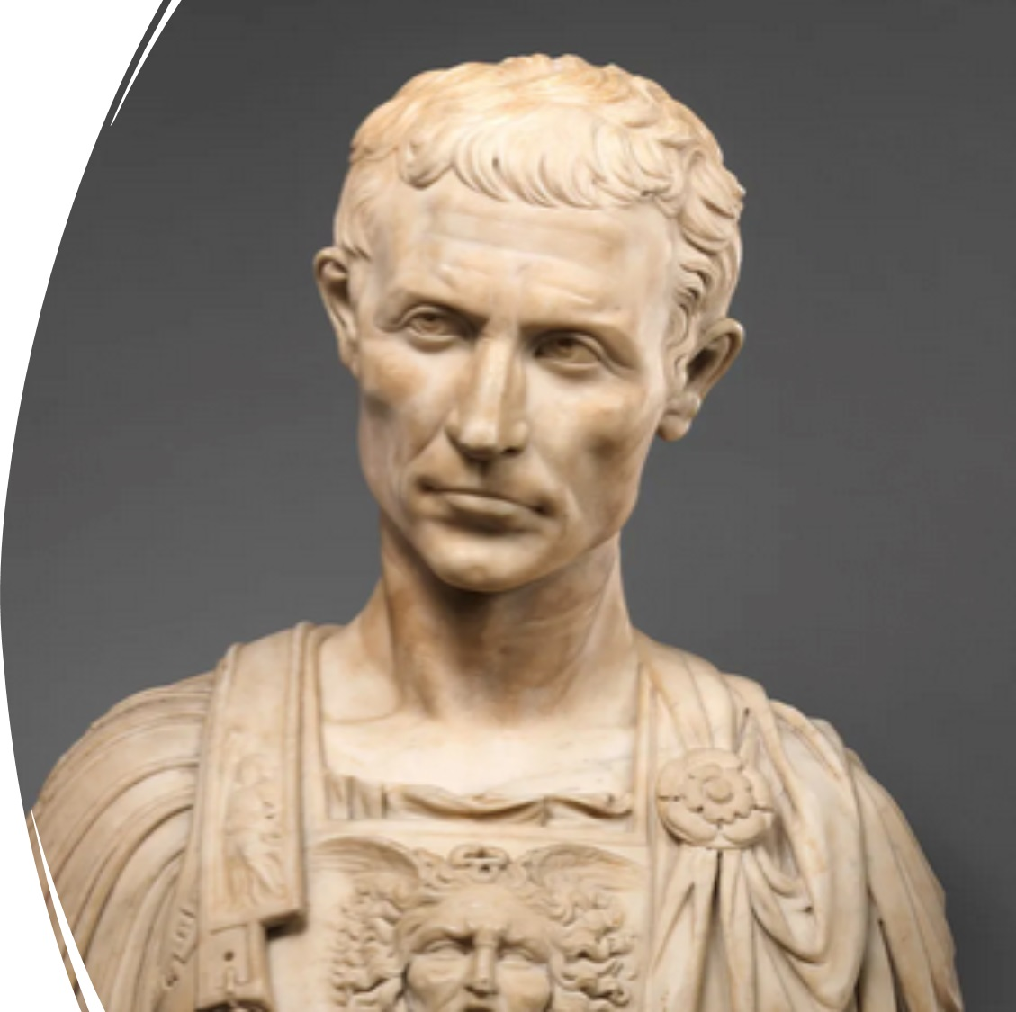
Purpose
To present Jesus as God’s anointed king (Messiah and Son of God) in opposition to Caesar, the other Son of God.
1:1; 8:29; 12:35; 14:61; 15:32, 39.

Slide 4
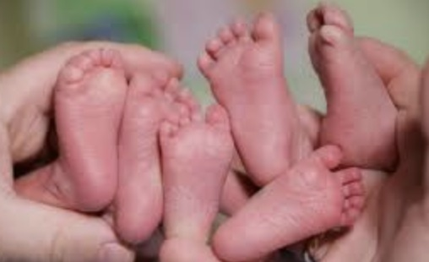
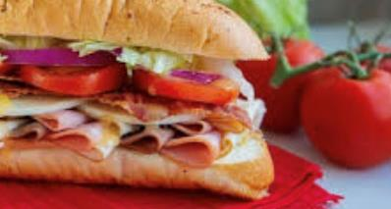
Structure
Triplets presented like a sandwich structure

Slide 5
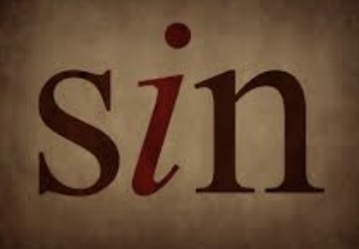
Today’s Triplet
Healing a paralytic and pronouncing, he has no sin (2:1–12).
Eating with tax collectors and sinners (2:13–17).
Not fasting like the students of John and the Pharisees (2:18–22).

Slide 6
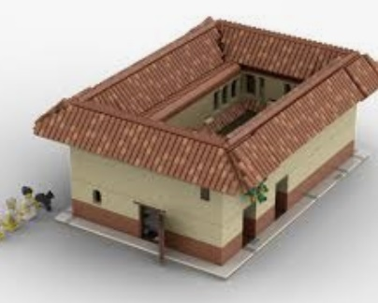
Story #1 (2:1–12)
Capernaum = a “village of consolation”
They bring him a paralytic via the roof!
Jesus: “Child, your sins are forgiven.”
Scribes dialogue in their hearts!
He blasphemes; Is he the “One God”?
Jesus, in his spirit, knows what they are discussing in their hearts! (kardia)
Sons/daughters of Adam can forgive!

Slide 7
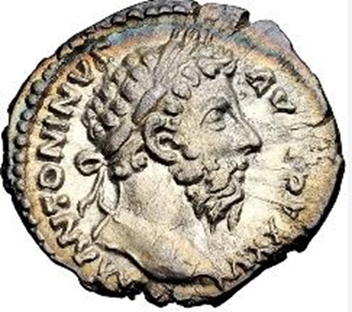
Story #2 (2:13–17)
By the Sea of Galilee
Jesus calls Levi, a tax collector
Many tax collectors and sinners recline with Jesus and his disciples to eat.
Scribes and Pharisees to Jesus’s disciples: He eats with them!
Jesus: Like the unhealthy need physicians, the sinners need me.

Slide 8
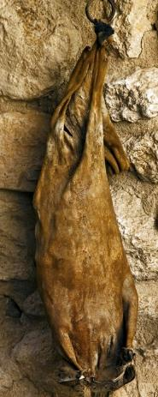
Story #3 (2:18–22)
Seeing John’s and Pharisees’ students fasting, some asked Jesus: “Why do your disciples not fast?” Accusation: They weren’t like saints!
Jesus: Friends of the bridegroom do not fast while he is with them; my disciples will fast when I am gone.
Jesus: Don’t mix old with the new.

Slide 9
What are the new lessons?
Like Jesus, we can forgive sins, especially when illnesses are emotionally paralyzing from sins.
Christians must fellowship with sinners, not to participate in their sins but to be healers, emotionally and spiritually (showing them Christ).
Christians feast or fast based on how close they are in their relationship to Christ, the groom.

Slide 10
Questions for us
Where do we fit in these stories?
What must we do differently to be like Jesus?

