Slide 1
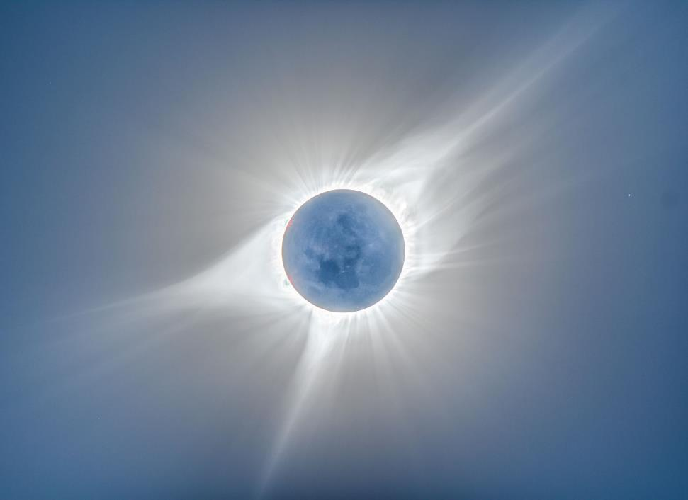
SOLAR ECLIPSE

Slide 2
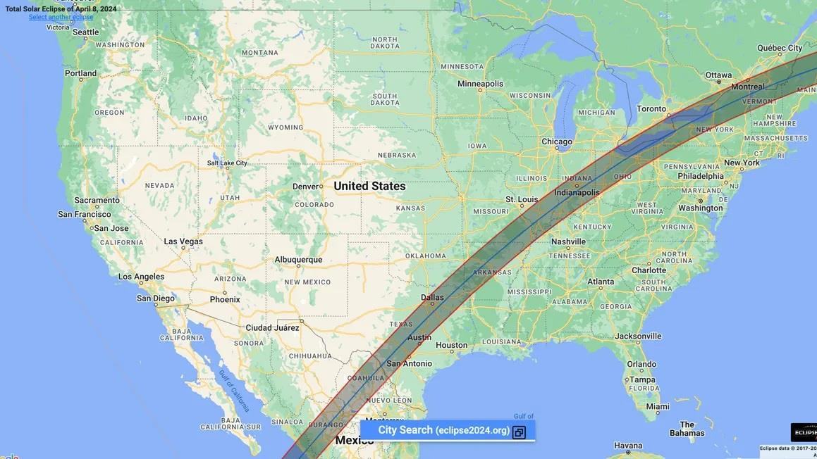
2024 Total Solar Eclipse
Notes:
https://science.nasa.gov/learn/heat/resource/interactive-map-2024-solar-eclipse-across-the-us/

Slide 3
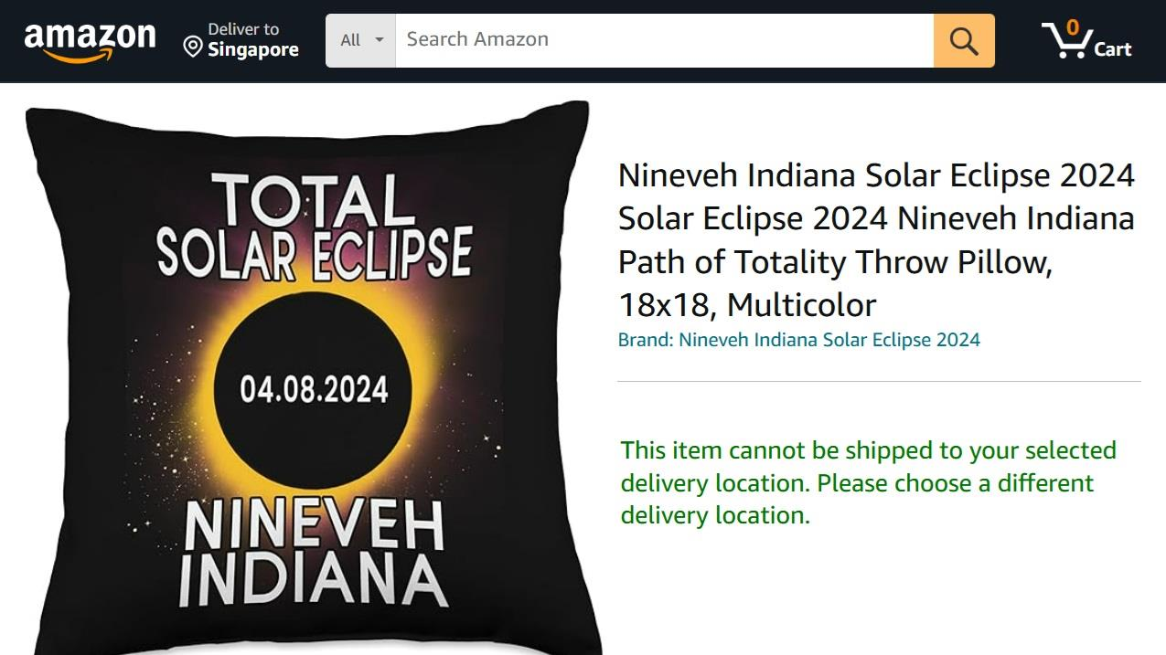

Slide 4
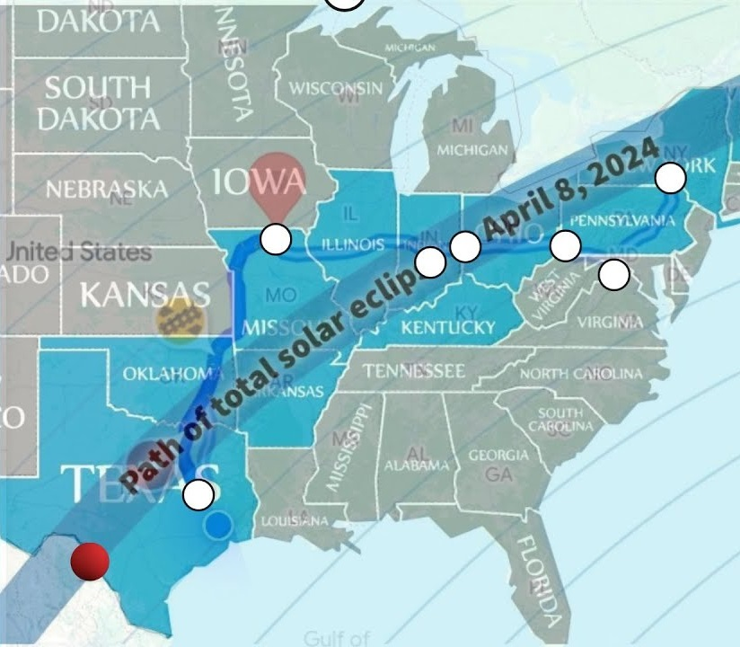
Nineveh TX
Nineveh MO
Nineveh IN
Nineveh OH
Nineveh PA
Nineveh VA
Nineveh NY

Slide 5
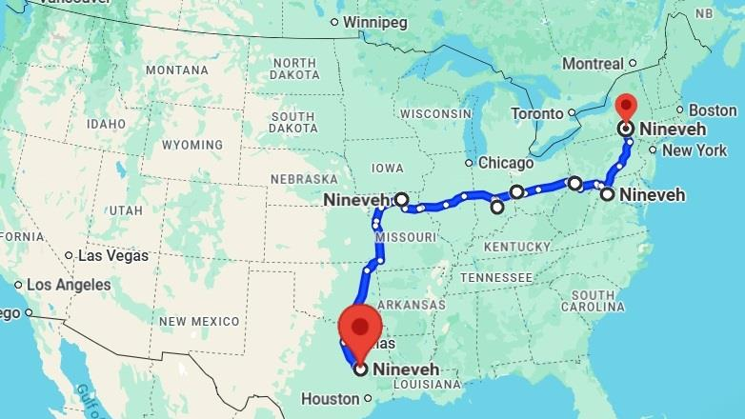


Slide 6
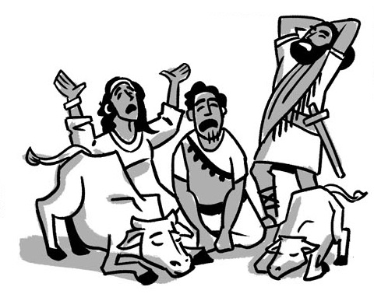

Unexpected Lessons From Jonah
The Reluctant Prophet
Jonah 1 & 2
(Ch 1) An Unexpected Experience
(Ch 2) An Expected Outcome
The Repentant People
Jonah 3 & 4
An Expected Outcome (ch 3)
An Unexpected Experience (ch 4)

Slide 7
Unexpected Lessons From Jonah
The Reluctant Prophet
Jonah 1 & 2
(Ch 1) Jonah’s disobedience
(Ch 2) => God’s discipline
The Repentant People
Jonah 3 & 4
God’s deferred punishment (ch 3)
=> Jonah’s displeasure (ch 4)

Slide 8

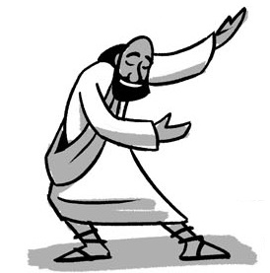


Jonah’s
and
reveal
Disobedience
Displeasure
Deeper Lessons

Slide 9
The unexpected call demonstrates
God’s compassion for all the world (1:1-2).
The unexpected response demonstrates
Jonah’s compassion ends with himself (1:3, 5).
The unexpected consequences demonstrate
God’s sovereignty over all creation (1:4-16).
The unexpected provision demonstrates
God’s mercy and discipline (1:17).

Slide 10
We (as the church and as individuals) need to demonstrate compassion for those we consider as enemies.
We (as the church and as individuals) need to ask, “what is our Nineveh?”
We (as the . . . ) need to acknowledge God’s
sovereignty with our words and our actions.
We (as the . . . ) need to accept not just God’s
mercy, but also his discipline.

Slide 11
Unexpected Lessons
From Jonah
The Repentant People - Jonah
3 & 4

Slide 12
Chapter 3
¹ Then the word of the Lord came to Jonah the second time, saying, ² “Arise, go to Nineveh, that great city, and call out against it the message that I tell you.” ³ So Jonah arose and went to Nineveh, according to the word of the Lord. Now Nineveh was an exceedingly great city, three days' journey in breadth. ⁴ Jonah began to go into the city, going a day's journey. And he called out, “Yet forty days, and Nineveh shall be overthrown!”

Slide 13
Chapter 3
⁵ And the people of Nineveh believed God. They called for a fast and put on sackcloth, from the greatest of them to the least of them. ⁶ The word reached the king of Nineveh, and he arose from his throne, removed his robe, covered himself with sackcloth, and sat in ashes.

Slide 14
Chapter 3
⁷ And he issued a proclamation and published through Nineveh, “By the decree of the king and his nobles: Let neither man nor beast, herd nor flock, taste anything. Let them not feed or drink water, ⁸ but let man and beast be covered with sackcloth, and let them call out mightily to God. Let everyone turn from his evil way and from the violence that is in his hands. ⁹ Who knows? God may turn and relent and turn from his fierce anger, so that we may not perish.”

Slide 15
Chapter 3
¹⁰ When God saw what they did, how they turned from their evil way, God relented of the disaster that he had said he would do to them, and he did not do it.

Slide 16
Ch 3: The Power of God’s Word:

Slide 17
Chapter 3
¹ Then the word of the Lord came to Jonah the second time, saying, ² “Arise, go to Nineveh, that great city, and call out against it the message that I tell you.” ³ So Jonah arose and went to Nineveh according to the word of the Lord.

Slide 18
Chapter 3
¹ Then the word of the Lord came to Jonah the second time, saying, ² “Arise, go to Nineveh, that great city, and call out against it the message that I tell you.” ³ So Jonah arose and went to Nineveh according to the word of the Lord.
The Prophet’s Calling

Slide 19
Chapter 3
¹ Then the word of the Lord came to Jonah the second time, saying, ² “Arise, go to Nineveh, that great city, and call out against it the message that I tell you.” ³ So Jonah arose and went to Nineveh according to the word of the Lord.
The Prophet’s Response

Slide 20
Chapter 3
¹ Then the word of the Lord came to Jonah the second time, saying, ² “Arise, go to Nineveh, that great city, and call out against it the message that I tell you.” ³ So Jonah arose and went to Nineveh according to the word of the Lord.
The Prophet’s Purpose

Slide 21
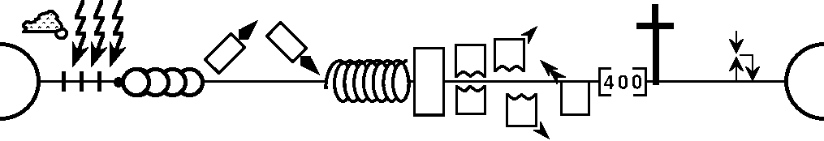
. . . according to the word of the lord (29x)
-------------------------------------------------1 & 2 Chronicles ------------------------------------------------
1 Kings 8x
2 Kings 7x
Deuteronomy
Nehemiah
Leviticus
Numbers
2 Samuel
Genesis 1-11
Exodus
Joshua
Judges
1 Samuel
Esther
Genesis 12-50
Ruth
Ezra
Moses
Cycles
S • D • S
Z • E • N
1st Coming
Eternity
Creation
Joshua
J (R) & I (J)
Eternity
Fall
Babel
J (B) & I (A)
Flood
P • G • H • R
2nd Coming
Abraham
Joseph
Isaac
Jacob
1000
1990+
Exodus
Judges
Church
Kingdom
Beginnings
Patriarchs
Conquests
Silent Years
Restoration
United Kingdom
Captivity
Divided Kingdom
Max Anders, Dallas Theological Seminary

Slide 22
Chapter 3
¹ Then the word of the Lord came to Jonah the second time, saying, ² “Arise, go to Nineveh, that great city, and call out against it the message that I tell you.” ³ So Jonah arose and went to Nineveh, according to the word of the Lord. Now Nineveh was an exceedingly great city, three days' journey in breadth. ⁴ Jonah began to go into the city, going a day's journey. And he called out, “Yet forty days, and Nineveh shall be overthrown!”

Slide 23

The number three in the Bible symbolizes divine completeness, resurrection, the Trinity,
and pivotal spiritual events.
The number forty symbolizes periods of testing, trial, and preparation, such as the Flood, Israel's wilderness, and Jesus' fasting.
three days' journey
Yet forty days

Slide 24
Chapter 3
¹ Then the word of the Lord came to Jonah the second time, saying, ² “Arise, go to Nineveh, that great city, and call out against it the message that I tell you.” ³ So Jonah arose and went to Nineveh, according to the word of the Lord. Now Nineveh was an exceedingly great city, three days' journey in breadth. ⁴ Jonah began to go into the city, going a day's journey. And he called out, “Yet forty days, and Nineveh shall be overthrown!”
הפך (hpk), vb. turn; overturn; overthrow; demolish; change; turn round.
Notes:
Brannan, R., ed. (2020). In . Lexham Press.
Brannan, R., ed. (2020). In Lexham Research Lexicon of the Hebrew Bible. Lexham Press.

Slide 25
Chapter 3
¹ Then the word of the Lord came to Jonah the second time, saying, ² “Arise, go to Nineveh, that great city, and call out against it the message that I tell you.” ³ So Jonah arose and went to Nineveh, according to the word of the Lord. Now Nineveh was an exceedingly great city, three days' journey in breadth. ⁴ Jonah began to go into the city, going a day's journey. And he called out, “Yet forty days, and Nineveh shall be overthrown!”
⁵ And the people of Nineveh believed God. . .

Slide 26
Chapter 3
¹ Then the word of the Lord came to Jonah the second time, saying, ² “Arise, go to Nineveh, that great city, and call out against it the message that I tell you.” ³ So Jonah arose and went to Nineveh, according to the word of the Lord. Now Nineveh was an exceedingly great city, three days' journey in breadth. ⁴ Jonah began to go into the city, going a day's journey. And he called out, “Yet forty days, and Nineveh shall be overthrown!”
⁵ And the people of Nineveh believed God. . .

Slide 27
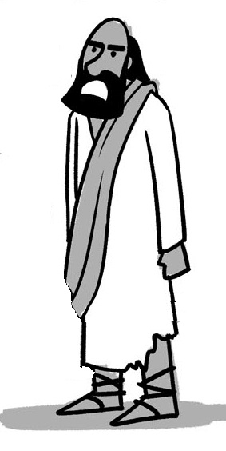
The Most Successful Prophet
in the Old Testament
Jonah

Slide 28
the empire experienced a great period of stagnation which was very harmful to the Assyrian military.
Strong
883-783
Strong
745-626
Weak
783-745
900
850
800
750
700
650
600
Jonah
Fall of Israel
https://ancientmesopotamia.org/
Notes:
https://ancientmesopotamia.org/cultures/neo-assyrian-empire#:~:text=Following%20the%20reign%20of%20Adad,(773%E2%80%93755%20BC).
Following the reign of Adad Nirari III the throne was passed down to his son Shalmaneser IV (783–773 BC) and the following rulers did not make many achievements towards the Assyrian Empire. Shalmaneser IV was succeeded in rule by Ashur-Dan III (773–755 BC). Under Ashur-Dan III and his successor Ashur Nirari V (755–745 BC) the empire experienced a great period of stagnation which was very harmful to the Assyrian military.

Slide 29
Events Leading to Nineveh's Repentance:
787 Monotheistic worship of Nabu started
765 Plague throughout Assyria
763 Revolt in the city of Asshur
763 Eclipse of the sun
762 Revolt in the city of Asshur
761 Revolt in the city of Arrapha
760 Revolt in the city of Arrapha
759 Another plague
758 "Peace in the land" (repentance under Jonah?)
Notes:
https://biblestudydownloads.org/files/eng/be/BE-32%20Jonah-Be%20Caring/32-Jonah-Be_Caring-92_eng_be_7600_v7.pptx

Slide 30
Ch 3: The Power of God’s Word:
Jonah Obeyed, Nineveh Prayed.

Slide 31
Chapter 3
⁵ And the people of Nineveh believed God. They called for a fast and put on sackcloth, from the greatest of them to the least of them. ⁶ The word reached the king of Nineveh, and he arose from his throne, removed his robe, covered himself with sackcloth, and sat in ashes.

Slide 32

What is the meaning of sackcloth and ashes?
sackcloth and ashes were used as an outward sign of one’s inward condition. Such a symbol made one’s change of heart visible and demonstrated the sincerity of one’s grief and/or repentance. It was not the act of putting on sackcloth and ashes itself that moved God to intervene, but the humility that such an action demonstrated (see 1 Samuel 16:7). God’s forgiveness in response to genuine repentance is celebrated by David’s words: “You removed my sackcloth and clothed me with joy” (Psalm 30:11).
The What
Notes:
https://www.gotquestions.org/sackcloth-and-ashes.html

Slide 33
when faced with impending catastrophe,
people are more likely
to recognize the fragility of life
and turn to God in repentance,
realizing that true security and hope
can only be found in Him,
and that it is never too late
to seek His mercy and grace.
The Why

Slide 34
Chapter 3
⁷ And he issued a proclamation and published through Nineveh, “By the decree of the king and his nobles: Let neither man nor beast, herd nor flock, taste anything. Let them not feed or drink water, ⁸ but let man and beast be covered with sackcloth, and let them call out mightily to God. Let everyone turn from his evil way and from the violence that is in his hands. ⁹ Who knows? God may turn and relent and turn from his fierce anger, so that we may not perish.”

Slide 35
Chapter 3
⁷ And he issued a proclamation and published through Nineveh, “By the decree of the king and his nobles: Let neither man nor beast, herd nor flock, taste anything. Let them not feed or drink water, ⁸ but let man and beast be covered with sackcloth, and let them call out mightily to God. Let everyone turn from his evil way and from the violence that is in his hands. ⁹ Who knows? God may turn and relent and turn from his fierce anger, so that we may not perish.”
הפך (hpk), vb. turn; overturn; overthrow; demolish; change; turn round.
שׁוב (šwb), vb. turn back, return.
Notes:
Brannan, R., ed. (2020). In . Lexham Press.
Brannan, R., ed. (2020). In Lexham Research Lexicon of the Hebrew Bible. Lexham Press.

Slide 36
Chapter 3
¹⁰ When God saw what they did, how they turned from their evil way, God relented of the disaster that he had said he would do to them, and he did not do it.

Slide 37
Ch 3: The Power of God’s Word:
Jonah Obeyed, Nineveh Prayed.
Nineveh Repented, God Relented.

Slide 38
God relented . . .
Can God
change his mind?

Slide 39
Attributes of God
omnipotence
omnipresence
omniscience
self-existence
self-sufficiency
eternality
absolute freedom
Impassibility
(yet impassioned)
immutability
Notes:
https://bibleproject.com/explore/category/character-of-god-series/

Slide 40

Notes:
https://answersingenesis.org/store/product/abc-attributes-god-poster/

Slide 41
Attributes of God
omnipotence
omnipresence
omniscience
self-existence
self-sufficiency
eternality
absolute freedom
Impassibility
(yet impassioned)
immutability
IMMUTABILITY (Unchangeableness)
Scripture shows us that God is unchanging in his being, perfections, purposes, and promises
(Psalm 102:27, Malachi 3:6,
James 1:17).
Notes:
https://www.jrmsydney.com/post/i-am_the-attributes-of-god-part-1

Slide 42


Attributes of God
omnipotence
omnipresence
omniscience
self-existence
self-sufficiency
eternality
absolute freedom
Impassibility
(yet impassioned)
immutability
Truthfulness
Wisdom
Holiness
Righteousness
Mercy
Compassion
Grace
Slow to Anger
Loyal Love Faithful
Exo 34:6-7
Incommunicable:
God Alone
Communicable: Shared with Us
Notes:
https://bibleproject.com/explore/category/character-of-god-series/

Slide 43
Chapter 4
¹ But it displeased Jonah exceedingly, and he was angry. . . .

Slide 44
Ch 3: The Power of God’s Word:
Jonah Obeyed, Nineveh Prayed.
Nineveh Repented, God Relented.
Ch 4: Jonah’s Pathetic Anger:
Jonah Complained, God Explained.

Slide 45
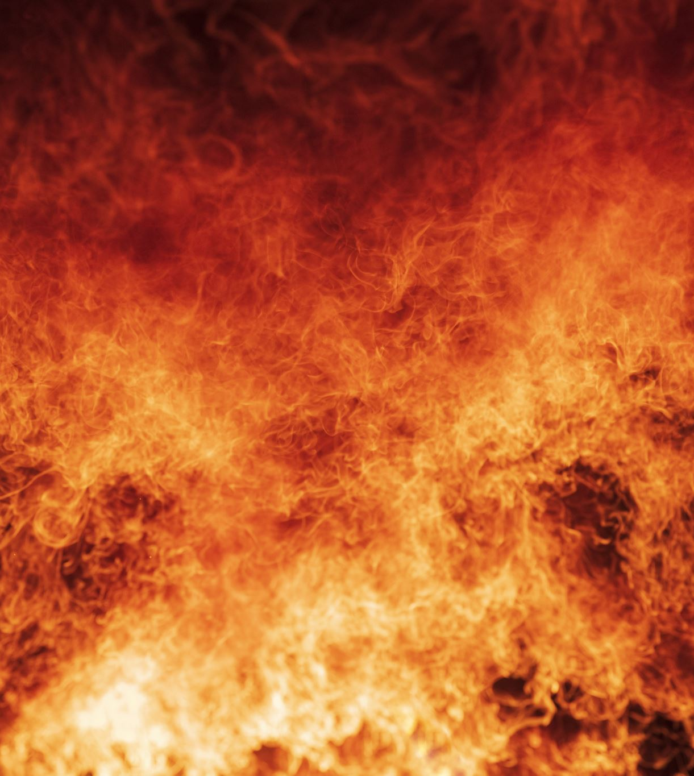
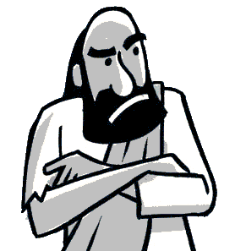
Jonah’s Anger Fueled his Disobedience
and Displeasure

Slide 46
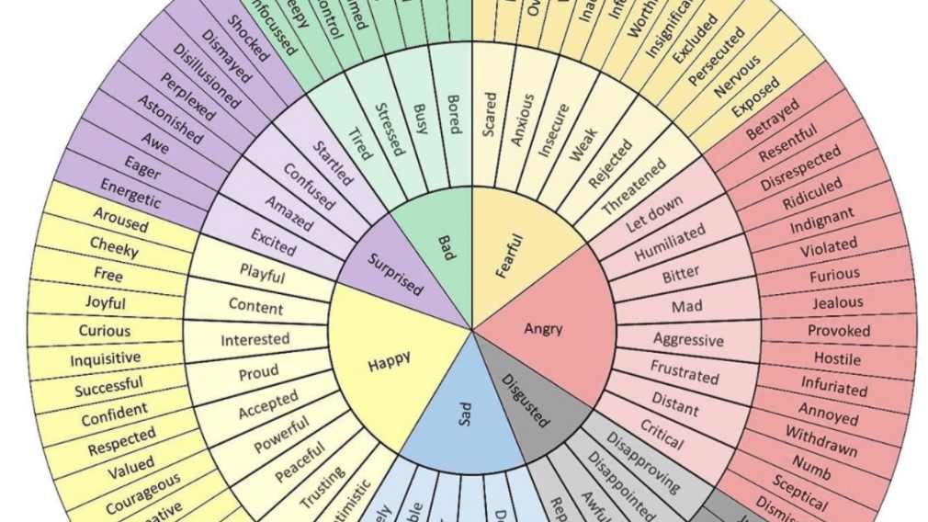
Notes:
https://commons.wikimedia.org/wiki/File:Emotions_wheel.png
Sydtomcat, CC BY-SA 4.0 <https://creativecommons.org/licenses/by-sa/4.0>, via Wikimedia Commons

Slide 47

Circumplex Model of Emotions
Intensity (+)
Tense
Alert
Angry
Excited
Valence (-)
Valence (+)
Distressed
Happy
Neutral
Sad
Content
Depressed
Relaxed
Bored
Calm
Intensity (-)
Notes:
https://en.wikipedia.org/wiki/Emotion_classification

Slide 48
Chapter 4
¹ But it displeased Jonah exceedingly, and he was angry. ² And he prayed to the Lord and said, “O Lord, is not this what I said when I was yet in my country? That is why I made haste to flee to Tarshish; for I knew that you are a gracious God and merciful, slow to anger and abounding in steadfast love, and relenting from disaster. ³ Therefore now, O Lord, please take my life from me, for it is better for me to die than to live.”

Slide 49
Chapter 4
⁴ And the Lord said, “Do you do well to be angry?”
⁵ Jonah went out of the city and sat to the east of the city and made a booth for himself there. He sat under it in the shade, till he should see what would become of the city.

Slide 50
Chapter 4
⁶ Now the Lord God appointed a plant and made it come up over Jonah, that it might be a shade over his head, to save him from his discomfort. So Jonah was exceedingly glad because of the plant.

Slide 51
Chapter 4
⁷ But when dawn came up the next day, God appointed a worm that attacked the plant, so that it withered. ⁸ When the sun rose, God appointed a scorching east wind, and the sun beat down on the head of Jonah so that he was faint. And he asked that he might die and said, “It is better for me to die than to live.”

Slide 52
Chapter 4
⁹ But God said to Jonah, “Do you do well to be angry for the plant?” And he said, “Yes, I do well to be angry, angry enough to die.”

Slide 53
Chapter 4
⁹ But God said to Jonah, “Do you do well to be angry for the plant?” And he said, “Yes, I do well to be angry, angry enough to die.” ¹⁰ And the Lord said, “You pity the plant, for which you did not labor, nor did you make it grow, which came into being in a night and perished in a night. ¹¹ And should not I pity Nineveh, that great city, in which there are more than 120,000 persons who do not know their right hand from their left, and also much cattle?”

Slide 54
Circumplex Model of Emotions
Intensity (+)
Tense
Alert
Angry
Excited
Valence (-)
Valence (+)
Distressed
Happy
Neutral
Sad
Content
Depressed
Relaxed
Bored
Calm
Intensity (-)
Notes:
https://en.wikipedia.org/wiki/Emotion_classification

Slide 55
Circumplex Model of Emotions
Intensity (+)
Tense
Alert
Angry
Excited
Valence (-)
Valence (+)
Distressed
Happy
Neutral
Sad
Content
Depressed
Relaxed
Bored
Calm
Intensity (-)
Notes:
https://en.wikipedia.org/wiki/Emotion_classification

Slide 56
Circumplex Model of Emotions
Intensity (+)
Tense
Alert
Excited
Angry
Valence (-)
Valence (+)
Distressed
Happy
Neutral
Sad
Content
Depressed
Relaxed
Bored
Calm
Intensity (-)
Notes:
https://en.wikipedia.org/wiki/Emotion_classification

Slide 57
⁶ The Lord passed in front of Moses, calling out,
“Yahweh! The Lord! The God of compassion and mercy!
I am slow to anger
and filled with unfailing love and faithfulness.
⁷ I lavish unfailing love to a thousand generations.
I forgive iniquity, rebellion, and sin.
But I do not excuse the guilty.
I lay the sins of the parents upon their children and grandchildren;
the entire family is affected—
even children in the third and fourth generations.”
Exodus 34:6-7

Slide 58
Chapter 3
⁷ And he issued a proclamation and published through Nineveh, “By the decree of the king and his nobles: Let neither man nor beast, herd nor flock, taste anything. Let them not feed or drink water, ⁸ but let man and beast be covered with sackcloth, and let them call out mightily to God. Let everyone turn from his evil way and from the violence that is in his hands. ⁹ Who knows? God may turn and relent and turn from his fierce anger, so that we may not perish.”

Slide 59
when faced with impending catastrophe,
people are more likely
to recognize the fragility of life
and turn to God in repentance,
realizing that true security and hope
can only be found in Him,
and that it is never too late
to seek His mercy and grace.
The Why

Slide 60
The Nineveh Eclipse
The Sign of Jonah
³⁸ Then some of the scribes and Pharisees answered him, saying, “Teacher, we wish to see a sign from you.” ³⁹ But he answered them, “An evil and adulterous generation seeks for a sign, but no sign will be given to it except the sign of the prophet Jonah. ⁴⁰ For just as Jonah was three days and three nights in the belly of the great fish, so will the Son of Man be three days and three nights in the heart of the earth.

Slide 61
The Sign of Jonah
⁴¹ The men of Nineveh will rise up at the judgment with this generation and condemn it, for they repented at the preaching of Jonah, and behold, something greater than Jonah is here.

Slide 62

Repent of your sins and turn to God, for the Kingdom of Heaven is near
Matt 3:2 & 4:17 (NLT)
John the Baptist
Jesus of Nazareth

Slide 63

Repent of your sins and turn to God,
For the forgiveness of your sins (Acts 2:38)
so your sins may be wiped away (Acts 3:19)
Peter

Slide 64
“God overlooked people’s ignorance about these things in earlier times, but now he commands everyone everywhere
to repent of their sins and turn to him. (Acts 17:30)
Paul in Athens

Slide 65
“God overlooked people’s ignorance about these things in earlier times, but now he commands everyone everywhere
to repent of their sins and turn to him. (Acts 17:30)
Paul in Athens

Slide 66
“I preached first to those in Damascus, then in Jerusalem and throughout all Judea, and also to the Gentiles, that all must repent of their sins and turn to God—and prove they have changed by the good things they do. (Acts 26:20)
Paul in Athens

Slide 67
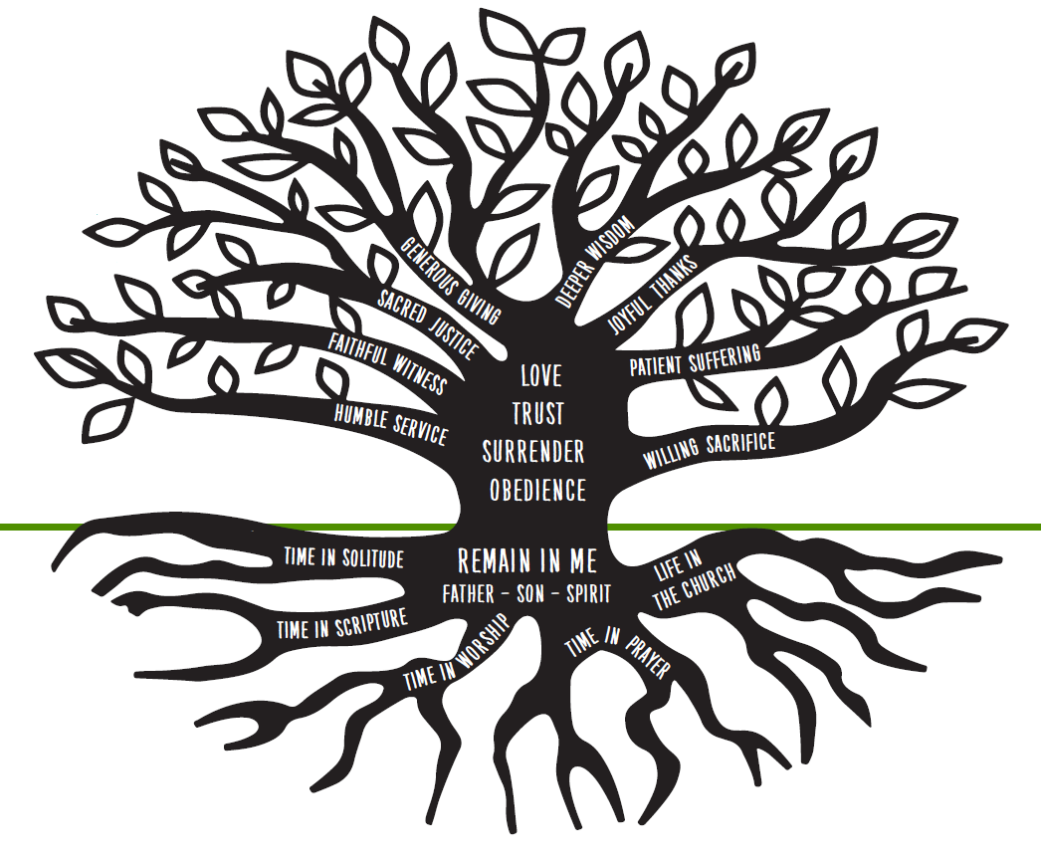
Displaying God’s communicable attributes
is not the root but the fruit
of salvation
Crystal Kirgiss / 2018 / crystal.kirgiss@comcast.net

