Slide 1
Something
Unexpected
Notes:
Image courtesy of https://bespokehabitat.com.sg/10-things-to-know-before-moving-to-singapore/

Slide 2
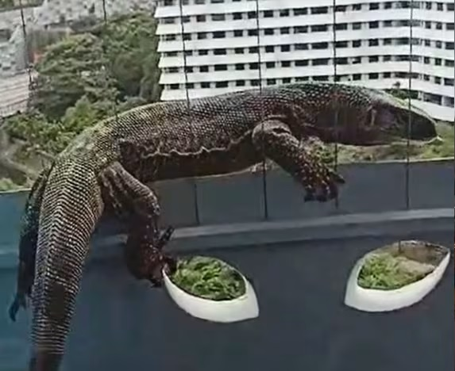
Channel News Asia
WHAT TO DO IF A MONITOR LIZARD VISITS YOUR HOME
Something
Unexpected
Notes:
https://www.channelnewsasia.com/singapore/punggol-monitor-lizard-11th-storey-hdb-nparks-4443036
https://www.channelnewsasia.com/singapore/monitor-lizard-non-native-punggol-nparks-investigating-4454741
Singapore resident Mr. Toh

Slide 3
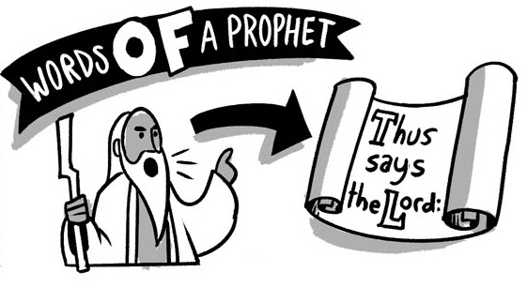
Notes:
https://bibleproject.com/guides/book-of-jonah/

Slide 4
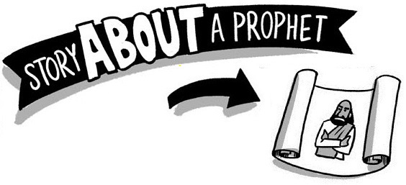
Jonah

Slide 5
The Prophet
Swallowed by a Whale
Jonah

Slide 6
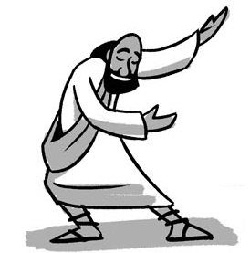
The Most Successful Prophet
in the Old Testament
Jonah

Slide 7
Jonah’s
and
reveal
Disobedience
Displeasure
Deeper Lessons

Slide 8
Unexpected Lessons
From Jonah
The Reluctant Prophet - Jonah
1 (&2)

Slide 9
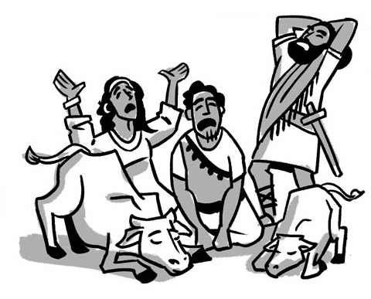
Unexpected Lessons
From Jonah
The Repentant People - Jonah
3 (&4)

Slide 10
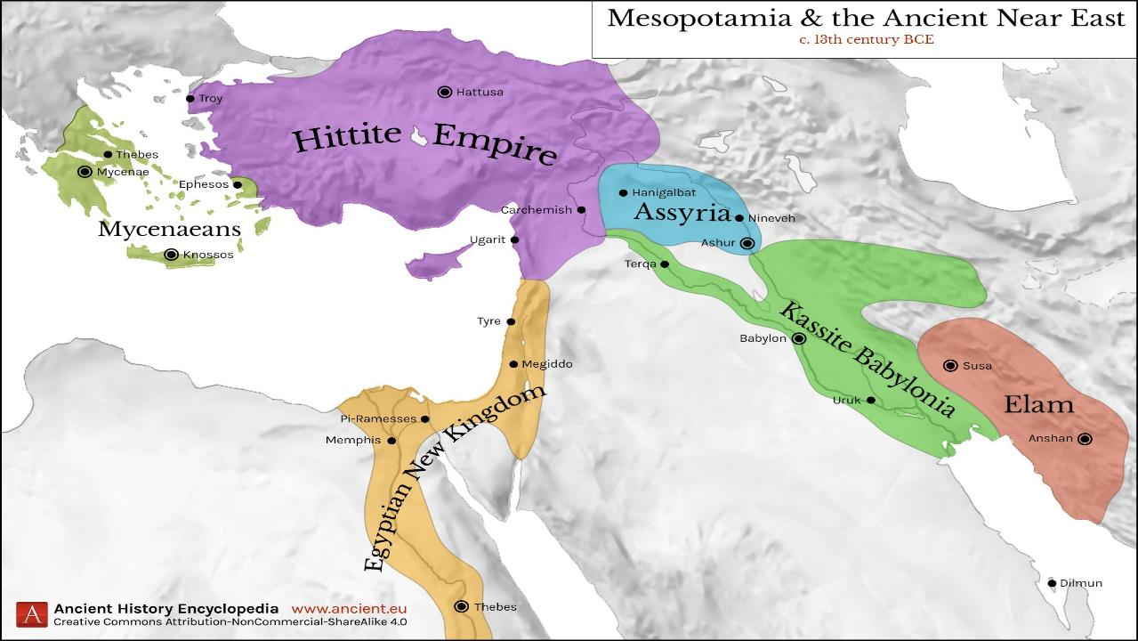
Ancient Israel was always surrounded by enemies
Notes:
Crabben, Jan van der. "Map of Mesopotamia and the Ancient Near East, c. 1300 BCE." World History Encyclopedia. Last modified February 01, 2020. https://www.worldhistory.org/image/11823/map-of-mesopotamia-and-the-ancient-near-east-c-130/.

Slide 11
Ancient Israel’s greatest enemy has always been itself.
Moses
Cycles
S • D • S
Z • E • N
1st Coming
Eternity
Creation
Joshua
J (R) & I (J)
Eternity
Fall
Babel
J (B) & I (A)
Flood
P • G • H • R
2nd Coming
Abraham
Joseph
Isaac
Jacob
1000
1990+
Exodus
Judges
Church
Kingdom
Patriarchs
Conquests
Silent Years
Beginnings
Restoration
United Kingdom
Captivity
Divided Kingdom
Max Anders, Dallas Theological Seminary

Slide 12
Throughout Israel’s history, God used a series of prophets to repeatedly warn his people to repent and turn to him
Prophet
A person who spoke divinely inspired messages. In biblical times, a prophet was a recognized formal role, but sometimes acted outside formal structures.

Slide 13
-------------------------------------------------1 & 2 Chronicles ------------------------------------------------
Deuteronomy
2 Kings
Nehemiah
Leviticus
Numbers
2 Samuel
Exodus
Judges
1 Samuel
Genesis 1-11
Genesis 12-50
Joshua
Ruth
1 Kings
Ezra
Esther
Moses
Cycles
S • D • S
Z • E • N
1st Coming
Eternity
Creation
Joshua
J (R) & I (J)
Eternity
Fall
Babel
J (B) & I (A)
Flood
P • G • H • R
2nd Coming
Abraham
Joseph
Isaac
Jacob
1000
1990+
Exodus
Judges
Church
Kingdom
Patriarchs
Conquests
Silent Years
Beginnings
Restoration
United Kingdom
Captivity
Divided Kingdom
Max Anders, Dallas Theological Seminary

Slide 14
History
Written Prophets
Major
&
Minor
Wisdom / Poetry

Slide 16
The Written Prophets
Pre-Exile
(900-606 BC)
Exile
(606-536 BC)
Post-Exile
(536-400 BC)
Israel
Assyria
Hosea
Amos
Jonah
Nahum
Jews in Exile
Jews in Jerusalem
Ezekiel
Daniel
Haggai
Zechariah
Malachi
S A U L
D A V I D
S O L O M O N
Judah
Edom
Isaiah
Jeremiah
Lamentations
Obadiah
Habakkuk
Joel
Micah
Zephaniah
The Daily Walk
Adapted from Walk Thru the Old Testament
Walk Thru the Bible Press, 1978

Slide 17
The unexpected . . .
The unexpected . . .
The unexpected . . .
The unexpected . . .

Slide 18
¹ Now the word of the Lord came to Jonah the son of Amittai, saying, ² “Arise, go to Nineveh, that great city, and call out against it, for their evil has come up before me.”

Slide 19
“the word of the Lord came to _______”
Abram, Samuel, Nathan, Soloman, Jehu, Elijah (5x), Jeremiah (23x), Ezekial (50x),
Prophet: A person who spoke divinely inspired messages.

Slide 20
¹ Now the word of the Lord came to Jonah the son of Amittai,
2 Kings 14:25 Jeroboam II recovered the territories . . . just as the Lord, the God of Israel, had promised through Jonah son of Amittai, the prophet from Gath-hepher.

Slide 21
¹ Now the word of the Lord came to Jonah the son of Amittai, saying, ² “Arise, go to Nineveh, that great city, and call out against it, for their evil has come up before me.”

Slide 22
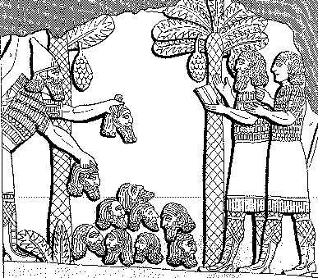
How evil were the Assyrians?
"A pyramid of heads I reared in front of his city. Their youths and their maidens I burnt up in the flames."
Shalmaneser, 859-824 BC = 80 years before Jonah, in
Luckenbill, Ancient Records of Assyria and Babylonia, 1:213
Notes:
From Jonah-Be_Caring-92_eng_op_7600_v7.pptx
www.biblestudydownloads.com

Slide 23
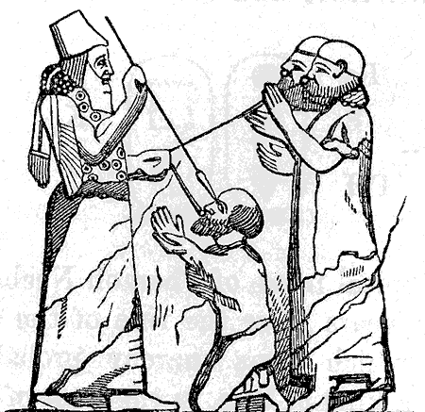
How evil were the Assyrians?
"I pierced his chin with my keen hand dagger. Through his jaw… I passed a rope, put a dog chain upon him and made him occupy a kennel"
Ashurbanipal, 669-626 BC = 100 years after Jonah, in
Luckenbill, Ancient Records of Assyria & Babylonia, 2:319
Notes:
From Jonah-Be_Caring-92_eng_op_7600_v7.pptx
www.biblestudydownloads.com

Slide 24
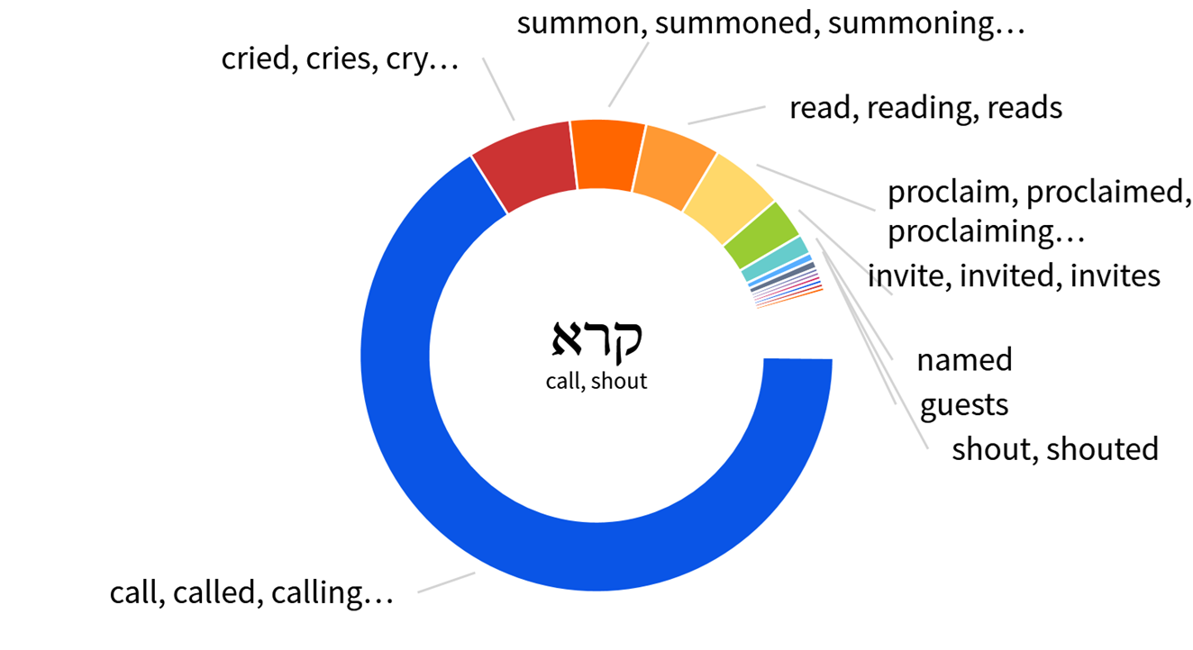
city, and call out against it, for their evil has come

Slide 25
Pre-Exile
(900-606 BC)
Amos 1-2: Send fire . . . devour strongholds
Damascus, Gaza, Tyre, Edom, Ammon, Moab,
Judah
Amos 5:
¹⁴ Seek good, and not evil,
that you may live; and so the Lord, the God of hosts, will be with you, as you have said. ¹⁵ Hate evil, and love good, and establish justice in the gate; it may be that the Lord, the God of hosts, will be gracious to the remnant of Joseph.
Israel
Hosea
Amos
Judah
Isaiah
Jeremiah
Lamentations
Habakkuk
Joel
Micah
Zephaniah
The Daily Walk
Adapted from Walk Thru the Old Testament
Walk Thru the Bible Press, 1978

Slide 26
The unexpected call demonstrates
God’s compassion for all the world (1:1-2).
God loves and cares for
“ALL the families of the earth”
(Gen 12:3).

Slide 27
The Missional Basis of the Bible
First Call
Genesis 12:1-9
Last Command
Matthew
28:16-20
What is the mission of God’s people?

Slide 28
We (as the church and as individuals) need to demonstrate compassion for those we consider enemies.

Slide 29
³ But Jonah rose to flee to Tarshish from the presence of the Lord. He went down to Joppa and found a ship going to Tarshish. So he paid the fare and went down into it, to go with them to Tarshish, away from the presence of the Lord.

Slide 30
The unexpected call demonstrates
God’s compassion for all the world (1:1-2).
The unexpected response demonstrates
Jonah’s compassion ends with himself (1:3, 5).
God’s “people” often fail to “love your neighbor as yourself”
(Luke 10:27)

Slide 31
³ But Jonah rose to flee to Tarshish from the presence of the Lord. He went down to Joppa and found a ship going to Tarshish. So he paid the fare and went down into it, to go with them to Tarshish, away from the presence of the Lord.

Slide 32
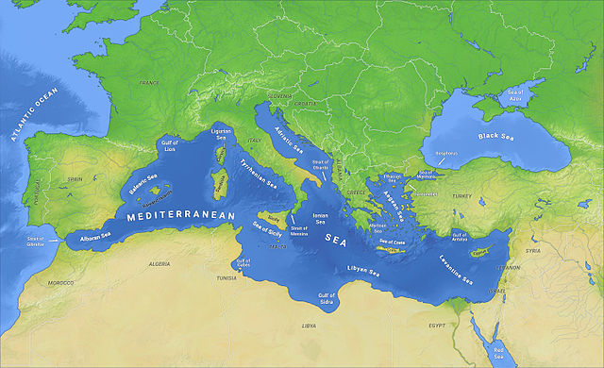
Jonah’s Flight
Tarshish
Ninevah
4
Gath-hepher
2
1
3
Not just down,
but in the opposite direction
and as far as possible
Joppa
Notes:
By O H 237 - Own work, CC BY-SA 4.0, https://commons.wikimedia.org/w/index.php?curid=38364150

Slide 33
When we decide to run from the Lord, Satan is happy
to provide the transportation.
Jonah’s Flight
Tarshish
Ninevah
4
Gath-hepher
2
1
3
Joppa
Notes:
By O H 237 - Own work, CC BY-SA 4.0, https://commons.wikimedia.org/w/index.php?curid=38364150

Slide 34
We (as the church and as individuals) need to demonstrate compassion for those we consider as enemies.
We (as the church and as individuals) need to ask, “what is our Ninevah?”

Slide 35
What happens when you don’t go to Ninevah?
"What are the consequences when we avoid God's calling, like Jonah avoided Nineveh?"

Slide 36
⁴ But the Lord hurled a great wind upon the sea, and there was a mighty tempest on the sea, so that the ship threatened to break up. ⁵ Then the mariners were afraid, and each cried out to his god. And they hurled the cargo that was in the ship into the sea to lighten it for them.

Slide 37
Consequences
Disobedience to God impacts not just us, but the lives of others around us."

Slide 38
⁴ But the Lord hurled a great wind upon the sea, and there was a mighty tempest on the sea, so that the ship threatened to break up. ⁵ Then the mariners were afraid, and each cried out to his god. And they hurled the cargo that was in the ship into the sea to lighten it for them.
1
2

Slide 39
SCORE
Jonah Gentiles
-1
1

Slide 40
Psalm 7:16
¹⁶ His mischief returns upon his own head, and on his own skull his violence descends.
Proverbs 26:27
²⁷ Whoever digs a pit will fall into it, and a stone will come back on him who starts it rolling.
Digging your own grave
Give someone enough rope to hang themselves

Slide 41
But Jonah had gone down into the inner part of the ship and had lain down and was fast asleep. ⁶ So the captain came and said to him, “What do you mean, you sleeper? Arise, call out to your god! Perhaps the god will give a thought to us, that we may not perish.”

Slide 42
SCORE
Jonah Gentiles
-1
1
-2
2

Slide 43
⁷ And they said to one another, “Come, let us cast lots, that we may know on whose account this evil has come upon us.” So they cast lots, and the lot fell on Jonah. ⁸ Then they said to him, “Tell us on whose account this evil has come upon us. What is your occupation? And where do you come from? What is your country? And of what people are you?”

Slide 44
Casting lots was a method used by the Jews of the Old Testament and by the Christian disciples prior to Pentecost to determine the will of God.
Cited in scriptures
Not condemned by God
In NT, last used after choosing of Mathias to replace Judas

Slide 45
⁹ And he said to them, “I am a Hebrew, and I fear the Lord, the God of heaven, who made the sea and the dry land.” ¹⁰ Then the men were exceedingly afraid and said to him, “What is this that you have done!” For the men knew that he was fleeing from the presence of the Lord, because he had told them.

Slide 46
SCORE
Jonah Gentiles
-2
-3
2
3

Slide 47
¹¹ Then they said to him, “What shall we do to you, that the sea may quiet down for us?” For the sea grew more and more tempestuous. ¹² He said to them, “Pick me up and hurl me into the sea; then the sea will quiet down for you, for I know it is because of me that this great tempest has come upon you.”

Slide 48
SCORE
Jonah Gentiles
-3
-4
3
4

Slide 49
¹³ Nevertheless, the men rowed hard to get back to dry land, but they could not, for the sea grew more and more tempestuous against them. ¹⁴ Therefore they called out to the Lord, “O Lord, let us not perish for this man's life, and lay not on us innocent blood, for you, O Lord, have done as it pleased you.” ¹⁵ So they picked up Jonah and hurled him into the sea,

Slide 50
The unexpected call demonstrates
God’s compassion for all the world (1:1-2).
The unexpected response demonstrates
Jonah’s compassion ends with himself (1:3,5).
The unexpected consequences demonstrate
God’s sovereignty over all creation (1:4-16).
The earth is the Lord’s (Ps 24:1)

Slide 51
We (as the church and as individuals) need to demonstrate compassion for those we consider as enemies.
We (as the church and as individuals) need to ask, “what is our Ninevah?”
We (as the . . . ) need to acknowledge God’s
sovereignty with our words and our actions.

Slide 52
and the sea ceased from its raging. ¹⁶ Then the men feared the Lord exceedingly, and they offered a sacrifice to the Lord and made vows.
¹⁷ And the Lord appointed a great fish to swallow up Jonah. And Jonah was in the belly of the fish three days and three nights.

Slide 53
The unexpected call demonstrates
God’s compassion for all the world (1:1-2).
The unexpected response demonstrates
Jonah’s compassion ends with himself (1:3, 5).
The unexpected consequences demonstrate
God’s sovereignty over all creation (1:4-16).
The unexpected provision demonstrates
God’s mercy and discipline (1:17).
For the Lord disciplines those He loves' (Prov 3:12).

Slide 54
We (as the church and as individuals) need to demonstrate compassion for those we consider as enemies.
We (as the church and as individuals) need to ask, “what is our Ninevah?”
We (as the . . . ) need to acknowledge God’s
sovereignty with our words and our actions.
We (as the . . . ) need to accept not just God’s
mercy, but also his discipline.

Slide 55
Ch 2 ¹ Then Jonah prayed to the Lord his God from the belly of the fish, ² saying,
“I called out to the Lord, out of my distress,
and he answered me;
out of the belly of Sheol I cried,
and you heard my voice.
³ For you cast me into the deep,
into the heart of the seas,
and the flood surrounded me;
all your waves and your billows
passed over me.

Slide 56
⁴ Then I said, ‘I am driven away
from your sight;
yet I shall again look
upon your holy temple.’
⁵ The waters closed in over me to take my life;
the deep surrounded me;
weeds were wrapped about my head
⁶ at the roots of the mountains.
I went down to the land
whose bars closed upon me forever;
yet you brought up my life from the pit,
O Lord my God.

Slide 57
7 When my life was fainting away,
I remembered the Lord,
and my prayer came to you,
into your holy temple.
8 Those who pay regard to vain idols
forsake their hope of steadfast love.
9 But I with the voice of thanksgiving
will sacrifice to you;
what I have vowed I will pay.
Salvation belongs to the Lord!”
10 And the Lord spoke to the fish, and it vomited Jonah out upon the dry land.

Slide 58
8 Those who pay regard to vain idols
forsake their hope of steadfast love.
9 But I with the voice of thanksgiving
will sacrifice to you;
God desires mercy, not sacrifice
Matt 9:13, 12:7
Hosea 6:6
Hosea 6:6
For I desire steadfast love
and not sacrifice,
the knowledge of God
rather than burnt offerings.

Slide 59
8 Those who pay regard to vain idols
forsake their hope of steadfast love.
9 But I with the voice of thanksgiving
will sacrifice to you;
God desires mercy, not sacrifice
Matt 9:13, 12:7
Hosea 6:6
Isaiah 1:11
“What to me is the multitude of your sacrifices? says the Lord; I have had enough of burnt offerings of rams and the fat of well-fed beasts; I do not delight in the blood of bulls, or of lambs, or of goats.

Slide 60
8 Those who pay regard to vain idols
forsake their hope of steadfast love.
9 But I with the voice of thanksgiving
will sacrifice to you;
God desires mercy, not sacrifice
Matt 9:13, 12:7
Hosea 6:6
Isaiah 1:11
Proverbs 21:3
To do righteousness and justice is more acceptable to the Lord than sacrifice.

Slide 61
8 Those who pay regard to vain idols
forsake their hope of steadfast love.
9 But I with the voice of thanksgiving
will sacrifice to you;
God desires mercy, not sacrifice
Matt 9:13, 12:7
Hosea 6:6
Isaiah 1:11
Proverbs 21:3
Mark 12:33
to love one's neighbor as oneself, is much more than all whole burnt offerings and sacrifices.”

Slide 62
SCORE
Jonah Gentiles
-4
-5
4

Slide 63
SCORE
God Does Not Keep Score! Gentiles
Something
Unexpected

Slide 64
SCORE
God Does Not Keep Score! Gentiles
-5,000

Slide 65
Jesus
Gen 12:3 I will bless those who bless you and curse those who treat you with contempt. All the families on earth will be blessed through you.”

Slide 66
Jesus
Gal 4:4-5 ⁴ But when the fullness of time had come, God sent forth his Son, born of woman, born under the law, ⁵ to redeem those who were under the law, so that we might receive
adoption as sons.

Slide 67
Jesus
Phil 3:8 Yes, everything else is worthless when compared with the infinite value of knowing Christ Jesus my Lord.

Slide 68
Romans 10:9-13
⁹ because, if you confess with your mouth that Jesus is Lord and believe in your heart that God raised him from the dead, you will be saved. ¹⁰ For with the heart one believes and is justified, and with the mouth one confesses and is saved. . . .
¹³ For “everyone who calls on the name of the Lord will be saved.”

Slide 69
"Lord God, I admit that I am a sinner and that there is nothing I can do on my own.
I know that you are full of compassion and that you love the world you created.
I acknowledge that you alone reign over this world with all with power and wisdom.
I come before you, knowing your mercy is abundant, and ask that you forgive me of my sins through your provision in Jesus Christ. I surrender to Your will, trusting in Your grace and the salvation You offer.

Slide 70
Unexpected Lessons
From Jonah
The Reluctant Prophet - Jonah
1 (&2)

