Slide 1
Know the Father’s Heart
Luke 15:11-32
Crossroads international Church

Slide 3
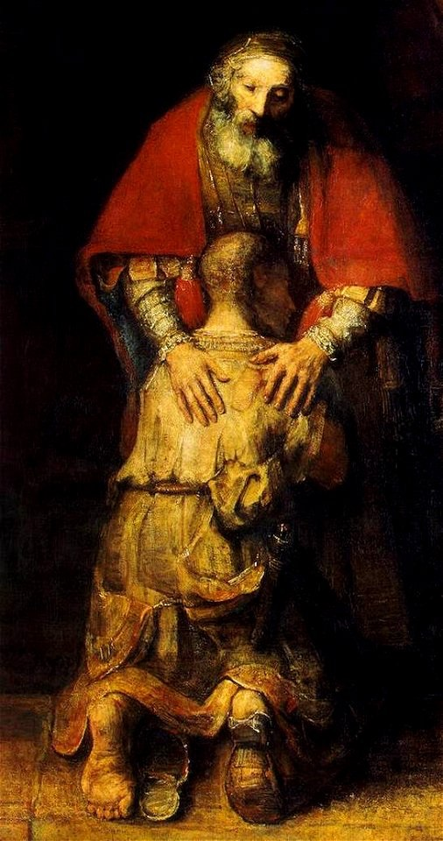
The Parable of the Prodigal Son
Luke 15:11-32

Slide 4
¹¹ And [Jesus] said, “There was a man who had two sons.
¹² And the younger of them said to his father, ‘Father, give me the share of property that is coming to me.’ And he divided his property between them.

Slide 5
¹¹ And [Jesus] said, “There was a man who had two sons.
¹² And the younger of them said to his father, ‘Father, give me the share of property that is coming to me.’ And he divided his property between them.
ousia
bios

Slide 6
¹³ Not many days later, the younger son gathered all he had and took a journey into a far country, and there he squandered his property in reckless living.

Slide 7
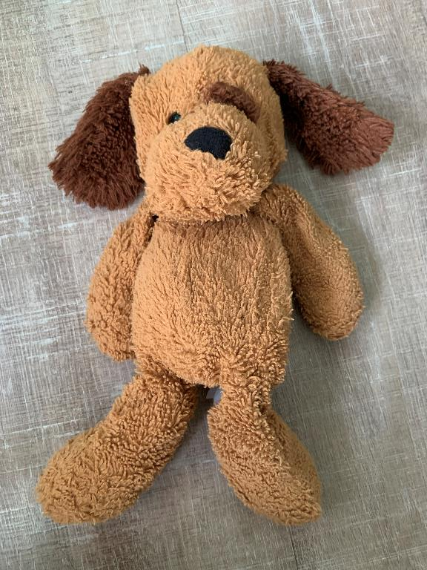
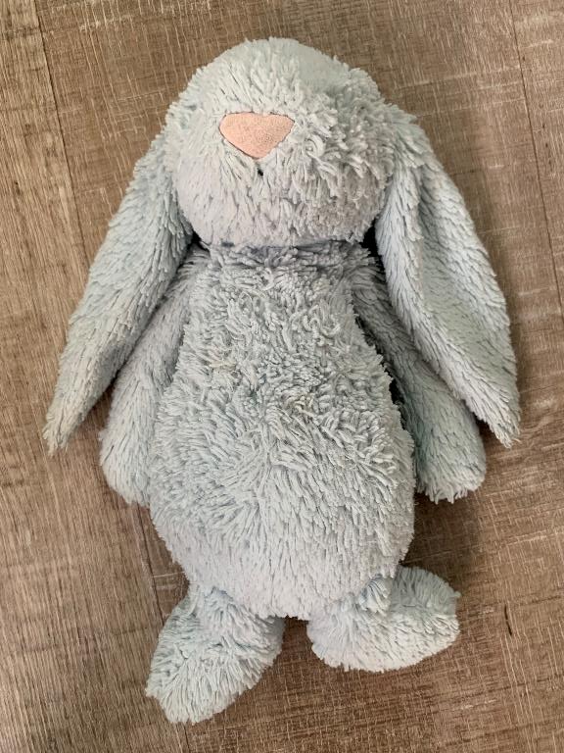

Slide 8
Because I like it.

Slide 9
Carpe Diem.
YOLO.
DIFTP.

Slide 10
¹⁴ And when he had spent everything, a severe famine arose in that country, and he began to be in need.
¹⁵ So he went and hired himself out to one of the citizens of that country, who sent him into his fields to feed pigs.
¹⁶ And he was longing to be fed with the pods that the pigs ate, and no one gave him anything.

Slide 11
¹⁷ “But when he came to himself, he said, ‘How many of my father’s hired servants have more than enough bread, but I perish here with hunger!
¹⁸ I will arise and go to my father, and I will say to him, “Father, I have sinned against heaven and before you.
¹⁹ I am no longer worthy to be called your son. Treat me as one of your hired servants.” ’

Slide 13
²⁵ “Now his older son was in the field, and as he came and drew near to the house, he heard music and dancing.
²⁶ And he called one of the servants and asked what these things meant.
²⁷ And he said to him, ‘Your brother has come, and your father has killed the fattened calf because he has received him back safe and sound.’

Slide 14
²⁸ But he was angry and refused to go in. His father came out and entreated him,
²⁹ but he answered his father, ‘Look, these many years I have served you, and I never disobeyed your command, yet you never gave me a young goat, that I might celebrate with my friends.
³⁰ But when this son of yours came, who has devoured your property with prostitutes, you killed the fattened calf for him!’

Slide 15
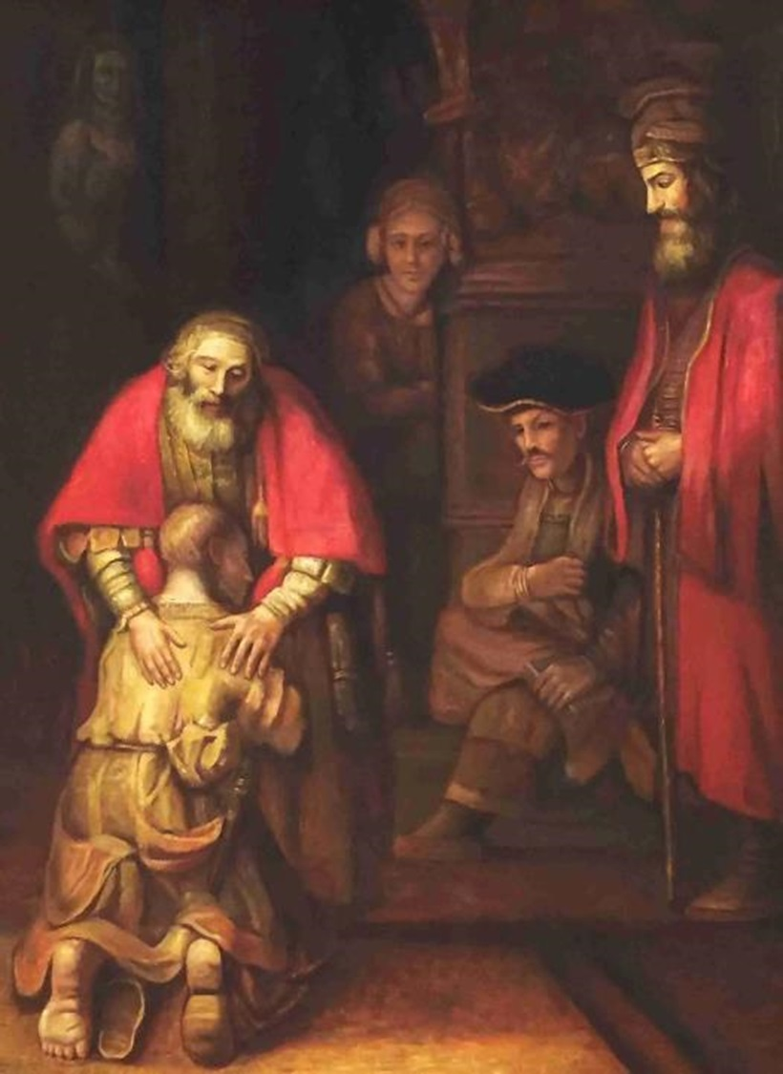
The Parable of the Prodigal Son
The Parable of the two lost sons
Luke 15:11-32

Slide 16
“Now the tax collectors and sinners were all gathering around to hear Jesus.
But the Pharisees and the teachers of the law muttered, “This man welcomes sinners and eats with them.”
Then Jesus told them this parable…
Luke 15:1-3

Slide 17
²⁰ And [the younger son] arose and came to his father. But while he was still a long way off, his father saw him and felt compassion, and ran and embraced him and kissed him.
²¹ And the son said to him, ‘Father, I have sinned against heaven and before you. I am no longer worthy to be called your son.’
²² But the father said to his servants, ‘Bring quickly the best robe, and put it on him, and put a ring on his hand, and shoes on his feet.
²³ And bring the fattened calf and kill it, and let us eat and celebrate.
²⁴ For this my son was dead, and is alive again; he was lost, and is found.’ And they began to celebrate.

Slide 18
²⁸ … His father came out and entreated (attempt to reconcile with) him…
³¹ And he said to him, ‘Son, you are always with me, and all that is mine is yours.
³² It was fitting to celebrate and be glad, for this your brother was dead, and is alive; he was lost, and is found.’ ”

Slide 19
Return, O faithless sons;
I will heal your faithlessness.”
“Behold, we come to you,
for you are the Lord our God.
- Jeremiah 3:22

Slide 20
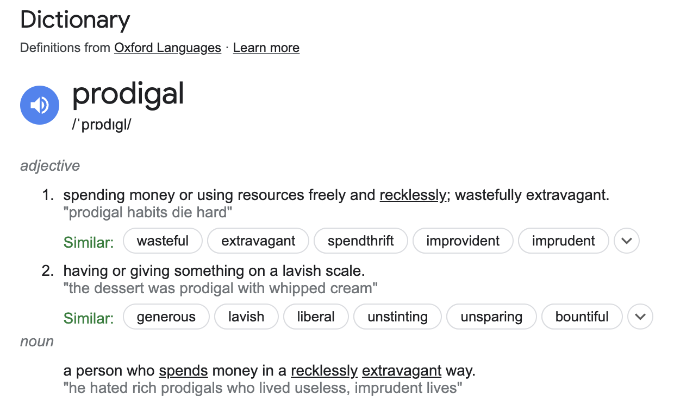

Slide 21
The Parable of the Prodigal Son
The Parable of the two lost sons
The Parable of the Prodigal Father
Luke 15:11-32

Slide 22
“For most of my life I have struggled to find God, to know God, to love God. I have tried hard to follow the guidelines of the spiritual life - pray always, work for others, read the Scriptures -and to avoid the many temptations to dissipate myself. I have failed many times but always tried again, even when I was close to despair.

Slide 23
Now I wonder whether I have sufficiently realized that during all this time God has been trying to find me, to know me, and to love me. The question is not "How am I to find God?" but "How am I to let myself be found by him?" The question is not "How am I to know God?" but "How am I to let myself be known by God?" And, finally, the question is not "How am I to love God?" but "How am I to let myself be loved by God?" God is looking into the distance for me, trying to find me, and longing to bring me home.”
-
- Henri J.M. Nouwen, The Return of the Prodigal Son: A Story of Homecoming

Slide 24
How should we know the Father’s heart?

Slide 25
Jesus – The True Elder Brother

Slide 26
1. Turn away from selfish living
2. Lavishly welcome people
3. Live for the joy of salvation
4. Celebrate Jesus!

Slide 27
Know the Father’s Heart
Luke 15:11-32
Crossroads international Church

